Slide 1
Organisational Performance against the PCC Priorities
Report to the Assurance and Accountability Board
Quarter 4 2025-26

Slide 2
Glossary of Terms
Common Terms:
Percentage Points (PP) – Percentage points are used to indicate the numeric difference between two percentages. For instance, moving from 10.0% to 12.0% is an increase of two percentage points.
Solved Crimes – For the purposes of this report, a crime is considered ‘solved’ if it has been finalised with a criminal justice outcome (outcomes 1-8, excluding 5). This includes out of court outcomes such as community resolutions and cautions, in addition to formal charges.
Solved Rate – The solved rate for a given quarter is calculated by dividing the number of crimes which were assigned a criminal justice outcome during that quarter by the number of crimes recorded during that quarter.
Graph Elements:
Average – For the purposes of this report, this graph element is calculated based on the mean value of the eight quarters preceding quarter four of the 2025-26 financial year.
Trendline – This graph element indicates the overall direction of the data within the graph. All 12 quarters represented within the graph are taken into account.
Upper and Lower Control Limits (Upper CL and Lower CL) – These graph elements mark the points beyond which a value is considered a special case, often implying the influence of one or more abnormal external factors. The upper control limit indicates that a value is higher than would be expected, whereas the lower control control limit indicates that the given value is below the expected level.

Slide 3
Pillar One - Preventing Crime and ASB
Representative Workforce
Sickness Rates
Quarterly Summary
Perceptions Survey - Engagement
Perceptions Survey – Local Concerns and Confidence
Overall Crime
Overall Incidents
Anti-Social Behaviour
Community Action Team
Preventing Crime and ASB – Emerging Issues

Slide 4
1. Representative Workforce
Employee Type | Establishment Numbers |  |  |  |  |  | Gender |  |  | Ethnicity
 | Finance Budget FTE | Establishment Budget FTE | Actual FTE | Actual FTE v Establishment FTE Variance | Headcount |  | Female | Male |  | Ethnic Heritage | Not Stated | Prefer Not to Say | White
Police Officer | 1506.0 | 1506.0 | 1559.1 | 53.1 | 1572 |  | 39.6% | 60.4% |  | 3.7% | 0.3% | 3.3% | 92.7%
Police Staff | 795.8 | 880.8 | 823.6 | -57.2 | 868 |  | 68.3% | 31.7% |  | 2.8% | 0.3% | 2.9% | 94.0%
PCSO | 144.0 | 144.0 | 143.8 | -0.2 | 148 |  | 48.6% | 51.4% |  | 8.1% | 0.0% | 1.4% | 90.5%
OPCC | 23.0 | 23.0 | 23.3 | 0.3 | 24 |  | 70.8% | 29.2% |  | 8.3% | 8.3% | 0.0% | 83.3%
Special Constable | - | 100.0 | - | -47 | 53 |  | 20.8% | 79.2% |  | 3.8% | 1.9% | 0.0% | 94.3%
Agency Worker | - | - | - | - | 7 |  | 57.1% | 42.9% |  | 0.0% | 0.0% | 0.0% | 100.0%
Cadets | - | - | - | - | 127 |  | 55.1% | 44.9% |  | 8.7% | 2.4% | 0.8% | 88.2%
Volunteers | - | - | - | - | 49 |  | 53.1% | 46.9% |  | 6.1% | 61.2% | 0.0% | 32.7%
Number of Officers by Operational Pillar
Crime | Neighbourhood | Response
386 | 196 | 531
These figures pertain to the numbers of Police Constables, Police Sergeants, Detective Constables, and Detective Sergeants assigned to departments within each operational pillar. At present, 322 officers operate outside of these pillars.
Operational Overview
There is a gender disparity evident in the workforce for both officers and staff. For officers, females are under-represented by approximately 11 percentage points (females account for 51% of the population in Gwent based on the 2021 Census). However, females are overrepresented in the staff workstream area by approximately 17 percentage points. There is also a disparity in ethnic heritage representation within the workforce. According to the 2021 Census, 5.8% of the Gwent population are people of ethnic heritage. As of March 2025, 3.7% of police officers are of ethnic heritage, whereas ethnic heritage representation in the staff workstream is lower, at 2.8%.
A representative workforce is crucial for fostering public trust, improving community relations and enhancing operational effectiveness. It is vitally important that Gwent Police mirrors the diversity of the community it serves, in order to better understand and address the unique needs and concerns of all residents. This can lead to greater public confidence in approaching officers for help, reporting incidents, or providing valuable information, as well as creating opportunities to build cohesion and forge stronger relationships. It is also important to recognise that officers from diverse backgrounds may be better equipped to handle specific situations involving vulnerable individuals or specific groups.
The force is organised into three operational pillars – Crime, Neighbourhood, and Response. There are currently 386 officers working within the Crime Pillar, 196 within the Neighbourhood Pillar, and 531 within the Response Pillar. This operating model has been designed to influence how the force works together to improve trust and confidence. Removing geographic barriers puts the community at the heart of everything the force does, working as one team to deliver on issues that matter to people. The model offers opportunities to bring consistency of approach to communities irrespective of the pillar or area of the force, notwithstanding local nuances which will require a tailored delivery dependent upon their needs.
The data on this slide is accurate as of March 2025. The Establishment Budget for Special Constables is a target headcount.

Slide 5
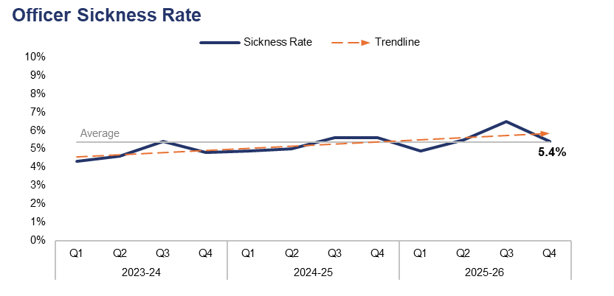
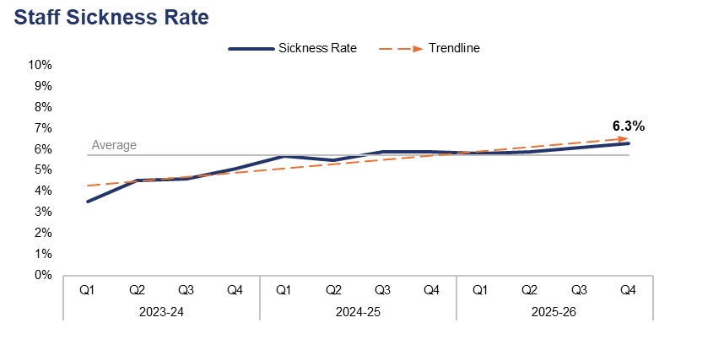
2. Sickness Rates
Financial Year | 21-22 | 22-23 | 23-24 | 24-25 | 25-26 |  | Quarter | Q3 25-26 | Q4 24-25
Sickness Rate | - | 4.7% | 4.8% | 5.3% | 5.6% |  | PP Change | -1.1 | -0.2
Financial Year | 21-22 | 22-23 | 23-24 | 24-25 | 25-26 |  | Quarter | Q3 25-26 | Q4 24-25
Sickness Rate | - | 4.9% | 4.4% | 5.7% | 6.0% |  | PP Change | 0.2 | 0.4
Operational Overview
During the fourth quarter of the 2025-26 financial year (Q4 2025-26), the sickness rate for police officers within the force stood at 5.4%. This represents a reduction of 1.1 percentage points when compared to the quarter prior, and a less prominent reduction of 0.2 percentage points when compared to the same quarter during the previous financial year.
The police staff sickness rate for the same period stands at 6.3%. This is the highest quarterly figure within the three-year timeframe, representing an increase of 0.2 percentage points when compared to the quarter prior, and a further increase of 0.4 percentage points when compared to the same quarter during the previous financial year.
In this context, the sickness rate is calculated by dividing the number of individuals who have taken a day or more of sick leave during the given period by the overall establishment figure for that group.

Slide 6
3. Quarterly Summary
Q4 2025-26 - Crime Volume and Solved Rate by Crime Category
Crime Category | Volume | Solved Rate
- | 120 | 15.0%
All Other Theft | 773 | 3.9%
Bicycle Theft | 53 | 5.7%
Commercial Burglary | 198 | 11.6%
Criminal Damage & Arson | 1,579 | 7.8%
Drug Offences | 457 | 58.9%
Homicide | 3 | 66.7%
Misc Crimes Against Society | 502 | 22.7%
Other Sexual Offences | 473 | 6.3%
Possession Of Weapons | 163 | 33.1%
Public Order Offences | 1,649 | 10.0%
Rape | 216 | 7.9%
Residential Burglary | 445 | 5.4%
Robbery | 98 | 19.4%
Shoplifting | 997 | 40.9%
Theft From The Person | 29 | 0.0%
Vehicle Crime | 823 | 5.0%
Violence With Injury | 1,370 | 13.1%
Violence Without Injury | 4,376 | 8.9%
Total | 14,324 | 13.3%
Crime Volumes in Red and Solved Rates in Green are above the eight-quarter rolling average.

Slide 7
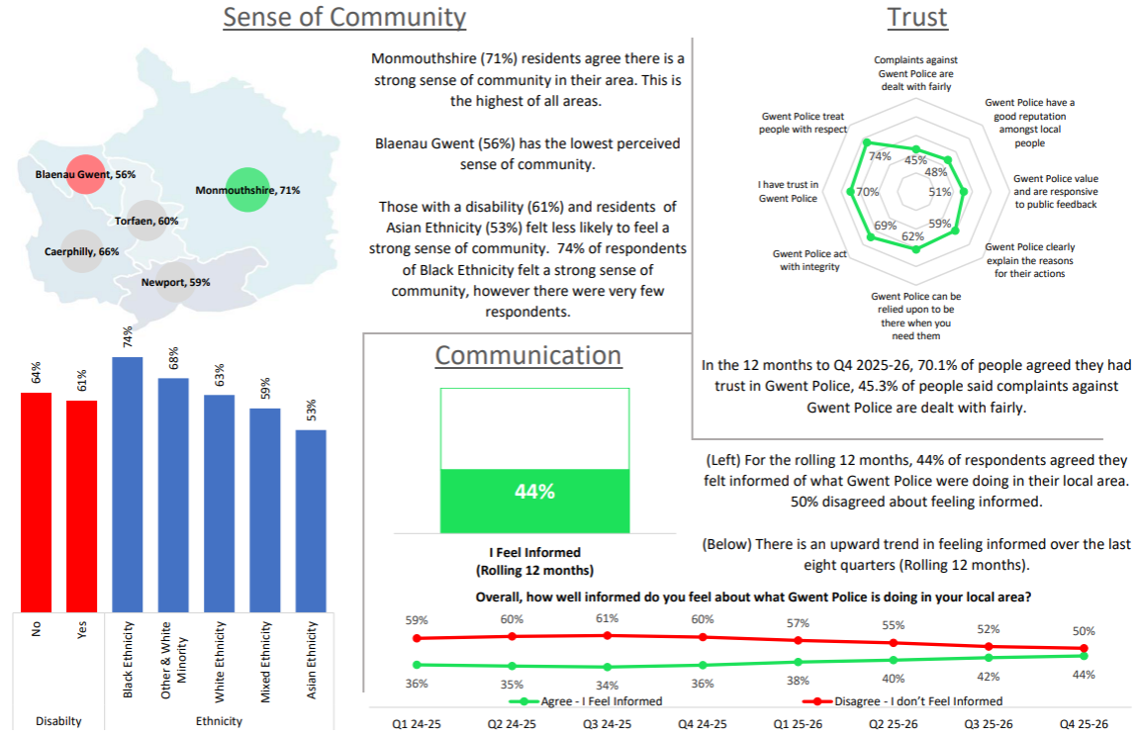
4. Perceptions Survey – Engagement

Slide 8
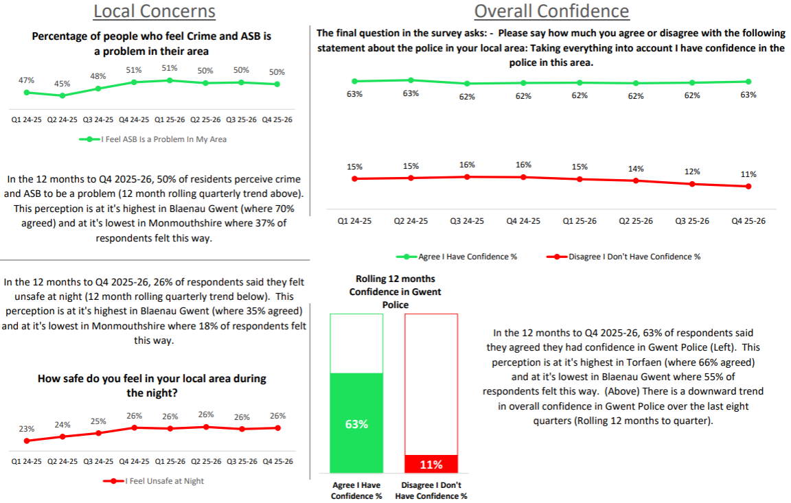
5. Perceptions Survey – Local Concerns and Confidence

Slide 9
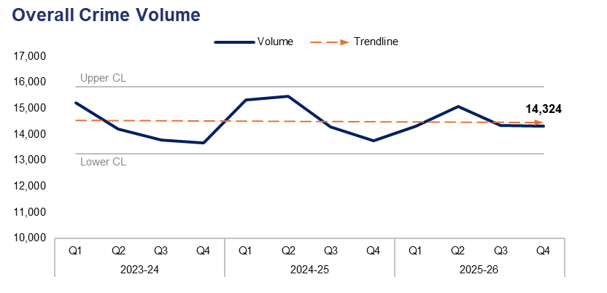
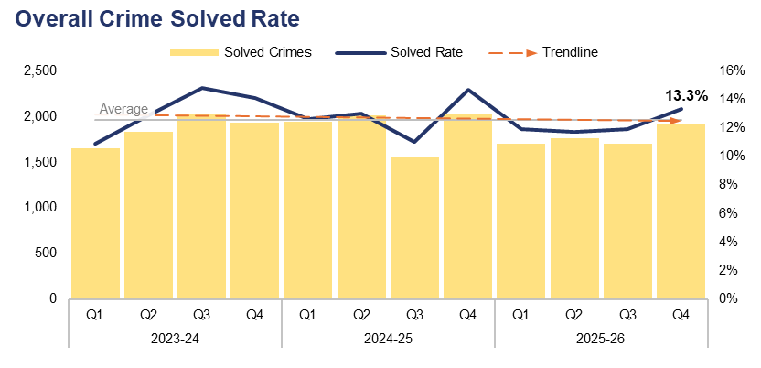
6. Overall Crime
Financial Year | 21-22 | 22-23 | 23-24 | 24-25 | 25-26 |  | Quarter | Q3 25-26 | Q4 24-25
Volume | 52,745 | 57,906 | 56,895 | 58,859 | 58,078 |  | % Change | -0.1% | 4.1%
Financial Year | 21-22 | 22-23 | 23-24 | 24-25 | 25-26 |  | Quarter | Q3 25-26 | Q4 24-25
Solved Rate | 11.0% | 9.7% | 13.1% | 12.8% | 12.2% |  | PP Change | 1.4 | -1.4
Operational Overview
Overall, 14,324 crimes were recorded in Gwent during Q4 2025-26. This represents a slight reduction of 0.1% (21 fewer offences) when compared to the quarter prior, but an increase of 4.1% (561 additional offences) when compared to the same quarter during the previous financial year.
The overall solved rate for Q4 2025-26 stands at 13.3%, with 1,909 crimes solved. This is an increase of 1.4 percentage points when compared to the quarter prior, with 206 additional crimes solved. Conversely, a reduction of 1.4 percentage points can be observed when comparing Q4 2025-26 to the same quarter during the previous financial year, with 110 fewer crimes solved.

Slide 10
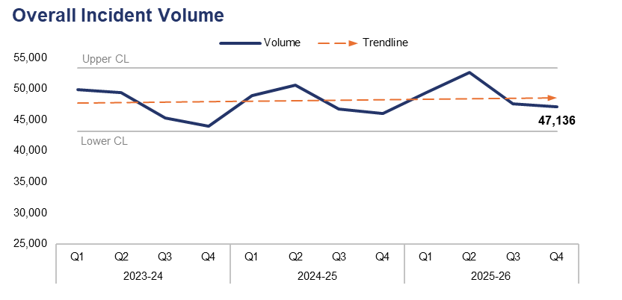
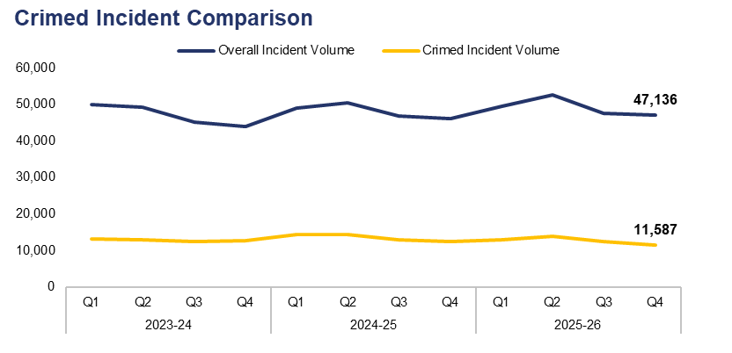
7. Overall Incidents
Financial Year | 21-22 | 22-23 | 23-24 | 24-25 | 25-26 |  | Quarter | Q3 25-26 | Q4 24-25
Volume | 170,175 | 170,356 | 188,434 | 192,239 | 196,826 |  | % Change | -1.0% | 2.4%
Financial Year | 21-22 | 22-23 | 23-24 | 24-25 | 25-26 |  | Quarter | Q3 25-26 | Q4 24-25
% Crimed | 26.6% | 28.8% | 27.2% | 28.0% | 25.8% |  | PP Change | -1.3 | -2.4
Operational Overview
Overall, 47,136 incidents were reported during Q4 2025-26. This represents a reduction of 1.0% (498 fewer incidents) when compared to the quarter prior, but an increase of 2.4% (1,118 additional incidents) when compared to the same quarter during the previous financial year.
Of the 47,136 incidents reported during Q4 2025-26, 11,587 were assigned a crime category, or ‘crimed’. This accounts for 24.6% of all incidents recorded during the quarter, representing a reduction of 1.3 percentage points when compared to the quarter prior. A further reduction of 2.4 percentage points can be observed when comparing Q4 2025-26 to the same quarter during the previous financial year.
Additional crimes can be created independently of incidents, accounting for the discrepancy between the number of crimed incidents and the overall crime volume for the quarter.

Slide 11
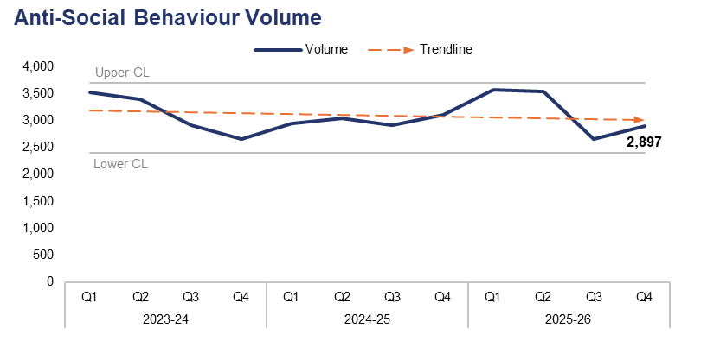
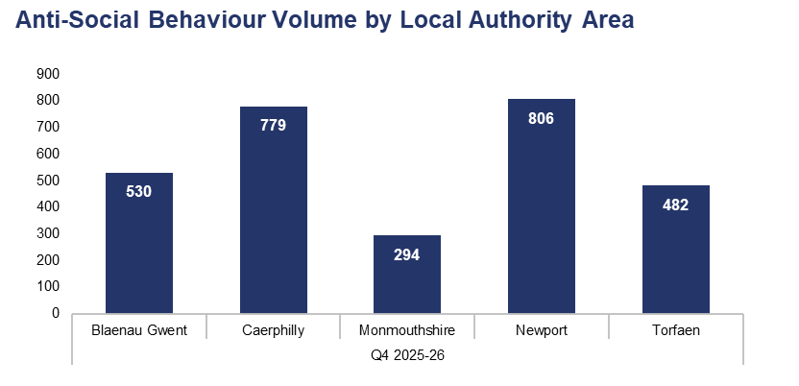
8. Anti-Social Behaviour
Financial Year | 21-22 | 22-23 | 23-24 | 24-25 | 25-26 |  | Quarter | Q3 25-26 | Q4 24-25
Volume | 12,747 | 10,594 | 12,500 | 11,999 | 12,658 |  | % Change | 9.1% | -6.6%
Local Authority Area |  | Blaenau Gwent | Caerphilly | Monmouthshire | Newport | Torfaen
% of Total |  | 18.3% | 26.9% | 10.1% | 27.8% | 16.6%
Operational Overview
A total of 2,897 incidents classified as Anti-Social Behaviour (ASB) were reported during Q4 2025-26. This represents an increase of 9.1% (241 additional incidents) when compared to the quarter prior, but a reduction of 6.6% (206 fewer incidents) when compared to the same quarter during the previous financial year.
The upper-right graph displays ASB incident volume during Q4 2025-26 by Local Authority Area. The highest volume of incidents were reported in Newport, accounting for 27.8% of the force-wide total with 806 incidents. Conversely, the lowest volume of incidents were reported in Monmouthshire, comprising 10.1% of the force-wide total with 294 incidents.
Dedicated patrols continue to take place throughout the 37 identified hot-spots in Gwent. By the end of Q4 2025-26, officers had undertaken 10,010 hours of dedicated overtime patrols in these areas, exceeding the requirement of 9,000 hours stipulated by the Home Office. Greater emphasis and resources were placed in and around town centre areas as part of the force's commitment to safer town centres within the Neighbourhood Policing Guarantee.
During Q4 2025-26, six ASB incidents were reported as having taken place outside of the force area, and have therefore been omitted from the Local Authority Area comparison.

Slide 12
9. Community Action Team
Community Action Team Activity – Q4 2025-26
Metric | Abersychan & Blaenavon Team | Bargoed Team | Bettws Team | Ebbw Vale Team | Overall
Offences Recorded | 22 | 25 | 34 | 44 | 125
Solved Rate | 68.2% | 28.0% | 44.1% | 34.1% | 41.6%
Arrests Made | 17 | 16 | 21 | 27 | 81
Stop Searches Performed | 13 | 25 | 41 | 20 | 99
Vehicles Seized | 4 | 15 | 11 | 9 | 39
Operational Overview
The Community Action Team (CAT) were deployed in Aberbargoed, Bettws, Ebbw Vale, and Llantarnam between October 2025 and February 2026. During February, the Aberbargoed team moved to Bargoed and the Llantarnam team moved to Abersychan & Blaenavon, with the Bettws and Ebbw Vale teams remaining in place. Across Q4 2025-26, the teams made a total of 81 arrests and seized 39 vehicles, primarily due to them being used or ridden in an anti-social manner. They also achieved a solved rate of 41.6% for crime investigations.
The teams continue to be well received by the communities of Gwent, as well as local councillors and stakeholders. They amplify their successes through posts on numerous social media platforms, which have gained significant positive traction online.

Slide 13
10. Preventing Crime and ASB – Emerging Issues
Operational Overview
The force completed and submitted its ASB Action Plan to the Home Office ahead of deadline in March 2026. The Plan encompasses closer working arrangements with community safety partners around key themes which include visibility, offender management, the use of ASB powers, youth intervention and prevention, application of innovative approaches and new technology, and the introduction of a new ASB risk assessment.
To address the topic of visibility, the force has introduced new IR3 telematics which will capture neighbourhood officer footfall, by hours, in both ward and town centre areas. This will then be monitored via monthly governance arrangements. The force has continued its investment in Newport through the night-time economy City Safe initiative. This includes additional and dedicated officers assigned to work Friday and Saturday evenings and nights. This initiative has been complemented by the introduction of Operation Vigilant, which involves the deployment of both overt and covert resources to the City Centre with the goal of identifying and addressing inappropriate sexualised behaviours. This supports the wider force approach to violence against women and girls.
The messaging alert system Neighbourhood Matters has now moved from its implementation phase to becoming business as usual. As of the end of Q4 2025-26 over 6,260 individuals were signed up to the platform, demonstrating continued growth.
The number of school engagements undertaken as part of the Safer Schools Programme continued to increase during Q4 2025-26. A total of 1,554 engagements took place throughout the 242 schools within Gwent during this period, half of which were conducted in person.
The 'We Don't Buy Crime' team have been supporting their colleagues with numerous crime prevention activities and events during the quarter, including several bike marking schemes. They have also been engaging with rural communities via the rural crime team.

Slide 14
Pillar Two - Making Our Communities Safer
999 Demand
101 Demand
999 and 101 Average Answer Speed
Response Times
Most Serious Violence
Serious Violence
Knife Crime
Overall Drug Offences
Drug Possession
Drug Supply
Shoplifting
Residential Burglary
Robbery
Theft from the Person
Making Our Communities Safer – Emerging Issues

Slide 15
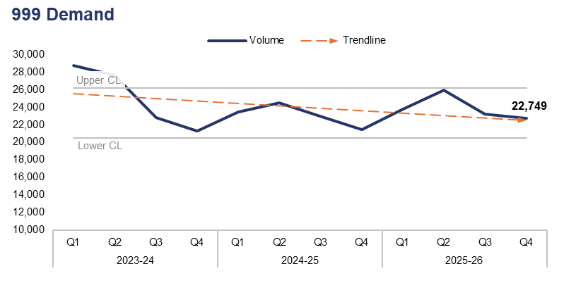
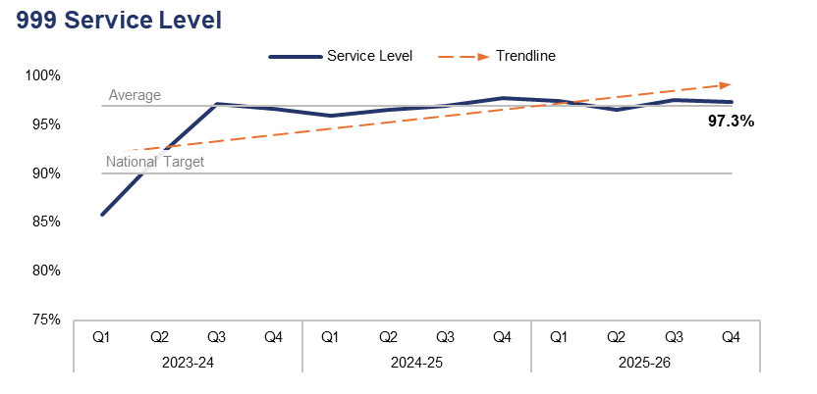
1. 999 Demand
Financial Year | 21-22 | 22-23 | 23-24 | 24-25 | 25-26 |  | Quarter | Q3 25-26 | Q4 24-25
Volume | 87,259 | 99,891 | 100,469 | 92,275 | 95,678 |  | % Change | -2.0% | 6.1%
Financial Year | 21-22 | 22-23 | 23-24 | 24-25 | 25-26 |  | Quarter | Q3 25-26 | Q4 24-25
Service Level | 89.5% | 85.7% | 92.4% | 97.0% | 97.2% |  | PP Change | -0.2 | -0.4
Operational Overview
999 demand has fallen by 2.0% during Q4 2025-26 when compared to the quarter prior, with 474 fewer calls received for a total of 22,749. Conversely, an increase of 6.1% (1,308 additional calls) can be observed when comparing Q4 2025-26 to the same quarter during the previous financial year.
999 service level (the percentage of 999 calls answered within 10 seconds) stands at 97.3% for Q4 2025-26. This represents a reduction of 0.2 percentage points when compared to the quarter prior, and a further reduction 0.4 percentage points when compared to the same quarter during the previous financial year. That said, 999 service level remains above the national target of 90%, as it has done for the last eleven consecutive quarters.

Slide 16
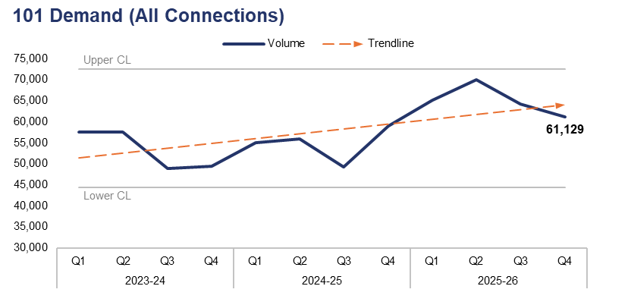
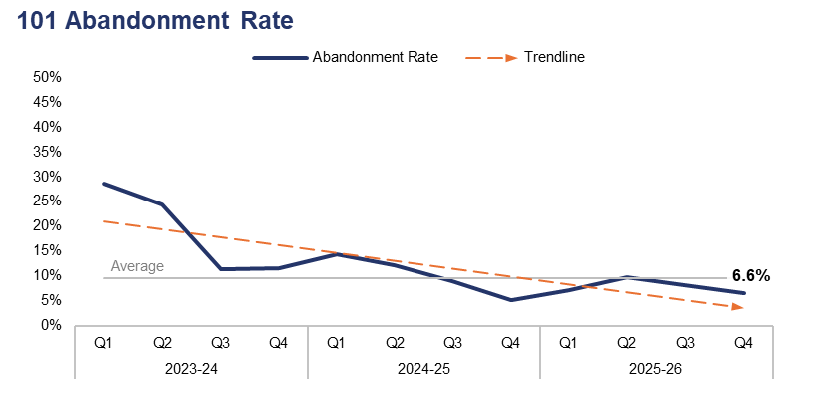
2. 101 Demand
Financial Year | 21-22 | 22-23 | 23-24 | 24-25 | 25-26 |  | Quarter | Q3 25-26 | Q4 24-25
Volume | 241,738 | 220,342 | 213,356 | 219,010 | 260,582 |  | % Change | -4.8% | 3.7%
Financial Year | 21-22 | 22-23 | 23-24 | 24-25 | 25-26 |  | Quarter | Q3 25-26 | Q4 24-25
Abandonment Rate | 26.7% | 36.3% | 19.5% | 9.1% | 8.0% |  | PP Change | -1.5 | 1.5
Operational Overview
101 demand (all connections) has fallen by 4.8% during Q4 2025-26 when compared to the quarter prior, with 3,102 fewer calls received for a total of 61,129. Conversely, an increase of 3.7% (2,179 additional calls) can be observed when comparing Q4 2025-26 to the same quarter during the previous financial year.
The abandonment rate for 101 calls during Q4 2025-26 was 6.6%. This is a reduction of 1.5 percentage points when compared to the quarter prior, but an increase of 1.5 percentage points when compared to the same quarter during the previous financial year.
The 101 abandonment rate figure is calculated based on call options one and two only, which pertain to new incidents and incident updates respectively.

Slide 17
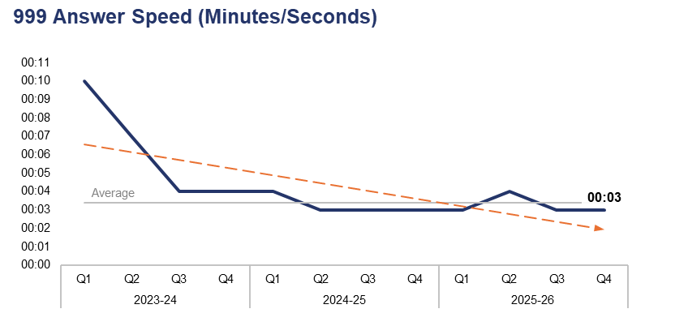
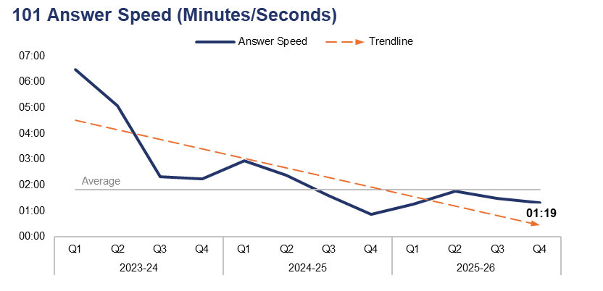
3. 999 and 101 Average Answer Speed
Financial Year | 21-22 | 22-23 | 23-24 | 24-25 | 25-26 |  | Quarter | Q3 25-26 | Q4 24-25
Answer Speed | 00:09 | 00:11 | 00:06 | 00:04 | 00:03 |  | Change | 00:00 | 00:00
Financial Year | 21-22 | 22-23 | 23-24 | 24-25 | 25-26 |  | Quarter | Q3 25-26 | Q4 24-25
Answer Speed | 05:45 | 08:01 | 03:59 | 01:43 | 01:27 |  | Change | -00:09 | 00:28
Operational Overview
The average answer speed for 999 calls during Q4 2025-26 was three seconds. This is equal to both the quarter prior and same quarter during the previous financial year.
The average answer speed for 101 calls during Q4 2025-26 was one minute and 19 seconds. This is a reduction of nine seconds when compared to the quarter prior, but an increase of 28 seconds when compared to the same quarter during the previous financial year.
The 101 average answer speed figure is calculated based on call options one and two only, which pertain to new incidents and incident updates respectively.

Slide 18
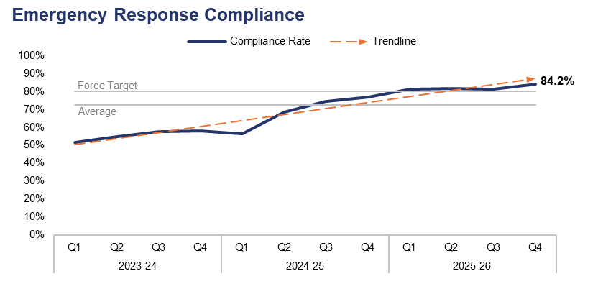
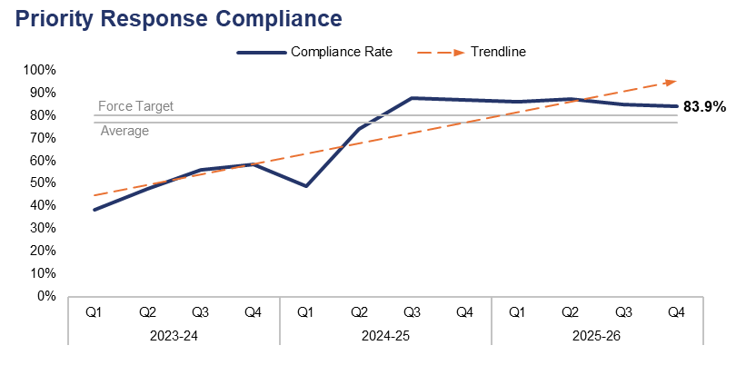
4. Response Times
Financial Year | 21-22 | 22-23 | 23-24 | 24-25 | 25-26 |  | Quarter | Q3 25-26 | Q4 24-25
Compliance Rate | 47.5% | 47.0% | 55.4% | 68.7% | 85.2% |  | PP Change | 2.9 | 7.2
Financial Year | 21-22 | 22-23 | 23-24 | 24-25 | 25-26 |  | Quarter | Q3 25-26 | Q4 24-25
Compliance Rate | 33.2% | 32.3% | 50.0% | 74.5% | 87.2% |  | PP Change | -1.1 | -3.1
Operational Overview
Based on the target arrival time of 15 minutes, the emergency create-to-arrival compliance rate for Q4 2025-26 stands at 84.2%. This is an increase of 2.9 percentage points when compared to the quarter prior, and a further increase of 7.2 percentage points when compared to the same quarter during the previous financial year. The compliance rate has exceeded the force target of 80.0% for a fourth consecutive quarter.
Based on the target arrival time of 60 minutes, the priority create-to-arrival compliance rate for Q4 2025-26 stands at 83.9%. This is a reduction of 1.1 percentage points when compared to the quarter prior, and a further reduction of 3.1 percentage points when compared to the same quarter during the previous financial year. Despite these reductions, the compliance rate has exceeded the force target of 80.0% for six consecutive quarters.
In this context, ‘create-to-arrival’ refers to the time elapsed between the creation of a Storm Log for a given incident, and the arrival of officers at the scene.
The above figures include regraded incidents, in which the target response time has been amended based on the receipt of new information which has altered the risk assessment and therefore response grade of the incident in question. This includes instances where the risk has increased, thus the response grade has been elevated, and likewise instances where the risk has decreased. This increased accuracy has been facilitated by recent improvements in the force’s reporting systems.

Slide 19
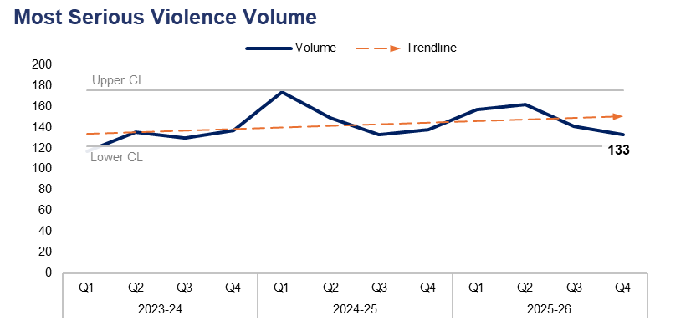
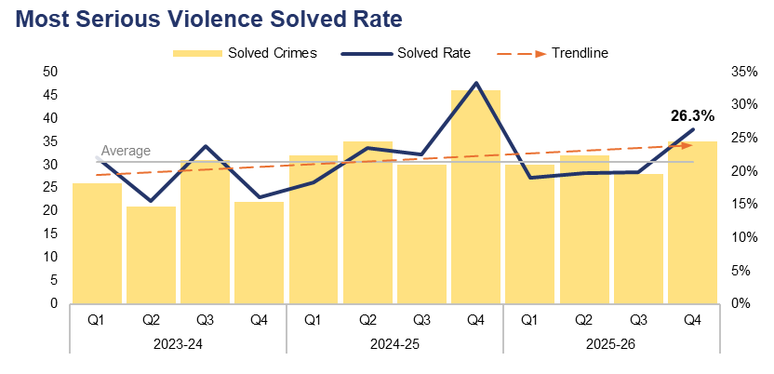
5. Most Serious Violence
Financial Year | 21-22 | 22-23 | 23-24 | 24-25 | 25-26 |  | Quarter | Q3 25-26 | Q4 24-25
Volume | 435 | 474 | 519 | 594 | 593 |  | % Change | -5.7% | -3.6%
Financial Year | 21-22 | 22-23 | 23-24 | 24-25 | 25-26 |  | Quarter | Q3 25-26 | Q4 24-25
Solved Rate | 16.3% | 19.0% | 19.3% | 24.1% | 21.1% |  | PP Change | 6.4 | -7.0
Operational Overview
A total of 133 crimes classified as Most Serious Violence were recorded during Q4 2025-26. This represents a reduction of 5.7% (eight fewer offences) when compared to the quarter prior, and a similar reduction of 3.6% (five fewer offences) when compared to the same quarter during the previous financial year.
The solved rate for Q4 2025-26 stands at 26.3%, with 35 crimes solved. This is the second-highest solved rate within the three-year timeframe, representing an increase of 6.4 percentage points when compared to the quarter prior, with seven additional crimes solved. Conversely, a reduction of 7.0 percentage points can be observed when comparing Q4 2025-26 to the same quarter during the previous financial year, with 11 fewer crimes solved.
The Homicide and Serious Violence meeting ensures appropriate oversight of investigations and is able to identify any changes in performance. Most Serious Violence is investigated by the Reactive Criminal Investigation Department (CID) who operate as part of the Crime Pillar. Scrutiny and the identification of patterns in offending allow for predicted demand analysis and the assignment of appropriate resources. The management and oversight of meetings has seen strong relationships forged between the three pillars, with problem solving plans devised to prevent and detect Most Serious Violence. The force tasking process and the Investigations Detective Chief Inspector ensure appropriate neighbourhood team ownership of emerging issues.
There were two homicide investigations during Q3 2025-26. One suspect has been convicted at court, offering a guilty plea, and the second has been charged, remanded, and is awaiting trial.
Most Serious Violence offences consist of homicide, grievous bodily harm with intent, and causing death by dangerous driving.

Slide 20
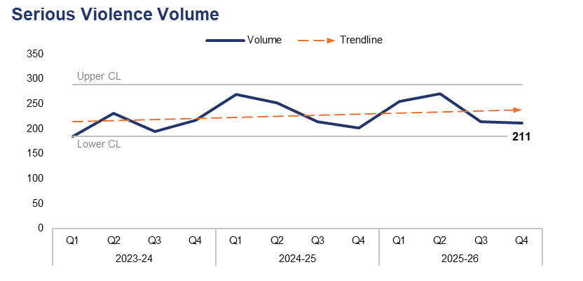
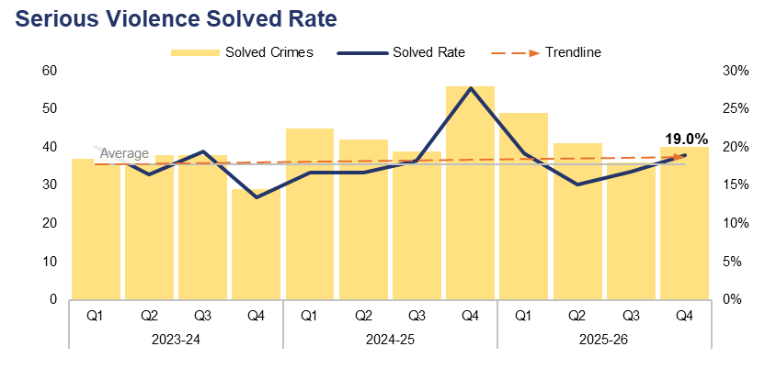
6. Serious Violence
Financial Year | 21-22 | 22-23 | 23-24 | 24-25 | 25-26 |  | Quarter | Q3 25-26 | Q4 24-25
Volume | 729 | 844 | 828 | 937 | 951 |  | % Change | -1.4% | 4.5%
Financial Year | 21-22 | 22-23 | 23-24 | 24-25 | 25-26 |  | Quarter | Q3 25-26 | Q4 24-25
Solved Rate | 16.2% | 15.6% | 17.1% | 19.4% | 17.5% |  | PP Change | 2.2 | -8.7
Operational Overview
Overall, 211 crimes classified as Serious Violence were recorded during Q4 2025-26. This represents a reduction of 1.4% (three fewer offences) when compared to the quarter prior, but an increase of 4.5% (nine additional offences) when compared to the same quarter during the previous financial year.
The solved rate for Q4 2025-26 stands at 19.0%, with 40 crimes solved. This is an increase of 2.2 percentage points when compared to the quarter prior, with four additional crimes solved. Conversely, a reduction 8.7 percentage points can be observed when comparing Q4 2025-26 to the same quarter during the previous financial year, with 16 fewer crimes solved.
Serious Violence is discussed in the Homicide and Serious Violence meeting. Given the multifaceted nature of this offending, it also features in the Serious Organised Crime (SOC) meeting, in which Organised Crime Group (OCG) nominals involved in Serious Violence are identified in order to explore opportunities under a ‘4Ps’ approach (Pursue, Prevent, Protect, and Prepare).
Funding provided by the Home Office to tackle county lines has been used to prevent Serious Violence and bring offenders to justice through proactive policing and partnership operations.
Tarian have provided considerable support to tackle an OCG which used Serious Violence, leading to the arrest and conviction of offenders.
Services have been commissioned via Serious Violence Duty funding which aim to prevent violent crime and promote early intervention through the identification of effective local practices and prevention programmes. This is aligned to the government’s Safer Streets mission, with interventions being delivered through the five Community Safety Partnerships.
Serious Violence offences consist of section 18 grievous bodily harm with intent, section 20 malicious wounding without intent, and personal robbery.

Slide 21
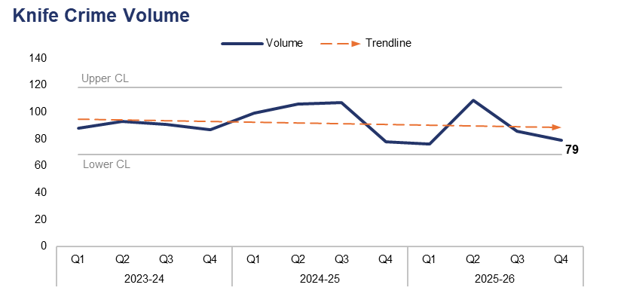
7. Knife Crime
Financial Year | 21-22 | 22-23 | 23-24 | 24-25 | 25-26 |  | Quarter | Q3 25-26 | Q4 24-25
Volume | 283 | 370 | 359 | 390 | 350 |  | % Change | -8.1% | 1.3%
Operational Overview
A total of 79 offences recorded during Q4 2025-26 were classified as knife crimes, as defined by the Home Office’s National Data Quality Improvement Service (NDQIS) reporting system. This represents a reduction of 8.1% (seven fewer offences) when compared to the quarter prior, but a slight increase of 1.3% (one additional offence) when compared to the same quarter during the previous financial year.
The force continually encourages the appropriate use of stop and search as a proactive tactic to limit access to knives for criminals. Appropriate performance and oversight meetings ensure that stop and search is used proportionately, with accurate and reliable grounds for each search recorded. Disproportionality is also considered to ensure an equitable policing response.
SOC profiles are used to identify the top three wards in each local authority area based on Crime Severity Score. Within these wards, knife crimes and those linked to SOC have been highlighted and are discussed at the SOC partnership meetings.
County Lines Intensification Week took place during Q4 2025-26, targeting individuals involved in organised crime, the exploitation of vulnerable people, and the use of violence. As part of this operation, 10 individuals were arrested, 12 people were safeguarded, and three knives were recovered.
In accordance with NDQIS reporting criteria, Possession of a Weapon and Homicide offences have been excluded from this dataset.

Slide 22
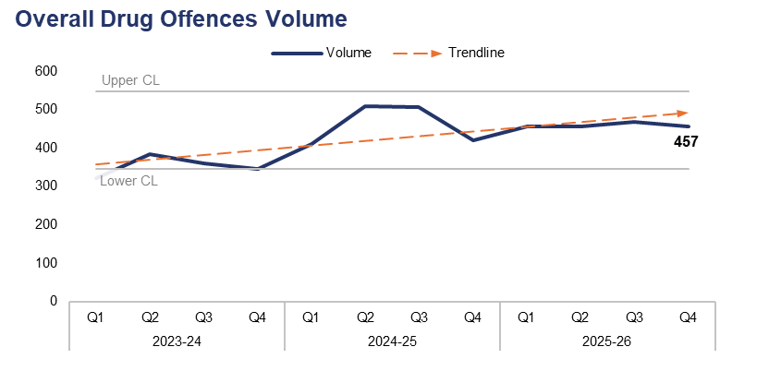
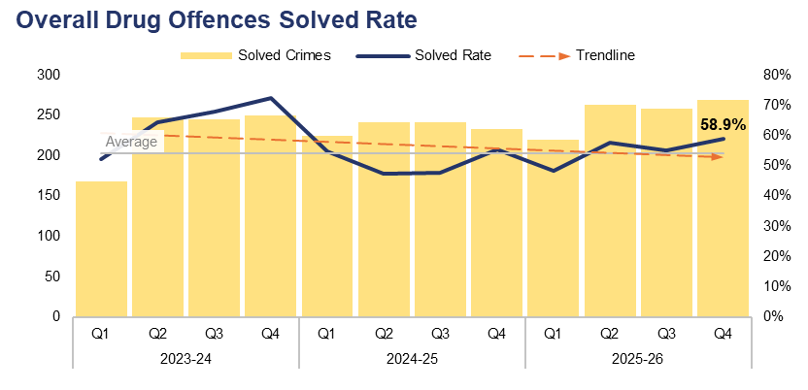
8. Overall Drug Offences
Financial Year | 21-22 | 22-23 | 23-24 | 24-25 | 25-26 |  | Quarter | Q3 25-26 | Q4 24-25
Volume | 1,328 | 1,296 | 1,412 | 1,846 | 1,838 |  | % Change | -2.4% | 8.8%
Financial Year | 21-22 | 22-23 | 23-24 | 24-25 | 25-26 |  | Quarter | Q3 25-26 | Q4 24-25
Solved Rate | 67.6% | 54.6% | 64.5% | 50.9% | 55.0% |  | PP Change | 3.8 | 3.4
Operational Overview
Overall, 457 crimes classified as Drug Offences were recorded during Q4 2025-26. This represents a reduction of 2.4% (11 fewer offences) when compared to the quarter prior, but an increase of 8.8% (37 additional offences) when compared to the same quarter during the previous financial year.
The solved rate for Q4 2025-26 stands at 58.9%, with 269 crimes solved. This is an increase of 3.8 percentage points when compared to the quarter prior, with 11 additional crimes solved. A similar increase of 3.4 percentage points can be observed when comparing Q4 2025-26 to the same quarter during the previous financial year, with 36 additional crimes solved.
The number of offences relating to the importation of drugs has risen by 14.6% (six additional offences) when compared to the quarter prior, for a total of 47.
New processes have been implemented by Gwent Police to manage drug importation offences. These offences saw an increase due to an international rise in the use of the fast parcel service to import drugs, particularly from areas which have legalised cannabis. The processes provide effective management of importations, with a focus on disruption to prevent further offending.

Slide 23
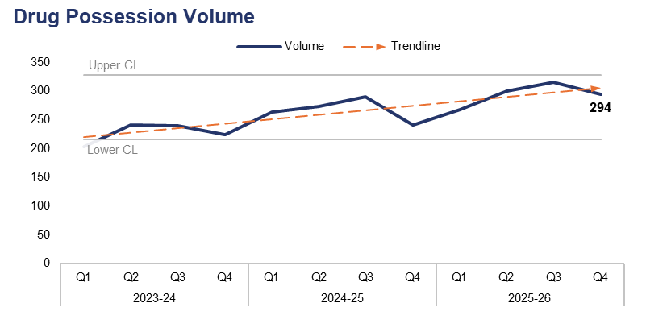
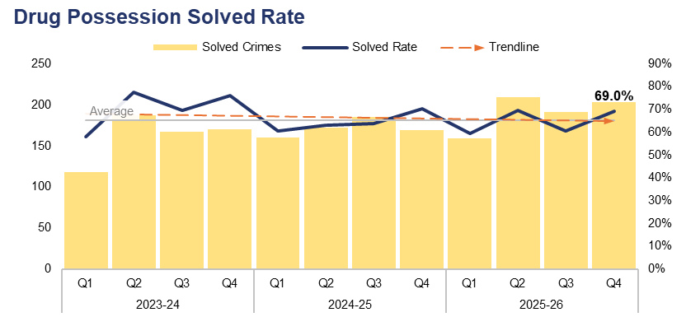
9. Drug Possession
Financial Year | 21-22 | 22-23 | 23-24 | 24-25 | 25-26 |  | Quarter | Q3 25-26 | Q4 24-25
Volume | 948 | 828 | 908 | 1,068 | 1,177 |  | % Change | -7.0% | 22.0%
Financial Year | 21-22 | 22-23 | 23-24 | 24-25 | 25-26 |  | Quarter | Q3 25-26 | Q4 24-25
Solved Rate | 70.1% | 60.9% | 70.7% | 64.2% | 64.7% |  | PP Change | 8.6 | -1.1
Operational Overview
A total of 294 drug possession offences were recorded during Q4 2025-26. This represents a reduction of 7.0% (22 fewer offences) when compared to the quarter prior, but a significant increase of 22.0% (53 additional offences) when compared to the same quarter during the previous financial year.
The solved rate for Q4 2025-26 stands at 69.0%, with 203 crimes solved. This is an increase of 8.6 percentage points when compared to the quarter prior, with 12 additional crimes solved. Conversely, a reduction of 1.1 percentage points can be observed when comparing Q4 2025-26 to the same quarter during the previous financial year, albeit with 34 additional crimes solved.
The force has significantly improved its proactive approach to tackling drug supply and use within local communities. Progress is monitored monthly at the force SOC meeting via the Agency and Partner Management Information System, which records disruption activity for each team. The rise in recorded drug possession offences directly corresponds with the increase in these disruption activities.
This slide pertains to possession offences for all controlled drugs, including Cannabis.

Slide 24
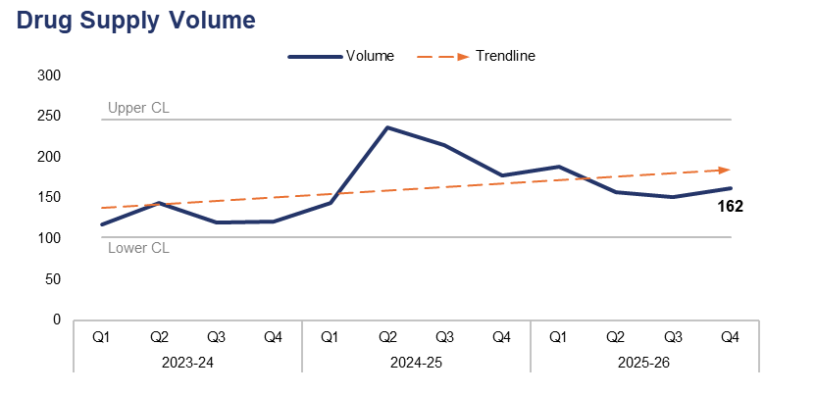
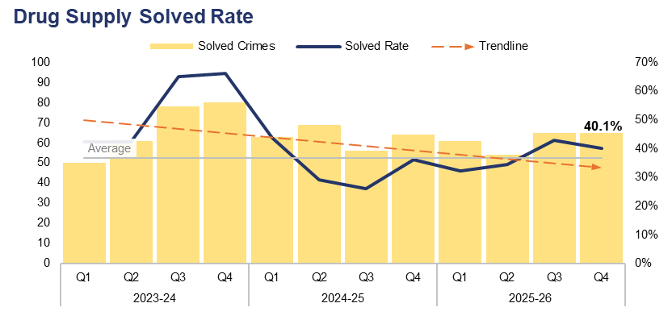
10. Drug Supply
Financial Year | 21-22 | 22-23 | 23-24 | 24-25 | 25-26 |  | Quarter | Q3 25-26 | Q4 24-25
Volume | 378 | 461 | 503 | 774 | 659 |  | % Change | 7.3% | -9.0%
Financial Year | 21-22 | 22-23 | 23-24 | 24-25 | 25-26 |  | Quarter | Q3 25-26 | Q4 24-25
Solved Rate | 61.4% | 43.4% | 53.5% | 32.6% | 37.2% |  | PP Change | -2.9 | 4.1
Operational Overview
Overall, 162 drug supply offences were recorded during Q4 2025-26. This represents an increase of 7.3% (11 additional offences) when compared to the quarter prior, but a reduction of 9.0% (16 fewer offences) when compared to the same quarter during the previous financial year.
The solved rate for Q4 2025-26 stands at 40.1%, with 65 crimes solved. This is a reduction of 2.9 percentage points when compared to the quarter prior, albeit with an equal number of crimes solved. An increase of 4.1 percentage points can be observed when comparing Q4 2025-26 to the same quarter during the previous financial year, with one additional crime solved.
The force has made significant arrests and secured substantial drug seizures linked to the highest‑harm and highest‑threat OCGs in the area. These targeted, intelligence‑led operations have resulted in several individuals being remanded in custody, awaiting trial. Collectively, this activity has had a meaningful impact on disrupting organised crime across Gwent.
This slide includes all offences pertaining to the supply, importation, or production of controlled drugs.

Slide 25
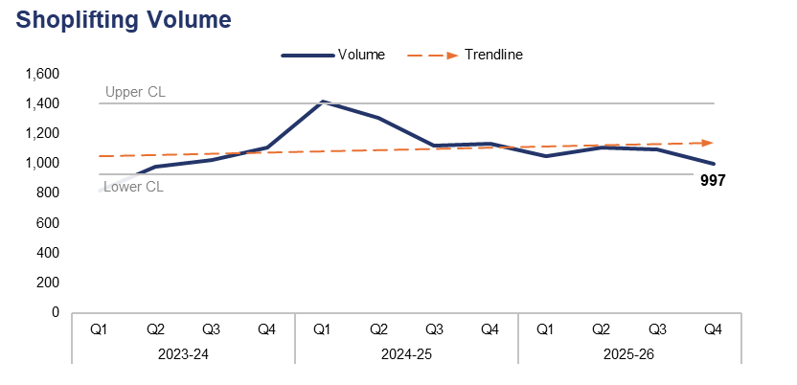
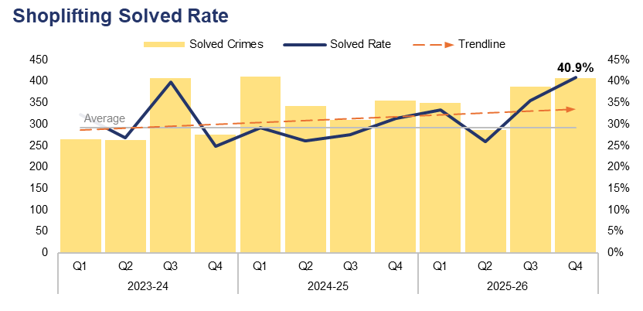
11. Shoplifting
Financial Year | 21-22 | 22-23 | 23-24 | 24-25 | 25-26 |  | Quarter | Q3 25-26 | Q4 24-25
Volume | 2,186 | 2,973 | 3,925 | 4,981 | 4,246 |  | % Change | -8.8% | -12.2%
Financial Year | 21-22 | 22-23 | 23-24 | 24-25 | 25-26 |  | Quarter | Q3 25-26 | Q4 24-25
Solved Rate | 27.7% | 23.7% | 30.8% | 28.5% | 33.7% |  | PP Change | 5.4 | 9.6
Operational Overview
During Q4 2025-26, 997 Shoplifting offences were recorded. This represents a reduction of 8.8% (96 fewer offences) when compared to the quarter prior, and a further reduction of 12.2% (138 fewer offences) when compared to the same quarter during the previous financial year.
The solved rate for Q4 2025-26 stands at 40.9%, with 408 crimes solved. This is the highest quarterly solved rate within the three-year timeframe, representing an increase of 5.4 percentage points when compared to the quarter prior, with 20 additional crimes solved. A further increase of 9.6 percentage points can be observed when comparing Q4 2025-26 to the same quarter during the previous financial year, with 53 additional crimes solved.
The force continues to focus on retail crime and maintains several Problem-Orientated Policing plans in town centre areas where shoplifting has been identified as adversely impacting crime levels and quality of life for retailers and the wider community. The introduction of dedicated demand reduction officers has placed specific emphasis on prolific offender management and ensuring that they work closely alongside Crime and Disorder Reduction Officers in securing Criminal Behaviour Orders, which are used to manage these individuals post charge/conviction.

Slide 26
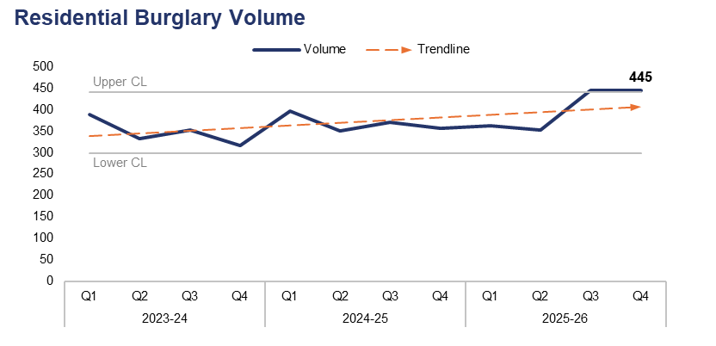
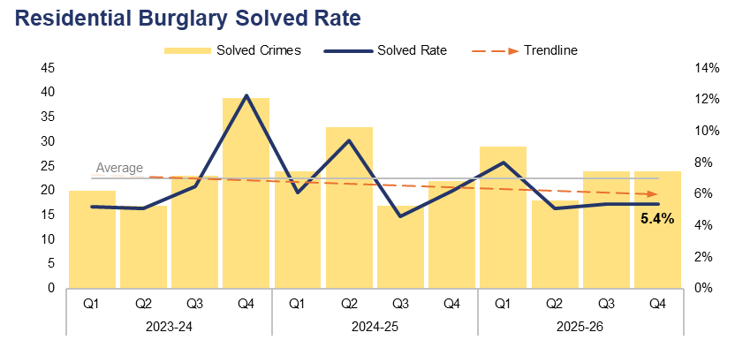
12. Residential Burglary
Financial Year | 21-22 | 22-23 | 23-24 | 24-25 | 25-26 |  | Quarter | Q3 25-26 | Q4 24-25
Volume | 1,755 | 1,615 | 1,389 | 1,473 | 1,605 |  | % Change | 0.0% | 25.0%
Financial Year | 21-22 | 22-23 | 23-24 | 24-25 | 25-26 |  | Quarter | Q3 25-26 | Q4 24-25
Solved Rate | 6.3% | 5.1% | 7.1% | 6.5% | 5.9% |  | PP Change | 0.0 | -0.8
Operational Overview
The volume of Residential Burglary offences exceeded the upper control limit during Q4 2025-26 for a second consecutive quarter, with 445 crimes recorded. This is the joint-highest quarterly figure within the three-year timeframe, equal to the quarter prior, and represents an increase of 25.0% (89 additional offences) when compared to the same quarter during the previous financial year.
The solved rate for Q4 2025-26 stands at 5.4%, with 24 crimes solved. This is again equal to the quarter prior, in terms of both solved rate and the number of crimes solved. A reduction of 0.8 percentage points can be observed when comparing Q4 2025-26 to the same quarter during the previous financial year, albeit with two additional crimes solved.
During Q4 2025-26, 88.8% of Residential Burglary of a Home incidents were attended by officers, with 49.7% of these attended within 60 minutes.
There is a notable disparity in solved rate between crimes classified as residential burglaries of homes and those classified as residential burglaries of unconnected buildings. The solved rate for residential burglaries of homes stands at 7.6% for the financial year, whereas the solved rate for residential burglaries of unconnected buildings is lower, at 2.1%.
The last two quarters of the 2025-26 financial year have seen established practice being adopted by Reactive CID to ensure that all dwelling burglary offences are identified on a daily basis. This allows ownership decisions to be made swiftly, whereas previously delays in this area could hamstring the policing response. Initial indications show that this has resulted in better identification of these offences, and their subsequent ownership by CID resources.

Slide 27
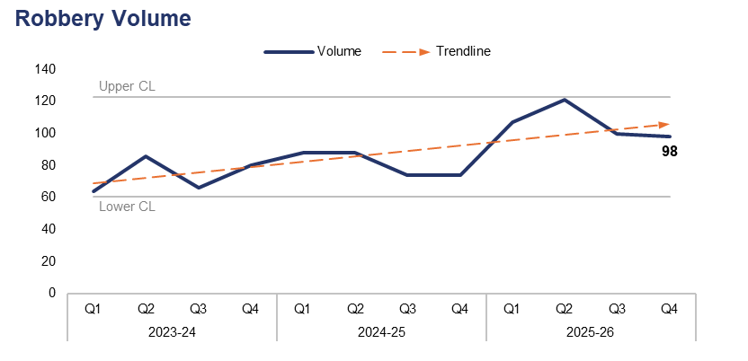
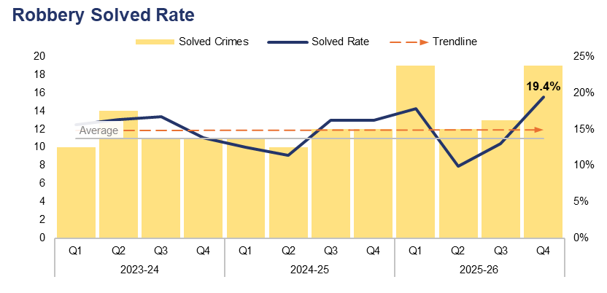
13. Robbery
Financial Year | 21-22 | 22-23 | 23-24 | 24-25 | 25-26 |  | Quarter | Q3 25-26 | Q4 24-25
Volume | 266 | 332 | 296 | 324 | 426 |  | % Change | -2.0% | 32.4%
Financial Year | 21-22 | 22-23 | 23-24 | 24-25 | 25-26 |  | Quarter | Q3 25-26 | Q4 24-25
Solved Rate | 18.8% | 12.7% | 15.5% | 13.9% | 14.8% |  | PP Change | 6.4 | 3.2
Operational Overview
A total of 98 Robbery offences were recorded during Q4 2025-26. This represents a reduction of 2.0% (two fewer offences) when compared to the quarter prior, but a significant increase of 32.4% (24 additional offences) when compared to the same quarter during the previous financial year.
The solved rate for Q4 2025-26 stands at 19.4%, with 19 crimes solved. This is the highest quarterly solved rate within the three-year timeframe, representing an increase of 6.4 percentage points when compared the the quarter prior, with six additional crimes solved. A less prominent increase of 3.2 percentage points can be observed when comparing Q4 2025-26 to the same quarter during the previous financial year, with seven additional crimes solved.
Offences pertaining to the robbery of personal property comprise 77.0% of those recorded during the financial year (328 offences). Robbery of business property offences account for the remaining 23.0% (98 offences). The solved rate for the former stands at 11.0% (36 crimes solved), whereas the solved rate for the latter is higher at 27.6% (27 crimes solved).
Force-wide performance regarding Robbery is tracked in the Homicide and Serious Violence Meeting. This highlights specific areas of concern and allows for the effective tasking of specialist resources to problem-solve and robustly investigate these offences. A daily process run by the CID ensures that all Robbery offences are correctly identified and owned by the appropriate investigative team. This is further supported by Level 1 tasking, where multiple departments come together to problem-solve any ongoing series of offences.
The data on this slide includes both personal and business Robbery offences.

Slide 28
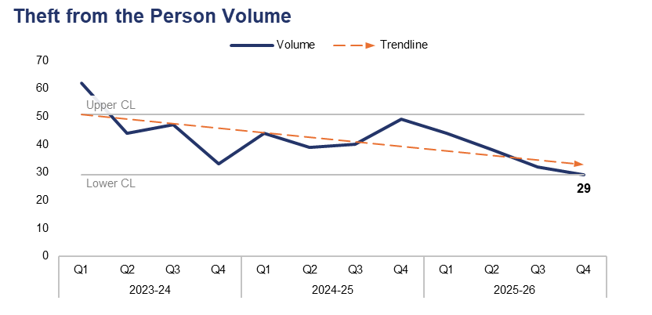
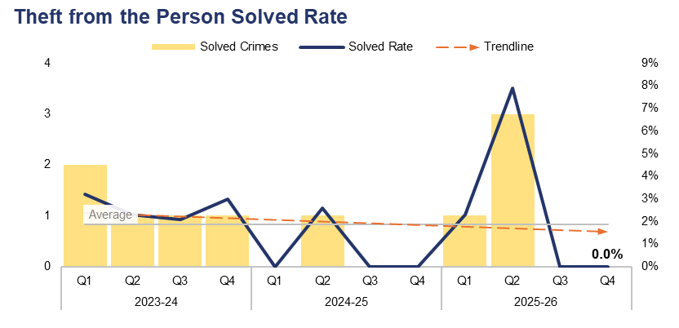
14. Theft from the Person
Financial Year | 21-22 | 22-23 | 23-24 | 24-25 | 25-26 |  | Quarter | Q3 25-26 | Q4 24-25
Volume | 166 | 207 | 186 | 172 | 143 |  | % Change | -9.4% | -40.8%
Financial Year | 21-22 | 22-23 | 23-24 | 24-25 | 25-26 |  | Quarter | Q3 25-26 | Q4 24-25
Solved Rate | 5.4% | 0.5% | 2.7% | 0.6% | 2.8% |  | PP Change | 0.0 | 0.0
Operational Overview
Theft from the Person offences fell below the lower control limit during Q4 2025-26, with 29 crimes recorded. This represents a reduction of 9.4% (three fewer offences) when compared to quarter prior, and a significant reduction of 40.8% (20 fewer offences) when compared to the same quarter during the previous financial year.
The solved rate for Q4 2025-26 stands at 0.0%, with no crimes solved. This is equal to both the quarter prior and the same quarter during the previous financial year.
The majority of the outcomes recorded for Theft from the Person offences during Q4 2025-26 were classified as Outcome 18: Investigation complete – no suspect identified. This is likely due in part to the nature of these offences, which include pickpocketing and ‘snatch thefts’, in which the victim typically has very little (if any) direct interaction with the offender.

Slide 29
15. Making our Communities Safer – Emerging Issues
Operational Overview
The continued use of electric bikes and scooters for criminal and ASB purposes presents a significant demand for neighbourhood policing teams, but this is a challenge which the teams are keen to meet head-on. There has been considerable success throughout Q4 2025-26 in relation to seizures and subsequent criminal investigations undertaken by both neighbourhood and CAT officers, which has been shared widely via social media platforms. The force utilises a suite of tactics to address this issue, including the increasing use of drones and fixed wing aircraft, in addition to covert approaches.
Dangerous dog activity continues to present a complex and ever-evolving risk within our communities that requires sustained focus from local neighbourhood policing teams and dog handlers. A month-on-month increase in dangerous dog crimes has been recorded throughout Q4 2025-26, which is in keeping with seasonal trends and patterns. That said, the force has made significant progress in this area through the introduction of robust governance arrangements which have resulted in a dramatic, sustained reduction in the number of dogs kennelled externally, with 16 held as of April 2026, down from 58 during June 2025. This has also resulted in fewer open investigations and improved case file timeliness.

Slide 30
Pillar Three – Protecting the Vulnerable
Violence Against Women and Girls
Domestic Offences
Rape
Serious Sexual Offences
Stalking
Harassment
Hate Crime
Child Criminal and Sexual Exploitation
Missing Children
Action Fraud
Cybercrime
Protecting the Vulnerable – Emerging Issues

Slide 31
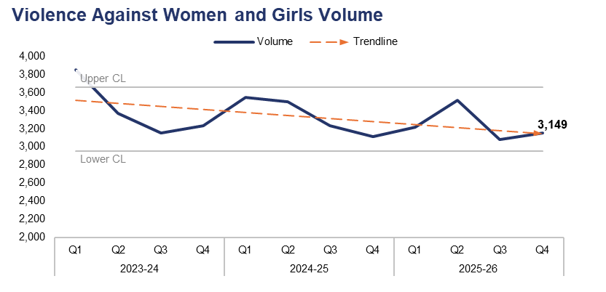
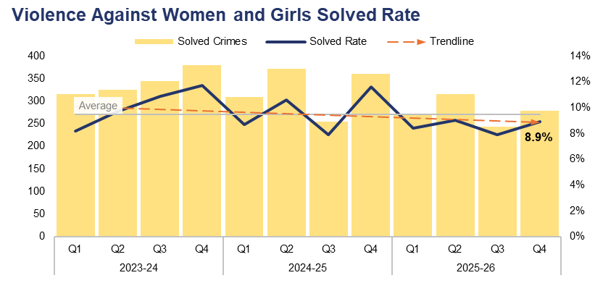
1. Violence Against Women and Girls
Financial Year | 21-22 | 22-23 | 23-24 | 24-25 | 25-26 |  | Quarter | Q3 25-26 | Q4 24-25
Volume | 13,085 | 14,923 | 13,603 | 13,390 | 12,958 |  | % Change | 2.3% | 1.3%
Financial Year | 21-22 | 22-23 | 23-24 | 24-25 | 25-26 |  | Quarter | Q3 25-26 | Q4 24-25
Solved Rate | 8.3% | 7.0% | 10.0% | 9.7% | 8.6% |  | PP Change | 1.0 | -2.7
Operational Overview
A total of 3,149 crimes classified as Violence Against Women and Girls (VAWG) offences were recorded during Q4 2025-26. This represents an increase of 2.3% (70 additional offences) when compared to the quarter prior, and a similar increase of 1.3% (39 additional offences) when compared to the same quarter during the previous financial year.
The solved rate for Q4 2025-26 stands at 8.9%, with 279 crimes solved. This is an increase of 1.0 percentage point when compared to the quarter prior, with 35 additional crimes solved. Conversely, a reduction of 2.7 percentage points can be observed when comparing Q4 2025-26 against the same quarter during the previous financial year, with 81 fewer crimes solved.

Slide 32
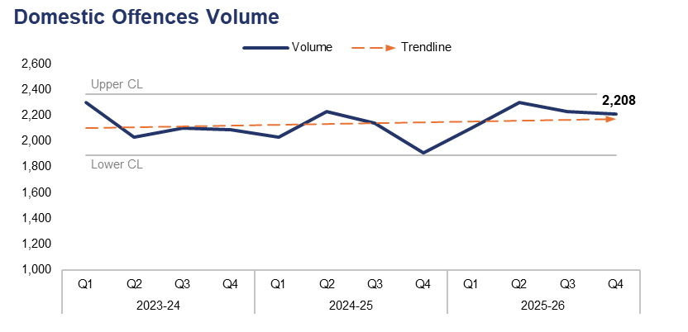
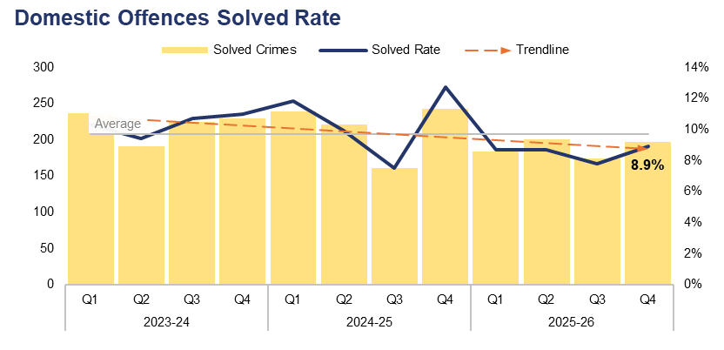
2. Domestic Offences
Financial Year | 21-22 | 22-23 | 23-24 | 24-25 | 25-26 |  | Quarter | Q3 25-26 | Q4 24-25
Volume | 8,949 | 8,534 | 8,515 | 8,313 | 8,844 |  | % Change | -1.0% | 15.8%
Financial Year | 21-22 | 22-23 | 23-24 | 24-25 | 25-26 |  | Quarter | Q3 25-26 | Q4 24-25
Solved Rate | 9.4% | 9.7% | 10.4% | 10.4% | 8.5% |  | PP Change | 1.1 | -3.8
Operational Overview
Overall, 2,208 crimes classified as domestic offences were recorded during Q4 2025-26. This represents a reduction of 1.0% (23 fewer offences) when compared to the quarter prior, but an increase of 15.8% (301 additional offences) when compared to the same quarter during the previous financial year.
The solved rate for Q4 2025-26 stands at 8.9%, with 197 crimes solved. This is an increase of 1.1 percentage points when compared to the quarter prior, with 23 additional crimes solved. Conversely, a reduction of 3.8 percentage points can be observed when comparing Q4 2025-26 to the same quarter during the previous financial year, with 46 fewer crimes solved.
Increases in domestic offences are due in part to better identification, whilst reductions in positive outcomes are largely driven by victim attrition, evidential challenges and system pressures.
Amendments to the governance for domestic abuse have been implemented during Q4 2025-26, in order to improve the scrutiny of performance metrics and ensure key partner agencies are able to contribute. Gwent Police will launch its Citizens First Programme during Q1 2026-27. This will assist with victim contact and engagement, which are key to reducing victim attrition. The force is committed to improving the solved rate for domestic offences.
For the purposes of this report, a domestic offence is defined as a crime which has been assigned a domestic abuse local qualifier and in which the victim and offender are both over 16 years of age, in accordance with the Domestic Abuse Act 2021. Offences assigned the qualifier but in which the age of the victim or offender has not been recorded have also been included, in order to prevent under-reporting.

Slide 33
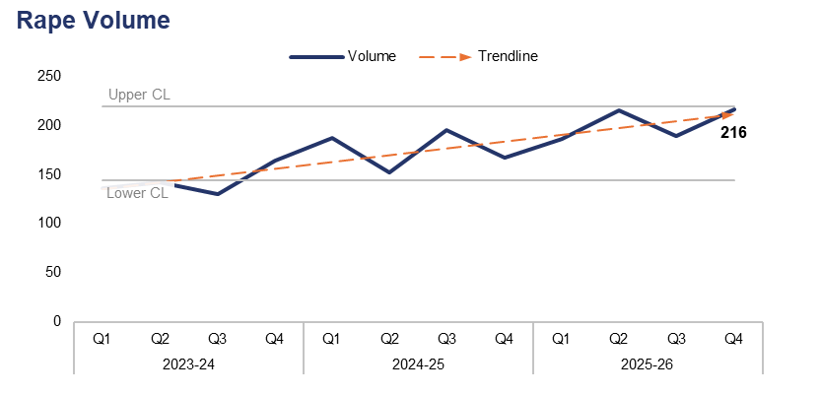
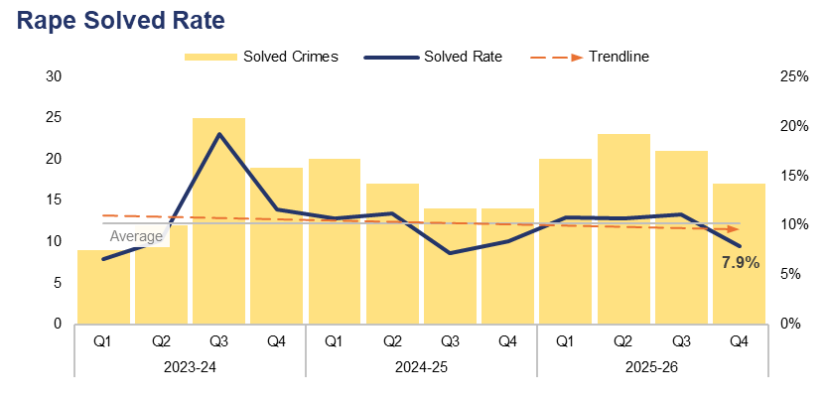
3. Rape
Financial Year | 21-22 | 22-23 | 23-24 | 24-25 | 25-26 |  | Quarter | Q3 25-26 | Q4 24-25
Volume | 573 | 579 | 572 | 701 | 806 |  | % Change | 14.3% | 29.3%
Financial Year | 21-22 | 22-23 | 23-24 | 24-25 | 25-26 |  | Quarter | Q3 25-26 | Q4 24-25
Solved Rate | 5.4% | 6.7% | 11.4% | 9.3% | 10.0% |  | PP Change | -3.2 | -0.5
Operational Overview
During Q4 2025-26, 216 Rape offences were recorded. This is the highest quarterly figure within the three-year timeframe, representing an increase of 14.3% (27 additional offences) when compared to the quarter prior, and a further increase of 29.3% (49 additional offences) when compared to the same quarter during the previous financial year.
The solved rate for Q4 2025-26 stands at 7.9%, with 17 crimes solved. This is a reduction of 3.2 percentage points when compared to the quarter prior, with four fewer crimes solved. A less prominent reduction of 0.5 percentage points can be observed when comparing Q4 2025-26 to the same quarter during the previous financial year, albeit with three additional crimes solved.
There is a continued upward trend in the reporting of Rape. Much of this increase is due to the reporting of non-recent crimes, which is consistent with national trends. The force has invested in additional investigative resources to meet this rise in demand, and further work is ongoing to ensure that the dedicated Rape investigation Team are able to meet new national requirements. Timeliness of investigations is a key focus going forward, in recognition of the impact this has on victim attrition.

Slide 34
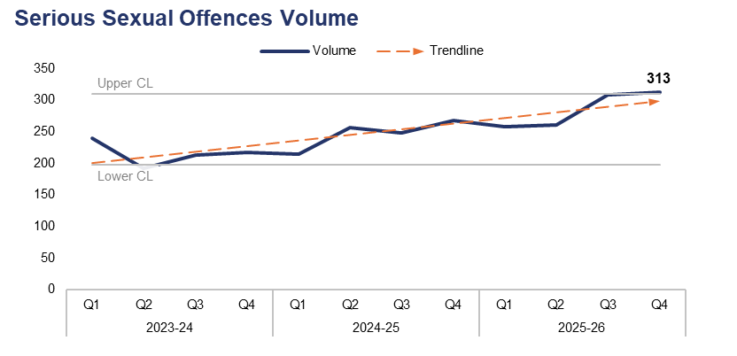
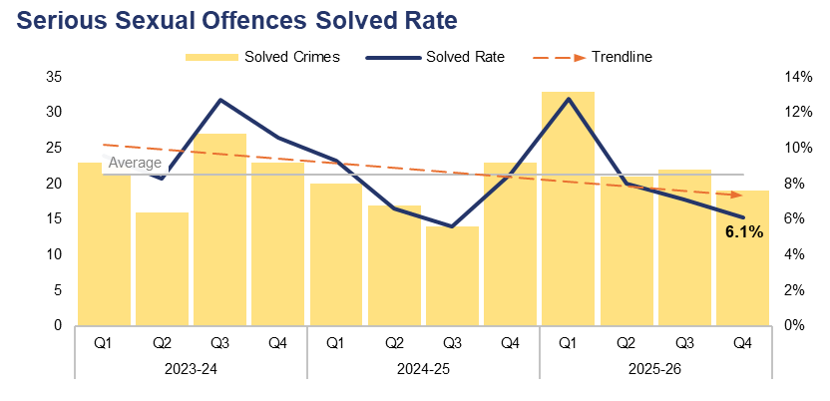
4. Serious Sexual Offences
Financial Year | 21-22 | 22-23 | 23-24 | 24-25 | 25-26 |  | Quarter | Q3 25-26 | Q4 24-25
Volume | 922 | 999 | 861 | 986 | 1,140 |  | % Change | 1.6% | 16.8%
Financial Year | 21-22 | 22-23 | 23-24 | 24-25 | 25-26 |  | Quarter | Q3 25-26 | Q4 24-25
Solved Rate | 6.3% | 6.5% | 10.3% | 7.5% | 8.3% |  | PP Change | -1.0 | -2.5
Operational Overview
The volume of crimes classified as serious sexual offences exceeded the upper control limit for a second consecutive quarter during Q4 2025-26, with 313 offences recorded. This is the highest quarterly figure with the three-year timeframe, representing an increase of 1.6% (five additional offences) when compared to the quarter prior, and a further increase of 16.8% (45 additional offences) when compared to the same quarter during the previous financial year.
The solved rate for Q4 2025-26 stands at 6.1%, with 19 crimes solved. This is a reduction of 1.0 percentage point when compared to the quarter prior, with three fewer crimes solved. A further reduction of 2.5 percentage points can be observed when comparing Q4 2025-26 to the same quarter during the previous financial year, with four fewer crimes solved.
In response to the Angiolini enquiry, Gwent Police now scrutinises non-contact sexual offending daily, ensuring appropriate ownership based on risk. This is in recognition that non-contact offending can lead to escalating criminal sexual behaviours. The sustained focus on non-contact offending may have had an impact on the level of offences recorded during Q4 2025-26. During the coming financial year, all serious sexual offences will be transferred to the dedicated Rape Investigation Team, with specialist officers leading each case. This is expected to improve timeliness, investigation quality, and solved rate for serious sexual offences.
Rape offences have been excluded from this dataset.

Slide 35
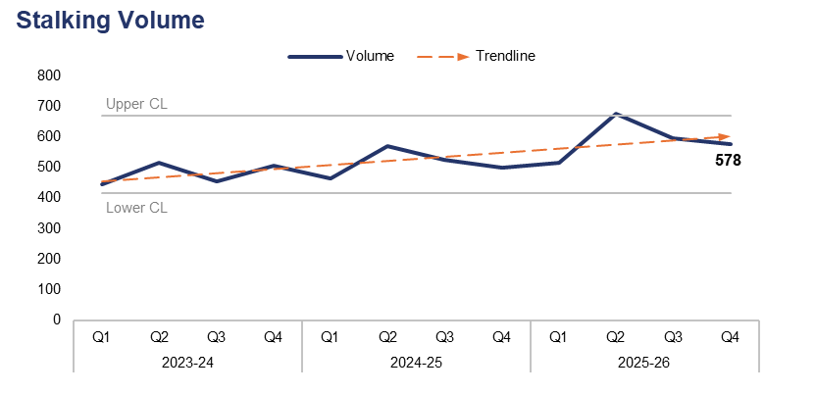
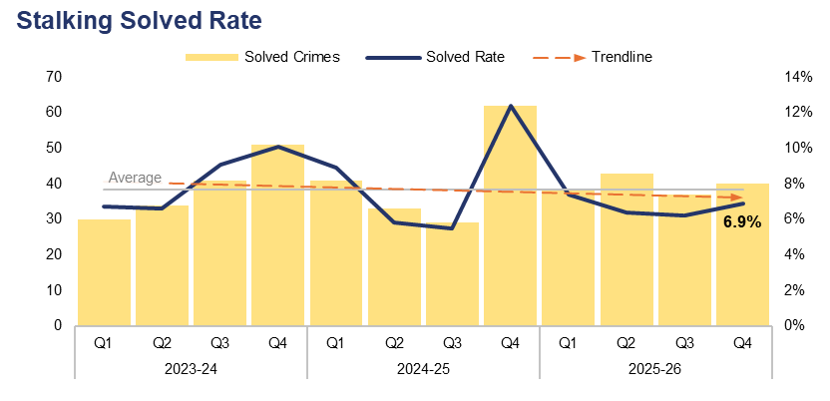
5. Stalking
Financial Year | 21-22 | 22-23 | 23-24 | 24-25 | 25-26 |  | Quarter | Q3 25-26 | Q4 24-25
Volume | 1,440 | 1,552 | 1,919 | 2,058 | 2,364 |  | % Change | -2.9% | 15.8%
Financial Year | 21-22 | 22-23 | 23-24 | 24-25 | 25-26 |  | Quarter | Q3 25-26 | Q4 24-25
Solved Rate | 7.6% | 8.5% | 8.1% | 8.0% | 6.7% |  | PP Change | 0.7 | -5.5
Operational Overview
Overall, 578 offences classified as stalking were recorded during Q4 2025-26. This represents a reduction of 2.9% (17 fewer offences) when compared to the quarter prior, but an increase of 15.8% (79 additional offences) when compared to the same quarter during the previous financial year.
The solved rate for Q4 2025-26 stands at 6.9%, with 40 crimes solved. This is an increase of 0.7 percentage points when compared to the quarter prior, with three additional crimes solved. Conversely, a reduction of 5.5 percentage points can be observed when comparing Q4 2025-26 to the same quarter during the previous financial year, with 22 fewer crimes solved.
The increase in offences recorded during the 2025-26 financial year can be attributed in part to the training delivered during this period, which has left officers and staff better equipped to identify stalking offences. This has yet to translate to improved outcomes. The stalking and harassment officer delivering this training will now have capacity to support investigators, with a view to improving the quality of stalking investigations. This will be monitored going forward.

Slide 36
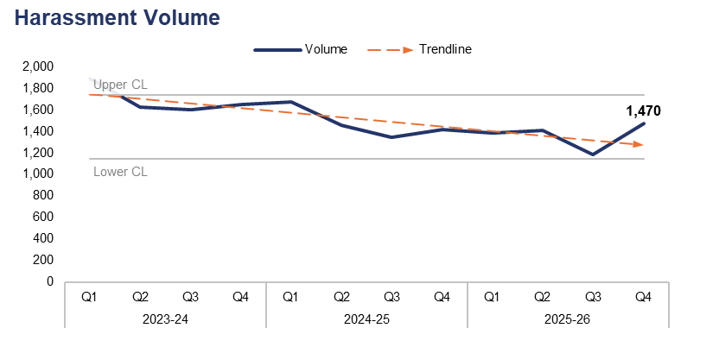
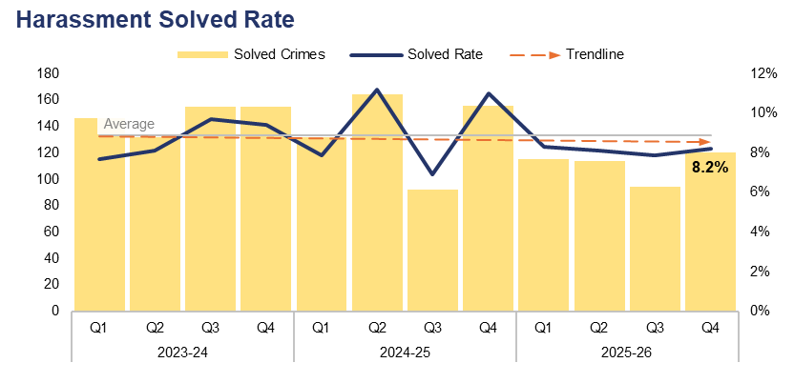
6. Harassment
Financial Year | 21-22 | 22-23 | 23-24 | 24-25 | 25-26 |  | Quarter | Q3 25-26 | Q4 24-25
Volume | 6,512 | 7,498 | 6,769 | 5,895 | 5,454 |  | % Change | 23.9% | 3.6%
Financial Year | 21-22 | 22-23 | 23-24 | 24-25 | 25-26 |  | Quarter | Q3 25-26 | Q4 24-25
Solved Rate | 7.8% | 5.5% | 8.7% | 9.2% | 8.1% |  | PP Change | 0.3 | -2.8
Operational Overview
A total of 1,470 offences classified as harassment were recorded during Q4 2025-26. This represents an increase of 23.9% (284 additional offences) when compared to the quarter prior, and a less prominent increase of 3.6% (51 additional offences) when compared to the same quarter during the previous financial year.
The solved rate for Q4 2025-26 stands at 8.2%, with 120 crimes solved. This is an increase of 0.3 percentage points when compared to the quarter prior, with 26 additional crimes solved. Conversely, a reduction of 2.8 percentage points can be observed when comparing Q4 2025-26 to the same quarter during the previous financial year, with 36 fewer crimes solved.
Work is ongoing to focus on 'golden hour' investigations in all areas, including harassment offences, in order to maximise evidence gathering opportunities.
The Detective Chief Inspectors for Investigations and Public Protection, along with the Superintendent for Response Policing, have initiated meetings in order to better understand a whole-system approach to the identification of both stalking and harassment offences, and to improve investigation quality in this area.

Slide 37
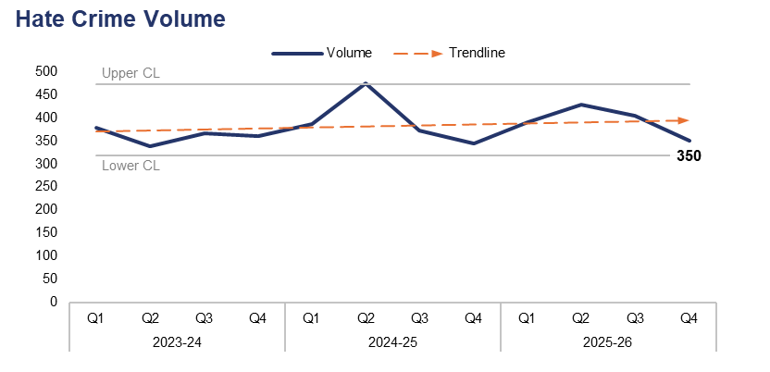

7. Hate Crime
Financial Year | 21-22 | 22-23 | 23-24 | 24-25 | 25-26 |  | Quarter | Q3 25-26 | Q4 24-25
Volume | 1,421 | 1,441 | 1,443 | 1,577 | 1,573 |  | % Change | -13.4% | 1.7%
Financial Year | 21-22 | 22-23 | 23-24 | 24-25 | 25-26 |  | Quarter | Q3 25-26 | Q4 24-25
Solved Rate | 11.6% | 9.3% | 14.8% | 14.5% | 12.3% |  | PP Change | 0.0 | -5.8
Operational Overview
Overall, 350 offences which met the definition of a hate crime were recorded during Q4 2025-26. This represents a reduction of 13.4% (54 fewer offences) when compared to the quarter prior, but a slight increase of 1.7% (six additional offences) when compared to the same quarter during the previous financial year. Crimes assigned the racial hate strand were the most prevalent during Q4 2025-26 with 229 such offences recorded. Conversely, crimes assigned the religious and transphobic hate strands were the least common, with 16 offences recorded for each.
The solved rate for Q4 2025-26 stands at 13.4%, with 47 crimes solved. This is equal the quarter prior, albeit with seven fewer crimes solved. A reduction of 5.8 percentage points can be observed when comparing Q4 2025-26 to the same quarter during the previous financial year, with 19 fewer crimes solved.
A single crime can be assigned multiple hate strands. The crime trend is based on recorded crimes, whilst the assessment of hate strands is based on the volume of each individual strand.

Slide 38


8. Child Criminal and Sexual Exploitation
Financial Year | 21-22 | 22-23 | 23-24 | 24-25 | 25-26 |  | Quarter | Q3 25-26 | Q4 24-25
Volume | 1 | 20 | 21 | 43 | 30 |  | % Change | -46.2% | -46.2%
Financial Year | 21-22 | 22-23 | 23-24 | 24-25 | 25-26 |  | Quarter | Q3 25-26 | Q4 24-25
Volume | 239 | 183 | 67 | 189 | 102 |  | % Change | 26.5% | -21.8%
Operational Overview
During Q4 2025-26, seven offences were assigned a child criminal exploitation local qualifier. This represents a reduction of 46.2% (six fewer offences) when compared to both the quarter prior and the same quarter during the previous financial year.
A total of 43 offences were assigned a child sexual exploitation local qualifier during Q4 2025-26. This is an increase of 26.5% (nine additional offences) compared to the quarter prior, but a reduction of 21.8% (12 fewer offences) compared to the same quarter during the previous financial year. It has been identified that this qualifier may have been incorrectly applied in the past.
Work continues to improve data quality regarding flags and qualifiers to ensure the accurate recording of exploitation offences. Gwent Police are a pilot force for Operation Beaconport, led by the National Crime Agency. This operation was established in response to the Casey Audit and wider national concern about the historic policing response to group‑based child sexual exploitation and abuse. It focuses on the review of closed investigations involving two or more offenders and one or more victims, to determine whether those investigations were correctly concluded and whether further action is required.
The force has governance and reporting on child sexual abuse and exploitation through the Regional Threat Group and Strategic Governance Group in order to provide a regional overview and understanding, as patterns and issues are reflected nationally.
Use of the Child Criminal Exploitation local qualifier commenced during 2022, limiting the scope of the currently available dataset.

Slide 39

9. Missing Children
Financial Year | 21-22 | 22-23 | 23-24 | 24-25 | 25-26 |  | Quarter | Q3 25-26 | Q4 24-25
Volume | 2,765 | 3,268 | 4,354 | 4,350 | 4,922 |  | % Change | -10.9% | 22.4%
Operational Overview
During Q4 2025-26, 1,165 missing person reports were created which pertained to a child. This represents a reduction of 10.9% (143 fewer reports) when compared to the quarter prior, but an increase of 22.4% (213 additional reports) when compared to the same quarter during the previous financial year.
The management of missing children has been greatly improved through a multi-agency response and weekly Missing Meetings. The force has equipped frontline staff with a greater understanding of risk through use of the Philomena Protocol and additional training for frontline teams throughout the 2025-26 financial year.
The Missing Children Team manage Missing Meetings to review all missing children and ensure that debriefs are completed. Trends regarding missing children are escalated via the Operational and Strategic Missing Meetings. Links between missing children and exploitation are mitigated through the Multi-Agency Child Exploitation meetings. Effective partnership working ensures a problem-solving approach to reducing the frequency and duration of missing episodes for children.
A missing person report is created each time an individual is reported as missing. Several reports can be created for the same individual if they are reported as missing on multiple occasions.

Slide 40

10. Action Fraud
Financial Year | 21-22 | 22-23 | 23-24 | 24-25 | 25-26 |  | Quarter | Q3 25-26 | Q4 24-25
Volume | 788 | 923 | 969 | 867 | 953 |  | % Change | 31.3% | 40.7%
Operational Overview
Overall, 294 action fraud occurrences were reported to Gwent Police via the National Fraud Intelligence Bureau during Q4 2025-26, exceeding the upper control limit. This is the highest quarterly figure within the three-year timeframe, representing a significant increase of 31.3% (70 additional occurrences) when compared to the quarter prior, and a further increase of 40.7% (85 additional occurrences) when compared to the same quarter during the previous financial year.
During Q4 2025-26, £31,300 of victim’s money was safeguarded by fraud investigations in Gwent. The total for the financial year stands at £345,171.

Slide 41

11. Cybercrime
Offences Most Commonly Classified as Cybercrime by Volume – Q4 2025-26
Offence Title | Volume | % of Total
Protection from Harassment Act Section 2 | 339 | 20.9%
Pursue course of conduct which amounts to stalking | 238 | 14.7%
Putting people in fear of violence | 128 | 7.9%
Sending letters etc with intent to cause distress or anxiety | 100 | 6.2%
Take/make indecent photographs/ pseudo-photographs of children | 85 | 5.3%
Financial Year | 25-26 |  |  |  |  |  | Quarter | Q3 25-26 | Q4 24-25
Volume | 6,340 |  |  |  |  |  | % Change | 10.0% | 13.9%
Operational Overview
A total of 1,619 offences recorded during Q4 2025-26 were classified as cybercrime, as defined by the NDQIS reporting system. This represents an increase of 10.0% (147 additional offences) when compared to the quarter prior, and a further increase of 13.9% (197 additional offences) when compared to the same quarter during the previous financial year.
During Q4 2025-26, three of the five offences which were most commonly classified as cybercrime can be defined as harassment offences, with a fourth defined as a stalking offence. Overall, crimes classified as either a harassment offence or a stalking offence accounted for 59.0% of all cybercrime recorded during the quarter, with a total of 955 offences reported. This is an increase of 2.2 percentage points when compared to the quarter prior, with 119 additional offences recorded.
Cybercrime reporting via the NDQIS system was first adopted by the force during June 2024, limiting the scope of the currently available dataset. As a full financial year of data is now available, reporting in the table beneath the graph has been reformatted to adhere to this timeframe.

Slide 42
12. Protecting the Vulnerable – Emerging Issues
Operational Overview
The government are creating a new standalone offence to prosecute adults committing child criminal exploitation. In addition, they are creating a new regime for child criminal exploitation civil preventative orders, to prevent exploitative conduct committed by adults against children from occurring or re-occurring.
The government are also creating a new bespoke criminal offence to tackle the practice known as cuckooing (home takeover), whereby offenders take control over the home of another person in order to use it for criminal activity. Furthermore, a standalone offence of coerced internal concealment will be created to deal with incidents where children or adults are forced, deceived, or compelled to internally conceal illicit items for criminal purposes. Activity will be co-ordinated across forces in the Regional Threat Group when this legislation is enacted.
Harmful Sexual Behaviour has been raised as an emerging issue by the Welsh Government and there will be requirements for a standardised multi-agency approach. Local Authorities are leading on this and ensuring that there is correlation between matters reported to social care and those reported to police. Additional training for officers has been arranged and co-ordinated by Gwent Safeguarding Board.

Slide 43
Pillar Four – Putting Victims First
Investigation Timeliness
Victims and Repeat Victims
Victim Satisfaction
Putting Victims First – Emerging Issues

Slide 44

1. Investigation Timeliness
Financial Year | 21-22 | 22-23 | 23-24 | 24-25 | 25-26 |  | Quarter | Q3 25-26 | Q4 24-25
Median Timeliness | 25 | 41 | 22 | 31 | 44 |  | % Change | -8.0% | 15.0%
Operational Overview
During Q4 2025-26, the median investigation length was 46 days. This represents a reduction of 8.0% (four fewer days) when compared to the quarter prior, but an increase of 15.0% (six additional days) when compared to the same quarter during the previous financial year.
It is recognised that whilst investigation timeliness is key for victims, an investigation also has to be proportionate and effective. A balance must be struck between investigation quality and timeliness. This messaging forms part of the Quality of Investigation and Victim Care framework. To further support this messaging, victim inputs have been delivered at force training days and are provided to all new recruits. These focus on maintaining victim updates, updating victims at key stages, ensuring the victim’s right to receive specialist support is met, and providing a Victim Impact Statement.
Gwent Police are participating in the Domestic Abuse Charging Pilot, which is improving investigation timeliness by allowing police to charge non-remand guilty anticipated plea domestic abuse cases. The earlier charging process is designed to enable immediate safeguarding measures, secure quicker access to protective orders, and potentially reduce victim attrition. This will support a more efficient investigative procedure and faster case progression within the justice system. In support of this, an initiative between the police and Crown Prosecution Service has introduced Real Time Case Conversations. This is being trialled successfully for domestic abuse investigations, and is intended to streamline the process of obtaining a charging decision for these cases.

Slide 45


2. Victims & Repeat Victims
Financial Year | 21-22 | 22-23 | 23-24 | 24-25 | 25-26 |  | Quarter | Q3 25-26 | Q4 24-25
Volume | 30,527 | 32,028 | 32,808 | 33,051 | 32,967 |  | % Change | 0.9% | 6.0%
Financial Year | 21-22 | 22-23 | 23-24 | 24-25 | 25-26 |  | Quarter | Q3 25-26 | Q4 24-25
Volume | 7,472 | 8,250 | 7,260 | 7,199 | 7,105 |  | % Change | 2.6% | -1.3%
Operational Overview
Overall, 9,729 unique victims were linked to crimes recorded during Q4 2025-26. This represents a slight increase of 0.9% (85 additional victims) when compared to the quarter prior, and a further increase of 6.0% (548 additional victims) when compared to the same quarter during the previous financial year.
During the 12 months to the end of Q4 2025-26, 7,105 victims were linked in this capacity to two or more separate offences, classifying them as repeat victims. This is an increase of 2.6% (180 additional repeat victims) when compared to the 12 months to the end of the quarter prior, but a reduction of 1.3% (94 fewer repeat victims) when compared to the 12 months to the end of the same quarter during the previous financial year.
The ‘Victim Care’ guiding principle of the Quality of Investigations and Victim Care Change Programme aims to improve understanding and recording principles, in order to ensure that appropriate and tailored services are delivered to victims. Level 1 Tasking ensures that repeat victims are identified and problem-solving plans are enacted by the appropriate resource.
The Gwent Police Victim Care Unit (VCU) continue to work collaboratively alongside Victim Support, a service commissioned by the OPCC to deliver ongoing assistance to victims. The VCU supports Daily Management Meeting processes, ensuring that victims of high threat/harm/risk investigations are identified much sooner and signposted to appropriate support.
For the purposes of this report, a repeat victim is defined as an individual who has been linked in this capacity to two or more separate offences within a 12-month period.
The financial year figures on this slide now refer to the number of repeat victims recorded across that timeframe, rather than being the sum of the quarterly figures for that year.

Slide 46
3. Victim Satisfaction
Victim Satisfaction Survey Data: Q4 2024-25 – Q4 2025-26
Survey Question | Percentage of Respondents Satisfied | Quarter-on-Quarter Difference |  | Number of Respondents Satisfied | Total Responses Received
How satisfied are you with the ease of initial contact with the Police? | 77.4% | +0.6pp | á | 205 | 265
How satisfied are you with the response time to your contact? (e.g. how long it took for your call to be answered) | 79.9% | +2.2pp | á | 211 | 264
Overall, how satisfied are you with your experience of the first point of contact with the police? | 79.9% | +2.2pp | á | 211 | 264
If an officer attended, how satisfied are you with the time it took for them to arrive? | 84.1% | +0.9pp | á | 116 | 138
How satisfied are you with the actions taken by the attending officer/s? | 73.8% | +0.5pp | á | 107 | 145
Thinking about your overall experience, how satisfied are you with the treatment you have received from Gwent Police? | 66.0% | +1.0pp | á | 173 | 262
Operational Overview
A total of 268 respondents have engaged with the victim satisfaction survey between Q4 2024-25 and Q4 2025-26 inclusive. Of those who replied to the given question, 84.1% of respondents were satisfied with the time it took for officers to attend, whereas only 66.0% of respondents were satisfied with the overall treatment they received from Gwent Police. When compared to the same period for the quarter prior (Q3 2024-25 – Q3 2025-26), the percentage of satisfied respondents has increased for all of the questions above.
Improving the trust and confidence of victims is a core part of how Gwent Police seeks to deliver its services. It is recognised that the initial satisfaction rates regarding contact and attendance are much higher than overall satisfaction rates following interaction with investigators. The victim satisfaction survey is currently under review, with the support of Victim Services and the OPCC. This review has identified a new question set which has been sent to the wider working group for consultation. Further opportunity to utilise the Citizens First project to amplify victim’s feedback has been identified and is being explored through the programme delivery.
All questions within the survey are optional, which may result in a disparity between the number of responses received for each question.

Slide 47
4. Putting Victims First – Emerging Issues
Operational Overview
The change programme seeks to implement improvements in how all investigators care for victims, seeking to embed meaningful and purposeful interactions with victims at every stage of the investigation. Work is progressing to fully understand operational practices and seek feedback from frontline practitioners. This not only puts victim care at the forefront of everything we do, but ensures that those who deliver the service continue to improve the trust and confidence of our communities by delivering a connected service that cares about getting it right and doing the right thing.
The force will soon deliver changes to the templates used for identifying and caring for victim’s needs, as well as satisfying Victims Rights under the Victims Codes of Practice.
Governance arrangements in the force ensure that victim’s voices are at the forefront of the priorities of policy makers, investigators, and Victim Services. The Survivor Engagement Coordinator brings together the collective voices of a committed advisory group, acting as a stakeholder group who are willing to advise and challenge Gwent Police on the services it delivers. A recent review has tightened procedure and ensures that the reference group deliver to the organisational goals, as set by the Chief Constable.
The Head of Victim Services has worked with other Welsh leads to deliver consistent Victims' Code of Practice reporting metrics, in order to create a common language and performance framework for all Welsh forces. The Head of Victim Services and an analyst are also engaged with the Ministry of Justice Analytical Working Group, a forum to provide insights to help develop the national framework for the Victims’ Code compliance metrics. Due to challenges at a national level, the force has been asked to pause system changes to the collection and review of this data, in anticipation of a consistent approach for all of England and Wales.

Slide 48
Pillar Five – Reducing Reoffending
Offenders and Repeat Offenders
Young Offenders and First-Time Entrants
Children in Police Custody
Reducing Reoffending – Emerging Issues

Slide 49


1. Offenders & Repeat Offenders
Financial Year | 21-22 | 22-23 | 23-24 | 24-25 | 25-26 |  | Quarter | Q3 25-26 | Q4 24-25
Volume | 19,347 | 20,016 | 20,528 | 20,809 | 20,485 |  | % Change | 2.5% | 3.6%
Financial Year | 21-22 | 22-23 | 23-24 | 24-25 | 25-26 |  | Quarter | Q3 25-26 | Q4 24-25
Volume | 6,961 | 7,455 | 7,019 | 7,044 | 6,839 |  | % Change | 0.5% | -2.9%
Operational Overview
Overall, 6,588 unique offenders were linked to crimes recorded during Q4 2025-26. This represents an increase of 2.5% (163 additional offenders) when compared to the quarter prior, and a further increase of 3.6% (226 additional offenders) when compared to the same quarter during the previous financial year.
During the 12 months to the end of Q4 2025-26, 6,839 offenders were linked in this capacity to two or more separate offences, classifying them as repeat offenders. This is a slight increase of 0.5% (37 additional repeat offenders) when compared to the 12 months to the end of the quarter prior, but a reduction of 2.9% (205 fewer repeat offenders) when compared to the 12 months to the end of the same quarter during the previous financial year.
The organisation has recognised a need to standardise its identification of suspects, with a view to enhancing its understanding and drive towards timely intervention from law enforcement. This has been delivered in force, with messaging and accountability in place within the pillar structure. The gold group has transitioned to business as usual, with outstanding suspects now established as a mainstay for pillar performance meetings.
For the purposes of this report, a repeat offender is defined as an individual who has been linked in this capacity to two or more separate offences within a 12-month period. This does not necessarily mean that they have been charged with or found guilty of the offence in question.
The financial year figures on this slide now refer to the number of repeat offenders recorded across that timeframe, rather than being the sum of the quarterly figures for that year.

Slide 50


2. Young Offenders and First-Time Entrants
Financial Year | 21-22 | 22-23 | 23-24 | 24-25 | 25-26 |  | Quarter | Q3 25-26 | Q4 24-25
Volume | 3,225 | 3,544 | 3,687 | 3,621 | 3,412 |  | % Change | 7.1% | -1.7%
Financial Year | 21-22 | 22-23 | 23-24 | 24-25 | 25-26 |  | Quarter | Q3 25-26 | Q4 24-25
Volume | 2,088 | 2,107 | 2,041 | 2,007 | 1,853 |  | % Change | 5.5% | -5.7%
Operational Overview
A total of 1,204 unique offenders under the age of 18 were linked to crimes recorded during Q4 2025-26. This represents an increase of 7.1% (80 additional young offenders) when compared to the quarter prior, but a reduction of 1.7% (21 fewer young offenders) when compared to the same quarter during the previous financial year.
Of these young offenders, 482 (40.0% of the quarterly total) have been identified as first-time entrants into the criminal justice system within Gwent. This represents an increase of 5.5% (25 additional entrants) when compared to the quarter prior, but a reduction of 5.7% (29 fewer entrants) when compared to the same quarter during the previous financial year.
The force is striving to ensure that young offenders are seen as children and dealt with appropriately, with a focus on restorative processes to divert them from future offending and the criminal justice process. The force is leading an approach to standardising processes between the four Welsh forces, focusing on child-centric procedures and out of court disposals. Governance arrangements into the Wales Youth Justice Advisory Panel and the Criminal Justice Board provide accountability, supported by the Youth Justice Board. Force metrics regarding children, such as levels of offending, are tracked in Superintendent-led performance meetings and the Operational Effectiveness Board. In support of this, Youth Justice are leading on internal processes to ensure that children's rights are afforded consistently, and that investigations with a released under investigation disposal receive the same levels of accountability as bail cases.
The age of the offenders included in this dataset has been calculated based on the committed date of the offence they were linked to. This does not necessarily mean that they have been charged with or found guilty of the offence in question. The dataset used to identify first-time entrants is limited to offences committed within Gwent from 2018 onwards. Offences committed outside of Gwent or prior to 2018 are not included in this calculation.

Slide 51

3. Children in Police Custody
Financial Year | 21-22 | 22-23 | 23-24 | 24-25 | 25-26 |  | Quarter | Q3 25-26 | Q4 24-25
Volume | 520 | 541 | 613 | 751 | 532 |  | % Change | 2.5% | -31.6%
Operational Overview
During Q4 2025-26, 121 custody records were created which had a juvenile subject. This represents an increase of 2.5% (three additional custody records) when compared to the quarter prior, but a significant reduction of 31.6% (56 fewer custody records) when compared to the same quarter during the previous financial year.
The above figures are based on custody footfall, which is the number of custody records with an arrival time within the specified timeframe. As such, if a subject came into custody on multiple occasions, they would be counted upon each arrival.

Slide 52
4. Reducing Reoffending – Emerging Issues
Operational Overview
Legislative changes allowing for eligible offenders to be released after serving one third of their sentence represent an emerging issue for policing, specifically the Integrated Offender Management (IOM) team and probation services. This is under constant review by statutory agencies, in order to understand the impact and scale of the added demand that could be placed on services. The independent sentencing review is being managed through Operation Redford, ensuring a consistent approach to Sentencing Act changes across England and Wales. The IOM team are leading this change for GWP, engaging internal and external stakeholders. In support of this, the IOM team have improved multi-agency planning to manage the incoming demand and have enhanced processes for identifying individuals who are suitable for removal from the cohort due to consistent positive qualifiers, as per the IOM doctrine.
The Reducing Reoffending Subgroup continues to meet and work towards a multi-agency plan for reducing reoffending. The group is focusing their efforts on three main crime categories: drugs importation and supply, violence, and theft. The group have agreed a consistent definition of ‘reoffending’ and have further broken down the crime categories into specific crime types which are most prevalent within the cohort of individuals who reoffend. As part of an innovative step forward for Gwent Police, data analysts have identified a consistent process for the identification of those who reoffend. This will be reviewed and tracked against protected characteristics to understand the efficacy of diversion programmes and the disproportionality or bias of outcome or decision making. Their progress is being reported to the Local Criminal Justice Board.

