Slide 1
Organisational Performance against the PCC Priorities
Report to the Assurance and Accountability Board
Quarter 1 2026-27
Notes:
Good afternoon. The headline from quarter one is that Gwent Police is sustaining several important service standards, but it is doing so against a sharp rise in demand and a worsening picture across a number of high-harm offences. The executive issue is therefore not whether activity is taking place—it clearly is—but whether capacity is being focused quickly enough on the areas where demand, risk and victim impact are increasing fastest.
Starting with organisational resilience, sickness has improved. Officer sickness is 4.6%, the joint-lowest quarterly level in the three-year period, and staff sickness has reduced to 5.1%. This gives us a stronger workforce platform. There remains, however, a representation gap: women are under-represented among officers and people of ethnic heritage account for 3.8% of officers compared with 5.8% of the local population. That matters for legitimacy, confidence and long-term workforce effectiveness.
The broad demand picture is the most immediate concern. Overall crime reached 15,441 offences—up 8.9% on the previous quarter and 7.9% year on year. The solved rate is 12.0%, down 1.4 percentage points quarter on quarter. Total incidents rose even faster, to 52,670, an 11.7% quarterly increase. Anti-social behaviour is particularly notable: 3,730 incidents, the highest quarterly level in three years and above the upper control limit. The Community Action Team response is producing tangible results, including 54 arrests, 41 vehicle seizures and a 43.7% solved rate for its investigations. The key test now is whether this targeted model, alongside the ASB Action Plan and Operation Krypton, can reduce repeat demand rather than simply absorb it.
Demand pressure is also visible in contact and response. There were 26,106 emergency calls, up 14.8% quarter on quarter, and 67,100 calls to 101, up 9.8%. The 999 service level remains strong at 96.1%, above the national 90% target for the twelfth consecutive quarter. Emergency response compliance is also just above the force target, at 81.2%. However, the pressure is transferring elsewhere: 101 abandonment is 9.3%, average 101 answer time has risen to one minute 48 seconds, and priority response compliance has fallen to 75.7%, below the 80% target for the first time since quarter two of 2024-25. This combination points to a capacity and demand-management issue requiring close oversight.
Within crime, the greatest executive attention should be on high-harm and high-volume categories. Serious violence increased by 32.4% quarter on quarter, knife crime by 24.1%, and robbery by 35.8%, with robbery at its highest level in the three-year period and above the upper control limit. Shoplifting rose by 15.5%, while its solved rate fell by 7.6 percentage points. Drug offences and drug supply have fallen, but the report is clear that proactive capacity has been diverted into homicide investigations. The reduction should therefore not automatically be read as reduced underlying threat; it may partly reflect reduced enforcement visibility.
The vulnerability picture is similarly mixed. Violence against women and girls increased by 8.1% to 3,403 offences. Domestic offences rose to 2,484—up 10.2% on the quarter and 18.1% year on year—while the solved rate fell to 7.2%. Hate crime increased by 23.1% quarter on quarter. Against that, rape volumes reduced, the solved rate for serious sexual offences reached a three-year high of 12.5%, and missing-child reports fell by 5.5%. Specialist investment, Operation Soteria, enhanced scrutiny and the Citizens First programme are the right direction of travel, but domestic abuse outcomes, victim attrition and investigative capacity remain material risks.
For victims, investigation timeliness improved from the previous quarter, with the median falling by 10 days to 36 days, although it remains 14 days longer than a year ago. The number of unique victims reached a three-year high of 10,327, and repeat victimisation increased. Overall treatment satisfaction is 68.7%, based on a small survey response base, so the organisation needs both better service and more reliable insight. The work to improve victim contact, survey participation and Victims’ Code reporting should be treated as an operational performance priority, not simply a measurement exercise.
Finally, demand associated with offending is also rising. Unique offenders increased to 6,890. Young offenders are broadly stable quarter on quarter but up 8.2% year on year; 515 were first-time entrants. Juvenile custody records increased by 22.3% from the previous quarter. At the same time, sentencing changes may increase pressure on Integrated Offender Management and probation. The proposed high-harm offender capacity and improved multi-agency planning therefore need timely governance decisions ahead of the first expected releases in quarter three.
In summary, there are four priorities for executive oversight in the next quarter. First, stabilise 101 performance and restore priority response compliance without weakening the strong 999 service. Second, concentrate ownership and resources on serious violence, robbery, domestic abuse and shoplifting, with clear outcome trajectories rather than activity measures alone. Third, protect proactive capability and make the operational effect of resource diversion explicit. Fourth, accelerate victim-care improvements, including contact quality, repeat-victim problem solving and more credible satisfaction data.
The overall assessment is one of a force responding actively and maintaining key emergency standards, but under clear strain from rising demand and increasing high-harm risk. The next quarter should demonstrate not only continued activity, but measurable improvement in priority response, solved outcomes and victim experience.

Slide 2
Glossary of Terms
Common Terms:
Financial Year to Date (FYTD) – This date range encompasses the first quarter of the current financial year through to the end of the latest complete quarter (in this case comprising quarter one of the 2026-27 financial year).
Percentage Points (PP) – Percentage points are used to indicate the numeric difference between two percentages. For instance, moving from 10.0% to 12.0% is an increase of two percentage points.
Solved Crimes – For the purposes of this report, a crime is considered ‘solved’ if it has been finalised with a criminal justice outcome (outcomes 1-8, excluding 5). This includes out of court outcomes such as community resolutions and cautions, in addition to formal charges.
Solved Rate – The solved rate for a given quarter is calculated by dividing the number of crimes which were assigned a criminal justice outcome during that quarter by the number of crimes recorded during that quarter.
Graph Elements:
Average – For the purposes of this report, this graph element is calculated based on the mean value of the eight quarters preceding quarter one of the 2026-27 financial year.
Trendline – This graph element indicates the overall direction of the data within the graph. All 12 quarters represented within the graph are taken into account.
Upper and Lower Control Limits (Upper CL and Lower CL) – These graph elements mark the points beyond which a value is considered a special case, often implying the influence of one or more abnormal external factors. The upper control limit indicates that a value is higher than would be expected, whereas the lower control control limit indicates that the given value is below the expected level.

Slide 3
Pillar One - Preventing Crime and ASB
Representative Workforce
Sickness Rates
Quarterly Summary
Perceptions Survey - Engagement
Perceptions Survey – Local Concerns and Confidence
Overall Crime
Overall Incidents
Anti-Social Behaviour
Community Action Team
Preventing Crime and ASB – Emerging Issues

Slide 4
1. Representative Workforce
Employee Type | Establishment Numbers |  |  |  |  |  | Gender |  |  | Ethnicity
 | Finance Budget FTE | Establishment Budget FTE | Actual FTE | Actual FTE v Establishment FTE Variance | Headcount |  | Female | Male |  | Ethnic Heritage | Not Stated | Prefer Not to Say | White
Police Officer | 1506.0 | 1506.0 | 1537.7 | 31.7 | 1,551 |  | 39.9% | 60.1% |  | 3.8% | 0.3% | 3.4% | 92.8%
Police Staff | 795.8 | 894.3 | 817.8 | -76.6 | 860 |  | 68.4% | 31.6% |  | 6.0% | 34.2% | 33.3% | 26.5%
PCSO | 144 | 144 | 140.7 | -3.3 | 145 |  | 49.7% | 50.3% |  | 8.3% | 0.0% | 1.4% | 90.3%
OPCC | 23 | 23 | 23.3 | 0.3 | 24 |  | 70.8% | 29.2% |  | 8.3% | 8.3% | 0.0% | 83.3%
Special Constable | 0 | 100 | 0 | -48 | 52 |  | 21.2% | 78.8% |  | 3.8% | 1.9% | 0.0% | 94.2%
Agency Worker | 0 | 0 | 0 | 0 | 7 |  | 57.1% | 42.9% |  | 0.0% | 0.0% | 0.0% | 100.0%
Cadets | 0 | 0 | 0 | 0 | 94 |  | 56.4% | 43.6% |  | 9.6% | 3.2% | 0.0% | 87.2%
Volunteers | 0 | 0 | 0 | 0 | 58 |  | 50.0% | 50.0% |  | 5.2% | 67.2% | 0.0% | 22.4%
Number of Officers by Operational Pillar
Crime | Neighbourhood | Response
386 | 197 | 563
These figures pertain to the numbers of Police Constables, Police Sergeants, Detective Constables, and Detective Sergeants assigned to departments within each operational pillar. At present, 275 officers operate outside of these pillars.
Operational Overview
There is a gender disparity evident in the workforce for both officers and staff. For officers, females are under-represented by approximately 11 percentage points (females account for 51% of the population in Gwent based on the 2021 Census). However, females are overrepresented in the staff workstream area by approximately 17 percentage points. There is also a disparity in ethnic heritage representation within the workforce. According to the 2021 Census, 5.8% of the Gwent population are people of ethnic heritage. As of July 2026, 3.8% of police officers are people of ethnic heritage, whereas ethnic heritage representation in the staff workstream is higher, at 6.0%.
A representative workforce is crucial for fostering public trust, improving community relations and enhancing operational effectiveness. It is vitally important that Gwent Police mirrors the diversity of the community it serves, in order to better understand and address the unique needs and concerns of all residents. This can lead to greater public confidence in approaching officers for help, reporting incidents, or providing valuable information, as well as creating opportunities to build cohesion and forge stronger relationships. It is also important to recognise that officers from diverse backgrounds may be better equipped to handle specific situations involving vulnerable individuals or specific groups.
The force is organised into three operational pillars – Crime, Neighbourhood, and Response. There are currently 386 officers working within the Crime Pillar, 197 within the Neighbourhood Pillar, and 563 within the Response Pillar. This operating model has been designed to influence how the force works together to improve trust and confidence. Removing geographic barriers puts the community at the heart of everything the force does, working as one team to deliver on issues that matter to people. The model offers opportunities to bring consistency of approach to communities irrespective of the pillar or area of the force, notwithstanding local nuances which will require a tailored delivery dependent upon their needs.
The data on this slide is accurate as of July 2026. The Establishment Budget for Special Constables is a target headcount.

Slide 5
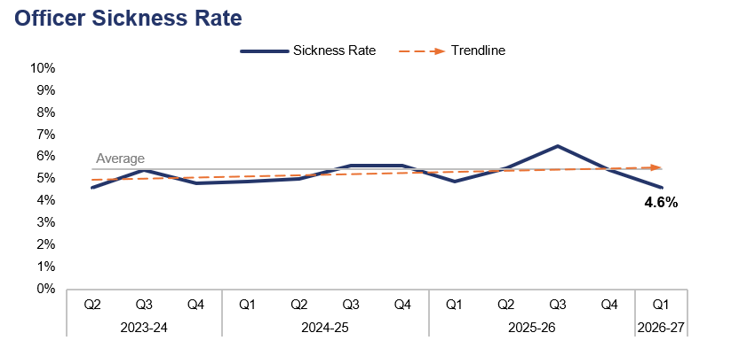
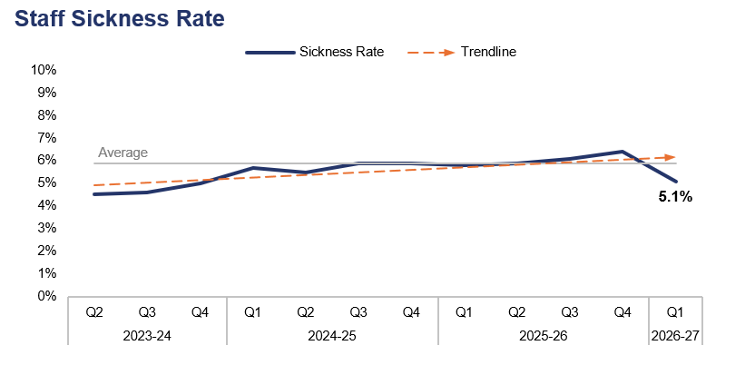
2. Sickness Rates
Financial Year | 22-23 | 23-24 | 24-25 | 25-26 |  | FYTD | 26-27 |  | Quarter | Q4 25-26 | Q1 25-26
Sickness Rate | 4.7% | 4.8% | 5.3% | 5.6% |  | Sickness Rate | 4.6% |  | PP Change | -0.8pp | -0.3pp
Financial Year | 22-23 | 23-24 | 24-25 | 25-26 |  | FYTD | 26-27 |  | Quarter | Q4 25-26 | Q1 25-26
Sickness Rate | 4.9% | 4.4% | 5.7% | 6.0% |  | Sickness Rate | 5.1% |  | PP Change | -1.3pp | -0.7pp
Operational Overview
During the first quarter of the 2026-27 financial year (Q1 2026-27), the sickness rate for police officers within the force stood at 4.6%. This is the joint-lowest quarterly figure within the three-year timeframe, representing a reduction of 0.8 percentage points when compared to the quarter prior, and of 0.3 percentage points when compared to the same quarter during the previous financial year.
The police staff sickness rate for the same period stands at 5.1%. This represents a reduction of 1.3 percentage points when compared to the quarter prior, and of 0.7 percentage points when compared to the same quarter during the previous financial year.
In this context, the sickness rate is calculated by dividing the number of individuals who have taken a day or more of sick leave during the given period by the overall establishment figure for that group.

Slide 6
3. Quarterly Summary
Q1 2026-27 - Crime Volume and Solved Rate by Crime Category
Crime Category | Volume | Solved Rate
- | 8 | 12.5%
All Other Theft | 920 | 3.8%
Bicycle Theft | 66 | 3.0%
Commercial Burglary | 256 | 7.8%
Criminal Damage & Arson | 1,771 | 6.6%
Drug Offences | 377 | 58.4%
Homicide | 6 | 83.3%
Misc Crimes Against Society | 566 | 19.3%
Other Sexual Offences | 424 | 14.2%
Possession Of Weapons | 148 | 31.8%
Public Order Offences | 1,956 | 6.9%
Rape | 179 | 8.4%
Residential Burglary | 385 | 7.3%
Robbery | 129 | 13.2%
Shoplifting | 1,147 | 33.4%
Theft From The Person | 36 | 5.6%
Vehicle Crime | 821 | 2.2%
Violence With Injury | 1,691 | 16.0%
Violence Without Injury | 4,555 | 8.0%
Total | 15,441 | 12.0%
Crime Volumes in Red and Solved Rates in Green are above the eight-quarter rolling average.

Slide 7
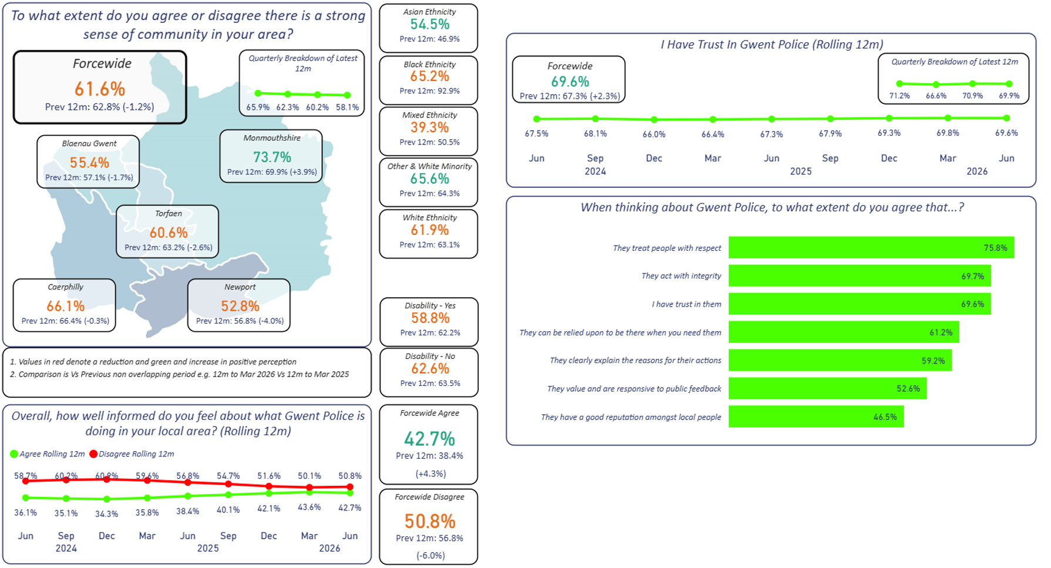
4. Perceptions Survey – Engagement

Slide 8
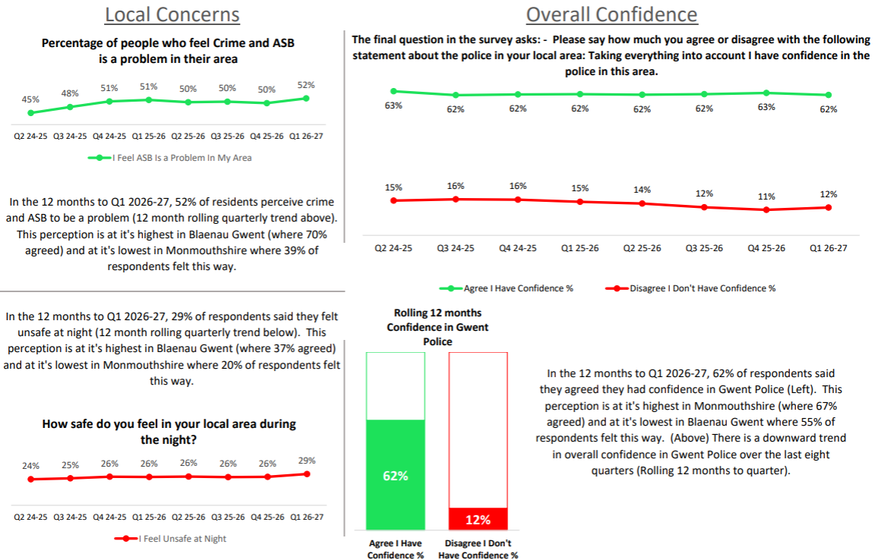
5. Perceptions Survey – Local Concerns and Confidence

Slide 9
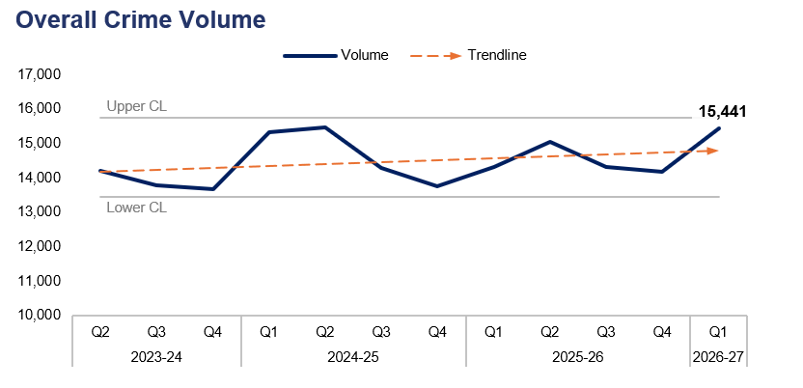
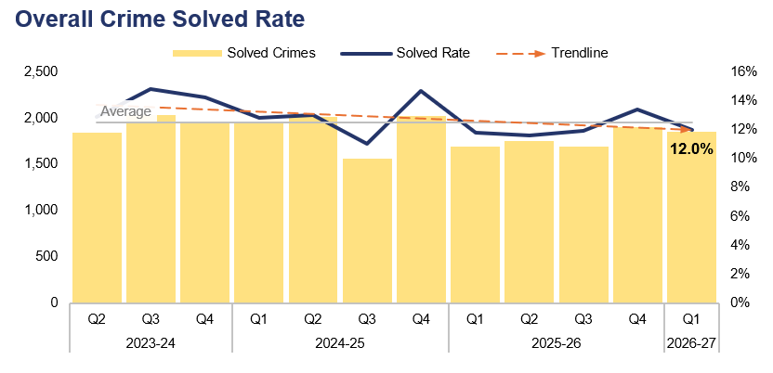
6. Overall Crime
Financial Year | 22-23 | 23-24 | 24-25 | 25-26 |  | FYTD | 26-27 |  | Quarter | Q4 25-26 | Q1 25-26
Volume | 57,885 | 56,896 | 58,850 | 57,824 |  | Volume | 15,441 |  | % Change | 8.9% | 7.9%
Financial Year | 22-23 | 23-24 | 24-25 | 25-26 |  | FYTD | 26-27 |  | Quarter | Q4 25-26 | Q1 25-26
Solved Rate | 9.7% | 13.1% | 12.8% | 12.2% |  | Solved Rate | 12.0% |  | PP Change | -1.4pp | 0.2pp
Operational Overview
Overall, 15,441 crimes were recorded in Gwent during Q1 2026-27. This represents an increase of 8.9% (1,258 additional offences) when compared to the quarter prior, and a similar increase of 7.9% (1,137 additional offences) when compared to the same quarter during the previous financial year.
The overall solved rate for Q1 2026-27 stands at 12.0%, with 1,850 crimes solved. This is a reduction of 1.4 percentage points when compared to the quarter prior, with 50 fewer crimes solved. Conversely, a slight increase of 0.2 percentage points can be observed when comparing Q1 2026-27 to the same quarter during the previous financial year, with 155 additional crimes solved.

Slide 10
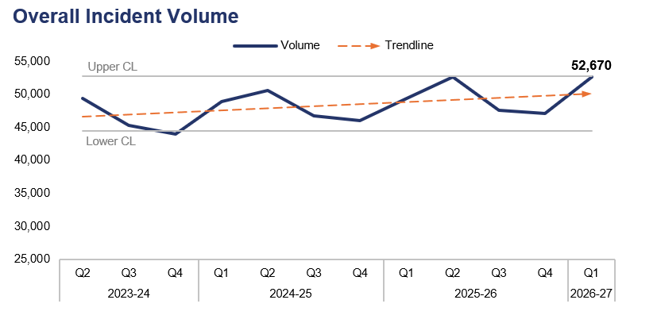
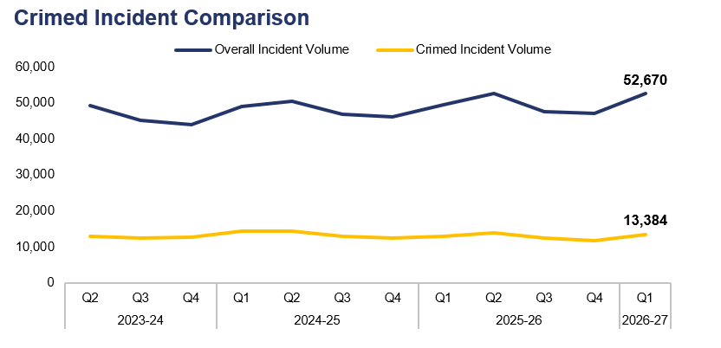
7. Overall Incidents
Financial Year | 22-23 | 23-24 | 24-25 | 25-26 |  | FYTD | 26-27 |  | Quarter | Q4 25-26 | Q1 25-26
Volume | 170,356 | 188,434 | 192,239 | 196,826 |  | Volume | 52,670 |  | % Change | 11.7% | 6.6%
Financial Year | 22-23 | 23-24 | 24-25 | 25-26 |  | FYTD | 26-27 |  | Quarter | Q4 25-26 | Q1 25-26
% Crimed | 28.8% | 27.2% | 28.0% | 25.9% |  | % Crimed | 25.4% |  | PP Change | 0.4pp | -1.0pp
Operational Overview
Overall, 52,670 incidents were reported during Q1 2026-27. This represents an increase of 11.7% (5,534 additional incidents) when compared to the quarter prior, and of 6.6% (3,244 additional incidents) when compared to the same quarter during the previous financial year.
Of the 52,670 incidents reported during Q1 2026-27, 13,384 were assigned a crime category, or ‘crimed’. This accounts for 25.4% of all incidents reported during the quarter, representing an increase of 0.4 percentage points when compared to the quarter prior. Conversely, a reduction of 1.0 percentage point can be observed when comparing Q1 2026-27 to the same quarter during the previous financial year.
Additional crimes can be created independently of incidents, accounting for the discrepancy between the number of crimed incidents and the overall crime volume for the quarter.

Slide 11
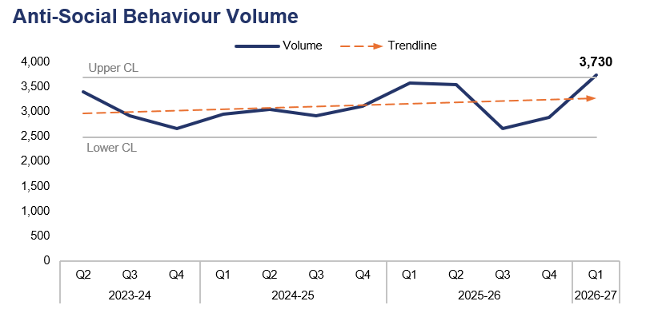
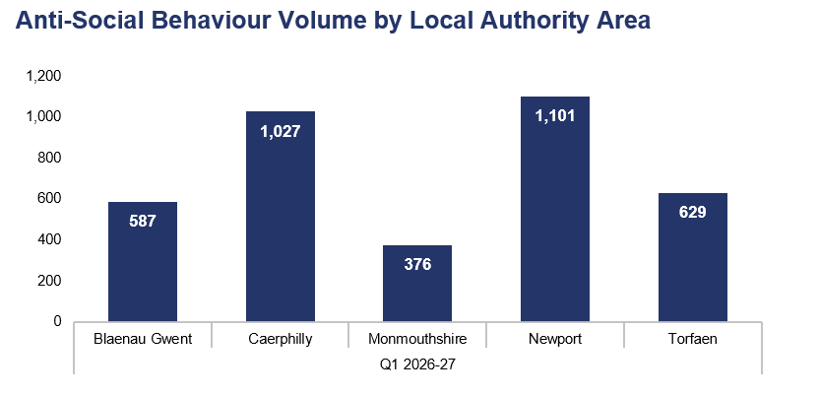
8. Anti-Social Behaviour
Financial Year | 22-23 | 23-24 | 24-25 | 25-26 |  | FYTD | 26-27 |  | Quarter | Q4 25-26 | Q1 25-26
Volume | 10,594 | 12,500 | 11,999 | 12,649 |  | Volume | 3,730 |  | % Change | 29.2% | 4.5%
Local Authority Area |  | Blaenau Gwent | Caerphilly | Monmouthshire | Newport | Torfaen
% of Total |  | 15.7% | 27.5% | 10.1% | 29.5% | 16.9%
Operational Overview
A total of 3,730 incidents classified as Anti-Social Behaviour (ASB) were reported during Q1 2026-27. This is the highest quarterly figure within the three-year timeframe, exceeding the upper control limit and representing an increase of 29.2% (842 additional incidents) when compared to the quarter prior. A less prominent increase of 4.5% (162 additional incidents) can be observed when comparing Q1 2026-27 to the same quarter during the previous financial year.
The upper-right graph displays ASB incident volume during Q1 2026-27 by Local Authority Area. The highest volume of incidents were reported in Newport, accounting for 29.5% of the force-wide total with 1,101 incidents. Conversely, the lowest volume of incidents were reported in Monmouthshire, comprising 10.1% of the force-wide total with 376 incidents.
The force's ASB Action Plan went live during Q1 2026-27, meeting the requirements of the Neighbourhood Policing Guarantee. The plan centres around increased visibility and patrols in city and town centres, increasing the use and application of ASB powers, enhancing partnership arrangements, identifying prevention opportunities, and further engagement with communities.
The force has sought to tackle ASB in Newport City Centre by launching Operation Krypton, a coordinated multi-agency crackdown combining high visibility patrols with daily joint tasking arrangements to target repeat offenders, street drinking, and shoplifting, as well as hot spot areas including the bus station and High Street.
During Q1 2026-27, 10 ASB incidents were reported as having taken place outside of the force area, and have therefore been omitted from the Local Authority Area comparison.

Slide 12
9. Community Action Team
Community Action Team Activity – Q1 2026-27
Metric | Abersychan & Blaenavon Team | Bargoed Team | Bettws Team | Ebbw Vale Team | Overall
Offences Recorded | 20 | 16 | 20 | 15 | 71
Solved Rate | 25.0% | 43.8% | 50.0% | 60.0% | 43.7%
Arrests Made | 14 | 6 | 20 | 14 | 54
Stop Searches Performed | 16 | 13 | 27 | 12 | 68
Vehicles Seized | 11 | 6 | 10 | 14 | 41
Operational Overview
The Community Action Team (CAT) were deployed in Abersychan & Blaenavon, Bargoed, Bettws, and Ebbw Vale between the ninth of February 2026 and the eight of June 2026. On the ninth of June, the Abersychan & Blaenavon team moved to Llantarnam, the Bargoed team moved to Llansbury Park, the Bettws team moved to Maesglas & Duffryn, and the Ebbw Vale team moved to Lliswerry. During Q1 2026-27, the teams made a total of 54 arrests and seized 41 vehicles, primarily due to them being used or ridden in an anti-social manner. They also achieved a solved rate of 43.7% for crime investigations.
As of the first of July, all CAT teams were temporarily redeployed to Newport for a period of six weeks.
CAT continues to provide a visible, intelligence-led capability that balances robust enforcement with meaningful community engagement in support of the local neighbourhood policing teams. Their proactive work has been (and continues to be) well received by local communities, elected members, and partner agencies, which reinforces public confidence.

Slide 13
10. Preventing Crime and ASB – Emerging Issues
Operational Overview
To address the topic of visibility and overarching commitment to the Neighbourhood Policing Guarantee, the force continues to produce monthly IR3 telematics which capture neighbourhood officer footfall, in hours, within town centre areas. This is monitored via monthly governance arrangements. The force continues to commit to Newport City Centre's City Safe initiative through increased visible resourcing, Operation Vigilant (which continues to focus on VAWG and public space safety), and through the proactive management of prolific offenders via Operation Krypton.
Membership for the messaging alert system Neighbourhood Matters continues to expand, with over 7,000 members having joined the programme. Q1 2026-27 also saw 1,065 engagements recorded by neighbourhood teams across the force area.
A total of 994 school engagements were undertaken as part of the Safer Schools Programme during Q1 2026-27, with 47.7% of these conducted in person.
The 'We Don't Buy Crime’ team continued to support their colleagues by conducting numerous crime prevention activities and events throughout the quarter. These included several bike marking schemes. They have also been engaging with rural communities via the Rural Crime Team.
The continued use of electric bikes and scooters for criminal and ASB purposes presents a significant demand for neighbourhood policing teams, but this is a challenge which the teams are keen to meet head-on. There has been considerable success throughout Q1 2026-27 in relation to seizures and subsequent criminal investigations undertaken by both neighbourhood and CAT officers, which has been shared widely via social media platforms. The force utilises a suite of tactics to address this issue, including the increasing use of drones and fixed wing aircraft, in addition to covert approaches.

Slide 14
Pillar Two - Making Our Communities Safer
999 Demand
101 Demand
999 and 101 Average Answer Speed
Response Times
Most Serious Violence
Serious Violence
Knife Crime
Overall Drug Offences
Drug Possession
Drug Supply
Shoplifting
Residential Burglary
Robbery
Theft from the Person
Making Our Communities Safer – Emerging Issues

Slide 15
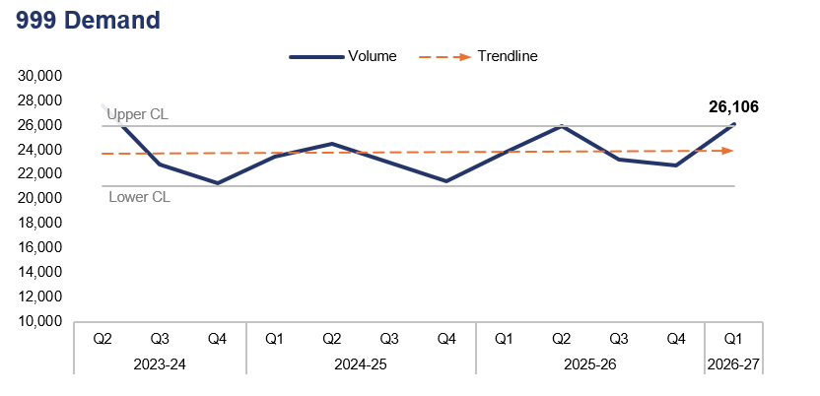
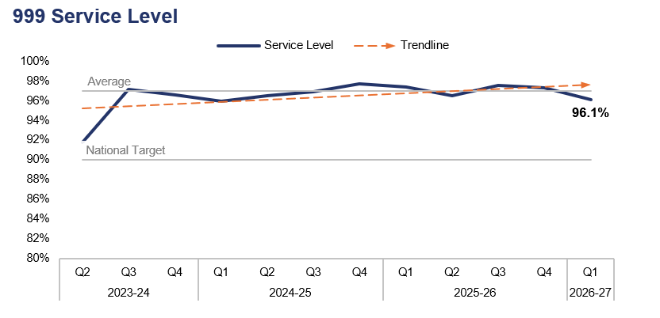
1. 999 Demand
Financial Year | 22-23 | 23-24 | 24-25 | 25-26 |  | FYTD | 26-27 |  | Quarter | Q4 25-26 | Q1 25-26
Volume | 99,891 | 100,469 | 92,275 | 95,678 |  | Volume | 26,106 |  | % Change | 14.8% | 9.7%
Financial Year | 22-23 | 23-24 | 24-25 | 25-26 |  | FYTD | 26-27 |  | Quarter | Q4 25-26 | Q1 25-26
Service Level | 85.7% | 92.4% | 97.0% | 97.2% |  | Service Level | 96.1% |  | PP Change | -1.2pp | -1.3pp
Operational Overview
999 demand has risen by 14.8% during Q1 2026-27 when compared to the quarter prior, exceeding the upper control limit with 3,357 additional calls received for a total of 26,106. An increase of 9.7% (2,314 additional calls) can be observed when comparing Q1 2026-27 to the same quarter during the previous financial year.
999 service level (the percentage of 999 calls answered within 10 seconds) stands at 96.1% for Q1 2026-27. This represents a reduction of 1.2 percentage points when compared to the quarter prior, and a similar reduction 1.3 percentage points when compared to the same quarter during the previous financial year. Despite these reductions, 999 service level remains above the national target of 90%, as it has done for the last twelve consecutive quarters.

Slide 16
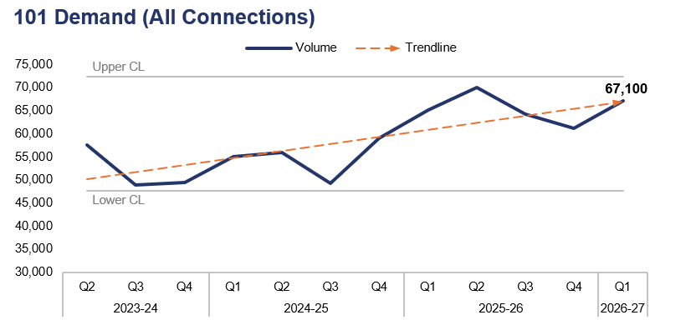
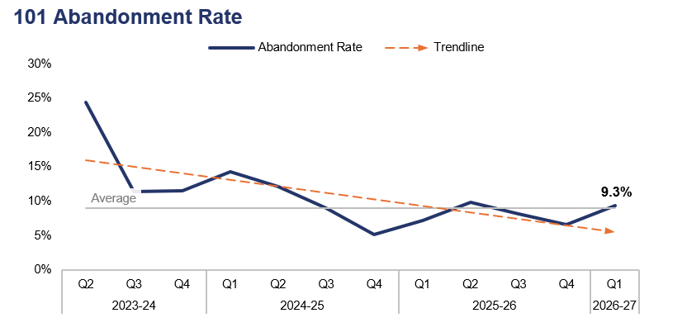
2. 101 Demand
Financial Year | 22-23 | 23-24 | 24-25 | 25-26 |  | FYTD | 26-27 |  | Quarter | Q4 25-26 | Q1 25-26
Volume | 220,342 | 213,356 | 219,010 | 260,582 |  | Volume | 67,100 |  | % Change | 9.8% | 2.9%
Financial Year | 22-23 | 23-24 | 24-25 | 25-26 |  | FYTD | 26-27 |  | Quarter | Q4 25-26 | Q1 25-26
Abandonment Rate | 36.3% | 19.5% | 9.1% | 8.0% |  | Abandonment Rate | 9.3% |  | PP Change | 2.7pp | 2.1pp
Operational Overview
101 demand (all connections) has risen by 9.8% during Q1 2026-27 when compared to the quarter prior, with 5,971 additional calls received for a total of 67,100. A less prominent increase of 2.9% (1,887 additional calls) can be observed when comparing Q1 2026-27 to the same quarter during the previous financial year.
The abandonment rate for 101 calls during Q1 2026-27 was 9.3%. This is an increase of 2.7 percentage points when compared to the quarter prior, and of 2.1 percentage points when compared to the same quarter during the previous financial year.
The 101 abandonment rate figure is calculated based on call options one and two only, which pertain to new incidents and incident updates respectively.

Slide 17
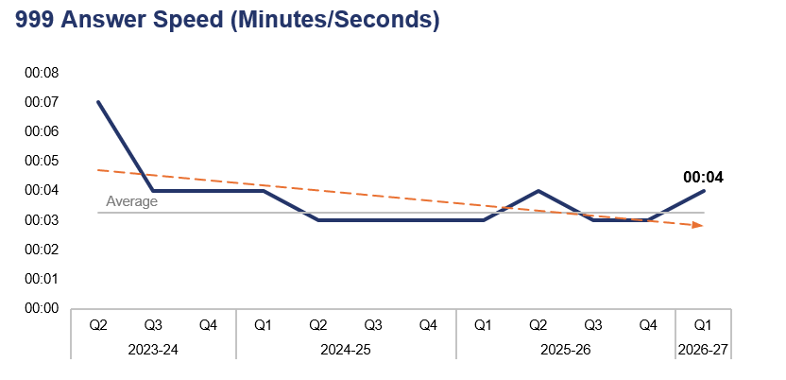
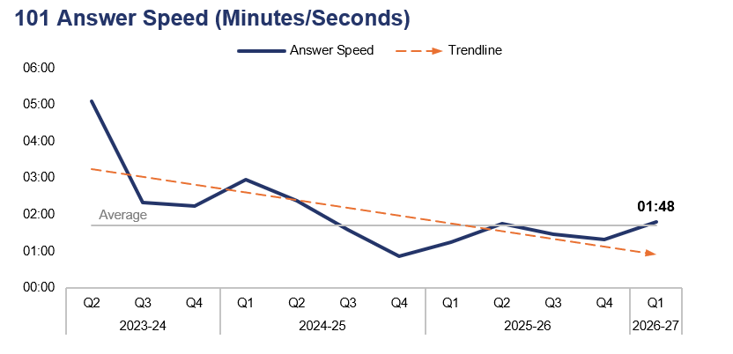
3. 999 and 101 Average Answer Speed
Financial Year | 22-23 | 23-24 | 24-25 | 25-26 |  | FYTD | 26-27 |  | Quarter | Q4 25-26 | Q1 25-26
Answer Speed | 00:11 | 00:06 | 00:04 | 00:03 |  | Answer Speed | 00:04 |  | Change | 00:01 | 00:01
Financial Year | 22-23 | 23-24 | 24-25 | 25-26 |  | FYTD | 26-27 |  | Quarter | Q4 25-26 | Q1 25-26
Answer Speed | 08:01 | 03:59 | 01:43 | 01:27 |  | Answer Speed | 01:48 |  | Change | 00:29 | 00:33
Operational Overview
The average answer speed for 999 calls during Q1 2026-27 was four seconds. This is an increase of one second when compared to both the quarter prior and same quarter during the previous financial year.
The average answer speed for 101 calls during Q1 2026-27 was one minute and 48 seconds. This represents an increase of 29 seconds when compared to the quarter prior, and a similar increase of 33 seconds when compared to the same quarter during the previous financial year.
The 101 average answer speed figure is calculated based on call options one and two only, which pertain to new incidents and incident updates respectively.

Slide 18
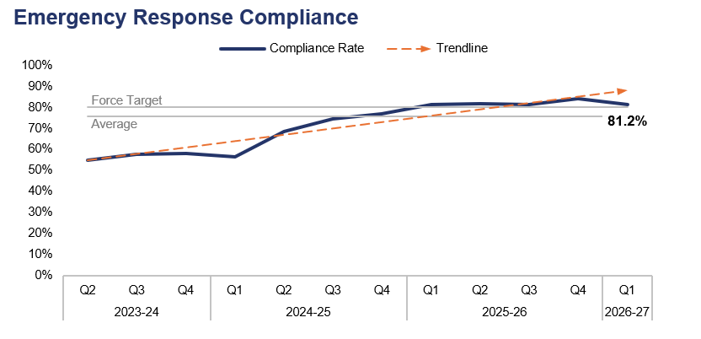
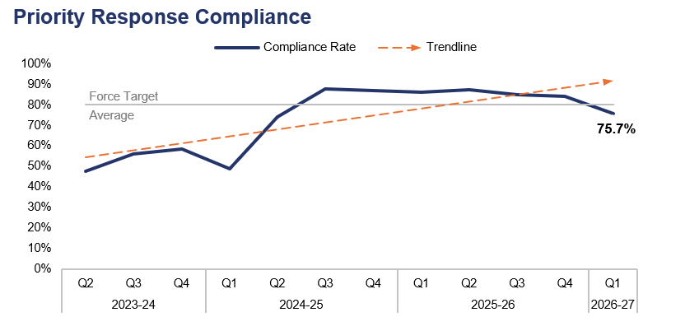
4. Response Times
Financial Year | 22-23 | 23-24 | 24-25 | 25-26 |  | FYTD | 26-27 |  | Quarter | Q4 25-26 | Q1 25-26
Compliance Rate | 47.0% | 55.4% | 68.7% | 85.2% |  | Compliance Rate | 81.2% |  | PP Change | -3.0pp | -0.2pp
Financial Year | 22-23 | 23-24 | 24-25 | 25-26 |  | FYTD | 26-27 |  | Quarter | Q4 25-26 | Q1 25-26
Compliance Rate | 32.3% | 50.0% | 74.5% | 87.2% |  | Compliance Rate | 75.7% |  | PP Change | -8.2pp | -10.5pp
Operational Overview
Based on the target arrival time of 15 minutes, the emergency create-to-arrival compliance rate for Q1 2026-27 stands at 81.2%. This is a reduction of 3.0 percentage points when compared to the quarter prior, and a slight reduction of 0.2 percentage points when compared to the same quarter during the previous financial year. The compliance rate has now exceeded the force target of 80.0% for a fifth consecutive quarter.
Based on the target arrival time of 60 minutes, the priority create-to-arrival compliance rate for Q1 2026-27 stands at 75.7%. This is a reduction of 8.2 percentage points when compared to the quarter prior, and a further reduction of 10.5 percentage points when compared to the same quarter during the previous financial year. The compliance rate has fallen below the force target of 80.0% for the first time since Q2 2024-25.
In this context, ‘create-to-arrival’ refers to the time elapsed between the creation of a Storm Log for a given incident, and the arrival of officers at the scene.
The above figures include regraded incidents, in which the target response time has been amended based on the receipt of new information which has altered the risk assessment and therefore the response grade of the incident in question. This includes instances where the risk has increased, thus the response grade has been elevated, and likewise instances where the risk has decreased. This increased accuracy has been facilitated by recent improvements in the force’s reporting systems.

Slide 19
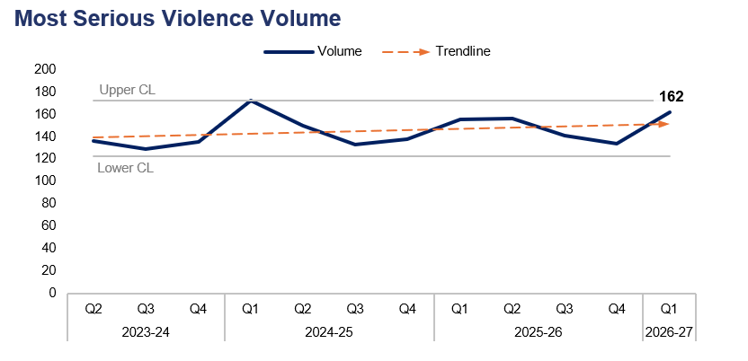
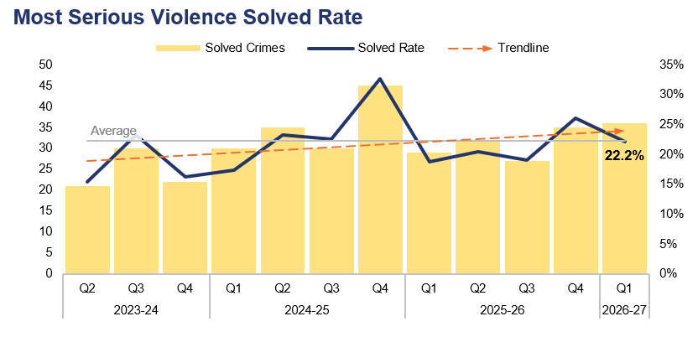
5. Most Serious Violence
Financial Year | 22-23 | 23-24 | 24-25 | 25-26 |  | FYTD | 26-27 |  | Quarter | Q4 25-26 | Q1 25-26
Volume | 474 | 516 | 593 | 586 |  | Volume | 162 |  | % Change | 20.9% | 4.5%
Financial Year | 22-23 | 23-24 | 24-25 | 25-26 |  | FYTD | 26-27 |  | Quarter | Q4 25-26 | Q1 25-26
Solved Rate | 18.8% | 19.0% | 23.6% | 21.0% |  | Solved Rate | 22.2% |  | PP Change | -3.9pp | 3.5pp
Operational Overview
A total of 162 crimes classified as Most Serious Violence were recorded during Q1 2026-27. This represents an increase of 20.9% (28 additional offences) when compared to the quarter prior, and a less prominent increase of 4.5% (seven additional offences) when compared to the same quarter during the previous financial year.
The solved rate for Q1 2026-27 stands at 22.2%, with 36 crimes solved. This represents a reduction of 3.9 percentage points when compared to the quarter prior, albeit with one additional crime solved. Conversely, an increase of 3.5 percentage points can be observed when comparing Q1 2026-27 to the same quarter during the previous financial year, with seven additional crimes solved.
Most Serious Violence offences consist of homicide, grievous bodily harm with intent, and causing death by dangerous driving.

Slide 20
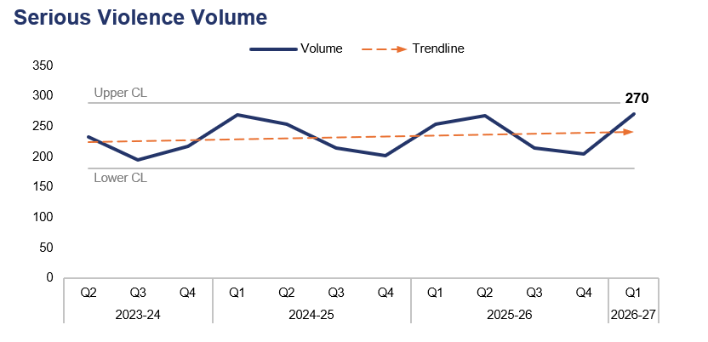
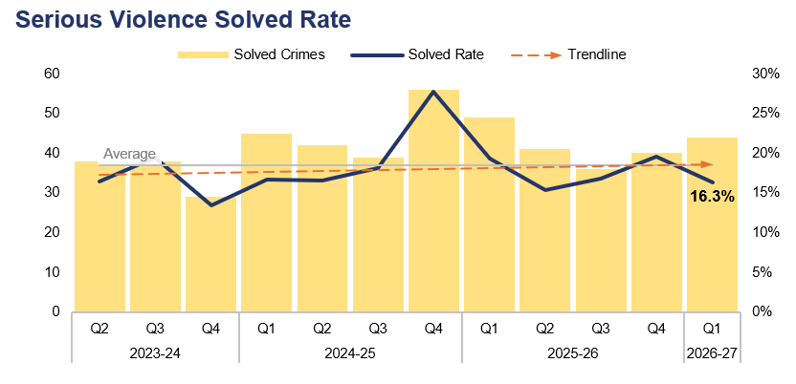
6. Serious Violence
Financial Year | 22-23 | 23-24 | 24-25 | 25-26 |  | FYTD | 26-27 |  | Quarter | Q4 25-26 | Q1 25-26
Volume | 844 | 829 | 939 | 939 |  | Volume | 270 |  | % Change | 32.4% | 6.3%
Financial Year | 22-23 | 23-24 | 24-25 | 25-26 |  | FYTD | 26-27 |  | Quarter | Q4 25-26 | Q1 25-26
Solved Rate | 15.6% | 17.1% | 19.4% | 17.7% |  | Solved Rate | 16.3% |  | PP Change | -3.3pp | -3.0pp
Operational Overview
Overall, 270 crimes classified as Serious Violence were recorded during Q1 2026-27. This represents a notable increase of 32.4% (66 additional offences) when compared to the quarter prior, and a less prominent increase of 6.3% (16 additional offences) when compared to the same quarter during the previous financial year.
The solved rate for Q1 2026-27 stands at 16.3%, with 44 crimes solved. This is a reduction of 3.3 percentage points when compared to the quarter prior, albeit with four additional crimes solved. A similar reduction of 3.0 percentage points can be observed when comparing Q1 2026-27 to the same quarter during the previous financial year, with five fewer crimes solved.
Serious Violence offences consist of section 18 grievous bodily harm with intent, section 20 malicious wounding without intent, and personal robbery.

Slide 21
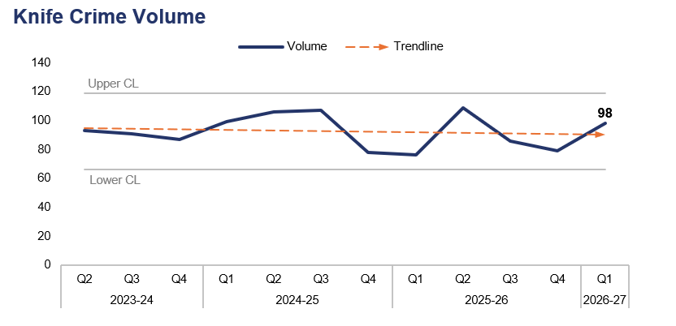
7. Knife Crime
Financial Year | 22-23 | 23-24 | 24-25 | 25-26 |  | FYTD | 26-27 |  | Quarter | Q4 25-26 | Q1 25-26
Volume | 370 | 359 | 390 | 350 |  | Volume | 98 |  | % Change | 24.1% | 28.9%
Operational Overview
A total of 98 offences recorded during Q1 2026-27 were classified as knife crimes, as defined by the Home Office’s National Data Quality Improvement Service (NDQIS) reporting system. This represents an increase of 24.1% (19 additional offences) when compared to the quarter prior, and a further increase of 28.9% (22 additional offences) when compared to the same quarter during the previous financial year.
During Q1 2026-27, 120 stop searches were undertaken on knife or bladed weapon type grounds. These resulted in an overall find rate of 19.2%, with 23 items found.
In accordance with NDQIS reporting criteria, Possession of a Weapon and Homicide offences have been excluded from this dataset.

Slide 22
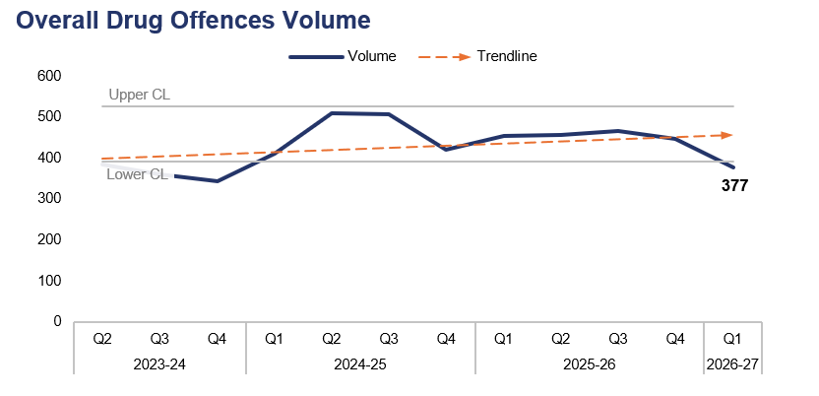
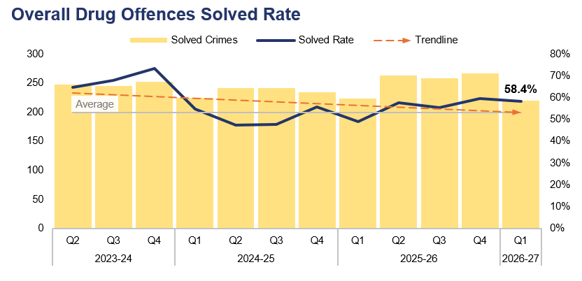
8. Overall Drug Offences
Financial Year | 22-23 | 23-24 | 24-25 | 25-26 |  | FYTD | 26-27 |  | Quarter | Q4 25-26 | Q1 25-26
Volume | 1,295 | 1,410 | 1,846 | 1,824 |  | Volume | 377 |  | % Change | -15.7% | -17.1%
Financial Year | 22-23 | 23-24 | 24-25 | 25-26 |  | FYTD | 26-27 |  | Quarter | Q4 25-26 | Q1 25-26
Solved Rate | 54.7% | 64.8% | 51.0% | 55.4% |  | Solved Rate | 58.4% |  | PP Change | -1.3pp | 9.4pp
Operational Overview
The number of crimes classified as Drug Offences fell below the lower control limit during Q1 2026-27, with 377 recorded. This represents a reduction of 15.7% (70 fewer offences) when compared to the quarter prior, and a further reduction of 17.1% (78 fewer offences) when compared to the same quarter during the previous financial year.
The solved rate for Q1 2026-27 stands at 58.4%, with 220 crimes solved. This is a reduction of 1.3 percentage points when compared to the quarter prior, with 47 fewer crimes solved. Conversely, an increase of 9.4 percentage points can be observed when comparing Q1 2026-27 to the same quarter during the previous financial year, albeit with three fewer crimes solved.
The number of offences relating to the importation of drugs fell by 36.8% during Q1 2026-27 when compared to the quarter prior, with 14 fewer offences recorded for a total of 24. This reduction is the result of a decline in the number of referrals received from border forces.
The force’s capacity to proactively police drug supply and use has been reduced, due to the number of homicide investigations during Q1 2026-27 and previous reporting periods. These investigations require substantial resources, and the force has had to use a significant portion of its proactive policing capacity to investigate these offences. The remaining resources dedicated to the proactive investigation of drug supply have been focused on the highest risk serious organised crime threats, using intelligence-led policing tactics.

Slide 23
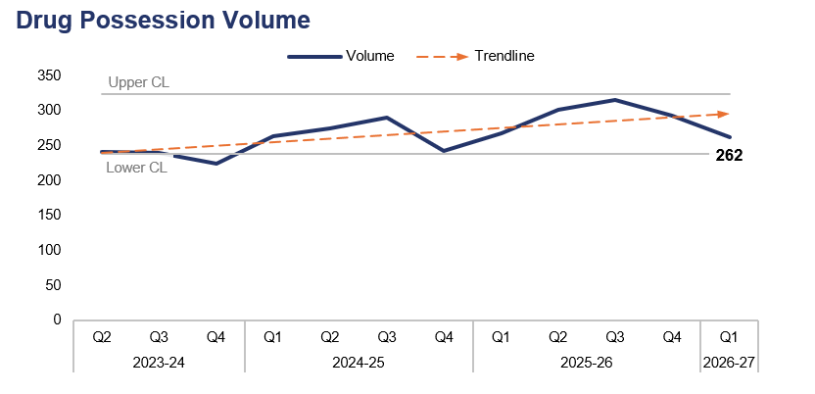
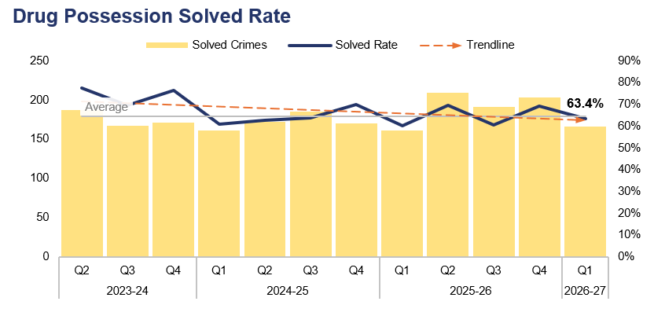
9. Drug Possession
Financial Year | 22-23 | 23-24 | 24-25 | 25-26 |  | FYTD | 26-27 |  | Quarter | Q4 25-26 | Q1 25-26
Volume | 829 | 908 | 1,071 | 1,176 |  | Volume | 262 |  | % Change | -10.6% | -1.9%
Financial Year | 22-23 | 23-24 | 24-25 | 25-26 |  | FYTD | 26-27 |  | Quarter | Q4 25-26 | Q1 25-26
Solved Rate | 60.9% | 70.8% | 64.2% | 65.0% |  | Solved Rate | 63.4% |  | PP Change | -5.9pp | 3.1pp
Operational Overview
A total of 262 drug possession offences were recorded during Q1 2026-27. This represents a reduction of 10.6% (31 fewer offences) when compared to the quarter prior, and a less prominent reduction of 1.9% (five fewer offences) when compared to the same quarter during the previous financial year.
The solved rate for Q1 2026-27 stands at 63.4%, with 166 crimes solved. This is a reduction of 5.9 percentage points when compared to the quarter prior, with 37 fewer crimes solved. Conversely, an increase of 3.1 percentage points can be observed when comparing Q1 2026-27 to the same quarter during the previous financial year, with five additional crimes solved.
This slide pertains to possession offences for all controlled drugs, including Cannabis.

Slide 24
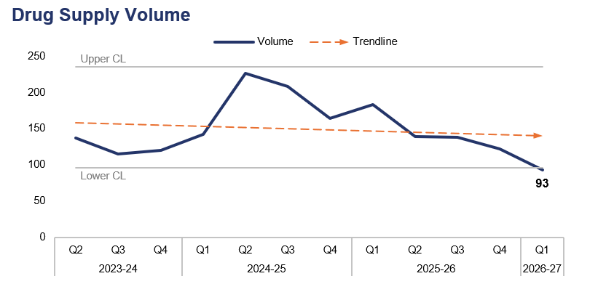
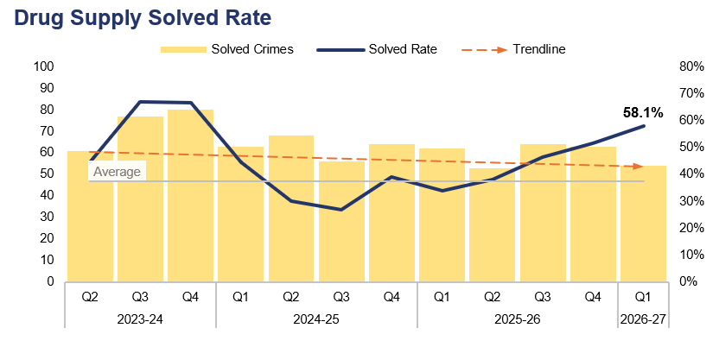
10. Drug Supply
Financial Year | 22-23 | 23-24 | 24-25 | 25-26 |  | FYTD | 26-27 |  | Quarter | Q4 25-26 | Q1 25-26
Volume | 455 | 488 | 740 | 582 |  | Volume | 93 |  | % Change | -23.8% | -49.2%
Financial Year | 22-23 | 23-24 | 24-25 | 25-26 |  | FYTD | 26-27 |  | Quarter | Q4 25-26 | Q1 25-26
Solved Rate | 44.0% | 54.9% | 33.9% | 41.6% |  | Solved Rate | 58.1% |  | PP Change | 6.5pp | 24.2pp
Operational Overview
Drug supply offences fell below the lower control limit during Q1 2026-27, with 93 recorded. This is the lowest figure within the three-year timeframe, and represents a reduction of 23.8% (29 fewer offences) when compared to the quarter prior. A further reduction of 49.2% (90 fewer offences) can be observed when comparing Q1 2026-27 to the same quarter during the previous financial year.
The solved rate for Q1 2026-27 stands at 58.1%, with 54 crimes solved. This is an increase of 6.5 percentage points when compared to the quarter prior, albeit with nine fewer crimes solved. A further increase of 24.2 percentage points can be observed when comparing Q1 2026-27 to the same quarter during the previous financial year, although eight fewer crimes were solved.
The Clear, Hold, Build site in Pillgwenlly is being developed. This will provide a long-term partnership approach to tackling a wide range of crime and ASB in this area of Newport, with drug supply being one of the operation’s key priorities.
This slide includes all offences pertaining to the supply, importation, or production of controlled drugs.

Slide 25
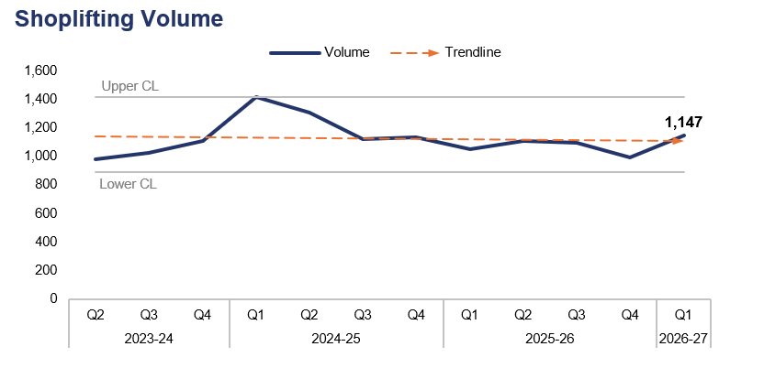
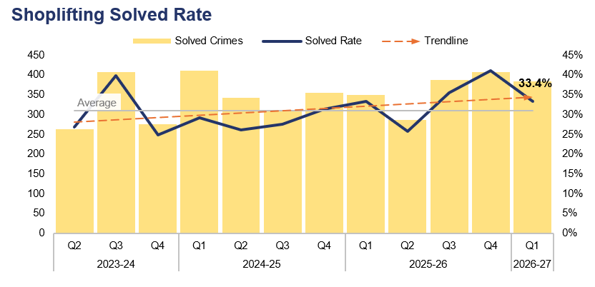
11. Shoplifting
Financial Year | 22-23 | 23-24 | 24-25 | 25-26 |  | FYTD | 26-27 |  | Quarter | Q4 25-26 | Q1 25-26
Volume | 2,973 | 3,925 | 4,980 | 4,242 |  | Volume | 1,147 |  | % Change | 15.5% | 9.4%
Financial Year | 22-23 | 23-24 | 24-25 | 25-26 |  | FYTD | 26-27 |  | Quarter | Q4 25-26 | Q1 25-26
Solved Rate | 23.7% | 30.8% | 28.5% | 33.7% |  | Solved Rate | 33.4% |  | PP Change | -7.6pp | 0.0pp
Operational Overview
During Q1 2026-27, 1,147 Shoplifting offences were recorded. This represents an increase of 15.5% (154 additional offences) when compared to the quarter prior, and of 9.4% (99 additional offences) when compared to the same quarter during the previous financial year.
The solved rate for Q1 2026-27 stands at 33.4%, with 383 crimes solved. This is a reduction of 7.6 percentage points when compared to the quarter prior, with 24 fewer crimes solved. The solved rate has remained steady when comparing Q1 2026-27 to the same quarter during the previous financial year, albeit with 33 additional crimes solved.
The force continues to focus on retail crime, and maintains several Problem-Orientated Policing plans in town centre areas where shoplifting has been identified as adversely impacting crime levels and quality of life for both retailers and the wider community. The introduction of dedicated Demand Reduction Officers has placed specific emphasis on prolific offender management and ensuring that these officers work closely alongside Crime and Disorder Reduction Officers in securing Criminal Behaviour Orders, which are used to manage these individuals post charge/conviction.

Slide 26
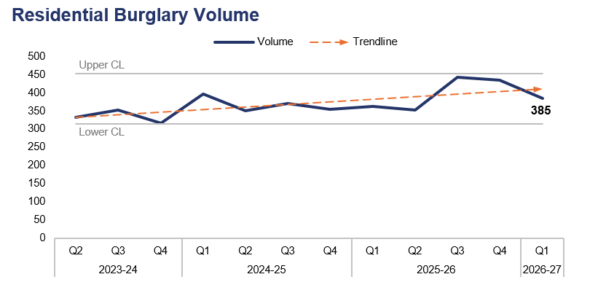
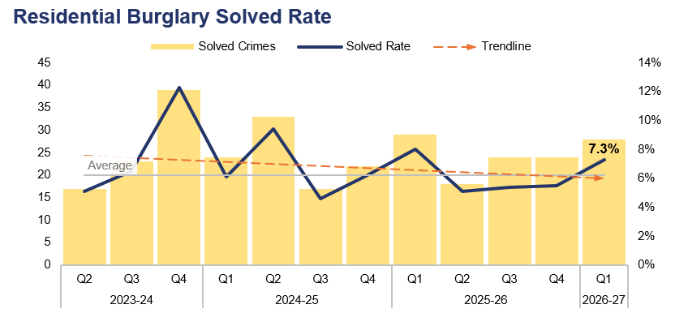
12. Residential Burglary
Financial Year | 22-23 | 23-24 | 24-25 | 25-26 |  | FYTD | 26-27 |  | Quarter | Q4 25-26 | Q1 25-26
Volume | 1,615 | 1,389 | 1,472 | 1,593 |  | Volume | 385 |  | % Change | -11.3% | 6.1%
Financial Year | 22-23 | 23-24 | 24-25 | 25-26 |  | FYTD | 26-27 |  | Quarter | Q4 25-26 | Q1 25-26
Solved Rate | 5.1% | 7.1% | 6.5% | 6.0% |  | Solved Rate | 7.3% |  | PP Change | 1.8pp | -0.7pp
Operational Overview
Overall, 385 Residential Burglary offences were recorded during Q1 2026-27. This represents a reduction of 11.3% (49 fewer offences) when compared to the quarter prior, but an increase of 6.1% (22 additional offences) when compared to the same quarter during the previous financial year.
The solved rate for Q1 2026-27 stands at 7.3%, with 28 crimes solved. This represents an increase of 1.8 percentage points when compared to the quarter prior, with four additional crimes solved. Conversely, a reduction of 0.7 percentage points can be observed when comparing Q1 2026-27 to the same quarter during the previous financial year, with one fewer crime solved.
During Q1 2026-27, 90.0% of Residential Burglary of a Home incidents were attended by officers, with 46.4% of these attended within 60 minutes.
There is a notable disparity in solved rate between crimes classified as residential burglaries of homes, and those classified as residential burglaries of unconnected buildings. The solved rate for residential burglaries of homes stands at 9.3% for the FYTD, whereas the solved rate for residential burglaries of unconnected buildings is lower, at 1.9%.
The process for the identification of residential burglary of a home offences is now part of daily business, ensuring that offences which were previously not flagged appropriately are identified via a daily search, resulting in effective ownership. Cross-pillar discussions are taking place to ensure that the strategy for the prevention of burglaries remains robust.

Slide 27
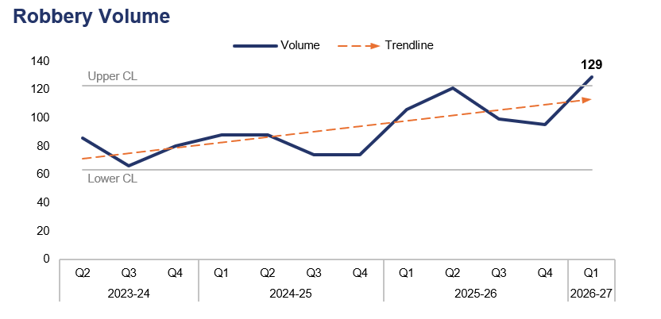
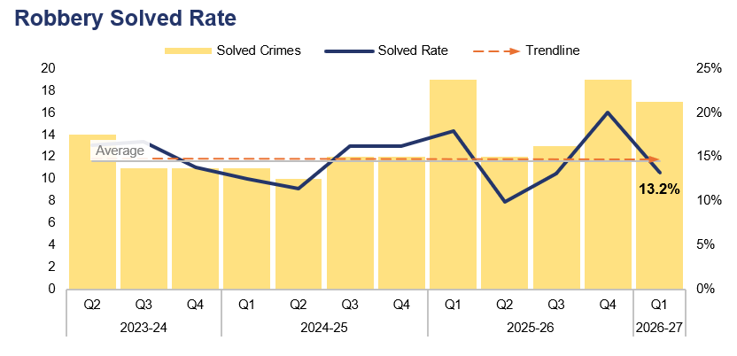
13. Robbery
Financial Year | 22-23 | 23-24 | 24-25 | 25-26 |  | FYTD | 26-27 |  | Quarter | Q4 25-26 | Q1 25-26
Volume | 332 | 296 | 324 | 421 |  | Volume | 129 |  | % Change | 35.8% | 21.7%
Financial Year | 22-23 | 23-24 | 24-25 | 25-26 |  | FYTD | 26-27 |  | Quarter | Q4 25-26 | Q1 25-26
Solved Rate | 12.7% | 15.5% | 13.9% | 15.0% |  | Solved Rate | 13.2% |  | PP Change | -6.8pp | -4.7pp
Operational Overview
A total of 129 Robbery offences were recorded during Q1 2026-27, exceeding the upper control limit. This is the highest quarterly figure within the three-year timeframe, representing an increase of 35.8% (34 additional offences) when compared to the quarter prior, and of 21.7% (23 additional offences) when compared to the same quarter during the previous financial year.
The solved rate for Q1 2026-27 stands at 13.2%, with 17 crimes solved. This is a reduction of 6.8 percentage points when compared to the quarter prior, with two fewer crimes solved. A reduction of 4.7 percentage points can be observed when comparing Q1 2026-27 to the same quarter during the previous financial year, again with two fewer crimes solved.
Offences pertaining to the robbery of personal property comprise 76.0% of those recorded during the FYTD (98 offences), whereas Robbery of business property offences account for the remaining 24.0% (31 offences). The solved rate for the former stands at 8.2% (eight crimes solved), whereas the solved rate for the latter is higher at 29.0% (nine crimes solved).
Force-wide performance regarding Robbery is tracked in the Homicide and Serious Violence Meeting. This highlights specific areas of concern and allows for the effective tasking of specialist resources to problem-solve and robustly investigate these offences. Established processes ensure that all Robbery offences are correctly identified and owned by the appropriate investigative team. This is further supported by Level 1 tasking, where multiple departments come together to problem-solve any ongoing series of offences. The force’s approach to youth violence is currently under review, and discussions are being held with neighbourhood policing via their 'threat desk' structure in order to effectively mitigate this risk and prevent offending.
The data on this slide includes both personal and business Robbery offences.

Slide 28
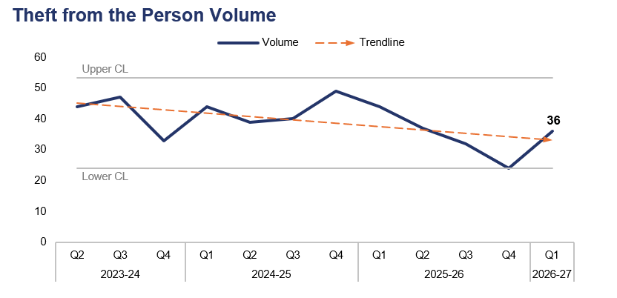
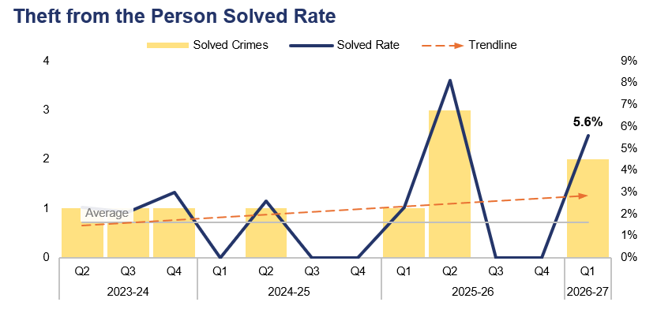
14. Theft from the Person
Financial Year | 22-23 | 23-24 | 24-25 | 25-26 |  | FYTD | 26-27 |  | Quarter | Q4 25-26 | Q1 25-26
Volume | 207 | 186 | 172 | 137 |  | Volume | 36 |  | % Change | 50.0% | -18.2%
Financial Year | 22-23 | 23-24 | 24-25 | 25-26 |  | FYTD | 26-27 |  | Quarter | Q4 25-26 | Q1 25-26
Solved Rate | 0.5% | 2.7% | 0.6% | 2.9% |  | Solved Rate | 5.6% |  | PP Change | 5.6pp | 3.3pp
Operational Overview
During Q1 2026-27, 36 Theft from the Person offences were recorded. This disrupts the downward trend observed following Q4 2024-25, representing an increase of 50.0% (12 additional offences) when compared to the quarter prior, but a reduction of 18.2% (eight fewer offences) when compared to the same quarter during the previous financial year.
The solved rate for Q1 2026-27 stands at 5.6%, with two crimes solved. This is an increase of 5.6 percentage points when compared to the quarter prior, with two additional crimes solved. An increase of 3.3 percentage points can be observed when comparing Q1 2026-27 to the same quarter during the previous financial year, with one additional crime solved.
The majority of the outcomes recorded for Theft from the Person offences during Q1 2026-27 were classified as Outcome 18: Investigation complete – no suspect identified. This is likely due in part to the nature of these offences, which include pickpocketing and ‘snatch thefts’, in which the victim typically has very little (if any) direct interaction with the offender.

Slide 29
15. Making our Communities Safer – Emerging Issues
Operational Overview
Dangerous dog activity continues to present a complex and ever-evolving risk within our communities that requires sustained focus from local neighbourhood policing teams and dog handlers.
Dangerous dog demand during Q1 2026-27 presents a mixed picture. Following an increase in dangerous dog crimes during May, in which 52 offences were recorded, June saw a significant reduction to 37 offences, disrupting the upward trend observed since January. Whilst the number of open investigations remained relatively stable at around 70, the reduction in crime volume recorded during June suggests that demand is not continuing to rise at the same rate as previously observed.
Importantly, the force has continued to make significant progress in managing the operational impact of dangerous dog investigations. Robust governance and case progression processes have reduced the number of seized dogs held in kennels from 20 in May to 14 in June, continuing a longer-term reduction from the 58 dogs held during June 2025. Consequently, whilst dangerous dog incidents and crimes remain a notable area of neighbourhood demand, the resource burden associated with kennelling and investigation management is reducing, placing Gwent Police in a stronger position than at the same point last year.

Slide 30
Pillar Three – Protecting the Vulnerable
Violence Against Women and Girls
Domestic Offences
Rape
Serious Sexual Offences
Stalking
Harassment
Hate Crime
Child Criminal and Sexual Exploitation
Missing Children
Report Fraud
Cybercrime
Protecting the Vulnerable – Emerging Issues

Slide 31
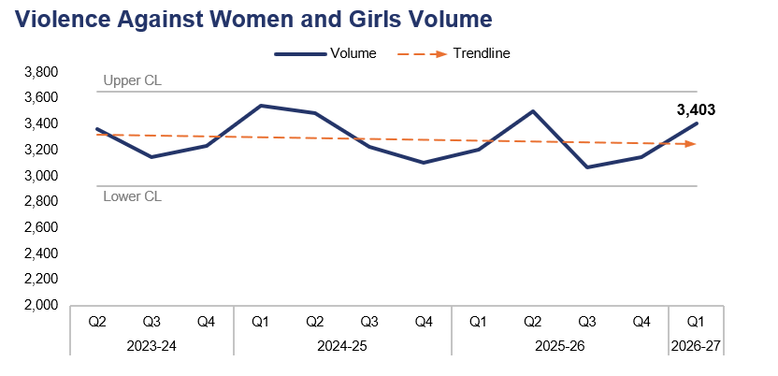
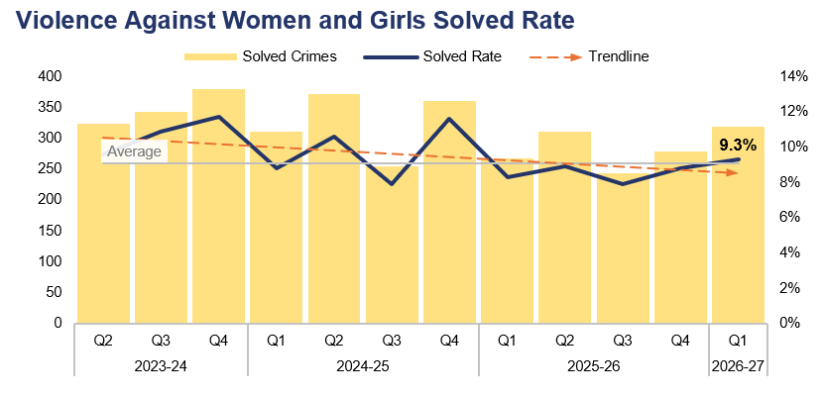
1. Violence Against Women and Girls
Financial Year | 22-23 | 23-24 | 24-25 | 25-26 |  | FYTD | 26-27 |  | Quarter | Q4 25-26 | Q1 25-26
Volume | 14,898 | 13,584 | 13,365 | 12,915 |  | Volume | 3,403 |  | % Change | 8.1% | 6.2%
Financial Year | 22-23 | 23-24 | 24-25 | 25-26 |  | FYTD | 26-27 |  | Quarter | Q4 25-26 | Q1 25-26
Solved Rate | 7.0% | 10.0% | 9.7% | 8.5% |  | Solved Rate | 9.3% |  | PP Change | 0.5pp | 1.0pp
Operational Overview
A total of 3,403 crimes classified as Violence Against Women and Girls (VAWG) offences were recorded during Q1 2026-27. This represents an increase of 8.1% (255 additional offences) when compared to the quarter prior, and of 6.2% (199 additional offences) when compared to the same quarter during the previous financial year.
The solved rate for Q1 2026-27 stands at 9.3%, with 318 crimes solved. This is an increase of 0.5 percentage points when compared to the quarter prior, with 40 additional crimes solved. A further increase of 1.0 percentage point can be observed when comparing Q1 2026-27 against the same quarter during the previous financial year, with 50 additional crimes solved.

Slide 32
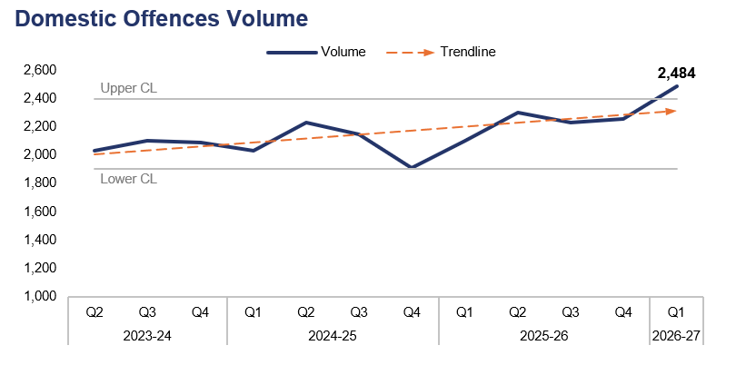
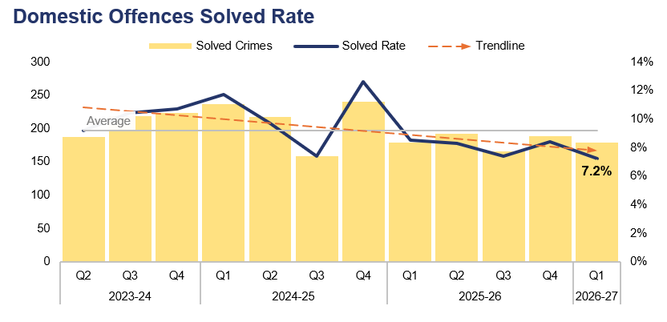
2. Domestic Offences
Financial Year | 22-23 | 23-24 | 24-25 | 25-26 |  | FYTD | 26-27 |  | Quarter | Q4 25-26 | Q1 25-26
Volume | 8,542 | 8,518 | 8,321 | 8,889 |  | Volume | 2,484 |  | % Change | 10.2% | 18.1%
Financial Year | 22-23 | 23-24 | 24-25 | 25-26 |  | FYTD | 26-27 |  | Quarter | Q4 25-26 | Q1 25-26
Solved Rate | 9.5% | 10.1% | 10.2% | 8.2% |  | Solved Rate | 7.2% |  | PP Change | -1.2pp | -1.3pp
Operational Overview
The volume of crimes classified as domestic offences exceeded the upper control limit during Q1 2026-27, with 2,484 recorded. This represents an increase of 10.2% (229 additional offences) when compared to the quarter prior, and a further increase of 18.1% (380 additional offences) when compared to the same quarter during the previous financial year.
The solved rate for Q1 2026-27 stands at 7.2%, with 179 crimes solved. This is a reduction of 1.2 percentage points when compared to the quarter prior, with 10 fewer crimes solved. A similar reduction of 1.3 percentage points can be observed when comparing Q1 2026-27 to the same quarter during the previous financial year, albeit with an equal number of crimes solved.
Increases in domestic offences can be attributed in part to better identification, whilst reductions in positive outcomes are largely driven by victim attrition, evidential challenges and system pressures. Amendments to the governance for domestic abuse have been implemented in order to improve the scrutiny of performance metrics and ensure that key partner agencies are able to contribute. Gwent Police will launch its Citizens First Programme during Q2 2026-27. This will assist with victim contact and engagement, which are key to reducing victim attrition. The force is committed to improving the positive outcome rate for domestic abuse and is part of the Domestic Abuse Charging Pilot. Previous scrutiny panels have been transitioned into a performance meeting, which will begin in earnest during Q2 2026-27. This will introduce greater accountability, which will in turn assist in improving outcome rates.
For the purposes of this report, a domestic offence is defined as a crime which has been assigned a domestic abuse local qualifier and in which the victim and offender are both over 16 years of age, in accordance with the Domestic Abuse Act 2021. Offences that have been assigned the qualifier but in which the age of the victim or offender has not been recorded have also been included, in order to prevent under-reporting.

Slide 33
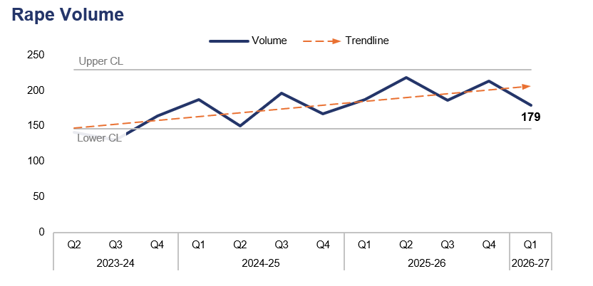
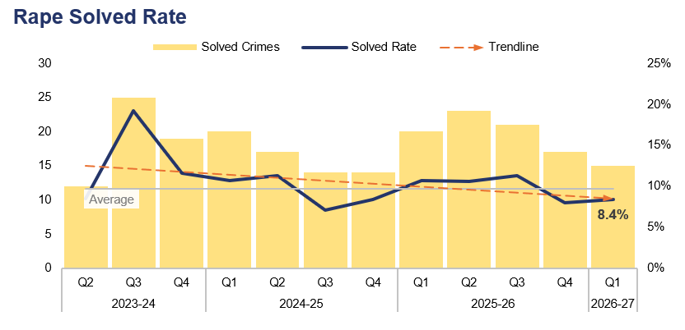
3. Rape
Financial Year | 22-23 | 23-24 | 24-25 | 25-26 |  | FYTD | 26-27 |  | Quarter | Q4 25-26 | Q1 25-26
Volume | 578 | 573 | 700 | 804 |  | Volume | 179 |  | % Change | -16.0% | -4.3%
Financial Year | 22-23 | 23-24 | 24-25 | 25-26 |  | FYTD | 26-27 |  | Quarter | Q4 25-26 | Q1 25-26
Solved Rate | 6.7% | 11.3% | 9.3% | 10.1% |  | Solved Rate | 8.4% |  | PP Change | 0.4pp | -2.3pp
Operational Overview
During Q1 2026-27, 179 Rape offences were recorded. This represents a reduction of 16.0% (34 fewer offences) when compared to the quarter prior, and of 4.3% (eight fewer offences) when compared to the same quarter during the previous financial year.
The solved rate for Q1 2026-27 stands at 8.4%, with 15 crimes solved. This is an increase of 0.4 percentage points when compared to the quarter prior, albeit with two fewer crimes solved. Conversely, a reduction of 2.3 percentage points can be observed when comparing Q1 2026-27 to the same quarter during the previous financial year, with five fewer crimes solved.
Whilst the volume of recorded Rape offences has reduced during Q1 2026–27, performance continues to be impacted by the complexity of investigations, the proportion of historic reports, and national challenges relating to victim engagement and evidential opportunities. Gwent Police has invested in specialist Rape Investigation Team capacity, digital media investigation support, and Operation Soteria improvements in order to strengthen investigative quality and victim care. Governance and scrutiny of Rape and Serious Sexual Offences (RASSO) performance has been enhanced, with a particular focus on investigation timeliness, case progression, victim attrition, and long-duration investigations. This is in response to emerging national expectations and the Centre for Women’s Justice super-complaint. Ongoing work is focused on improving timeliness, reducing investigation backlogs, increasing charge rates, and supporting victims, with performance monitored through dedicated internal and partnership governance arrangements.

Slide 34
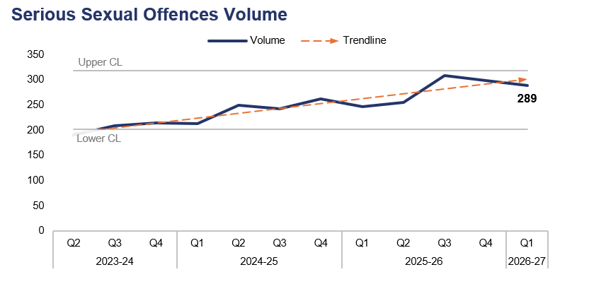
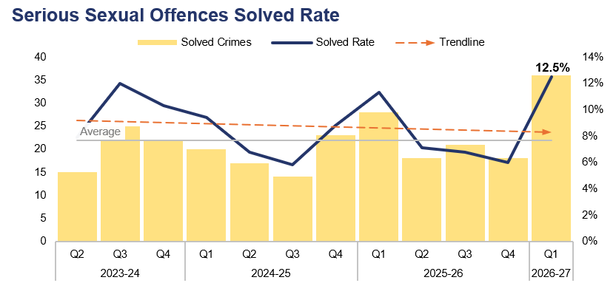
4. Serious Sexual Offences
Financial Year | 22-23 | 23-24 | 24-25 | 25-26 |  | FYTD | 26-27 |  | Quarter | Q4 25-26 | Q1 25-26
Volume | 990 | 847 | 968 | 1,110 |  | Volume | 289 |  | % Change | -3.3% | 17.0%
Financial Year | 22-23 | 23-24 | 24-25 | 25-26 |  | FYTD | 26-27 |  | Quarter | Q4 25-26 | Q1 25-26
Solved Rate | 6.4% | 10.0% | 7.6% | 7.7% |  | Solved Rate | 12.5% |  | PP Change | 6.5pp | 1.2pp
Operational Overview
A total of 289 crimes classified as serious sexual offences were recorded during Q1 2026-27. This represents a reduction of 3.3% (10 fewer offences) when compared to the quarter prior, but an increase of 17.0% (42 additional offences) when compared to the same quarter during the previous financial year.
The solved rate for Q1 2026-27 stands at 12.5%, with 36 crimes solved. This is the highest quarterly solved rate within the three-year timeframe, representing an increase of 6.5 percentage points when compared to the quarter prior, with 18 additional crimes solved. A less prominent increase of 1.2 percentage points can be observed when comparing Q1 2026-27 to the same quarter during the previous financial year, with eight additional crimes solved.
In response to the Angiolini enquiry, Gwent Police now scrutinises non-contact sexual offending daily, ensuring appropriate ownership based on risk. This is in recognition that non-contact offending can lead to escalating criminal sexual behaviours. The improvement in solved rate during Q1 2026-27 is due in part to the adoption of the national training products under Operation Soteria, and the improved scrutiny arrangements in place for these offences. By December 2027, all serious sexual offences will be transferred to the dedicated RASSO Investigation Team, with specialist officers leading each case. This is expected to further improve timeliness, investigation quality, and solved rate for serious sexual offences.
Rape offences have been excluded from this dataset.

Slide 35
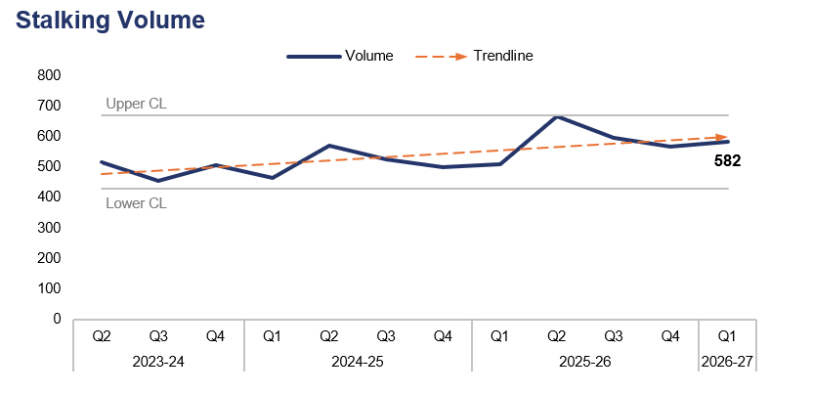
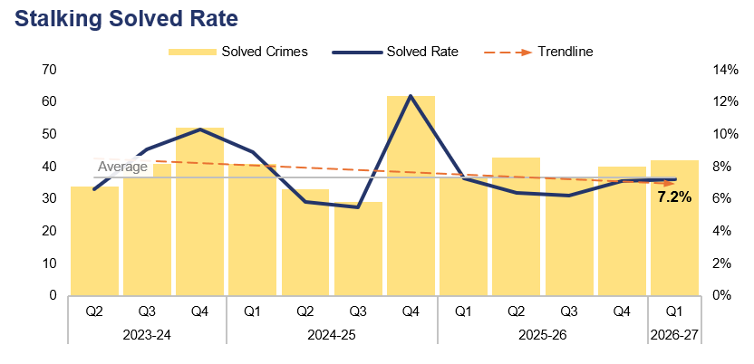
5. Stalking
Financial Year | 22-23 | 23-24 | 24-25 | 25-26 |  | FYTD | 26-27 |  | Quarter | Q4 25-26 | Q1 25-26
Volume | 1,552 | 1,918 | 2,057 | 2,338 |  | Volume | 582 |  | % Change | 2.6% | 14.3%
Financial Year | 22-23 | 23-24 | 24-25 | 25-26 |  | FYTD | 26-27 |  | Quarter | Q4 25-26 | Q1 25-26
Solved Rate | 8.5% | 8.2% | 8.0% | 6.7% |  | Solved Rate | 7.2% |  | PP Change | 0.1pp | -0.1pp
Operational Overview
Overall, 582 offences classified as stalking were recorded during Q1 2026-27. This represents an increase of 2.6% (15 additional offences) when compared to the quarter prior, and a further increase of 14.3% (73 additional offences) when compared to the same quarter during the previous financial year.
The solved rate for Q1 2026-27 stands at 7.2%, with 42 crimes solved. This is a slight increase of 0.1 percentage points when compared to the quarter prior, with two additional crimes solved. Conversely, a slight reduction of 0.1 percentage points can be observed when comparing Q1 2026-27 to the same quarter during the previous financial year, albeit with five additional crimes solved.
The force has employed a protective officer who is responsible for assisting investigating officers in applying for a range of protective orders to mitigate risk and promote victim safety. Work between Gwent Police and Joint Legal Services is already showing positive indicators, with orders currently being applied for via the court system, and five appearing at court during 2026. The Vulnerability Project is leading this piece of work and will also look to strengthen the force’s approach when the new Domestic Abuse Protection Order is introduced during Q3 2026-27.
As a result of changes to supervisor templates in Niche, supervisors are now directed to consider the eligibility of a protective order at the earliest stage. This is in line with His Majesty’s Inspectorate of Constabulary and Fire & Rescue Services recommendations, and further supported by Suzy Lamplugh review.

Slide 36
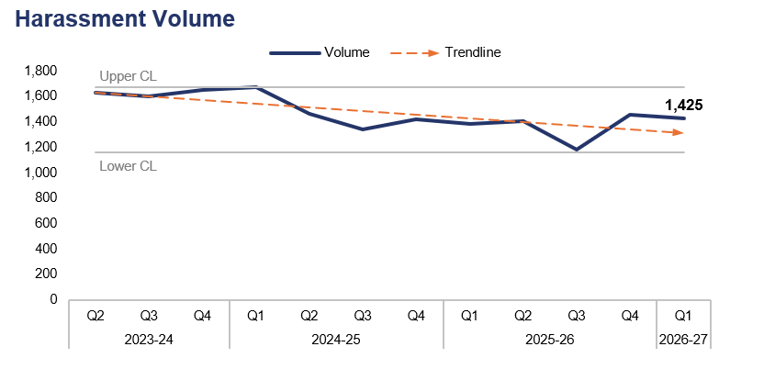
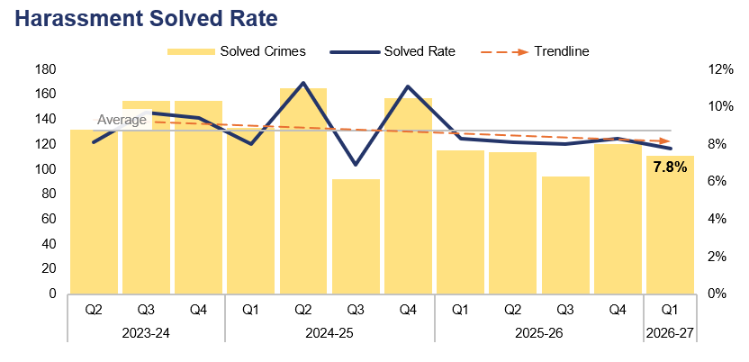
6. Harassment
Financial Year | 22-23 | 23-24 | 24-25 | 25-26 |  | FYTD | 26-27 |  | Quarter | Q4 25-26 | Q1 25-26
Volume | 7,499 | 6,769 | 5,894 | 5,426 |  | Volume | 1,425 |  | % Change | -2.0% | 2.7%
Financial Year | 22-23 | 23-24 | 24-25 | 25-26 |  | FYTD | 26-27 |  | Quarter | Q4 25-26 | Q1 25-26
Solved Rate | 5.5% | 8.7% | 9.3% | 8.2% |  | Solved Rate | 7.8% |  | PP Change | -0.5pp | -0.5pp
Operational Overview
A total of 1,425 offences classified as harassment were recorded during Q1 2026-27. This represents a reduction of 2.0% (29 fewer offences) when compared to the quarter prior, but an increase of 2.7% (38 additional offences) when compared to the same quarter during the previous financial year.
The solved rate for Q1 2026-27 stands at 7.8%, with 111 crimes solved. This is a reduction of 0.5 percentage points when compared to both the quarter prior and the same quarter during the previous financial year, with nine and four fewer crimes solved respectively.
The Detective Chief Inspectors for Investigations and Public Protection, together with the Superintendent for Response Policing, have commenced meetings to develop a better understanding of a whole-system approach to the identification of both stalking and harassment offences. These meetings will also serve to improve investigation quality in these areas. Harassment offences were recognised as an area of worsening performance, with recorded demand and positive outcomes both declining.

Slide 37
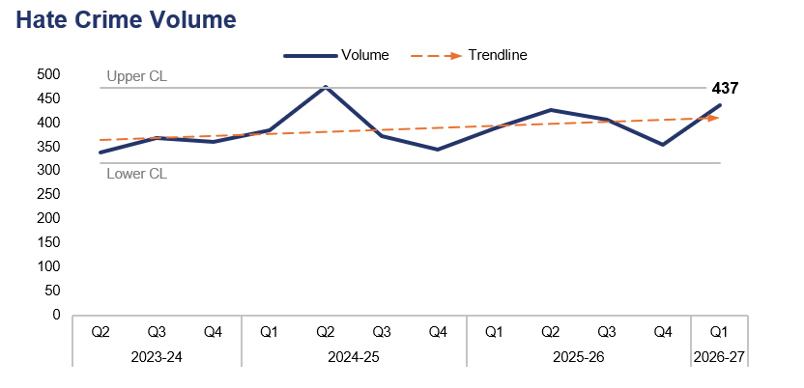

7. Hate Crime
Financial Year | 22-23 | 23-24 | 24-25 | 25-26 |  | FYTD | 26-27 |  | Quarter | Q4 25-26 | Q1 25-26
Volume | 1,443 | 1,446 | 1,575 | 1,575 |  | Volume | 437 |  | % Change | 23.1% | 12.6%
Financial Year | 22-23 | 23-24 | 24-25 | 25-26 |  | FYTD | 26-27 |  | Quarter | Q4 25-26 | Q1 25-26
Solved Rate | 9.3% | 14.9% | 14.6% | 12.4% |  | Solved Rate | 11.0% |  | PP Change | -2.8pp | 2.0pp
Operational Overview
Overall, 437 offences which met the definition of a hate crime were recorded during Q1 2026-27. This represents an increase of 23.1% (82 additional offences) when compared to the quarter prior, and of 12.6% (49 additional offences) when compared to the same quarter during the previous financial year.
Crimes assigned the racial hate strand were the most prevalent during Q1 2026-27, with 263 such offences recorded. Conversely, crimes assigned the religious and transphobic hate strands were the least common, with each being assigned to 22 offences. These rankings are consistent with the quarter prior.
The solved rate for Q1 2026-27 stands at 11.0%, with 48 crimes solved. This is a reduction of 2.8 percentage points when compared to the quarter prior, with one fewer crime solved. Conversely, an increase of 2.0 percentage points can be observed when comparing Q1 2026-27 to the same quarter during the previous financial year, with 13 additional crimes solved.
A single crime can be assigned multiple hate strands. The crime trend is based on recorded crimes, whilst the assessment of hate strands is based on the volume of each individual strand.

Slide 38


8. Child Criminal and Sexual Exploitation
Financial Year | 23-24 | 24-25 | 25-26 |  |  | FYTD | 26-27 |  | Quarter | Q4 25-26 | Q1 25-26
Volume | 21 | 43 | 30 |  |  | Volume | 3 |  | % Change | -57.1% | 0.0%
Financial Year | 22-23 | 23-24 | 24-25 | 25-26 |  | FYTD | 26-27 |  | Quarter | Q4 25-26 | Q1 25-26
Volume | 177 | 68 | 172 | 112 |  | Volume | 19 |  | % Change | -62.0% | 90.0%
Operational Overview
During Q1 2026-27, three offences were assigned a child criminal exploitation local qualifier. This represents a reduction of 57.1% (four fewer offences) when compared to the quarter prior, but is equal to the same quarter during the previous financial year.
A total of 19 offences were assigned a child sexual exploitation local qualifier during Q1 2026-27. This is a reduction of 62.0% (31 fewer offences) when compared to the quarter prior, but an increase of 90.0% (nine additional offences) when compared to the same quarter during the previous financial year. It has been identified that this qualifier may have been applied incorrectly in the past.
The force recognises that improvements in data quality and recording consistency are required in order to ensure that performance information accurately reflects operational activity. Local and national work is being progressed to ensure the consistent application of flags and markers, so that data relating to exploitation is fully understood. Force governance continues to monitor child exploitation through established exploitation arrangements, including Multi-Agency Child Exploitation processes, Regional Threat Group oversight, and Strategic Governance Group reporting. The force maintains a dedicated exploitation capability and works closely with safeguarding partners to identify, safeguard and support children at risk of exploitation. It is recognised that reductions in recorded child sexual exploitation may reflect improved early intervention, disruption activity, and changes in recording practice, rather than a reduction in underlying threat and risk.
Use of the Child Criminal Exploitation local qualifier commenced during 2022, limiting the scope of the currently available dataset.

Slide 39

9. Missing Children
Financial Year | 22-23 | 23-24 | 24-25 | 25-26 |  | FYTD | 26-27 |  | Quarter | Q4 25-26 | Q1 25-26
Volume | 3,276 | 4,359 | 4,391 | 4,983 |  | Volume | 1,118 |  | % Change | -5.5% | -3.5%
Operational Overview
A total of 1,118 missing person reports were created during Q1 2026-27 which pertained to a child. This represents a reduction of 5.5% (65 fewer reports) when compared to the quarter prior, and a similar reduction of 3.5% (40 fewer reports) when compared to the same quarter during the previous financial year.
The management of missing children has been greatly improved through a multi-agency response and weekly Missing Meetings. The force has equipped frontline staff with a greater understanding of risk through use of the Philomena Protocol and the delivery of additional training throughout the 2025-26 financial year.
The Missing Children Team manage Missing Meetings to review all missing children and ensure that debriefs are completed. The team work closely with partner agencies and care providers to ensure that housing and other support provisions are meeting the child's needs. This problem-solving approach helps reduce the frequency and duration of missing episodes for children. Links between missing children and exploitation are mitigated through the Multi-Agency Child Exploitation meetings.
A missing person report is created each time an individual is reported as missing. Several reports can be created for the same individual if they are reported as missing on multiple occasions.

Slide 40

10. Report Fraud
Financial Year | 22-23 | 23-24 | 24-25 | 25-26 |  | FYTD | 26-27 |  | Quarter | Q4 25-26 | Q1 25-26
Volume | 923 | 969 | 867 | 945 |  | Volume | 252 |  | % Change | -13.7% | 34.0%
Operational Overview
Overall, 252 Report Fraud occurrences were assigned to Gwent Police by the National Fraud Intelligence Bureau during Q1 2026-27. This represents a reduction of 13.7% (40 fewer occurrences) when compared to the quarter prior, but an increase of 34.0% (64 additional occurrences) when compared to the same quarter during the previous financial year.
During Q1 2026-27, £7,500 of victim’s money was safeguarded by fraud investigations in Gwent.
Report Fraud has replaced Action Fraud as the national platform for reporting cyber crime and fraud.

Slide 41

11. Cybercrime
Offences Most Commonly Classified as Cybercrime by Volume – Q1 2026-27
Offence Title | Volume | % of Total
Protection from Harassment Act Section 2 | 292 | 20.4%
Pursue course of conduct which amounts to stalking | 274 | 19.2%
Putting people in fear of violence | 133 | 9.3%
Sending letters etc with intent to cause distress or anxiety | 97 | 6.8%
Take/make/distribute indecent photographs/pseudo-photographs of children | 71 | 5.0%
Financial Year | 25-26 |  |  |  |  | FYTD | 26-27 |  | Quarter | Q4 25-26 | Q1 25-26
Volume | 6,340 |  |  |  |  | Volume | 1,438 |  | % Change | -11.2% | -6.5%
Operational Overview
A total of 1,438 offences recorded during Q1 2026-27 were classified as cybercrime, as defined by the NDQIS reporting system. This represents a reduction of 11.2% (181 fewer offences) when compared to the quarter prior, and of 6.5% (100 fewer offences) when compared to the same quarter during the previous financial year.
During Q1 2026-27, three of the five offences which were most commonly classified as cybercrime can be defined as harassment offences, with a fourth defined as a stalking offence. Overall, crimes classified as either a harassment offence or a stalking offence accounted for 64.1% of all cybercrime recorded during the quarter, with a total of 922 offences reported. This is an increase of 6.2 percentage points when compared to the quarter prior, albeit with 16 fewer offences recorded.
Cybercrime reporting via the NDQIS system was first adopted by the force during June 2024, limiting the scope of the currently available dataset.

Slide 42
12. Protecting the Vulnerable – Emerging Issues
Operational Overview
As a pilot force for Operation Beaconport, Gwent is preparing for the review and reinvestigation of historic group-based child sexual exploitation cases. This work is being carried out under enhanced governance arrangements and national scrutiny, with a strong focus on victim-centred reviews, learning from historic investigations, and strengthening the force response to organised exploitation. Workforce training, senior investigating officer capability, trauma-informed practice, and specialist safeguarding support are all being developed in preparation for this work.
Organised Drug Facilitated Sexual Assault (ODFSA) has emerged as an increasing area of national focus, reflecting growing concern regarding the identification, investigation, and safeguarding response to cases in which drugs are used to facilitate sexual offending. Forces are being asked to provide updates on ODFSA investigations and intelligence, and to ensure operational readiness as national products and guidance continue to develop.
There is increasing concern from partners regarding misogynistic attitudes and harmful behaviours among school-age children. Safeguarding governance is considering the links between online harms, VAWG, child-on-child abuse, harmful sexual behaviour, and exploitation. This sits alongside wider national work on VAWG prevention and education, with growing recognition that early intervention and partnership activity are required to address harmful attitudes before they escalate into offending behaviour.
Domestic Abuse Protection Orders (DAPO) will be rolled out nationally from November 2026. DAPO implementation is expected to deliver stronger victim protection and improved perpetrator management, whilst also acting as a catalyst for a wider transformation of the force's approach to protective orders, domestic abuse risk management, and vulnerability governance. The key risk is ensuring that sufficient capacity, systems, and governance are in place to manage what is anticipated to be a significant increase in the volume, complexity, and duration of protective orders. Implementation meetings are currently underway to address this.

Slide 43
Pillar Four – Putting Victims First
Investigation Timeliness
Victims and Repeat Victims
Victim Satisfaction
Putting Victims First – Emerging Issues

Slide 44

1. Investigation Timeliness
Financial Year | 22-23 | 23-24 | 24-25 | 25-26 |  | FYTD | 26-27 |  | Quarter | Q4 25-26 | Q1 25-26
Median Timeliness | 41 | 22 | 31 | 44 |  | Median Timeliness | 36 |  | % Change | -21.7% | 63.6%
Operational Overview
During Q1 2026-27, the median investigation length was 36 days. This represents a reduction of 21.7% (10 fewer days) when compared to the quarter prior, but an increase of 63.6% (14 additional days) when compared to the same quarter during the previous financial year.
It is recognised that whilst investigation timeliness is key for victims, an investigation also has to be proportionate and effective. A balance must be struck between investigation quality and timeliness. This messaging forms part of the Quality of Investigation and Victim Care framework. To further support this messaging, victim inputs have been delivered at force training days and are provided to all new recruits. These focus on maintaining victim updates, updating victims at key stages, ensuring the victim’s right to receive specialist support is met, and providing a Victim Impact Statement.
A detailed review of outstanding crimes is taking place in order to understand the reasons behind the volume of investigations held by officers. It is anticipated that this review will result in a significant reduction in the median investigation length, although the force will take a balanced approach, ensuring that investigation thoroughness is not compromised by a focus on timeliness.

Slide 45


2. Victims and Repeat Victims
Financial Year | 22-23 | 23-24 | 24-25 | 25-26 |  | FYTD | 26-27 |  | Quarter | Q4 25-26 | Q1 25-26
Volume | 32,013 | 32,788 | 33,026 | 32,796 |  | Volume | 10,327 |  | % Change | 7.1% | 8.7%
Financial Year | 22-23 | 23-24 | 24-25 | 25-26 |  |  |  |  | Quarter | Q4 25-26 | Q1 25-26
Volume | 8,247 | 7,260 | 7,189 | 7,045 |  |  |  |  | % Change | 3.4% | 4.6%
Operational Overview
Overall, 10,327 unique victims were linked to crimes recorded during Q1 2026-27. This is the highest quarterly figure within the three-year timeframe, representing an increase of 7.1% (687 additional victims) when compared to the quarter prior, and a further increase of 8.7% (830 additional victims) when compared to the same quarter during the previous financial year.
During the 12 months to the end of Q1 2026-27, 7,284 victims were linked in this capacity to two or more separate offences, classifying them as repeat victims. This is an increase of 3.4% (239 additional repeat victims) when compared to the 12 months to the end of the quarter prior, and a further increase of 4.6% (320 additional repeat victims) when compared to the 12 months to the end of the same quarter during the previous financial year.
The ‘Victim Care’ guiding principle of the Quality of Investigations and Victim Care Change Programme aims to improve understanding and recording principles, in order to ensure that appropriate and tailored services are delivered to victims. Level 1 tasking ensures that repeat victims are identified and problem-solving plans are enacted by the appropriate resource. A review of tasking has taken place, as it is recognised that there is a need to improve the force’s understanding and response to vulnerable victims.
For the purposes of this report, a repeat victim is defined as an individual who has been linked in this capacity to two or more separate offences within a 12-month period.
The financial year figures in the right-hand graph refer to the number of repeat victims recorded across that timeframe, rather than being the sum of the quarterly figures for that year.

Slide 46
3. Victim Satisfaction
Victim Satisfaction Survey Data: Q1 2025-26 – Q1 2026-27
Survey Question | Percentage of Respondents Satisfied | Quarter-on-Quarter Difference |  | Number of Respondents Satisfied | Total Responses Received
How satisfied are you with the ease of initial contact with the Police? | 79.2% | +1.8pp | á | 187 | 236
How satisfied are you with the response time to your contact? (e.g. how long it took for your call to be answered) | 81.4% | +1.5pp | á | 192 | 236
Overall, how satisfied are you with your experience of the first point of contact with the police? | 80.9% | +1.0pp | á | 190 | 235
If an officer attended, how satisfied are you with the time it took for them to arrive? | 82.9% | -1.2pp | â | 107 | 129
How satisfied are you with the actions taken by the attending officer/s? | 76.1% | +2.3pp | á | 102 | 134
Thinking about your overall experience, how satisfied are you with the treatment you have received from Gwent Police? | 68.7% | +2.7pp | á | 160 | 233
Operational Overview
A total of 238 respondents have engaged with the victim satisfaction survey between Q1 2025-26 and Q1 2026-27 inclusive. Of those who replied to the given question, 82.9% of respondents were satisfied with the time it took for attending officers to arrive, whereas only 68.7% of respondents were satisfied with the overall treatment they received from Gwent Police. When compared to the same period for the quarter prior (Q4 2024-25 – Q4 2025-26), the percentage of satisfied respondents has increased for all but one of the questions above.
Gwent Police has recognised that current victim satisfaction survey response rates are poor, and that improvement is required to better understand victim experience and service quality. A Task and Finish Group has been established, with clear aims and objectives identified, to review the current approach and drive improvements. Alongside this, the Office of the Police and Crime Commissioner is progressing an external application to potential providers, in order to explore the outsourcing of the victim satisfaction survey. This work is intended to improve response rates, strengthen organisational learning, and provide greater insight into specific areas of service delivery where targeted improvement is required.
All questions within the survey are optional, which may result in a disparity between the number of responses received for each question.

Slide 47
4. Putting Victims First – Emerging Issues
Operational Overview
The change programme seeks to implement improvements in how all investigators care for victims, embedding meaningful and purposeful interactions with victims at every stage of the investigation.
Work is underway to improve the Victim Satisfaction Survey, ensuring that it better captures victims’ lived experience, identifies themes for learning, and supports a more consistent understanding of confidence, satisfaction, and service quality. This places victim care at the forefront of everything Gwent Police does and ensures that those who deliver the service continue to improve trust and confidence within local communities by providing a connected service that is focused on getting it right and doing the right thing.
Improvements to the performance metrics for Victims’ Code of Practice (VCOP) reporting are ongoing. Until now, Gwent Police has been directed by the Ministry of Justice to not make any changes to key performance indicators or reporting, which has left the force in a state of flux. The decision to move forward has now been made (in consultation with the OPCC), with work in progress to improve the force’s performance. Analysis and Research are building appropriate measures in support of this.
Alongside this, the force is developing its approach to VCOP reporting metrics so that compliance is not viewed solely as a data return, but as a meaningful measure of whether victims are receiving the information, support, and service they are entitled to. The Head of Victim Services is working with other Welsh leads and Analysis and Research to develop consistent VCOP reporting metrics.
The force has introduced changes to the templates used to identify and respond to victims’ needs, as well as to evidence and satisfy victims’ rights under the VCOP. These changes are intended to allow investigators to record victim contact, entitlements, needs, and outcomes more consistently, whilst also enabling supervisors and leaders to better understand compliance, quality, and areas requiring further improvement.
Governance arrangements in the force ensure that victims’ voices remain at the forefront of priorities for policy makers, investigators and Victim Services.
The Survivor Engagement Coordinator brings together the collective voices of a committed advisory group, acting as a stakeholder reference group willing to advise and challenge Gwent Police on the services it delivers. This group have recently contributed to the aims and objectives of the Victim Satisfaction Survey.

Slide 48
Pillar Five – Reducing Reoffending
Offenders and Repeat Offenders
Young Offenders and First-Time Entrants
Children in Police Custody
Reducing Reoffending – Emerging Issues

Slide 49


1. Offenders and Repeat Offenders
Financial Year | 22-23 | 23-24 | 24-25 | 25-26 |  | FYTD | 26-27 |  | Quarter | Q4 25-26 | Q1 25-26
Volume | 20,006 | 20,517 | 20,797 | 20,512 |  | Volume | 6,890 |  | % Change | 3.5% | 3.3%
Financial Year | 22-23 | 23-24 | 24-25 | 25-26 |  |  |  |  | Quarter | Q4 25-26 | Q1 25-26
Volume | 7,453 | 7,016 | 7,039 | 6,838 |  |  |  |  | % Change | 1.5% | 0.5%
Operational Overview
Overall, 6,890 unique offenders were linked to crimes recorded during Q1 2026-27. This represents an increase of 3.5% (230 additional offenders) when compared to the quarter prior, and a similar increase of 3.3% (218 additional offenders) when compared to the same quarter during the previous financial year.
During the 12 months to the end of Q1 2026-27, 6,943 offenders were linked in this capacity to two or more separate offences, classifying them as repeat offenders. This is an increase of 1.5% (105 additional repeat offenders) when compared to the 12 months to the end of the quarter prior, and a slight increase of 0.5% (34 additional repeat offenders) when compared to the 12 months to the end of the same quarter during the previous financial year.
The Outstanding Suspect Risk Assessment is now live in Gwent Police, allowing for early identification of the force’s highest-harm outstanding suspects, with daily scrutiny to positively intervene and disrupt their offending. In addition to this, Gwent Police have put plans in place and submitted papers to repurpose a Crime team in order to deal with high-harm offenders, who, due to Sentencing Act changes, do not have intervention from Integrated Offender Management (IOM), Probation, or Management of Sexual Offenders and Violent Offenders. This will be coordinated through Level 1 tasking.
For the purposes of this report, a repeat offender is defined as an individual who has been linked in this capacity to two or more separate offences within a 12-month period. This does not necessarily mean that they have been charged with or found guilty of the offence in question.
The financial year figures in the right-hand graph refer to the number of repeat offenders recorded across that timeframe, rather than being the sum of the quarterly figures for that year.

Slide 50


2. Young Offenders and First-Time Entrants
Financial Year | 22-23 | 23-24 | 24-25 | 25-26 |  | FYTD | 26-27 |  | Quarter | Q4 25-26 | Q1 25-26
Volume | 3,539 | 3,684 | 3,615 | 3,419 |  | Volume | 1,208 |  | % Change | -0.2% | 8.2%
Financial Year | 22-23 | 23-24 | 24-25 | 25-26 |  | FYTD | 26-27 |  | Quarter | Q4 25-26 | Q1 25-26
Volume | 2,208 | 2,072 | 1,993 | 1,823 |  | Volume | 515 |  | % Change | 7.3% | 6.8%
Operational Overview
A total of 1,208 unique offenders under the age of 18 were linked to crimes recorded during Q1 2026-27. This represents a slight reduction of 0.2% (three fewer young offenders) when compared to the quarter prior, but an increase of 8.2% (92 additional young offenders) when compared to the same quarter during the previous financial year.
Of these young offenders, 515 (42.6% of the quarterly total) have been identified as first-time entrants into the criminal justice system within Gwent. This is an increase of 7.3% (35 additional entrants) when compared to the quarter prior, and a similar increase of 6.8% (33 additional entrants) when compared to the same quarter during the previous financial year.
The force is striving to ensure that young offenders are seen as children and dealt with appropriately, with a focus on restorative processes to divert them from future offending and the criminal justice process. The force is leading an approach to standardising practises between the four Welsh forces, focusing on child-centric procedures and out of court disposals. Governance arrangements into the Wales Youth Justice Advisory Panel and the Criminal Justice Board provide accountability, supported by the Youth Justice Board. Force metrics regarding children, such as levels of offending, are tracked in Superintendent-led performance meetings and the Operational Effectiveness Board. In support of this, Youth Justice are leading on internal processes to ensure that children's rights are afforded consistently, and that investigations with a released under investigation disposal receive the same levels of accountability as bail cases.
The age of the offenders included in this dataset has been calculated based on the committed date of the offence they were linked to. This does not necessarily mean that they have been charged with or found guilty of the offence in question. The dataset used to identify first-time entrants is limited to offences committed within Gwent from 2018 onwards. Offences committed outside of Gwent or prior to 2018 are not included in this calculation.

Slide 51

3. Children in Police Custody
Financial Year | 22-23 | 23-24 | 24-25 | 25-26 |  | FYTD | 26-27 |  | Quarter | Q4 25-26 | Q1 25-26
Volume | 541 | 613 | 751 | 532 |  | Volume | 148 |  | % Change | 22.3% | 0.0%
Operational Overview
During Q1 2026-27, 148 custody records were created which had a juvenile subject. This represents an increase of 22.3% (27 additional custody records) when compared to the quarter prior, but is equal to the same quarter during the previous financial year.
The above figures are based on custody footfall, which refers to the number of custody records with an arrival time within the specified timeframe. As such, if a subject came into custody on multiple occasions, they would be counted upon each arrival.

Slide 52
4. Reducing Reoffending – Emerging Issues
Operational Overview
Legislative changes allowing for eligible offenders to be released after serving one third of their sentence represent an emerging issue for policing, specifically for the IOM team and probation services. This is under constant review by statutory agencies, in order to understand the impact and scale of the added demand that could be placed on services. The independent sentencing review is being managed through Operation Redford, ensuring a consistent approach to Sentencing Act changes across England and Wales. The IOM team are leading this change for Gwent Police, engaging with internal and external stakeholders. In support of this, the IOM team have improved multi-agency planning to manage the incoming demand and have enhanced processes for identifying individuals who are suitable for removal from the cohort due to consistent positive qualifiers, as per the IOM doctrine.
Changes to existing teams will allow for a relentless focus on priority offenders, preventing further community impact. The repurposing of a Crime team, if agreed by force governance processes, will be in place during Q3 2026-27 in readiness for the first tranche release.

