Slide 1
INTERNAL COMMUNICATIONS STRATEGY
2026-2029

Slide 2
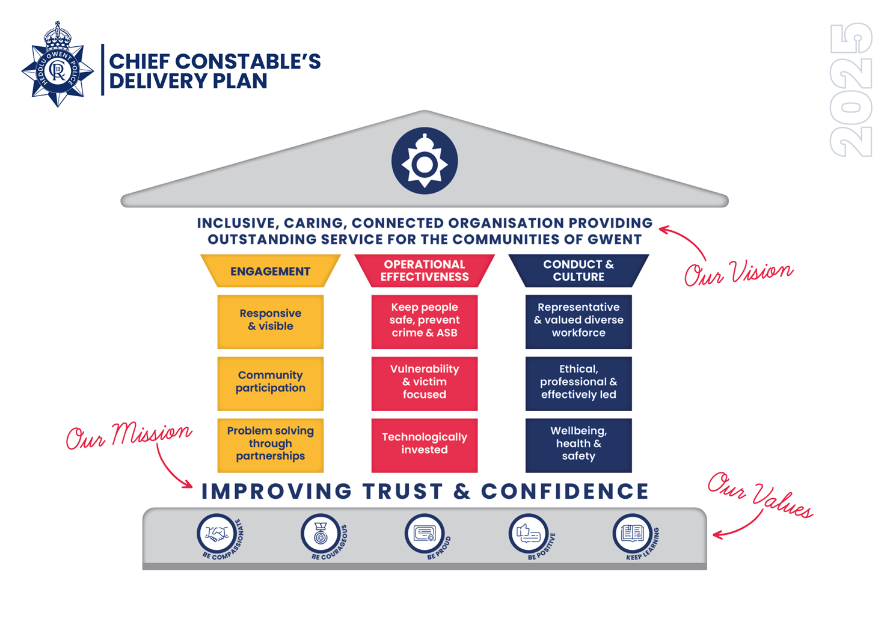
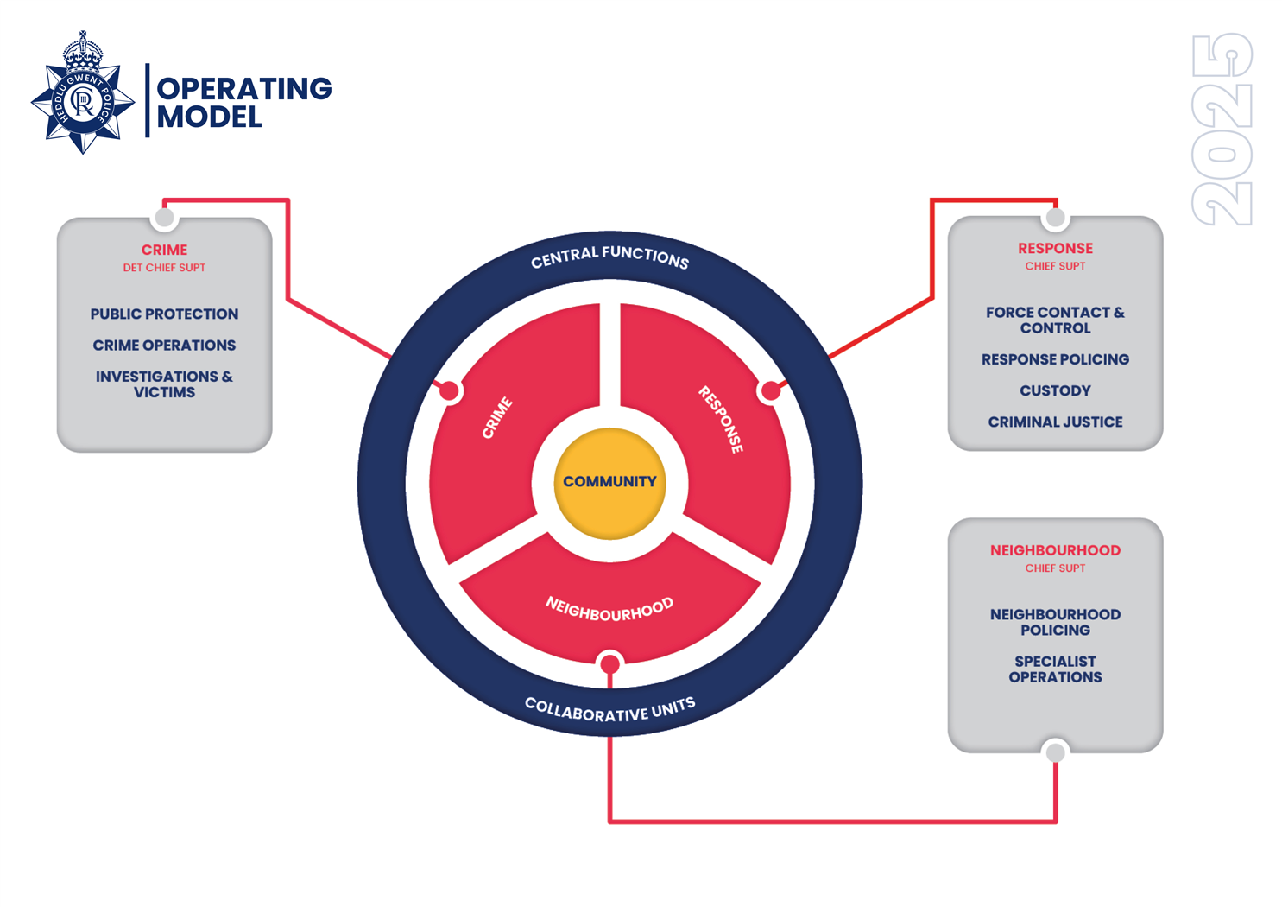
BACKGROUND – A NEW VISION AND MISSION
The Chief Constable’s Delivery Plan 2025 – 2029 was published in spring 2025. This sets out our shared mission to improve trust and confidence in Gwent Police, and details key initiatives to achieve our vision, which is to create an inclusive, caring, connected organisation providing outstanding service for the communities of Gwent.
The delivery plan is based around three key strategic pillars: engagement, operational effectiveness, and conduct and culture. These are aligned with the Police and Crime Commissioners five key priorities as set out in the 2025 – 2029 in the Police, Crime and Justice Plan. Our existing force values underpin this plan.
Further to this, introduced in January 2025, a new functional operating model removed geographical barriers and aligned the force as one team, putting the community we serve at the heart of everything we do.

Slide 3
INTERNAL COMMUNICATIONS – OUR PURPOSE
Everyone in our organisation plays a role in improving trust and confidence in Gwent Police.
Effective internal communication is a major contributor and by aligning everyone to our mission, we can help people feel informed, supported and motivated to deliver our priorities and achieve our vision.
This strategy outlines how we will evolve and deliver in support of our new mission and delivery plan, leveraging new technology to develop our internal communications function and activity, so that Gwent Police can achieve its vision and be trusted by its workforce and wider community.
Gwent Police invested in a dedicated internal communications function in 2021. Since then, we have moved from a cascade model to a ‘starting with me’ tailored communications approach, where colleagues receive information that is most relevant to them across a mixture of digital, environmental and in-person channels.
Our approach to internal communication has also moved from reactive and primarily information broadcast, to proactive, two-way communication, allowing colleagues to share their feedback and views.
Alongside the core internal communication function, our wider corporate communications department has 24/7 on-call capabilities in the event of an emergency or critical incident impacting colleague safety and/or wellbeing, or any other incident that could impact trust and confidence of our workforce. Senior leadership are supportive of prioritising internal communication in these circumstances wherever possible.

Slide 4
OUR INTERNAL COMMUNICATIONS JOURNEY
 | 2026 | 2027 | 2028+
Where we started | Where we are now | Where we are going | Our end goal
Limited resource juggling ongoing tasks while working to set up communications platforms | Dedicated resource with a rhythm of content production, working to manage volume | Efficient flow of internal communications with automated metrics to guide strategy | Internal communications has demonstrable impact on employee engagement and experience
No defined strategy Ad hoc production process Limited consistency around design and tone Minimal targeting Lack of measurement | Defined strategy Defined production process Proactive editorial and events calendar Targeted content to specific audiences Consistent design and tone Evolving communications channels Support for content contributors Manual measurement processes | Further evolved comms channels Leaders’ briefings and support Automated metrics available | Metrics guide decisions AI and technology help automate routine activities to allow function to focus on value-adding strategic activities
Engaged with the mission Aware of delivery plan and how they connect Believes and acts in line with the force values Higher productivity and performance Our people are external advocates
People outcomes
Organisational outcomes

Slide 5
CURRENT CONTEXT AND CHALLENGES
The Chief Constable’s Delivery Plan has launched at a time when trust and confidence in policing nationally remains low. This is as a result of years of cases involving male officer violence against women, and inappropriate behaviour by officers, including discrimination. Issues locally affecting confidence includes ongoing misconduct and performance issues highlighted by the HMIC PEEL inspection, which are both now improving.
Burn-out is affecting frontline officers, with the national Oscar Kilo wellbeing survey reporting that 55% of colleagues experience persistent fatigue. We see a lack of confidence from officers and staff generated by the perception of negative news – which is affecting engagement.
There is a perception that Gwent Police is poor at managing change. This is a current AFI and area for improvement.
While our latest employee opinion results show a high support for inclusion, colleagues report microaggressions.
New technologies, including AI, is developing at rapid pace. Colleagues' expectations are driven by their experiences of technology outside of the workplace. Gwent Police has invested in Microsoft O365, including CoPilot, and further technology investment is planned from 2026.
Budgets within public services remain challenging, with higher inflation and recent rising costs, including national insurance increases, squeezing budgets further.
The UK Government has already announced scrapping the existing PCC model and planned changes to police governance and accountability. There are currently unknown changes with police reform, with a white paper set to be published early 2026.

Slide 6
OUR VISION
Working in partnership with senior leaders, acting as trusted advisors, our internal communications function will:
Engagement: deliver people-focused communication, facilitating genuine two-way communication between colleagues and leadership
Operational effectiveness: focus our people on what is important to know, understand, and do, through proactive, transparent communication that gets the right message, to the right people at the right time, in the right way
Culture and conduct: support cultural change to create an inclusive workforce with trusted leadership, where everyone feels heard, valued and that they belong.
We will take an evidence-based approach to developing and refining our communications and work effectively with our partners and stakeholders for the benefit of the public, always ensuring victims are at the heart.

Slide 7
OUR PEOPLE
Understanding our people and their day-to-day realities, together with their likes, needs and wants, helps us to identify how we should develop our internal communications.
Building this picture also gives us an ability to target our content and messaging, keeping our internal communications as relevant as possible, to ensure it lands effectively.
Our communication is tailored to each audience, beginning with an individual-focused approach.
Role | Headcount | Operational / non-operational
Police officers | 1,636 | Operational
Police staff | 971 | Operational staff and non-operational business support functions
PCSOs | 139 | Operational
Special Constabulary and other volunteers | 51 | Operational
OPCC | 30 | Non-operational

Slide 8
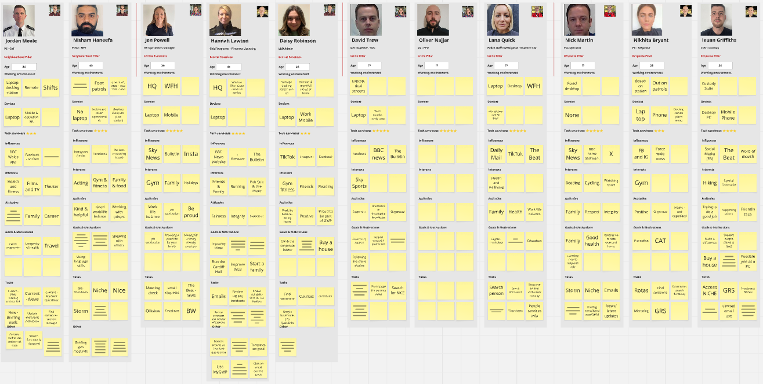
OUR PEOPLE
We develop audience personas to help guide our strategies and plans, ensuring we develop approaches and content that meet the wants and needs of Gwent Police colleagues. We will check and test these regularly.

Slide 9
Our guiding principles
Our guiding principles thread through our strategy and communications approach.
These principles, when applied to our communication plans and delivery, will help build colleague trust and confidence in Gwent Police.
Clarity – we remove complexity and help ensure that information flows smoothly to every colleague, keeping people connected and working toward common goals
Consistency – we help provide colleagues with trusted sources of information that can be relied upon
Connection – we help build trusted relationships by facilitating conversation and collaboration.

Slide 10
Our scope
To build trust with our colleagues, our focus as a team centres on three core areas. In each, we act as trusted advisors to deliver strategic and tactical communication to help inform, support and motivate colleagues.
Corporate – telling our story to align everyone to a shared common goal
Engagement – facilitating alignment and prioritisation, and promoting conversation and collaboration
Operational – need to know information, including crisis and emergency communication.

Slide 11
INTERNAL COMMUNICATIONS STRATEGY
Engagement: deliver people-focused communication, facilitating genuine two-way communication between colleagues and leadership
Sustain a strong narrative around the force’s mission and vision over the plan’s five-year term, sharing information about what we’re doing to achieve it
Promote opportunities for two-way dialogue between leaders and colleagues, and show how leaders have listened and acted
Ensure internal alignment with external messages on issues that may affect trust and confidence.
Operational effectiveness: focus our people on what is important to know, understand, and do, through proactive, transparent communication that gets the right message, to the right people, at the right time.
Sustain clarity and consistency
Further develop our channels to be effective, efficient and enable collaboration
Improve our measurement strategies to better evaluate as we develop our internal communications approaches
Leverage developments in AI to improve efficiencies
Support organisational improvements within identified areas
Support line managers to communicate effectively with their teams.
Conduct and culture: support ongoing cultural change to create an inclusive workforce with trusted leadership, where everyone feels heard, valued and that they belong
Connect leadership with colleagues through in-person and online events to build trust and alignment
Help our people feel included to create a positive workplace for everyone
Further embed our values through the promotion of our reward and recognition programmes
Create meaningful conversations around equality, diversity and inclusion that develop knowledge and understanding.

Slide 12
OUR CHANNEL MATRIX – CURRENT
Existing channels | Channel name | Type / description / broadcast or two-way | Purpose / content | Frequency | Reach
 | The Beat (Sorce) | Intranet – accessed via a web browser two-way (comments, likes, Q&As) | Internal website – our single source of truth. Find how to carry out your role, what it means to work for Gwent Police and a place to access all the other apps/platforms. | Always-on | All officers and staff who have an email address and access to a laptop or desktop
 | Viva Engage (MS365) | Internal social platform enhancing the overall employee experience Enables colleagues to share views, their own news (fundraising, Police Sport, retirements) and link together in areas of common interest. two-way (comments, likes, Q&As) | Reduces silos by enabling colleagues to reach out for help, support, guidance from others across Gwent Police. | Always-on | All officers and staff who have an email address and access to a laptop, desktop and/or mobile
 | The Bulletin | Email newsletter two-way (likes, shares, comments, polls) | Digest of operational and organisational updates, linking to intranet content | Weekly | All officers and staff. Content is targeted to relevant employee types. Mobile and desktop
 | Flash email (corporate announcement) | Short, single topic announcements used only when required to communicate urgent updates – Broadcast | Ad hoc, when required – targeted only to those who need to know the information | Ad hoc | All officers and staff. Content is targeted to relevant employee types/departments

Slide 13
OUR CHANNEL MATRIX – CURRENT CONTINUED
Existing channels | Channel name | Type / description / broadcast or two-way | Purpose / content | Frequency | Reach
 | Chief Officer Vlog | Video – broadcast | Senior leadership message | Ad hoc | Available via the intranet - audience largely CI level and above
 | Force direction forum and Team Gwent events | Two-way | Teams / live broadcast – speaker/presentation format, Q&A | Once per quarter | Dependent on invited audience
 | Team meetings | In person / on Teams – Two-way | Lead by managers, updates and relevant team news/actions | Variable | Specific teams / departments
 | NotifyX | App / message – Broadcast | Operational only – recalls to duty and mutual aid | Ad hoc | Specific officers / skills
 | Employee Ideas | Two-way, digital platform access via MS Teams | Campaigns to gather views and ideas from the workforce on specific topics | Ad hoc | All officers and staff.

Slide 14
OUR CHANNEL MATRIX – EMERGING
Emerging / new channels | Channel name | Type / Broadcast or Two-way | Purpose / content | Frequency | Reach
 | Digital signage | Broadcast | Visual reminders and direction to other channels to highlight key messages, information and initiatives, | Ad hoc | Location specific
Informal channels | Channel name | Type / Broadcast or Two-way | Purpose / content | Frequency | Reach
 | WhatsApp | Two-way, personal communication between colleagues/teams using Meta owned App |  | Ad hoc / personal use | Employee controlled
 | Facebook groups | Two-way, personal communication between colleagues/teams using Meta owned platform |  | Ad hoc / personal use | Employee controlled

Slide 15
LEADERSHIP COMMUNICATIONS
Leadership is key for internal communications.
Leaders across the organisation are delivering internal communications every day and they must be informed to be able to do this and understand the desired approach from senior leaders.
Chief officer team: Inspire, motivate and give the confidence that we can achieve our vision.
Senior managers: Translate the vision into objectives for their business area. Help their business area understand how they align what they do to the vision – alignment and prioritisation.
Line managers: As the trusted source of information for the workforce and the person who understands their teams’ specific roles, line managers help their teams understand how their role helps deliver our vision and then supports them deliver.
Internal communications: Champion best practice in internal communications, lead internal communications for the organisation and support leaders to communicate effectively.

Slide 16
HOW WILL WE MEASURE SUCCESS?
In evaluating employee experience, measurement will focus on the following six areas. These can be influenced by communications interventions and broader people services led factors.
Channels | Content | Conversations | Voice | Sentiment | Behaviour
What are we measuring?
Are they working? | Are colleagues getting the content they want and need? What are they interested in? Is communication timely, relevant, accurate and consistent | Are people communicating effectively? How well do leaders, senior managers, middle managers, line managers and colleagues communicate, both formally and informally? | Do colleagues have the opportunity to have a say across the organisation? How much are views actively sought and treated seriously? | What do colleagues think and feel about the organisation? Do people identify with our strategy and values? Are they advocates? | Do people act to help the organisation achieve its objectives and priorities? Has communication influenced colleague behaviour?

Slide 17
HOW WILL WE MEASURE SUCCESS?
Engagement | Operational effectiveness | Conduct and culture
KPIs:
85% awareness of chief’s mission and delivery plan Further KPIs detailed in individual strategies | 100% of employees to have awareness of at least two core internal communications channels. 75% to use a channel on a regular basis and feel its content contributes to doing their role effectively. Open rate of The Bulletin to increase 1% year-on-year for the next 3 years. 2.5% annual increase in engagement levels across The Beat and The Bulletin over the next 3 years | Be Proud award nominations to increase 2.5% year-on-year for the next 3 years 75% of colleagues to access senior leader led communication at least once per quarter.
How will this be measured?
Employee Opinion Survey data | Annual evaluation of channel performance against objectives set out in channel matrix. Analysis of individual channel metrics X1 focus group session or vox pops to collect feedback Survey data | Analysis of individual channel metrics

Slide 18
NEXT STEPS
Quarterly – review plan to check it is still valid and appropriate, check progress on meeting objectives
Annually – review objectives against annual plan
Review if leadership changes, or significant issues internally arise, e.g budget or major structural changes including police reform
Horizon scan to ensure we are fit for the future

