Slide 1
DIGITAL COMMUNICATIONS STRATEGY
2026 | 2029
Notes:
Subtitle – Arial: Bold. Sentence case. 24 Pt.
Main text – Arial: Reg. Sentence case. 20 Pt.
Bullet Points – Arial: Reg. Sentence case. 20 Pt. Line Spacing 1.5.
Bold where appropriate.
Alternate slide formats between Left & Right.
Do not:
Change text colour.
Enlarge text size.
Move content over background images.

Slide 2
WHY ARE WE DOING THIS?
Social media and other digital platforms provide us with access to a large local audience and help us update, inform and reassure the public and increase the visibility of our local policing teams. By using these channels effectively, we can build public trust and confidence in our services. We become more approachable and are seen as a trusted source of information.
Investing time and resource into our digital estate helps us build a receptive local audience for times when we need to distribute, seek, or publish vital information. Digital communication also enables us to engage with our communities, gather their views on local policing and understand how we can better engage with those who’ve previously been hesitant to.
Finally, we can improve accessibility and enable people to begin conversations with us when they need to.
WHAT IS THE IMPACT?
The national policing social media survey was carried out in the summer of 2025, which asked audiences to provide feedback on our social media channels. We had an increase of respondents from the survey carried out in 2023 with 728 respondents taking part in the 2025 survey.
OF THOSE SURVEYED:
57% said they agree or strongly agree that our social media accounts make them feel confident about the police
51% said they agree or strongly agree that our social media accounts made them feel safe
75% said they agree or strongly agree that our social media posts are interesting and helpful content
83% said they agree or strongly agree that our social media accounts provide relevant posts about my area
The preferred platform for those respondents for us was through Facebook at 56%.

Slide 3
OUR STRATEGY
CONDUCT & CULTURE | ENGAGEMENT | OPERATIONAL EFFECTIVENESS
To put equality and inclusion at the centre of all we do | Ensure our communications reach the right people, with the right message, at the right time | Help build public confidence by increasing our people’s awareness of organisational priorities and goals and their role in delivering them
Provide a safe environment for officers and staff to use digital communications in operational policing | Support operational policing by using digital channels in a timely manner to seek information and inform our communities of outcomes and the issues which matter to them | Keep growing our digital audience along with increasing the percentage of followers who view our channels as trusted sources of information and feel confident in our police service
Create a mechanism to continually engage with officers and staff who contribute to digital channels, providing them with additional learning opportunities and a safe space to develop their own digital engagement skills | Develop our use of insight, data and evaluation tools to better to understand our digital audiences and ensure more targeted and effective communication | Ensure our tone of voice and our external digital communication's approach is consistent, honest and transparent and that we reflect when we get things wrong
Provide the appropriate technology and training to officers and staff, enabling them to use digital communication to assist operational policing and increase community cohesion | Use legislation and policy development to ensure the effective and safe use of our digital channels | Develop our creative skills and knowledge to increase engagement through human-interest led content and support wider organisational objectives

Slide 4
WHAT DOES SUCCESS LOOK LIKE?
ACHIEVE A TACTICAL OR OPERATIONAL OBJECTIVE | CHANGE OR INFLUENCE THE BEHAVIOUR OF OUR COMMUNITY | BUILD CAPACITY & TRUST WITH COMMUNTITIES
Examples Gaining intelligence to support an investigation with witnesses, identification of suspects and other vital information Increasing community involvement in and support for prevention work and events Warning and informing the public. | Examples Building confidence in policing and encouraging increased reporting Raising awareness of issues like modern day slavery, terrorism and county lines Signposting services of appropriate partner agencies for a more effective response Correcting false rumors or news Influencing behaviour to help our communities stay safe. | Examples Building trust that we are a credible and trusted voice by providing relevant updates and responding to questions Testing out new approaches, channels and applications to adapt to change in use by our communities Scanning current policing, national and international issues that may conflict with our content.
Evaluation & Measurement Base success on the achievement of the objective, not the reach of the post. Did we get the information needed? How quickly? How effectively? Did the community take action as intended? How much unhelpful ‘noise’ was there? | Evaluation & Measurement Benchmarked surveys before and after. Tone and sentiment of comments. Feedback and level of engagement. Reporting within the wider media, including sentiment. Community impact. | Evaluation & Measurement Is there an increase in followers? If so, do they live or work in the target community? Increase in click through rates. Likes, shares, reposts but by who and why? Comments received and were they responded to? Are the comments helpful or detracting from the post?

Slide 5
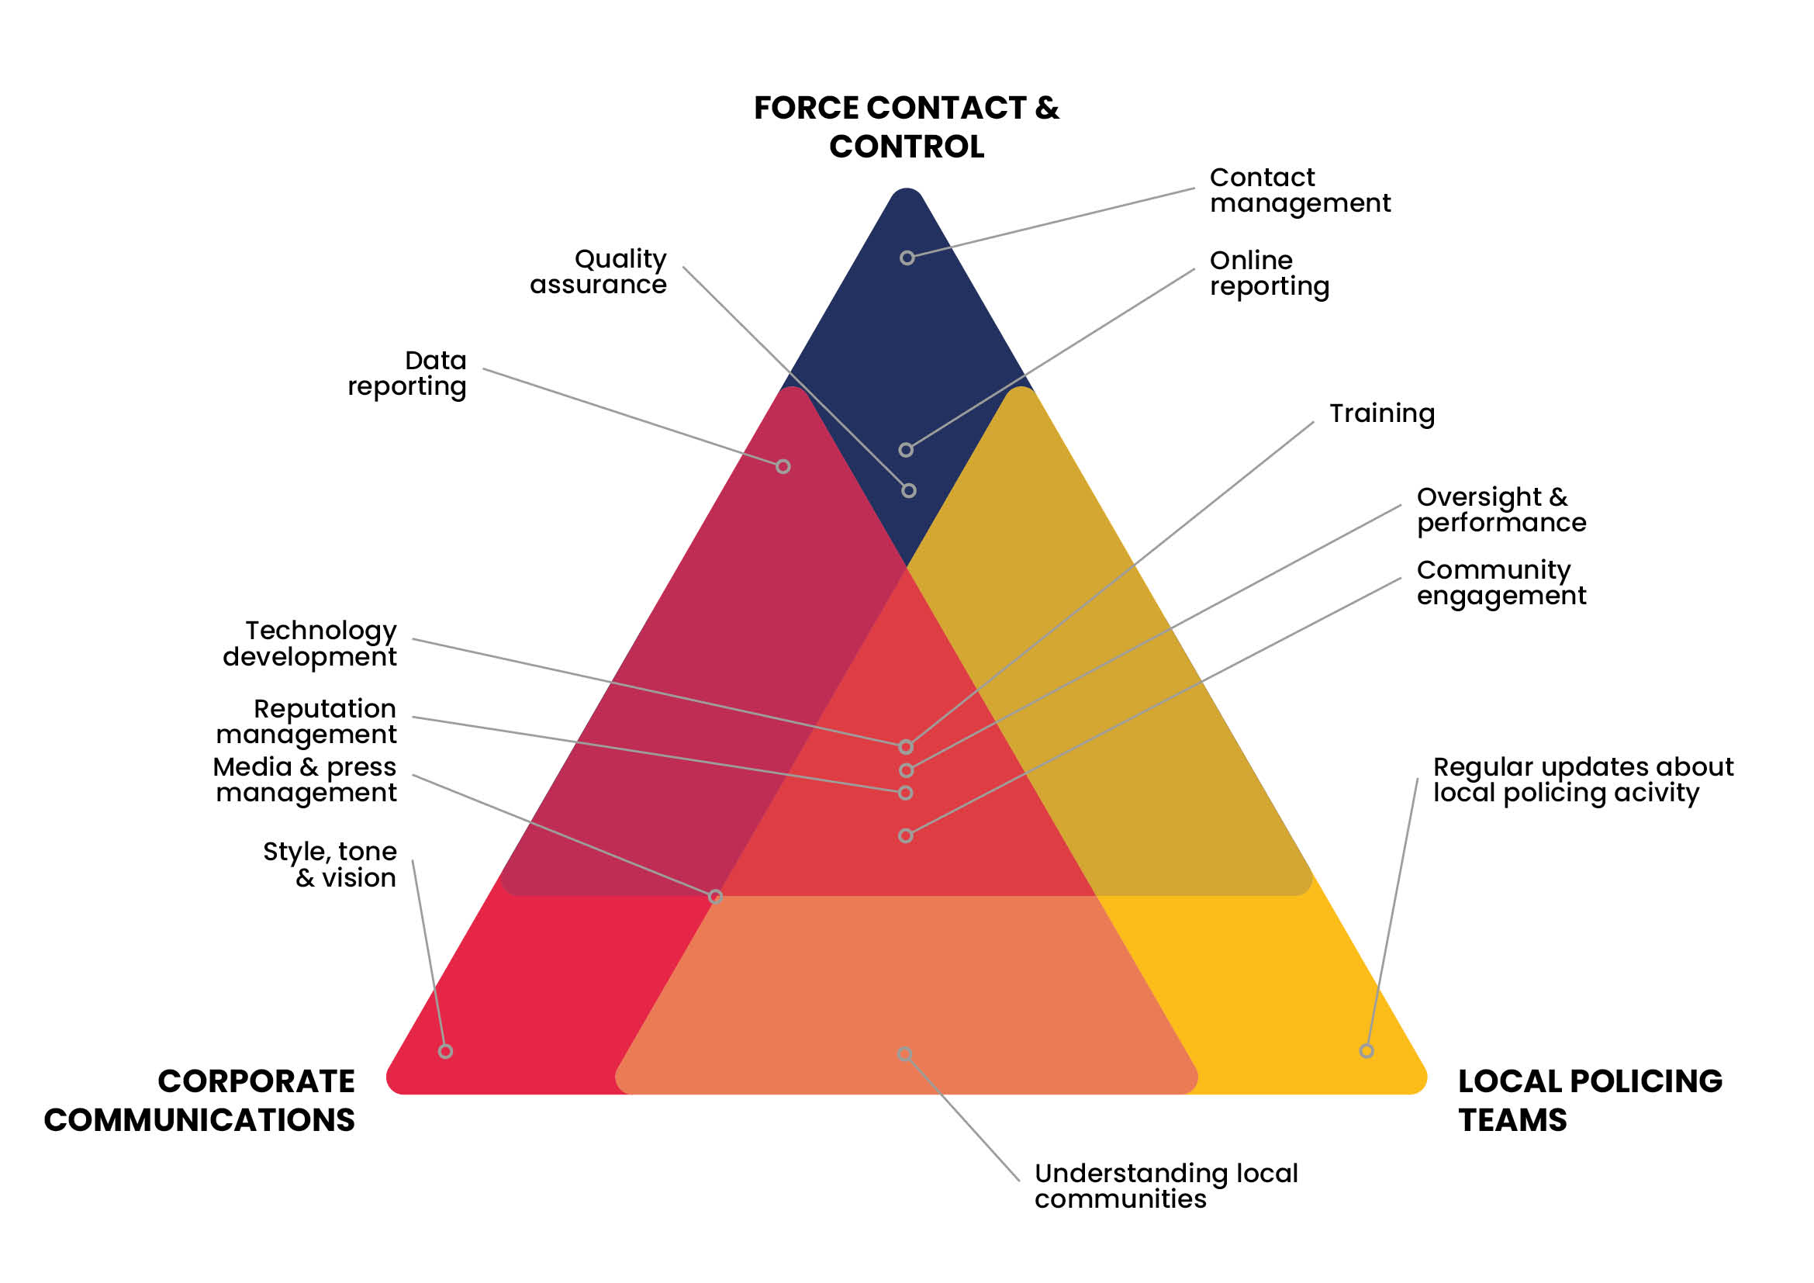
HOW WILL WE ACHIEVE OUR GOAL?
Achieving our ambition to improve engagement and accessibility is only possible if departments across the organisation understand their role in delivering a digitally inclusive service, and championing performance and continuous improvement.

Slide 6
CHANNEL MATRIX & OWNERSHIP
 | DETAILS | PERFORMANCE | OWNERSHIP
Facebook | 2 x Corporate accounts (English) 2 x Corporate accounts (Welsh) 188.2k followers Audience gender | 37.8% men & 62.2% women Audience age | 35-44 | An increase of 11.8k followers in 2025 from previous year On average 12.5k inbound messages per month In 2025 we received 152.5k inbound messages Approximately 60% of our on Facebook followers live in Gwent Newport has the highest proportion of users willing to engage, followed by Cwmbran. Sentiment of messages is predominantly neutral or negative based on Orlo interpretation | Communications - updates to communities and stakeholders FCC - method of contact
X | 1 x Corporate accounts (English) 1 x Corporate accounts (Welsh) 84.5k followers | In 2025 we received 9.6k inbound messages Sentiment of messages is predominantly neutral or negative based on Orlo interpretation | Communications - updates to communities and stakeholders Operational officers - hyper local content
Instagram | 1 x Corporate accounts (Bilingual) 27k followers Audience gender | 38.5% men & 61.5% women Audience age | 35-44 | Increase of 5K followers since last year Newport has the highest proportion of users willing to engage, followed by Cwmbran. | Communications
TikTok | 1 x Corporate accounts (English) 16.5k followers Audience gender |58% men & 42% women Audience age | 25-34 | Increase of 3.2K followers since last year In 2025 we posted 76 videos with a total number of views at 1.7m Total likes for 2025 on all videos comes to 43k | Communications
YouTube | 1 x Corporate accounts (Bilingual) 1790 subscribers | In 2025 the number of views sits at 23.3k The impressions have decreased to 264.6k In 2025. the average view duration was 1min 28s The click-through rate from other channels to YouTube is 5.1% | Communications
LinkedIn | 1 x Corporate accounts (Bilingual) 4.7k followers | Increase of 467 followers since last year Post reach and impressions have declined Post impressions has dropped to 46.9k due to a decrease in the number of posts | Communications
NBH Matters | 1 x Corporate accounts (English) 4699 subscribers | Managed by Neighbourhood Policing Teams (NPTs) Re-introduced in October 2025 | Operational officers

Slide 7
OUR JOURNEY
LEGACY | 2025 | 2026/2027 | 2028/2029 +
Where we started | Where we are now | Where we are going | Our end goal
Digital communications viewed as a ‘nice to do’ and, due to a lack of understanding, only seen as a method of one-way engagement. | Increase in use of video and engagement with our digital audiences. We are focussed on creating more creative and impactful content to constantly increase public confidence in our service. | We will develop new and existing channels to increase our reach and interaction with our communities. | Our goal is to use a multi-channel approach – where digital communications aids operational policing through good customer service and targeted communications.
No defined strategy Ad hoc approach to content generation Limited consistency around design/branding and tone of voice Minimal targeting and use of local accounts Organisational aims not woven into communications Social media management platform in place, with a dedicated social media desk Adoption of other channels (Instagram) | Defined strategy Defined social media standard operating procedure Effective content planning process Strong local following, equating to 57% of the local population Building on newer platforms such as TikTok Focus on creativity and pushing short form videos across existing channels Rollout of local Facebook channels completed to target content Focus on performance data to inform ways of working Reviewed digital social media policy Increasingly consistent design and tone of voice Increased use of digital tools to improve accessibility (subtitles on videos, for example including in Welsh and other languages when required) 200 officers and staff trained on Orlo | Implementation of strategy Refined content planning process and evaluation process Building on increasing local following, with a goal of reaching 60% of the population of Gwent Continued development of short-form videos across existing channels Building on increasing following of local Facebook channels Introduction of WhatsApp as a new digital channel Introduction of 2nd Instagram page for Welsh language content Developing YouTube and long-form videos Renewed digital audience profiles Continuous review of performance Established design and tone of voice for all content Diverse content based on local audiences Use of population data and other insights to inform how we communicate to different groups Clear misinformation/disinformation/malinformation guidance and escalation framework Establishment of network of learning and development to aid online users | Service level agreement for all digital forms of communication Review existing strategy Digital channels where we are a trusted voice Develop more tailored digital campaigns aligned to operational objectives

Slide 8
MEASURING PERFORMANCE
Delivering the objectives set out within this strategy can only be achieved through robust monitoring of key performance indicators (KPIs). All identified will adhere to the SMART principle:
Specific | Measurable | Attainable | Relevant | Timely
IDENTIFIED MEASURES | IDENTIFIED REPORTING | DESIRED OUTCOMES
followers reach engagements and engagement rate demand and inbox analysis sentiment conversion and click-through rate | bi-weekly overview of notable social media content supplied to chief officers at Strategic Force Direction meetings monthly social media performance report annual digital communication report national social media survey | learn from our successes identify areas of improvement respond effectively to new trends

Slide 9
RISKS
RISK | MITIGATION
X landscape and hateful rhetoric | We have reduced our accounts on X to two corporate accounts – Eng and Welsh. We have rolled out our local Facebook pages in place of the previous geographical and specialist X accounts which is proving fruitful with high engagement. NPCC's digital lead believes that forces at this time shouldn't come off X all together and that a corporate account should be kept as a 'warning and informing' function. We will continue to review our digital estate and monitor engagement rate.
Misinformation/disinformation/malinformation | The new Authorised Professional Practice sets out clear process for forces to tackle disinformation. Of which communications play a part. We will build our process with our Force Contact and Control to ensure misinformation is acted on quickly to ensure trust and confidence in our communities.
Social media moderation – hate comments | We have developed a social media standard operating process which includes a guide on when to disable comments. There is a national working group on social media moderation which we are involved in and will continue to review processes. We have done refresher training with the digital desk officers in the Force Contact and Control around the need to act quickly on hateful comments. We will continue to monitor our response and any further training needed.
HMIC believe that police services need to be better equipped to monitor, analyse, and utilise social media in the right way | Currently HMIC do not evaluate social media demand and how we respond to the public. The likelihood is that HMIC will start to include more audits of digital contact in the future. We will work with Force Contact and Control on training and how we can work together to improve trust and confidence.
TikTok security issues | Monitor and keep abreast of national NPCC digital communications advice. iPhone being used which is not on the GWP network.

