Slide 1



Slide 2
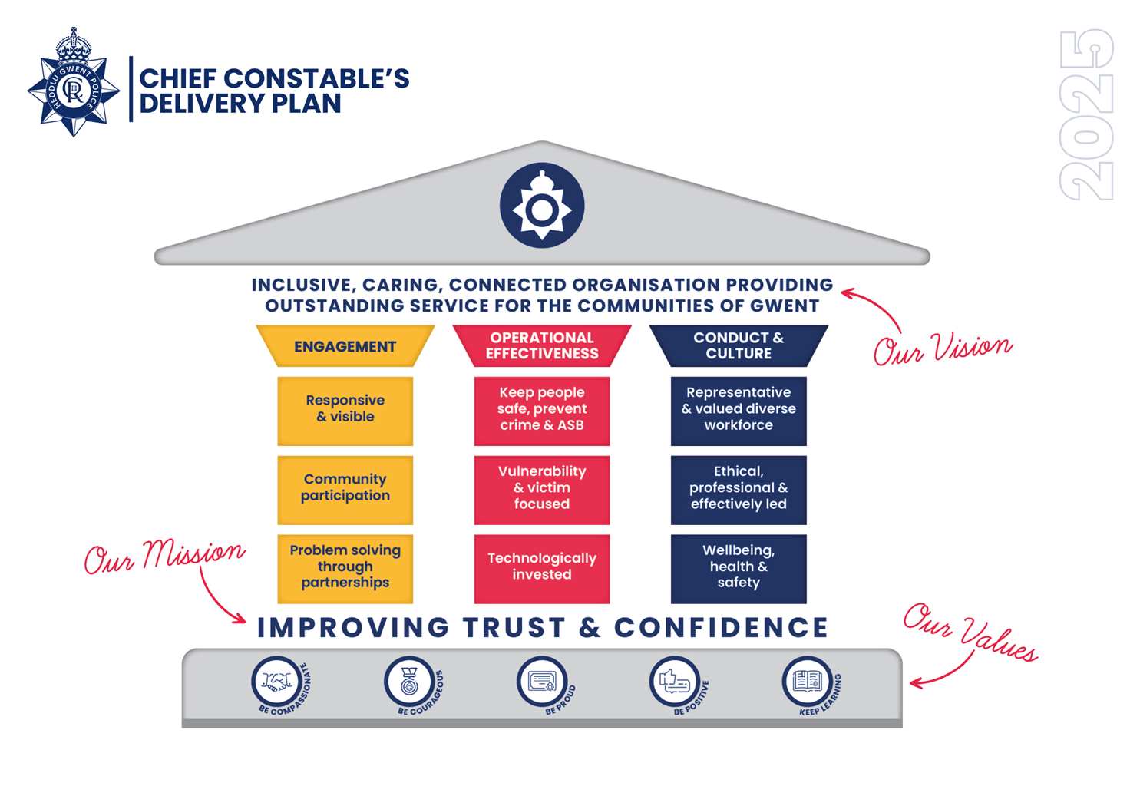

Commitment to improving Trust and Confidence
Working as one team that puts communities at the heart of everything
Engagement – Listening, involving and updating our communities
Operational Effectiveness – Delivering a service that’s responsive, visible and fair
Conduct and Culture – creating a workplace that including, caring and connected

Slide 3
Context
Context – 2025 Policing Challenges
Rising Complexity: Thousands of protests, increased cross-border responsibilities, and new Home Office requirements.
Legislative Change: Crime and Policing Bill, Sentencing Bill, Policing Reform White Paper.
Funding Pressures: Public service budgets squeezed by inflation and cost-of-living crisis.
National Priorities: Vulnerability Action Plan, Beating Crime Plan, Race Action Plan, Strategic Policing Requirement.
Community Risks: Growing hate crime and cohesion challenges.
Innovation Needed: Investment in digital tools and smarter ways of working

Slide 4

National Impact on Local Resourcing – 1st January to 1st October 2025
2025 (dates) | Operational name | Host Force |  | Officers supplied | Mutual Aid | TOTAL OFFICERS
17-19 January | Op Brocks | MET |  | 2 x PSU serial | Y | 14
8-9 August | Op Leste | NPoCC |  | 1 x PSU Commander, 2 x PSU serial | Y | 17
8 – 10 August | Palestine Coalition National Call Out | MET |  | 1 x PSU Commander, 2 x PSU L2 serial | Y | 17
23 August | Op Barrett | Avon & Somerset |  | 11 x officers PSU L2 + 1 x PO Driver | Y | 12
12-14 September | Unite The Kingdom | MET |  | 1 x PSU L2 | Y | 25

Slide 5
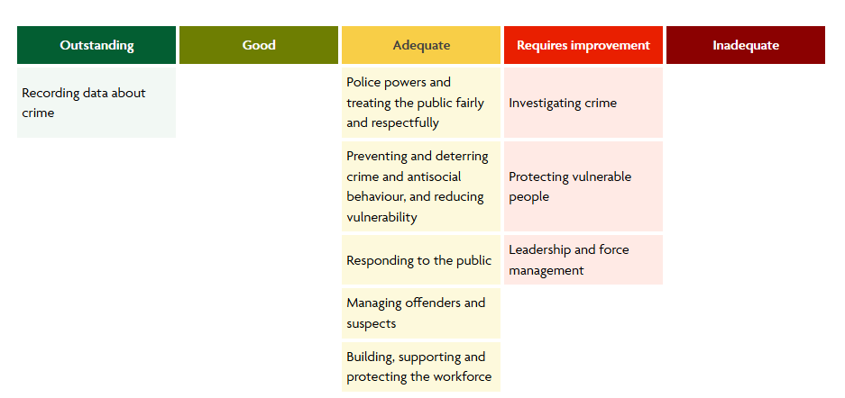
HMICFRS Peel Inspection 2025
Outstanding areas for improvement 87 down from 128 end of January 2025
2025 SOC Inspection – resulting pending
2025 Firearms Licensing Thematic Inspection (December 2025)

Slide 6

Crime Data Integrity 95.59 % compliance
Gwent Police is outstanding at recording crime.
HMICFRS estimate that Gwent Police is recording 95.6 percent (+/- 2.3 percentage points) of all reported crime (excluding fraud).
That the force is recording 94.5 percent (+/- 4.2 percentage points) of violent offences.
The force is recording 98.0 percent (+/- 2.4 percentage points) of sexual offences.

Slide 7

Quality of Investigation and Vulnerability Projects
Workstreams have been established and strategic leads assigned, governance in place for both projects.
Benchmarking has taken place with top performing forces against HMICFRS Peel Inspections.
Immediate improvements to performance reporting put in place data reviewed and performance dashboards created
Focus on working practices and process improvement
Training reviewed and refreshed programme being delivered

Slide 8
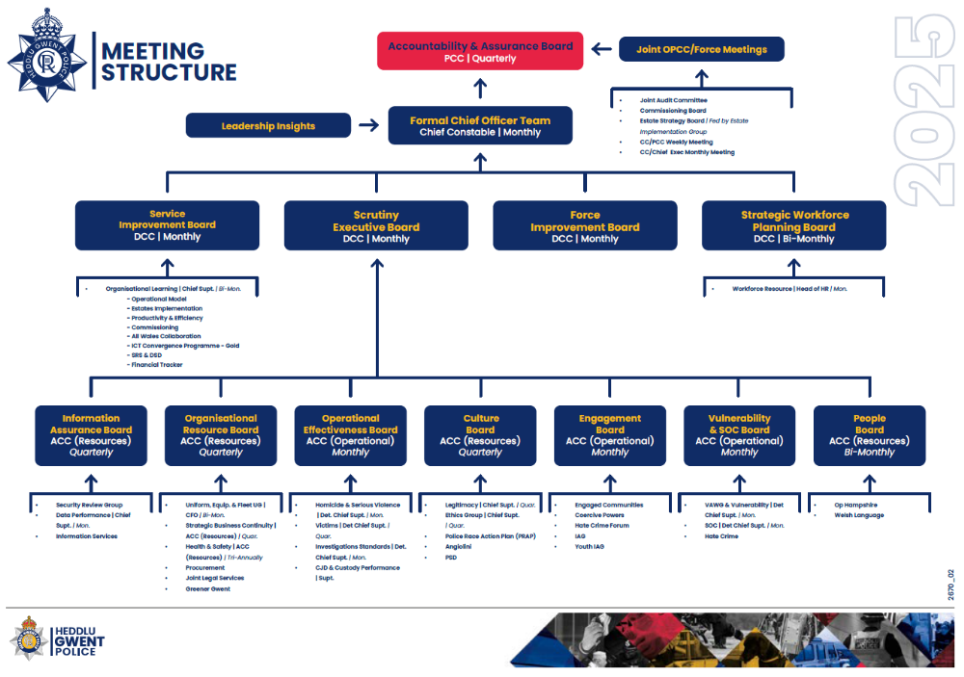
Reviewed the Force Governance Model

Slide 9
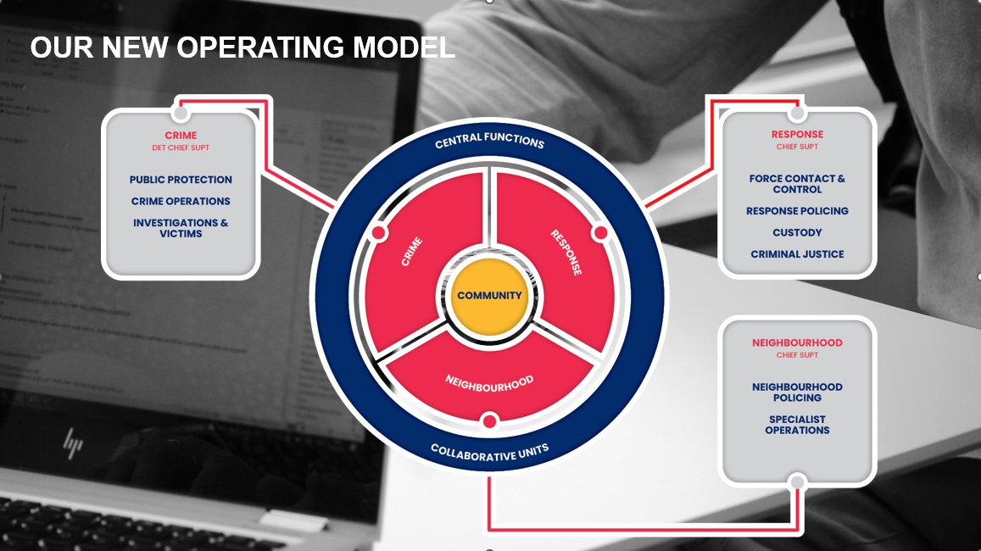
Increase Cost of the model
£701,680 recurring

Slide 10
Impact of the Community Action Team
Community Action Team CAT launched to tackle crime and ASB hotspots sits within the Neighbourhood Pillar
Launch Announcement – June 2025
Gwent Police launched the Community Action Team to tackle crime and anti-social behavior (ASB) hotspots. The team includes 16 PCs, 10 PCSOs, 2 sergeants, and is led by Inspector Laura Paget. Focus areas include illegal off-road biking, drugs, vehicle crime and increasing neighbourhood visibility.
PCC Blog – July 2025
PCC Jane Mudd highlighted CAT’s role in Caerphilly, supported by local council funding.
Early Impact – October 2025
In just four months, CAT made 120 arrests and seized over 110 vehicles. Areas targeted include Tredegar, Blackwood, Llantarnam, and Alway. The team also supported investigations into shoplifting and drug-related crimes.
Community Engagement and Expansion
29 October 2025, CAT expanded its patrols to Llantarnam, Ebbw Vale, Aberbargoed, and Bettws. The team continues to analyse crime trends and engage with communities through initiatives such as Operation Lockwood and a new community messaging service.

Slide 11

£2 million investment has resulted in 22 Police Staff being appointed releasing 22 Police Officers from supporting roles to Neighbourhood Policing posts, 6 Direct Entry Neighbourhood Police Constables, 9 Police Community Support Officers and 5 Special Constables
No national guarantee on further funding at this time

Slide 12

Op Lockwood Funding
37 Hotspots across the force area
5401additional hours (April – October 25)
50 Arrests (April – September 25)
98 Searches (April – September 25)

Slide 13
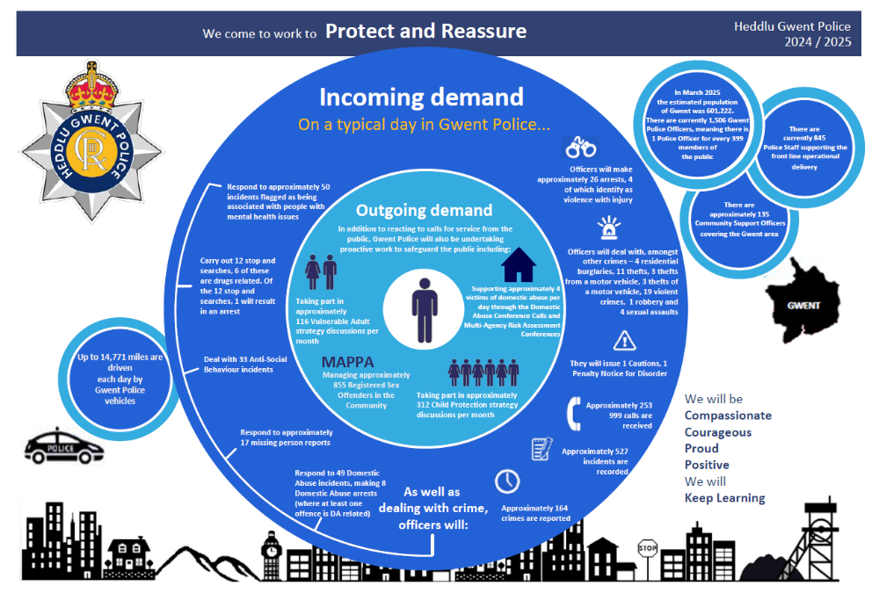
Daily Demand for Gwent Police
2024/25

Slide 14



WE HAVE: Made communities safer by
999 Calls – Answered within 10 Seconds
FYTD 2025-26: 97.0%
FYTD 2022-23: 97:0%
101 Calls – Answer Rate
FYTD 2025-26: 91.1%
FYTD 2022-23: 59.0%
101 Calls – Abandonment Rate
FYTD 2025-26: 9.0%
FYTD 2022-23: 41.0%
Crimes Under Investigation
October 2024: 10,347, a reduction of 1,432 since July 2024
This is the earliest comparable data range as this is a manual collection
Emergency Response Compliance
FYTD 2025-26: 81.5%
FYTD 2022-23: 45.8%
Routine Response Compliance
FYTD 2025-26: 86.8%
FYTD 2022-23: 30.9%
Residential Burglary of a Home Attendance
FYTD 2025-26: 96.0%
FYTD 2022-23: 75.0%

Slide 15
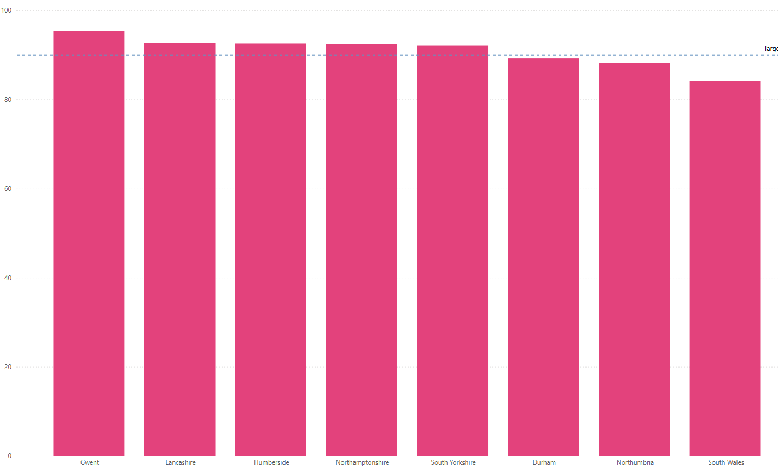
OUR FOCUS: Operational Delivery
Our Force Contact and Control continue to deliver excellent service to the public and remains in 1st place for answering 999 calls within 10 seconds against our most similar forces a position that has been held since 1st April 2023. UK wide Gwent sit consistently within the top 3.

Slide 16
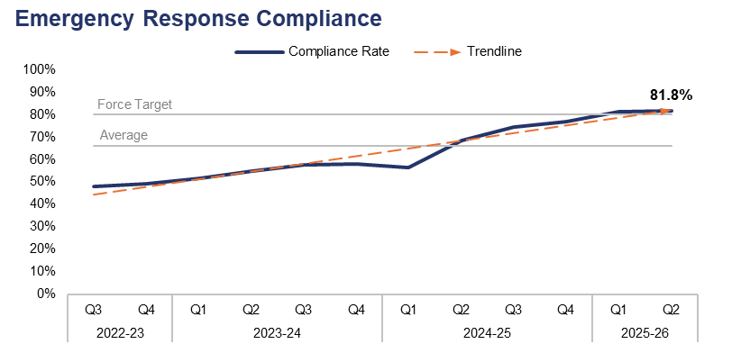
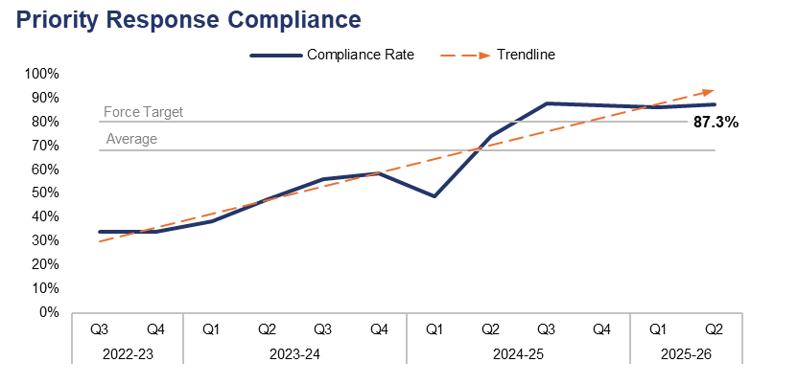


OUR FOCUS: Operational Delivery
Response Rates
The force continues to maintain the improvements seen in 2023/2024

Slide 17



We have also investigated crime and brought offenders to justice, resulting in:
Drug Offences Vs FYTD 2022-23
Increased Solved Rate by 3.4pp
Shoplifting Vs
FYTD 2022-23
Increased Solved Rate by 10.4pp
Outcome 18 Vs
FYTD 2022-23
Reduced ‘No Suspect identified’ by 2.7pp
Neighbourhood
Newly formed Community Action Team have made 120 arrests since inception
Repeat Victims Vs 12m to October 2023
Reduction of Repeat Victims by 9.2%
Robbery Vs FYTD 2022-23
Increased Solved Rate by 1.4pp
Serious Violence Vs FYTD 2022-23
Increased Solved Rate by 2.2pp
Anti Social Behaviour Vs FYTD 2022-23
Reduction of Personal ASB by 20.4%

Slide 18

Key Areas: Operational Delivery
TECHNOLOGY: M365 Power platform, Process Efficiency Project, GoodSam, Co-Pilot, AI and Innovation, Citizen First Project, Joint Data Analytics Project (JDAP)
ESTABLISHMENT PRIORITISATION: Neighbourhood Pledge, Community Action Team, DC Recruitment, Rape investigation team, Public Protection, Custody and Force Contact and Control Centre
VULNERABILITY Project Formed benchmarking with Humberside and Cheshire following HMICFRS inspection results – improvements made in compliance rates but more to do!
ESTABLISHMENT EFFICIENCIES: CDI, File Management Unit, Operational Model Board – maximizing opportunities through Neighborhood Pledge to release officers from supporting posts
NEIGHBOURHOODS: Neighborhood Strategy, Community Action Team (CAT), Safer Schools Approach, Performance Framework and governance accountability

Slide 19

Our Focus: Our People
WELLBEING STRATEGY: Embedded in organisational delivery at all levels.
OSCAR KILO: Embedded psychological screening programme and wellbeing ambassadors shortlisted to national award
Oscar kilo national survey 67% of officers report physical exhaustion, 58% emotional burnout
TRIM Process (available to all staff following a traumatic incident)
LEADERSHIP FOCUS: A comprehensive leadership programme from core leadership and first-line management to ethical and inclusive, mid-line and senior leadership development
Requirement to reduce sickness and absence rates
College of Policing – LIT Leading Inclusive Teams (behavioral science based initiative designed to foster inclusive culture within policing)
South Wales University – Hydra Programme for Leadership

Slide 20

Process efficiency through technology
Automate workflows with M365
AI CoPilot efficiency drive
Continuous Improvement: streamline Info Governance, Offender & Victim Services, Business Support
Robotic Process Automation – Niche and Info Services
Advanced Data Analytics
Citizen First- putting people at the heart of service

Slide 21
Our Challenges
Managing increasing demand SOC and Cyber anticipated demand increased and vulnerability, increases in partnership demand, increases in disclosure requests
Demand of RIT (Rape Investigation Team) Op Soteria National Programme of Improvement, self assessment feedback was positive in 2025.
Data Analytics the need/want for increased data to inform decisions and direction and the issues of data quality and supporting systems supported by investment in the joint analytics programme
Continuing the building of successful equal collaborative partnerships

Slide 22
Our Challenges
NPAS (National Police Air Support) increased costs
Taser replacement programme
Dangerous Dogs Legislation changes and local impact
Police Race Action Plan
Airwave / ESN replacement programme and timeline
ICT Convergence Programme
National Litigation challenges
Evidential Property and Training Provision
Equality Diversity and Inclusion

Slide 23

Case Study – Victim of Cyber Fraud
Mrs Edith Thomas is an 82-year-old widow living alone in a rural village in Gwent. She has limited digital literacy but uses her tablet to stay in touch with family and manage her pension online.
In June 2025, Edith received an email appearing to be from her bank, warning her of suspicious activity. The email contained a link to a fake website where she was prompted to enter her banking credentials. Within hours £4000 was withdrawn from her account.

Slide 24

Case Study – Victim of Cyber Fraud
Police Response
The local neighbourhood policing team was alerted by her carer.
A digital forensics officer was deployed to trace the IP address and gather evidence.
Officers spent over 20 hours liaising with the bank, Action Fraud, and Edith’s family.
Edith was emotionally distressed and required safeguarding support.
Impact on Resources
Cybercrime Unit: Already stretched, diverted from ongoing investigations.
Neighbourhood Team: Time spent on reassurance visits and safeguarding.
Mental Health Liaison: Called in due to Edith’s anxiety and confusion.
Multi-agency Coordination: Required with adult social care and financial institutions.
Outcome
The funds were partially recovered, but Edith remains fearful of using technology.
No suspect was apprehended due to jurisdictional issues (IP traced to overseas).
The case highlighted the need for preventative education, digital policing skills, and cross-border cooperation.

Slide 25
Risks:
Limited opportunities for savings- Police officer numbers are protected by Op Uplift and Neighbourhood Policing Pledge and PCSO numbers
Ongoing Cost of Living Crisis; on our communities and our people
Continued pressure on overtime budgets from ongoing demand
No Funding Formula introduction built into the projections.
Taser replacement – cost pressure
Sentencing review & No NPG – Significant risk if no Home Office funding
Equality Diversity and Inclusion portfolio
Assumption we will have an establishment of 1535 officers, 144 PCSOs (70 WG GP funded by GP 74) and 849.62 funded staff for the full year.

Slide 26
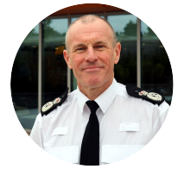
The Ask:
Support for a budget that enables further transformation, meets the legislative and national changes and challenges faced by policing and helps Gwent Police build on and restore public confidence.
Mark Hobrough
Chief Constable
Gwent Police

Slide 27



