Slide 1
Culture Within Gwent Police
ACC Nick McLain
November 2025
Notes:
Subtitle – Arial: Bold. Sentence case. 24 Pt.
Main text – Arial: Reg. Sentence case. 20 Pt.
Bullet Points – Arial: Reg. Sentence case. 20 Pt. Line Spacing 1.5.
Bold where appropriate.
Alternate slide formats between Left & Right.
Do not:
Change text colour.
Enlarge text size.
Move content over background images.

Slide 2

Culture Risk
Culture underpins public trust, internal fairness, and ethical leadership.
Current risk:
The culture within policing has been at the forefront of the media in recent times. This has related to a vast array of incidents whereby the behaviour of individuals has fallen far below the professional standards expected within policing. Gwent Police are no exception to this, and we need to be cognisant to any culture issues that are identified and deal with them promptly.
Desired outcome:
The intended outcome is that Gwent Police is an organisation whereby all its employees follow the Code of Ethics and adopt the professional behaviours and culture which the public expect.
Mitigation & control:
Force Strategy and Plan overseen by Culture Board-

Slide 3
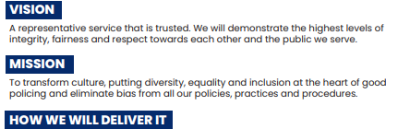
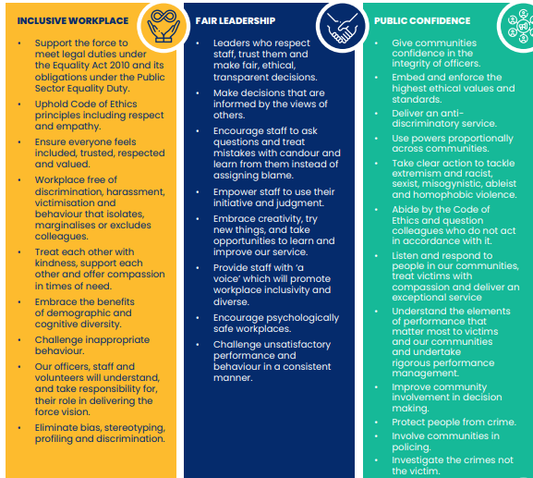
Culture Strategy and Key Indicators​
DRIVERS
Public Sector Equality Duty | Human Rights Act | National Police Race Action Plan Casey Review | National Policing Statement 2024 Violence Against Women and Girls (VAWG).

Slide 4
2025 Review- key achievements
Angiolini Recommendations - tackling misogynistic cultures
Strong progress made with local actions completed and aligned with national standards for cultural transformation- Force marked as 'Complete' and ready for Angioli 2.
CoP Leading Inclusive Teams Pilot​
The LIT pilot trained 46 sergeants with positive feedback on classroom and experiential sessions despite some engagement challenges.​
Cultural Hydra Programme​ Developed with USW
This programme offers immersive ethical training focused on reflective leadership and psychological safety in partnership with universities.​
Police Race Action Plan and Inclusion​ Meeting
Ongoing benchmarking and community engagement initiatives support the Police Race Action Plan and align with national inclusion efforts- Force Inclusion Meeting and CI Post.
Leadership Academi
Introduction of leadership courses for all first and mid-line supervisors providing the best learning opportunities for leaders to flourish, grow, and become outstanding in their practice.
National Recogniton- NPCC/APCC Summitt/ CoP Invite/ HeforShe National Conference.

Slide 5
Next Steps in 2026
Be an Upstander 2
Part 2 of the Award- winning comms campaign
Enhanced Programme Delivery​
Launch LIT Version 2, Cultural Hydra and Angiolini 2.
Sustaining Cultural Change​
Develop Culture Champions programme with governance and training to embed lasting cultural improvements.​ Analysing and responding to the EoS
New priorities-
Absence and Supervision- Focus through new governance arrangements
Rising sickness rates and supervisory anomalies highlight the need for improved absence management and supervision.
Crime Solved Rates- Investigation Quality Project
Decreases in solve rates for crime and violence against women require enhanced investigative practices.
Public Confidence and Engagement - CC's Delivery Plan
The level of public confidence is presently 61.7%.

