Slide 1
Strategy Performance Board
Quarter 3 2024-25

Slide 2
Keeping Neighbourhoods Safe
All Crime
Beating Crime Plan
Residential Burglary
Neighbourhood Crime
Public Order
Anti-Social Behaviour
Roads Policing
Key Commitments
Reduce public order offences and anti-social behaviour, and the number of people who repeatedly carry out these acts.
Reduce acquisitive crime and repeat offenders.
Improve the safety of roads throughout Gwent.
Commission and invest in effective crime prevention initiatives.

Slide 3
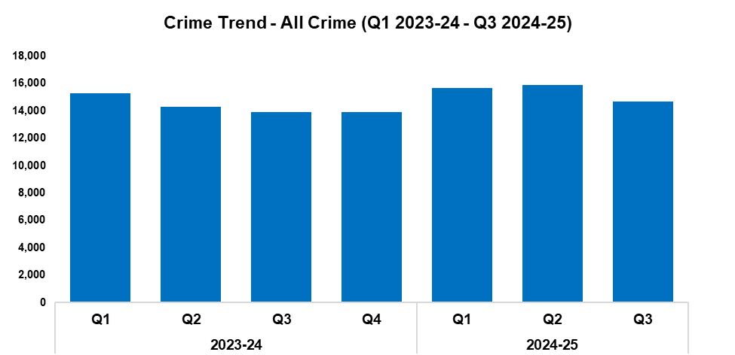
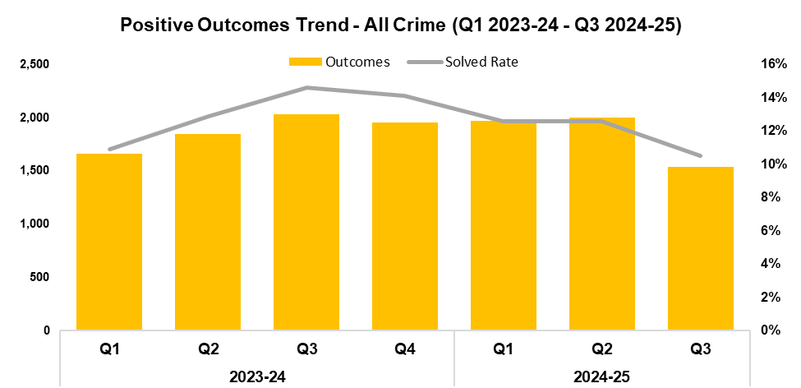
1. All Crime
2023-24 |  |  |  | 2024-25
Q1 | Q2 | Q3 | Q4 | Q1 | Q2 | Q3 | Q4
15,278 | 14,295 | 13,928 | 13,884 | 15,641 | 15,859 | 14,690 | -
2023-24 |  |  |  | 2024-25
Q1 | Q2 | Q3 | Q4 | Q1 | Q2 | Q3 | Q4
10.9% | 12.9% | 14.6% | 14.1% | 12.6% | 12.6% | 10.5% | -
Overview
Overall crime levels have fallen by 7.4% during the third quarter of the 2024-25 financial year (Q3 2024-25) when compared the quarter prior, with 1,169 fewer offences recorded for a total of 14,690. This reduction disrupts the upward trend observed following Q4 2023-24, whilst appearing to conform to seasonal trends. Conversely, an increase of 5.5% (762 additional offences) can be observed when comparing Q3 2024-25 against the same quarter during the previous financial year. In total, 46,190 offences have been recorded during the current financial year to date (FYTD). This represents an increase of 6.2% (2,689 additional offences) when compared to the previous FYTD.
When compared to the quarter prior, the overall solved rate has fallen by 2.1 percentage points to 10.5%, with 470 fewer crimes solved for a total of 1,536. This represents the lowest quarterly solved rate within the timeframe. A more prominent reduction of 4.1 percentage points can be observed when comparing the solved rate for Q3 2024-25 against the same quarter during the previous financial year, with 495 fewer crimes solved. The solved rate for the current FYTD stands at 11.9%, 0.9 percentage points below that recorded during the previous FYTD, with 38 fewer crimes solved for a total of 5,510.

Slide 4
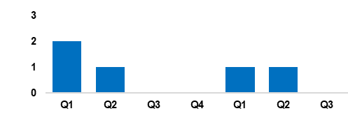
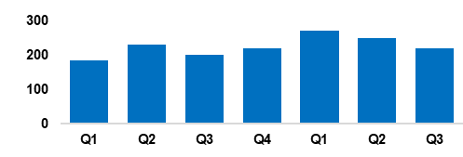
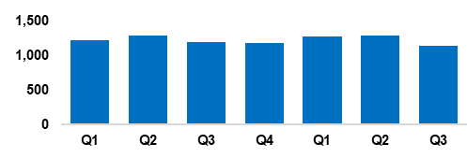
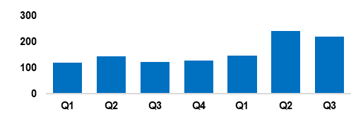
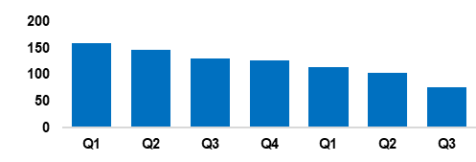
2. Beating Crime Plan
Crime Trend - Homicide (Q1 2023-24 – Q3 2024-25)
The homicide and Serious Violence Meeting is now focussing on intervention and prevention, bringing in problem solving hubs and integrating serious violence patrols along with Operation Lumley ASB patrols.
The Force has developed a knife crime performance pack as part of the violence portfolio, and whilst there have been no recent homicides in Gwent associated with knife crime, this is a national trend.
The recent discussion with the Serious Violence Duty has focussed on tackling youth violence.
Homicide
Crime Trend - Serious Violence (Q1 2023-24 – Q3 2024-25)
Gwent Police utilises a problem-solving, partnership-based approach to preventing Serious Violence.
The force’s Most Serious Violence governance and delivery has been reviewed, and recent meetings have seen focussed discussions regarding youth violence and knife crime.
Particular focus has been placed on night-time economy related violence and knife crime, with recent ‘knife sweeps’, partnerships, and amnesties receiving positive feedback from the public.
A 12% increase in knives seized during stop and searches has been recorded, compared to the previous FYTD.
Serious Violence
Crime Trend - Neighbourhood Crime (Q1 2023-24 – Q3 2024-25)
The new burglary app is being piloted in force and has undergone table-top testing in preparation for a full roll out. It is aimed at improving investigation quality.
There is a daily Criminal Investigation Department resource for burglary response and review.
Focus has been placed on hard-to-reach groups considered adversely affected by robbery, such as homeless individuals living in Newport.
Neighbourhood Crime
Crime Trend - Drug Trafficking and Supply (Q1 2023-24 – Q3 2024-25)
Drug trafficking and supply offence volume and outcome rates have been adversely affected by a significant increase in border force seizures at ports of packages bound for Gwent addresses. A regional task and finish group has been established to better understand and tackle this issue.
There has been a continued roll out of an internal communications strategy regarding the awareness of Serious Organised Crime, County Lines, and drugs. This has resulted in a strong focus on publicising operational drug enforcement activity to positively influence public confidence.
Drug Trafficking
Action Fraud Occurrences Assigned a Cyber-Enabled Local Qualifier (Q1 2023-24 – Q3 2024-25)
Cyber-volunteers are being embedded to increase specialist knowledge and boost community engagement relating to cyber crime.
The Digital Media Investigator role has been expanded, and they have been made more accessible. This has been implemented alongside the cyber volunteer programme.
Cyber awareness training has been provided to an array of front front-line departments.
Gwent is fully engaged with the All Wales Forensic Alliance Programme.
Cyber Crime

Slide 5
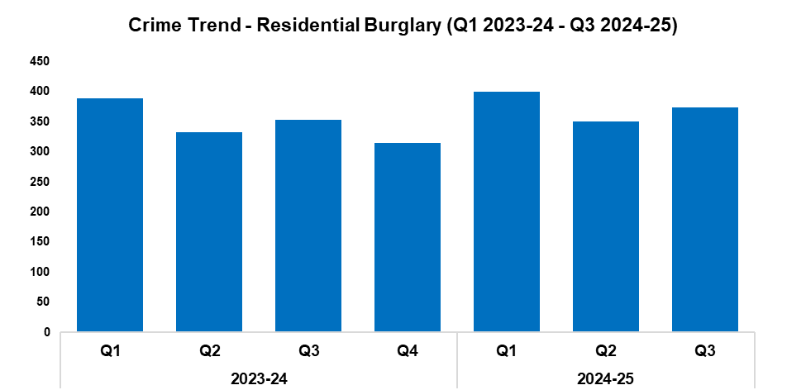
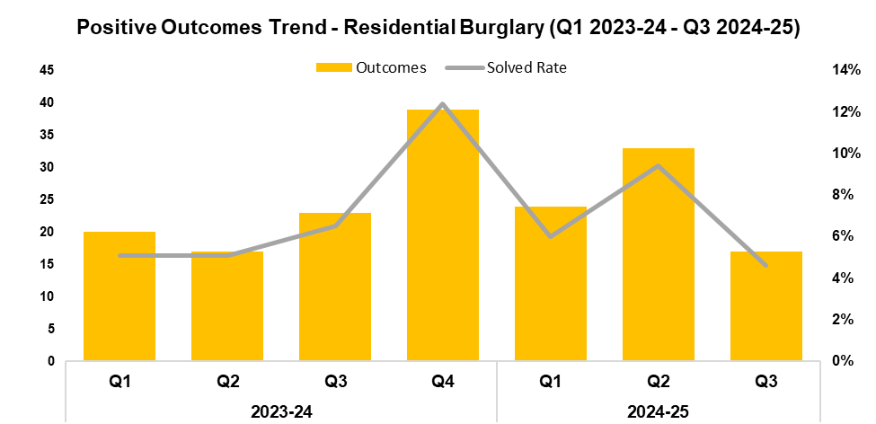
3. Residential Burglary
2023-24 |  |  |  | 2024-25
Q1 | Q2 | Q3 | Q4 | Q1 | Q2 | Q3 | Q4
389 | 332 | 353 | 315 | 400 | 351 | 373 | -
2023-24 |  |  |  | 2024-25
Q1 | Q2 | Q3 | Q4 | Q1 | Q2 | Q3 | Q4
5.1% | 5.1% | 6.5% | 12.4% | 6.0% | 9.4% | 4.6% | -
Overview
Residential Burglary offences have seen an increase of 6.3% when compared to the quarter prior, with 22 additional offences recorded for a total of 373. This continues the trend of quarterly fluctuations observed for this metric throughout the timeframe. A similar increase of 5.7% (20 additional offences) can be observed when comparing Q3 2024-25 against the same quarter during the previous financial year. In total, 1,124 offences have been recorded during the current FYTD. This represents an increase of 4.7% (50 additional offences) when compared to the previous FYTD.
When compared to the quarter prior, the solved rate for Residential Burglary offences has fallen by 4.8 percentage points to 4.6%, with 16 fewer crimes solved for a total of 17. This represents the lowest quarterly solved rate within the timeframe. A less prominent reduction of 1.9 percentage points can be observed when comparing Q3 2024-25 against the same quarter during the previous financial year, with six fewer crimes solved. Conversely, the solved rate for the current FYTD has risen by 1.0 percentage point to to 6.6% when compared to the previous FYTD, with 14 additional crimes solved for a total of 74.
During Q3 2024-25, 88.3% of incidents classified as Residential Burglary of a Home were attended. Of these incidents, 58.0% were attended within 60 minutes.

Slide 6
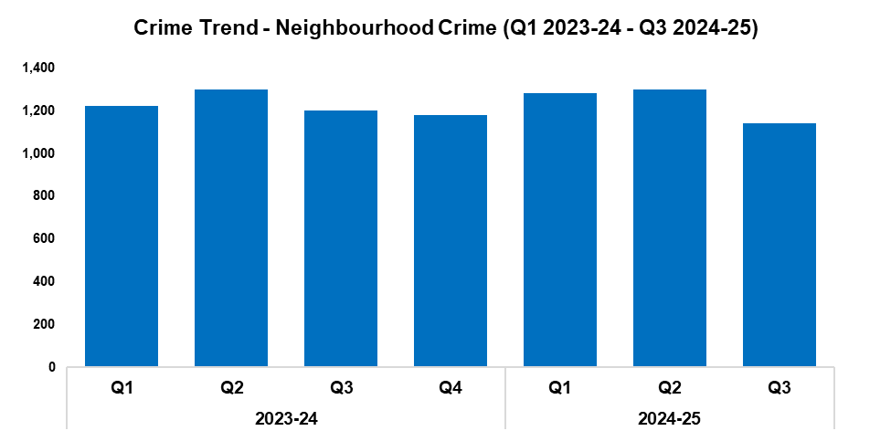
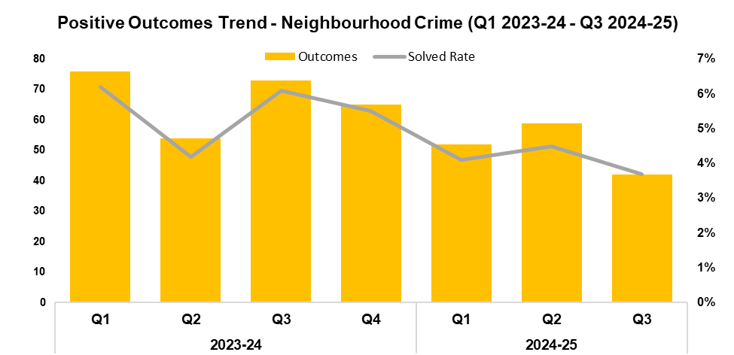
4. Neighbourhood Crime
2023-24 |  |  |  | 2024-25
Q1 | Q2 | Q3 | Q4 | Q1 | Q2 | Q3 | Q4
1,224 | 1,298 | 1,201 | 1,179 | 1,282 | 1,298 | 1,139 | -
2023-24 |  |  |  | 2024-25
Q1 | Q2 | Q3 | Q4 | Q1 | Q2 | Q3 | Q4
6.2% | 4.2% | 6.1% | 5.5% | 4.1% | 4.5% | 3.7% | -
Overview
Neighbourhood Crime offences have fallen in volume by 12.2% when compared to the quarter prior, with 159 fewer offences recorded for a total of 1,139. This disrupts the upward trend observed following Q4 2023-24, and represents the lowest quarterly figure within the timeframe. A less prominent reduction of 5.2% can be observed when comparing Q3 2024-25 against the same quarter during the previous financial year. In total, 3,719 offences have been recorded during the current FYTD. This represents a slight reduction of 0.1% (four fewer offences) when compared to the previous FYTD.
Vehicle Crime offences continued to account for the majority of Neighbourhood Crime during Q3 2024-25, comprising 57.4% of the quarterly total with 654 offences recorded.
When compared to the quarter prior, the solved rate for Neighbourhood Crime offences has fallen by 0.8 percentage points to 3.7%, with 17 fewer crimes solved for a total of 42. This represents the lowest quarterly solved rate within the timeframe. A more prominent reduction of 2.4 percentage points can be observed when comparing Q3 2024-25 against the same quarter during the previous financial year, with 31 fewer crimes solved. The solved rate for the current FYTD stands at 4.1%, a reduction of 1.4 percentage points when compared to the previous FYTD, with 50 fewer crimes solved for a total of 153.

Slide 7
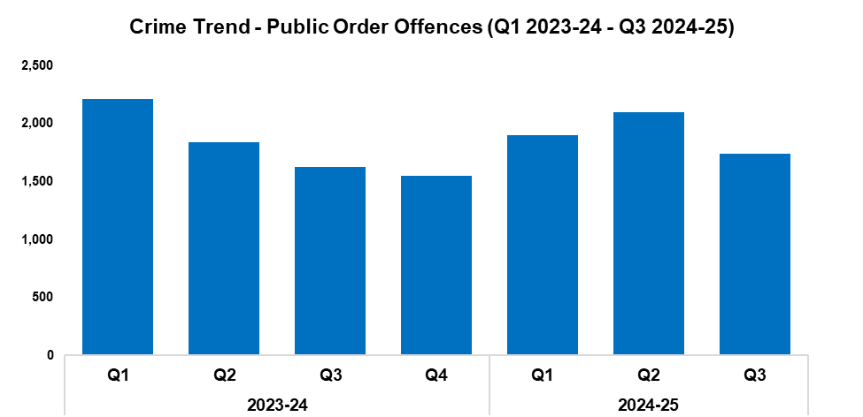
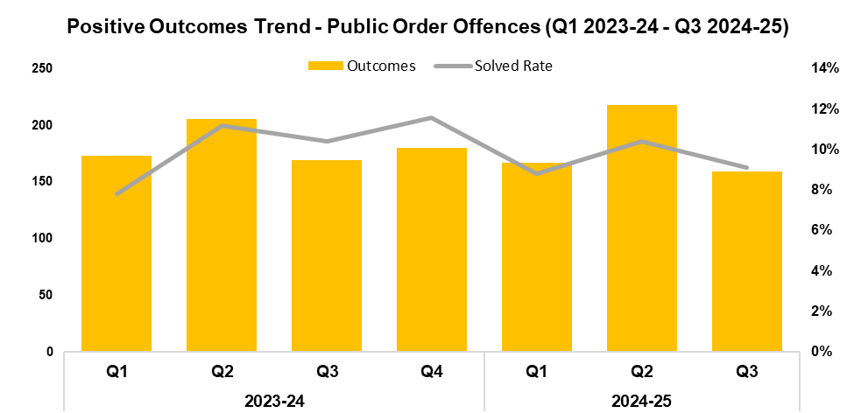
5. Public Order
2023-24 |  |  |  | 2024-25
Q1 | Q2 | Q3 | Q4 | Q1 | Q2 | Q3 | Q4
2,215 | 1,838 | 1,625 | 1,553 | 1,901 | 2,097 | 1,743 | -
2023-24 |  |  |  | 2024-25
Q1 | Q2 | Q3 | Q4 | Q1 | Q2 | Q3 | Q4
7.8% | 11.2% | 10.4% | 11.6% | 8.8% | 10.4% | 9.1% | -
Overview
Public Order Offences have seen a reduction of 16.9% when compared to the quarter prior, with 354 fewer offences recorded for a total of 1,743. This disrupts the upward trend observed following Q4 2023-24. Conversely, an increase of 7.3% (118 additional offences) can be observed when comparing Q3 2024-25 against the same quarter during the previous financial year. A total of 5,741 offences have been recorded during the current FYTD, representing a slight increase of 1.1% (63 additional offences) when compared to the previous FYTD.
As offences under Section 5 of the Public Order Act 1986 have been classified as non-notifiable by the Home Office, they have been retroactively removed from this dataset to facilitate the accurate monitoring of long-term trends.
When compared to the quarter prior, the solved rate for Public Order Offences has fallen by 1.3 percentage points to 9.1%, with 59 fewer crimes solved for a total of 159. This continues the trend of quarterly fluctuations observed for this metric throughout the timeframe. A reduction of 1.3 percentage points can also be observed when comparing Q3 2024-25 against the same quarter during the previous financial year, with 10 fewer crimes solved. The solved rate for the current FYTD stands at 9.5%, a slight reduction of 0.2 percentage points when compared to the previous FYTD, with four fewer crimes solved for a total of 544.

Slide 8
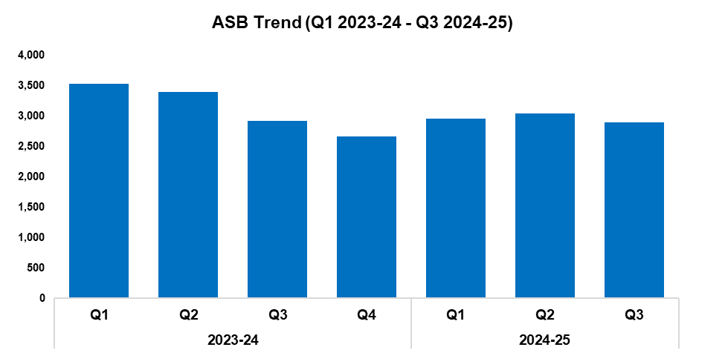
6. Anti-Social Behaviour
Overview
Levels of anti-social behaviour (ASB) in Gwent have fallen by 4.4% during Q3 2024-25 when compared to the quarter prior, with 135 fewer incidents recorded for a total of 2,900. This disrupts the upward trend observed following Q4 2023-24. A slight reduction of 0.5% (14 fewer incidents) can be observed when comparing Q3 2024-25 against the same quarter during the previous financial year. A more prominent reduction of 9.6% has been recorded when comparing the current FYTD against the previous FYTD, with 948 fewer incidents recorded for a total of 8,885.
When assessed by closing category, incidents classified as ‘ASB - Personal’ saw a reduction of 27.6% when compared to the quarter prior, with a less prominent decline of 4.4% observed for those classified as ‘ASB - Nuisance’. Conversely, incidents classified as ‘ASB - Environmental’ saw a significant increase of 56.7%, with 139 additional incidents recorded for a total of 384.
The force has received several messages of appreciation from business owners on Upper Dock Street in Newport, regarding the force’s Problem-Oriented Policing approach to ASB in the area.
2023-24 |  |  |  | 2024-25
Q1 | Q2 | Q3 | Q4 | Q1 | Q2 | Q3 | Q4
3,524 | 3,395 | 2,914 | 2,659 | 2,950 | 3,035 | 2,900 | -

Slide 9
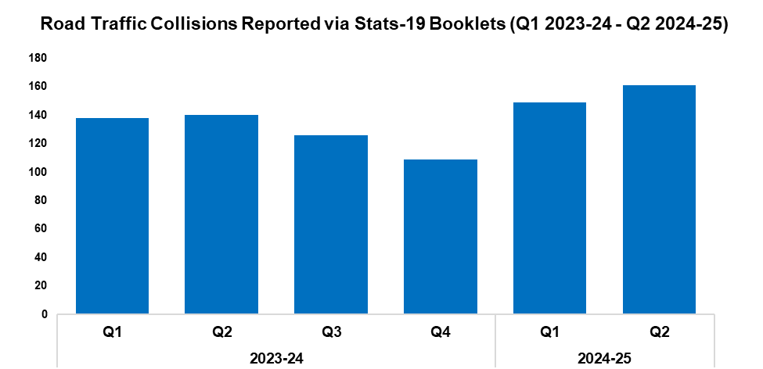
7. Roads Policing
Overview
During Q2 2024-25, 161 Road Traffic Collisions (RTCs) were reported via Stats-19 booklets. This is an increase of 8.1% (12 additional RTCs) when compared to the quarter prior, and is the highest figure within the timeframe. A more prominent increase of 15.0% (21 additional RTCs) can be observed when comparing Q2 2024-25 against the same quarter during the previous financial year. This metric is reported a quarter in arrears, due to a lag time between incidents occurring and the corresponding booklets being submitted. Measures have been implemented to address this delay, with seven booklets currently outstanding for Q2 2024-25, down from the 24 marked as such for Q1 2024-25 during the previous report.
A total of 570 individuals were reported for one of the ‘Fatal Five’* factors during Q3 2024-25, an increase of 2.2% (12 additional reports) when compared to the quarter prior. The most commonly reported factor during Q3 2024-25 was drink/drug driving, which accounted for 50.2% of all Fatal Five reports with 286 instances recorded. This was followed by careless driving, which comprised 14.4% of all Fatal Five reports with 82 instances recorded.
*The ‘Fatal Five’ refer to the five main causes of serious injury and death in RTCs. They consist of: careless driving; drink/drug driving; not wearing a seatbelt; using a mobile phone; and excessive speed.
2023-24 |  |  |  | 2024-25
Q1 | Q2 | Q3 | Q4 | Q1 | Q2 | Q3 | Q4
138 | 140 | 126 | 109 | 149 | 161 | - | -
Roads Policing and Specialist Operations (RPSO) officers are leading Operation Wheeler, a new initiative created within Gwent to tackle a rise in demand around car cruising, racing, and dangerous driving. The organisers of car cruise events have been targeted as part of this operation, with assistance from colleagues in the cyber and intelligence teams utilised to infiltrate online groups and gather intelligence. As a result, three organisers have been arrested and are due to appear in court. This tactic has also acted as a deterrent, with many other groups closing down pre-emptively.
RPSO officers are working with Newport City Council and local policing teams to implement Public Space Protection Orders at key sites across the city.

Slide 10
  Combat Serious Crime
Combat Serious Crime
Most Serious Violence
Serious Violence
VAWG Domestic Priority Offences
Drug Supply and Organised Crime
Key Commitments
Reduce the number of repeat victims of child criminal and sexual exploitation.
Increase disruption of serious organised crime, and reinvest assets seized back into communities.
Improve the overall criminal justice response to violence against women, domestic abuse and sexual violence.
Commission and invest in services that work with perpetrators of serious crime to prevent and reduce re-offending.

Slide 11
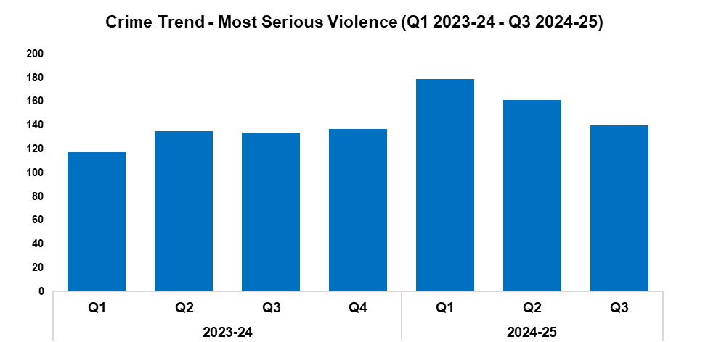
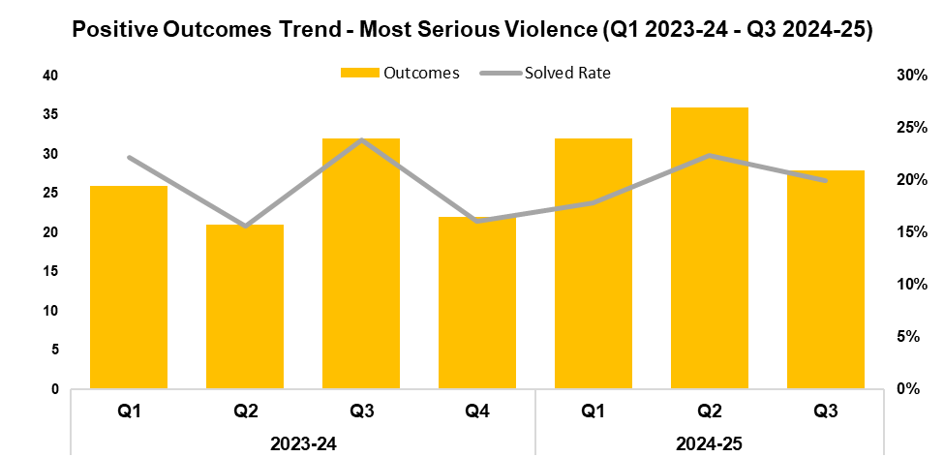
1. Most Serious Violence
2023-24 |  |  |  | 2024-25
Q1 | Q2 | Q3 | Q4 | Q1 | Q2 | Q3 | Q4
117 | 135 | 134 | 137 | 179 | 161 | 140 | -
2023-24 |  |  |  | 2024-25
Q1 | Q2 | Q3 | Q4 | Q1 | Q2 | Q3 | Q4
22.2% | 15.6% | 23.9% | 16.1% | 17.9% | 22.4% | 20.0% | -
Overview
Most Serious Violence offences consist of homicide, grievous bodily harm with intent, and causing death by dangerous driving. A reduction of 13.0% has been recorded for these offences during Q3 2024-25 when compared to the quarter prior, with 21 fewer crimes recorded for a total of 140. This establishes a downward trend following Q1 2024-25. Conversely, an increase of 4.5% (six additional offences) can be observed when comparing Q3 2024-25 against the same quarter during the previous financial year. A further increase of 24.4% has been recorded when comparing the current FYTD against the previous FYTD, with 94 additional offences reported for a total of 480.
When compared to the quarter prior, the solved rate for Most Serious Violence offences has fallen by 2.4 percentage points to 20.0%, with eight fewer crimes solved for a total of 28. This disrupts the upward trend observed following Q4 2023-24. A more prominent reduction of 3.9 percentage points can be observed when comparing Q3 2024-25 against the same quarter during the previous financial year, with four fewer crimes solved. The solved rate for the current FYTD also stands at 20.0%, a reduction of 0.5 percentage points when compared to the previous FYTD, albeit with 17 additional crimes solved for a total of 96.
During the quarter, officers responded to an incident near Maindee Police Station, wherein a male had been stabbed multiple times and the offender had fled the scene. The officers managed to treat the victim's injuries, whilst also obtaining sufficient information (a nickname) to establish a possible offender. This information was rapidly relayed to other officers, resulting in the offender being arrested approximately 40 minutes later on George Street Bridge, with the weapon being located a short distance away. The offender was charged with attempted murder the same day.

Slide 12
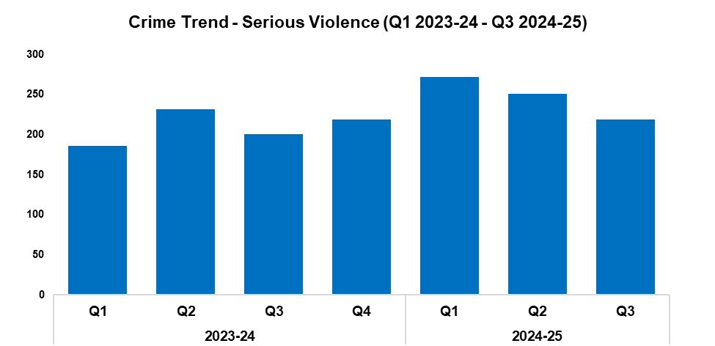
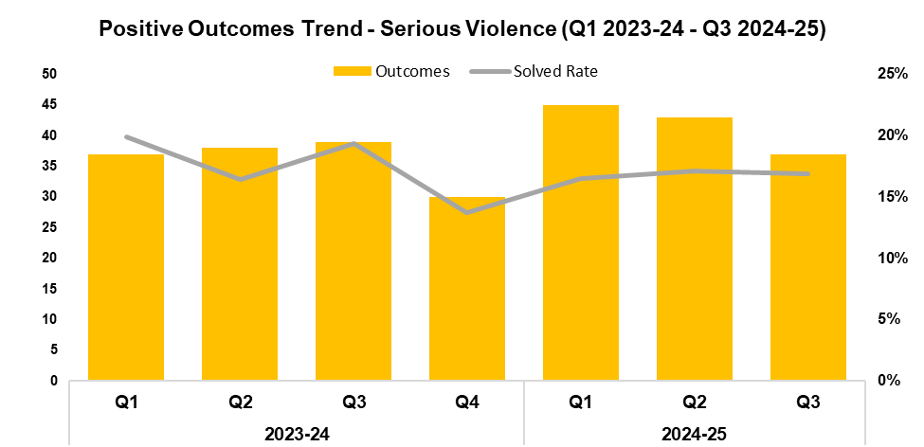
2. Serious Violence
2023-24 |  |  |  | 2024-25
Q1 | Q2 | Q3 | Q4 | Q1 | Q2 | Q3 | Q4
186 | 232 | 201 | 219 | 272 | 251 | 219 | -
2023-24 |  |  |  | 2024-25
Q1 | Q2 | Q3 | Q4 | Q1 | Q2 | Q3 | Q4
19.9% | 16.4% | 19.4% | 13.7% | 16.5% | 17.1% | 16.9% | -
Overview
Serious Violence offences consist of section 18 grievous bodily harm with intent, section 20 malicious wounding without intent, and personal robbery. These offences have seen a reduction of 12.7% during Q3 2024-25 when compared to the quarter prior, with 32 fewer offences recorded for a total of 219. This reduction establishes a downward trend following Q1 2024-25. Conversely, an increase of 9.0% (18 additional offences) can be observed when comparing Q3 2024-25 against the same quarter during the previous financial year. A further increase of 19.9% has been recorded when comparing the current FYTD against the previous FYTD, with 123 additional offences recorded for a total of 742.
When compared to the quarter prior, the solved rate for Serious Violence offences has fallen by 0.2 percentage points to 16.9%, with six fewer crimes solved for a total of 37. A more prominent reduction of 2.5 percentage points can be observed when comparing Q3 2024-25 against the same quarter during the previous financial year, with two fewer crimes solved. The solved rate for the current FYTD stands at 16.8%, a reduction of 1.6 percentage points when compared to the previous FYTD. Despite this reduction in solved rate, 11 additional crimes have been solved during the current FYTD for a total of 125.
During November, specialist officers joined the neighbourhood policing team in Pillgwenlly, Newport to carry out a weapons search as part of Operation Sceptre. Officers performed a thorough search of the hedges, undergrowth, street furniture, drains, and guttering along Francis Drive, recovering two knives and a handsaw in the process. It is hoped that the removal of these concealed or discarded weapons from the area will help prevent serious assaults and other violent crime within the local community.

Slide 13
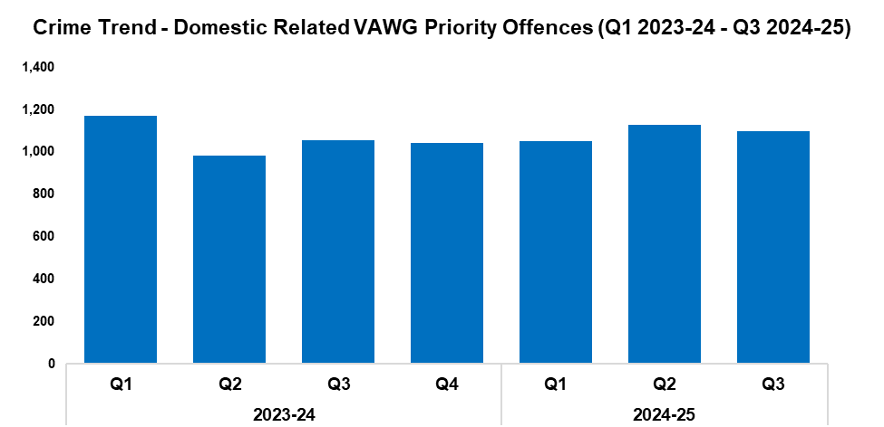
3. VAWG Domestic Priority Offences
Overview
The adjacent graph displays the number of Violence against Women and Girls (VAWG) priority offences which have been assigned a domestic abuse qualifier, have at least one female victim linked, and in which the victim and offender were both aged 16 years or over.*
During Q3 2024-25 1,098 of these offences were recorded, representing a reduction of 2.7% (30 fewer offences) when compared to the quarter prior. This disrupts the upward trend observed following Q4 2023-24. Conversely, an increase of 4.2% (44 additional offences) can be observed when comparing Q3 2024-25 against the same quarter during the previous financial year. In total, 3,276 offences have been recorded during the current FYTD. This represents an increase of 2.1% (68 additional offences) when compared to the previous FYTD.
679 females have been linked as a victim in more than one VAWG domestic priority offence within the last 12 months,** whereas 15 females have been linked as a victim in more than five separate offences.
During the last 12 months,** there were 461 female offenders and 2,820 male offenders linked to domestic priority offences against females.
*Domestic priority areas include Homicide, Violence with Injury, Stalking and Harassment, Public Fear, Alarm or Distress, Rape, Other Sexual Offences, and Modern Slavery.
**Up to the end of Q3 2024-25
2023-24 |  |  |  | 2024-25
Q1 | Q2 | Q3 | Q4 | Q1 | Q2 | Q3 | Q4
1,171 | 983 | 1,054 | 1,043 | 1,050 | 1,128 | 1,098 | -

Slide 14
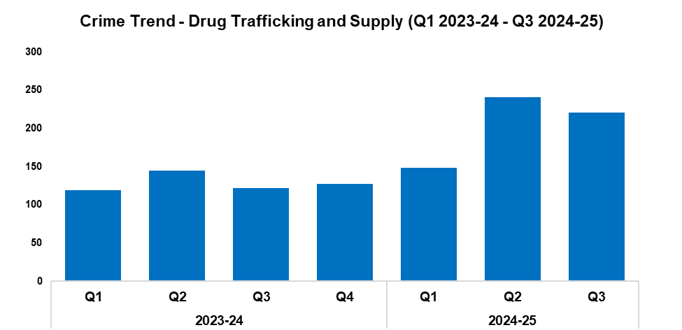
4. Drug Supply and Organised Crime
Overview
Drug Trafficking and Supply offences have seen a reduction of 8.3% during Q3 2024-25 when compared to the quarter prior, with 20 fewer offences recorded for a total of 221. This disrupts the upward trend observed following Q3 2023-24, but remains the second-highest quarterly figure within the timeframe. Over half of these offences related to drugs importation or border force seizures, accounting for 55.2% of the quarterly total (122 offences). A significant increase of 81.1% (99 additional offences) can be observed when comparing Q3 2024-25 against the same quarter during the previous financial year. In total, 610 offences have been recorded during the current FYTD, an increase of 58.0% (224 additional offences) when compared to the previous FYTD.
A total of 2,165 Drug Supply and Dealing intelligence logs were submitted during Q3 2024-25. Whilst this represents a reduction of 7.4% (172 fewer logs) when compared to the quarter prior, it remains the second-highest quarterly figure within the timeframe. An increase of 3.8% (80 additional logs) can be observed when comparing Q3 2024-25 against the same quarter during the previous financial year. In total, 6,505 logs have been submitted during the current FYTD, an increase of 23.2% (1,227 additional logs) when compared to the previous FYTD.
2023-24 |  |  |  | 2024-25
Q1 | Q2 | Q3 | Q4 | Q1 | Q2 | Q3 | Q4
119 | 145 | 122 | 127 | 148 | 241 | 221 | -
Six members of a Newport drug gang were sentenced to a combined total of over 52 years in prison during December, after pleading guilty to a number of drug offences. This is the result of Operation Silver, a year-long covert operation which culminated in the largest enforcement operation in the force’s history, involving 80 firearms officers and over 100 supporting officers and staff. Five warrants were carried out during September at buildings across Newport and Cardiff, resulting in the seizure of five vehicles, multiple phones, over a million lignocaine and paracetamol tablets, and drugs with a street value of approximately £138,000.
Five members of a Newport-based organised crime group were sentenced to a combined total of over 21 years in prison, after they pleaded guilty to conspiring to supply class A controlled drug – cocaine. A sixth member is currently awaiting sentencing. As part of Operation Biggin, officers had carried out warrants at multiple addresses in Newport, resulting in the seizure of 15 mobile phones. Upon analysis, these phones revealed that two members of the group were responsible for controlling a drugs line, via which they had trafficked almost 3kg of cocaine between 2023 and 2024. The other four members of the group were involved in the sale of these drugs to users across Newport, Cwmbran, and Pontypool.
During November, officers conducted a raid at a disused commercial premises on Chepstow High Street as part of Operation Altar. Within, they discovered a large cannabis cultivation which spanned five floors, and seized 652 plants worth an estimated £182,560. The offender has been sentenced to 12 months imprisonment after pleading guilty to the production of cannabis.
Operation Firecrest has been run via a partnership between Gwent Police and Newport City Council Trading Standards. Since the operation began in October 2023, closure orders have been issued against more than 50 premises which sold illegal vapes and tobacco products. In addition, more than 330,000 illegal cigarettes and 23,000 illegal vapes have been seized, with an estimated market value of almost two million pounds. These measures serve to deny organised crime groups in the area a potential source of income.

Slide 15
Support Victims and Protect the Vulnerable
Hate Crime
Rape
Domestic Related Crime
Domestic Abuse Repeat Victims/Offenders
Modern Day Slavery and Human Trafficking
Child Sexual Exploitation/Child Criminal Exploitation
Cyber Fraud
Victim Support/Repeat Victims
Key Commitments
Improve victim services and ensure that the needs of victims are identified and responded to appropriately through Connect Gwent and the Victim Care Unit.
Further improve our work with partners to protect those most vulnerable.
Increase the timeliness of police investigation updates provided to victims.
Commission and invest in specialist services to support victims throughout the criminal justice process.

Slide 16
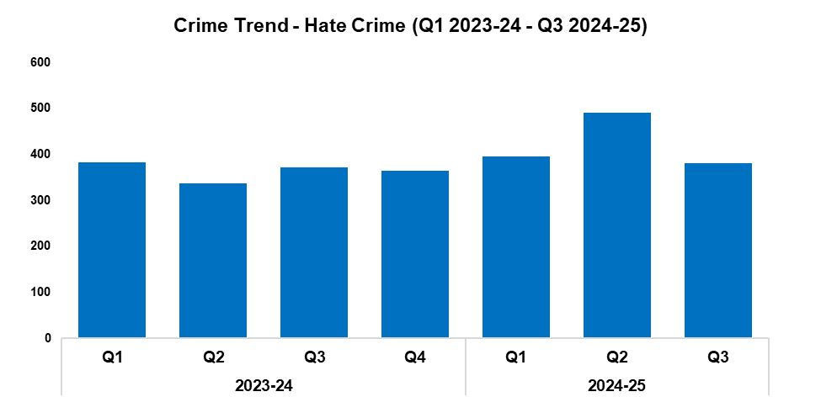
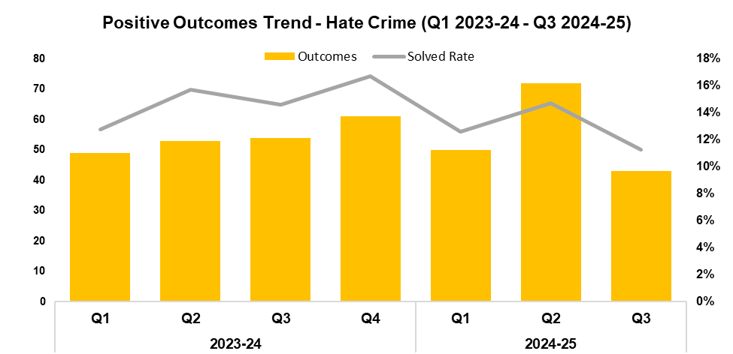
1. Hate Crime
2023-24 |  |  |  | 2024-25
Q1 | Q2 | Q3 | Q4 | Q1 | Q2 | Q3 | Q4
382 | 337 | 371 | 365 | 396 | 490 | 381 | -
2023-24 |  |  |  | 2024-25
Q1 | Q2 | Q3 | Q4 | Q1 | Q2 | Q3 | Q4
12.8% | 15.7% | 14.6% | 16.7% | 12.6% | 14.7% | 11.3% | -
Overview
The volume of offences classified as hate crimes has fallen by 22.2% during Q3 2024-25 when compared to the quarter prior, with 109 fewer offences recorded for a total of 381. This disrupts the upward trend observed following Q4 2023-24. Offences containing the disability hate strand saw the largest increase, rising by 25.0% (17 additional offences for a total of 85), whereas those containing the religious hate strand saw the largest reduction, falling by 41.7% (10 fewer offences for a total of 14). An increase of 2.7% (10 additional offences) can be observed when comparing Q3 2024-25 against the same quarter during the previous financial year. In total, 1,267 offences have been recorded during the current FYTD. This represents an increase of 16.2% (177 additional offences) when compared to the previous FYTD.
When compared to the quarter prior, the solved rate for hate crime offences has fallen by 3.4 percentage points to 11.3%, with 29 fewer crimes solved for a total of 43. This continues the trend of quarterly fluctuations observed for this metric throughout the timeframe. A similar reduction of 3.3 percentage points can be observed when comparing Q3 2024-25 against the same quarter during the previous financial year, with 11 fewer crimes solved. The solved rate for the current FYTD stands at 13.0%. Whilst this represents a reduction of 1.3 percentage points when compared to the previous FYTD, nine additional crimes have been solved for a total of 165.
The equality, diversity and inclusion (EDI) team provided inputs on hate crime to schools and hospitals across Gwent, in order to improve awareness of what constitutes a hate crime, and how to report them. The independent advisory group (IAG) attended this quarter’s Hate Crime Scrutiny Panel, providing an independent perspective on how the force tackles hate crime.
A single crime can have multiple hate strands. The crime trend is based on recorded crimes, whilst the assessment of hate strands is based on the volume of each individual strand.

Slide 17
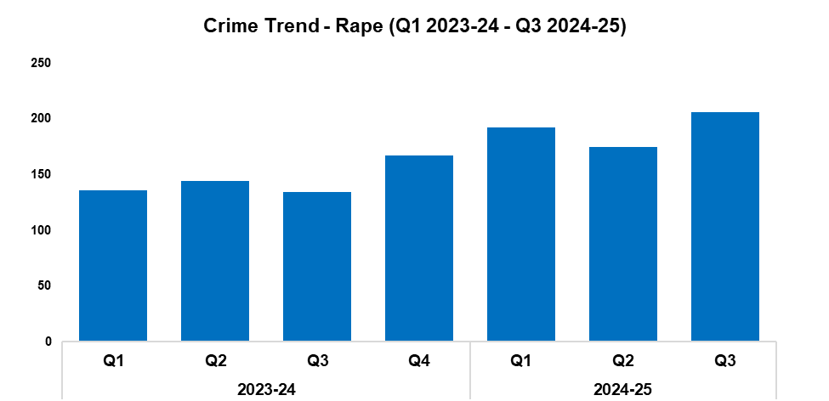
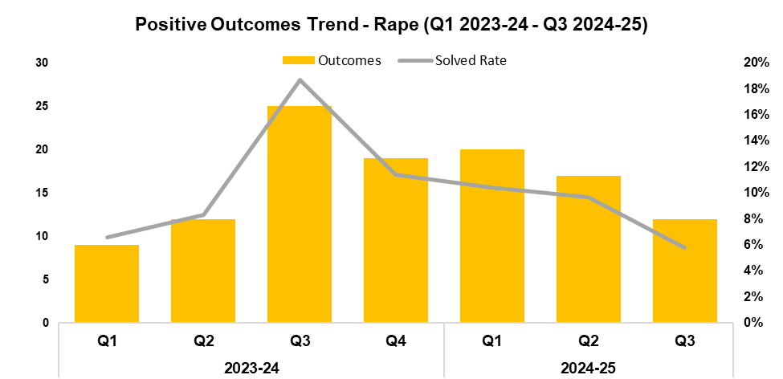
2. Rape
2023-24 |  |  |  | 2024-25
Q1 | Q2 | Q3 | Q4 | Q1 | Q2 | Q3 | Q4
136 | 144 | 134 | 167 | 192 | 175 | 206 | -
2023-24 |  |  |  | 2024-25
Q1 | Q2 | Q3 | Q4 | Q1 | Q2 | Q3 | Q4
6.6% | 8.3% | 18.7% | 11.4% | 10.4% | 9.7% | 5.8% | -
Overview
The number of recorded Rape offences has risen by 17.7% during Q3 2024-25 when compared to the quarter prior, with 31 additional offences recorded for a total of 206. This represents the highest quarterly figure within the timeframe for this historically under-reported crime category. A more prominent increase of 53.7% (72 additional offences) can be observed when comparing Q3 2024-25 against the same quarter during the previous financial year. In total, 573 offences have been recorded during the current FYTD. This represents an increase of 38.4% (159 additional offences) when compared to the previous FYTD.
When compared to the quarter prior, the solved rate for Rape offences has fallen by 3.9 percentage points to 5.8%, with five fewer crimes solved for a total of 12. This continues the downward trend observed following Q3 2023-24. A more prominent reduction of 12.9 percentage points can be observed when comparing Q3 2024-25 against the same quarter during the previous financial year, with 13 fewer crimes solved. The solved rate for the current FYTD stands at 8.6%. Whilst this represents a reduction of 2.5 percentage points when compared to the previous FYTD, three additional crimes have been solved for a total of 49.

Slide 18
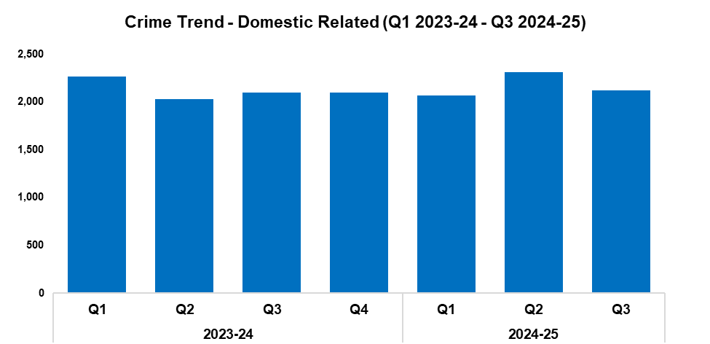
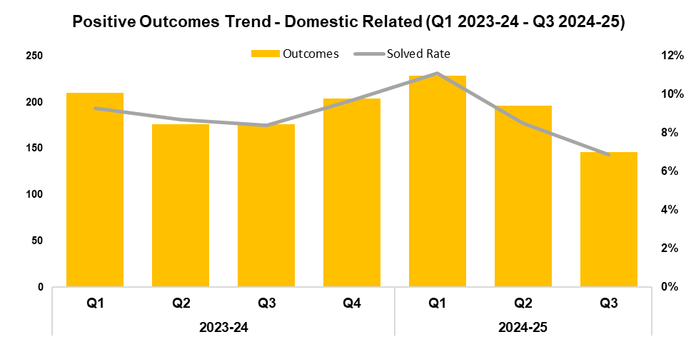
3. Domestic Related Crime
2023-24 |  |  |  | 2024-25
Q1 | Q2 | Q3 | Q4 | Q1 | Q2 | Q3 | Q4
2,264 | 2,026 | 2,101 | 2,095 | 2,070 | 2,312 | 2,119 | -
2023-24 |  |  |  | 2024-25
Q1 | Q2 | Q3 | Q4 | Q1 | Q2 | Q3 | Q4
9.3% | 8.7% | 8.4% | 9.7% | 11.1% | 8.5% | 6.9% | -
Overview
Domestic related offences have seen a reduction of 8.3% when compared to the quarter prior, with 193 fewer offences recorded for a total of 2,119. Conversely, a slight increase of 0.9% (18 additional offences) can be observed when comparing Q3 2024-25 against the same quarter during the previous financial year. In total, 6,501 offences have been recorded during the current FYTD, an increase of 1.7% (110 additional offences) when compared to the previous FYTD.
When compared to the quarter prior, the solved rate for domestic related offences has fallen by 1.6 percentage points to 6.9%, with 50 fewer crimes solved for a total of 146. This establishes a downward trend following Q1 2024-25, and represents the lowest quarterly solved rate within the timeframe. A similar reduction of 1.5 percentage points can be observed can comparing Q3 2024-25 against the same quarter during the previous financial year, with 30 fewer crimes solved. The solved rate for the current FYTD stands at 8.8%, equal to that recorded during the previous FYTD, albeit with nine additional crimes solved for a total of 571.
This data only includes offences in which the victim and offender were both aged 16 or over at the time of the offence, as specified in the Domestic Abuse Act 2021, or where the victim or offender do not have a determined age.

Slide 19
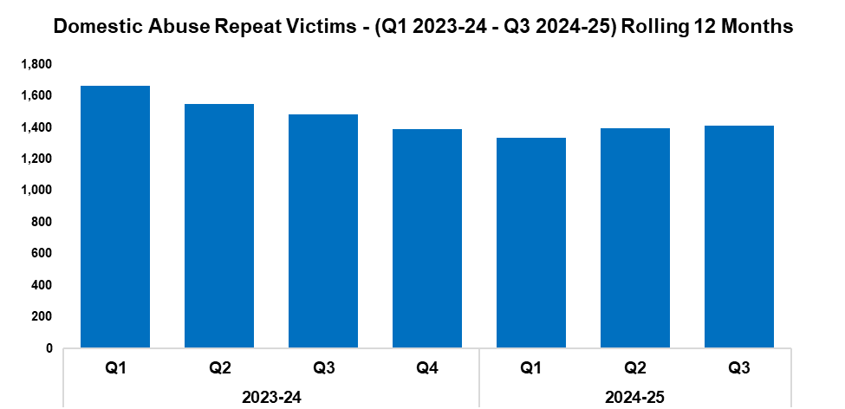
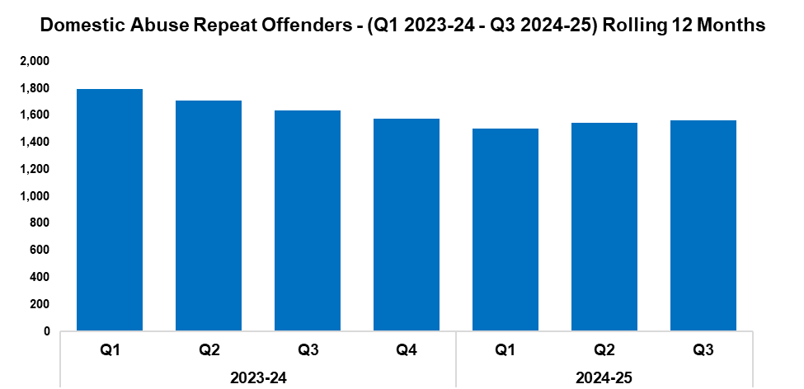
4. Domestic Abuse Repeat Victims/Offenders
2023-24 |  |  |  | 2024-25
Q1 | Q2 | Q3 | Q4 | Q1 | Q2 | Q3 | Q4
1,665 | 1,548 | 1,485 | 1,390 | 1,336 | 1,396 | 1,413 | -
2023-24 |  |  |  | 2024-25
Q1 | Q2 | Q3 | Q4 | Q1 | Q2 | Q3 | Q4
1,795 | 1,709 | 1,634 | 1,575 | 1,503 | 1,543 | 1,562 | -
Overview
The number of repeat domestic abuse victims* has increased by 1.2% when comparing Q3 2024-25 against the quarter prior, with 17 additional repeat victims recorded for a total of 1,413. This establishes an upward trend following Q1 2024-25. Conversely, a reduction of 4.8% (72 fewer repeat victims) can be observed when comparing Q3 2024-25 against the same quarter during the previous financial year. A total of 4,145 repeat victims have been recorded when combining the quarterly figures for the current FYTD, a reduction of 11.8% (553 fewer repeat victims) when compared to the previous FYTD.
The number of repeat domestic abuse offenders* has also risen by 1.2% when comparing Q3 2024-25 against the quarter prior, with 19 additional repeat offenders recorded for a total of 1,562. As with repeat victims, this establishes an upward trend following Q1 2024-25, with both metrics appearing closely aligned throughout the timeframe. A reduction of 4.4% (72 fewer repeat offenders) can be observed when comparing Q3 2024-25 against the same quarter during the previous financial year. A total of 4,608 repeat offenders have been recorded when combining the quarterly figures for the current FYTD, a reduction of 10.3% (530 fewer repeat offenders) when compared to the previous FYTD.
There is a Multi-Agency Tasking and Coordination (MATAC) process in place which focuses on identifying serial perpetrators of domestic abuse, in order to limit the risk of them reoffending. A range of interventions can be delivered via MATAC to safeguard victims and families, including support, prevention, diversion, disruption, and enforcement.
This data only includes offences in which the victim and offender were both aged 16 or over at the time of the offence, as specified in the Domestic Abuse Act 2021.
*Based on rolling 12 months to the end of each quarter, where persons are linked in this capacity to two or more crimes within this period.

Slide 20
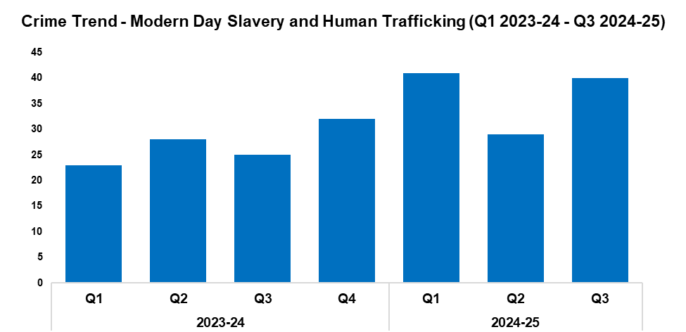
5. Modern Day Slavery and Human Trafficking
Overview
Modern Day Slavery and Human Trafficking offences have seen an increase of 37.9% during Q3 2024-25 when compared to the quarter prior, with 11 additional offences recorded for a total of 40. This represents the second-highest quarterly figure within the timeframe. A more prominent increase of 60.0% (15 additional offences) can be observed when comparing Q3 2024-25 against the same quarter during the previous financial year. A total of 110 offences have been recorded during the current FYTD. This represents an increase of 44.7% when compared to the previous FYTD, with 34 additional offences reported.
Awareness training is being delivered to new starters, new community support officers, and trainee detectives.
The number of National Referral Mechanisms (NRMs) which have been submitted has risen by 55.2% during Q3 2024-25 when compared to the quarter prior, with 16 additional referrals submitted for a total of 45. This represents the highest quarterly figure within the timeframe. A more prominent increase of 73.1% (19 additional referrals) can be observed when comparing Q3 2024-25 against the same quarter during the previous financial year. A total of 116 NRMs have been submitted during the current FYTD. This represents an increase of 52.6% when compared to the previous FYTD, with 40 additional referrals submitted.
2023-24 |  |  |  | 2024-25
Q1 | Q2 | Q3 | Q4 | Q1 | Q2 | Q3 | Q4
23 | 28 | 25 | 32 | 41 | 29 | 40 | -

Slide 21
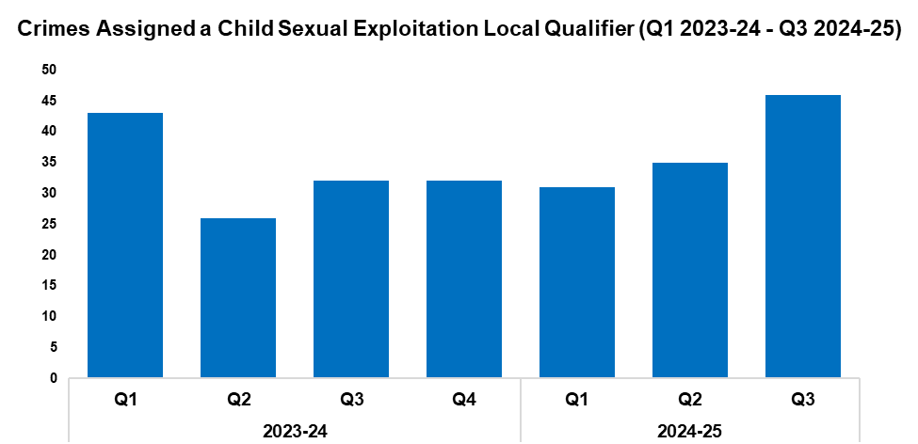
6. Child Sexual Exploitation/Child Criminal Exploitation
Overview
The number of crimes assigned a Child Sexual Exploitation (CSE) local qualifier has risen by 31.4% during Q3 2024-25 when compared to the quarter prior, with 11 additional crimes recorded for a total of 46. This represents the highest quarterly figure within the timeframe, establishing an upward trend following Q1 2024-25. A further increase of 43.8% (14 additional crimes) can be observed when comparing Q3 2024-25 against the same quarter during the previous financial year. A less prominent increase of 10.9% has been recorded when comparing the current FYTD against the previous FYTD, with 11 additional crimes reported for a total of 112.
The offence most commonly assigned a CSE local qualifier during Q3 2024-25 was ‘take/make indecent photographs/pseudo-photographs of children’, with 16 instances recorded. This accounted for 34.8% of all crimes assigned a CSE local qualifier during the quarter.
2023-24 |  |  |  | 2024-25
Q1 | Q2 | Q3 | Q4 | Q1 | Q2 | Q3 | Q4
43 | 26 | 32 | 32 | 31 | 35 | 46 | -
Operation Helsinki was a proactive intelligence led operation which commenced in April 2024. The initial investigation concerned the possession and distribution of indecent images of children. During the execution of a warrant officers discovered child abuse videos on the suspect’s devices which had not previously been identified as being in circulation. These ‘first generation’ images were of a male sexually assaulting two children. The suspect was arrested, charged, and remanded into custody. As the suspect remained ‘no comment’ in interviews, a significant number of digital enquiries were completed in order to attribute the devices to him and identify the suspect and children within the images. Given that the children provided no evidence or account, this was an evidence-led investigation which resulted in the offender pleading guilty to over 15 charges, including three counts of rape of a child under 13, attempted rape of child under 13, inciting a child to engage in sexual activity, and the possession and distribution of indecent images of children. This case was considered particularly harrowing, as chat messages were recovered in which the offender had bragged about the abuse, and distributed videos of the rapes to other paedophiles around the world. He also had a sexual interest in other identified children, who have now been safeguarded. On 23rd December 2024 the offender was given a life sentence, with a minimum term of 14 years. There was local and national media coverage of this case, with the force receiving positive comments from members of the public via social media.

Slide 22
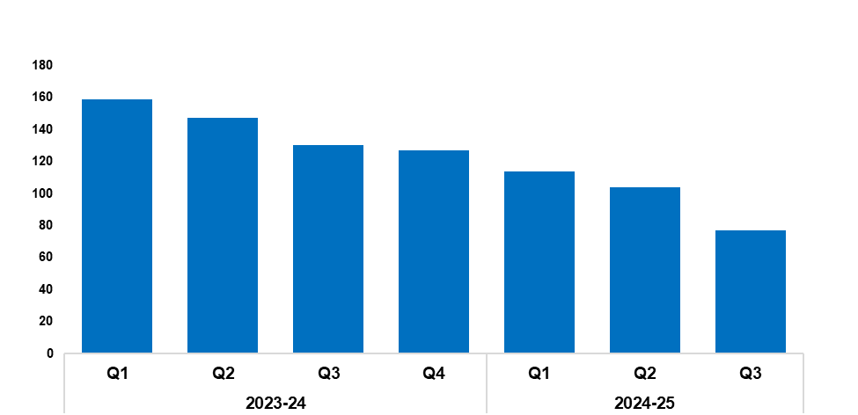
7. Cyber Fraud
Overview
Since Q1 2023-24, a total of 1,473 Action Fraud occurrences have been reported to Gwent Police via the National Fraud Intelligence Bureau. Of these, 58.2% (858 occurrences) have been assigned a cyber-enabled local qualifier.
The number of Action Fraud occurrences assigned a cyber-enabled local qualifier has fallen by 26.0% during Q3 2024-25 when compared to the quarter prior, with 27 fewer occurrences reported for a total of 77. This continues the downward trend that has been observed for this metric throughout the timeframe. A more prominent reduction of 40.8% (53 fewer occurrences) can be observed when comparing Q3 2024-25 against the same quarter during the previous financial year. In total, 295 Action Fraud occurrences with a cyber-enabled local qualifier have been recorded during the current FYTD, a reduction of 32.3% (141 fewer occurrences) when compared to the previous FYTD.
2023-24 |  |  |  | 2024-25
Q1 | Q2 | Q3 | Q4 | Q1 | Q2 | Q3 | Q4
159 | 147 | 130 | 127 | 114 | 104 | 77 | -

Slide 23
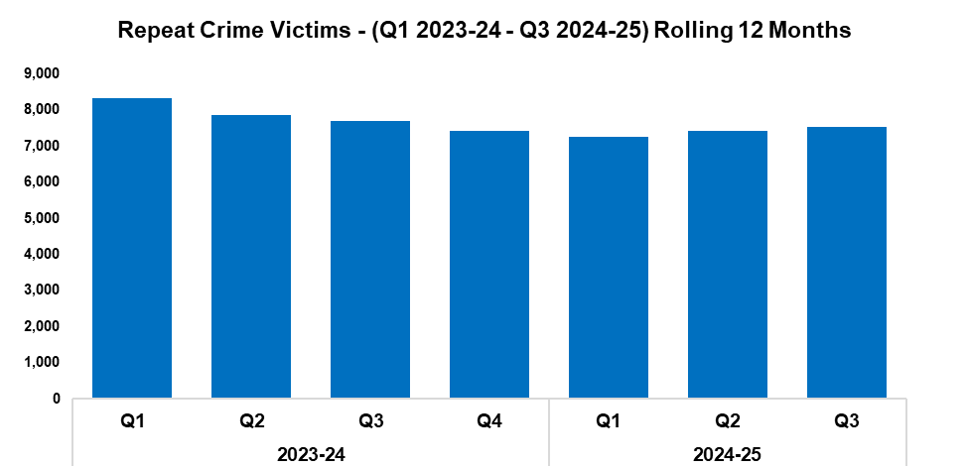
8. Victim Support/Repeat Victims
Overview
In this context, a repeat crime victim is defined as an individual who has been linked as a victim in two or more crimes within a 12-month rolling period.
The number of repeat crime victims has risen by 1.6% during Q3 2024-25* when compared to the quarter prior, with 118 additional repeat victims recorded for a total of 7,541. This establishes an upward trend following Q1 2024-25.
Conversely, a reduction of 2.1% (158 fewer repeat victims) can be observed when comparing Q3 2024-25 against the same quarter during the previous financial year. A total of 22,213 repeat victims have been recorded when combining the quarterly totals for the current FYTD, representing a reduction of 7.1% (1,688 fewer repeat victims) when compared to the previous FYTD.
*Based on the rolling 12 months to the end of the quarter.
2023-24 |  |  |  | 2024-25
Q1 | Q2 | Q3 | Q4 | Q1 | Q2 | Q3 | Q4
8,335 | 7,867 | 7,699 | 7,408 | 7,249 | 7,423 | 7,541 | -

Slide 24
Increase Community Confidence in Policing
Perceptions Survey: Levels of Policing
Perceptions Survey: Police Effectiveness
Perceptions Survey: Fairness
Perceptions Survey: Engagement
Perceptions Survey: Local Concerns and Overall
Victim Satisfaction
Representative Workforce
Investigation Timeliness
Response Rates
999 Demand
101 Demand
Social Media and Single Online Home
Initiatives & Events
Key Commitments
Increase the effectiveness of officer and staff engagement with residents in their communities, and community confidence and trust in Gwent Police.
Improve the accessibility of neighbourhood police teams through a variety of contact channels that meet the needs of the public.
Increase reporting of crime by communities that are less likely to engage with the police.
Further increase officer and staff diversity to ensure our police service reflects the communities that we serve.

Slide 25
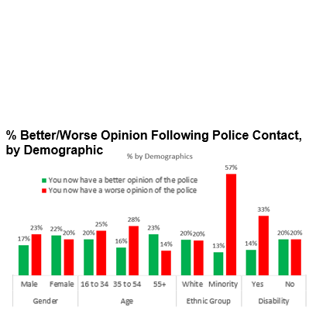
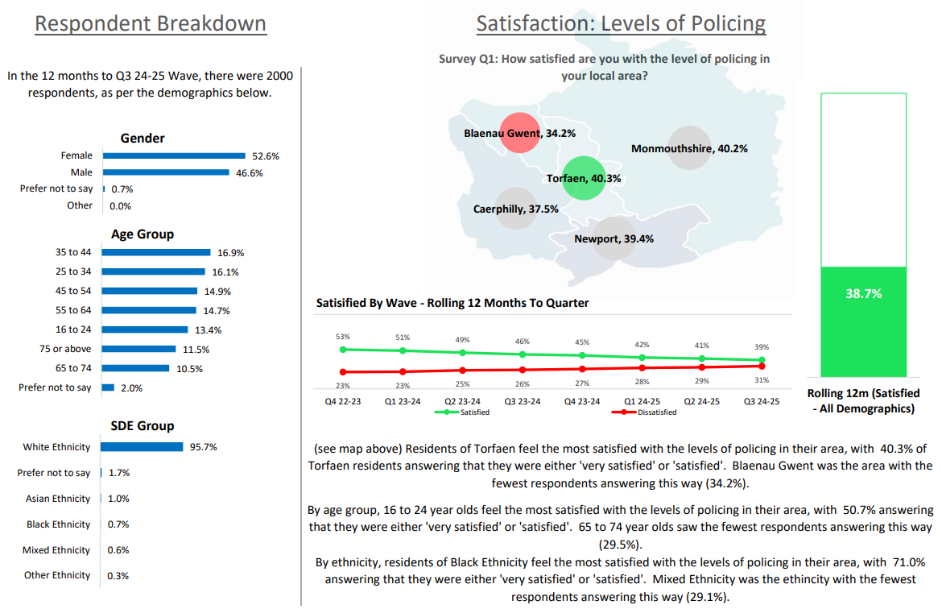
1. Perceptions Survey: Levels of Policing

Slide 26
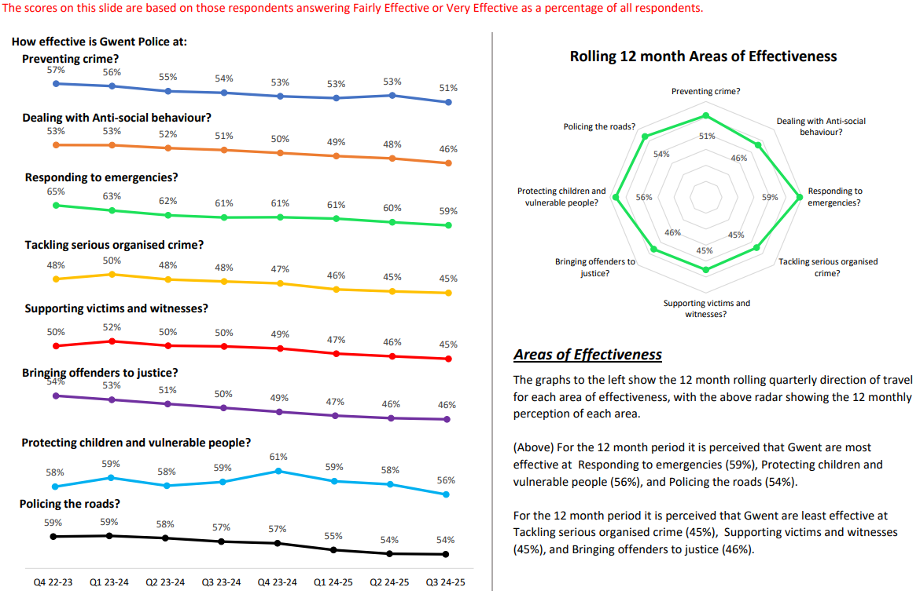
2. Perceptions Survey: Police Effectiveness

Slide 27
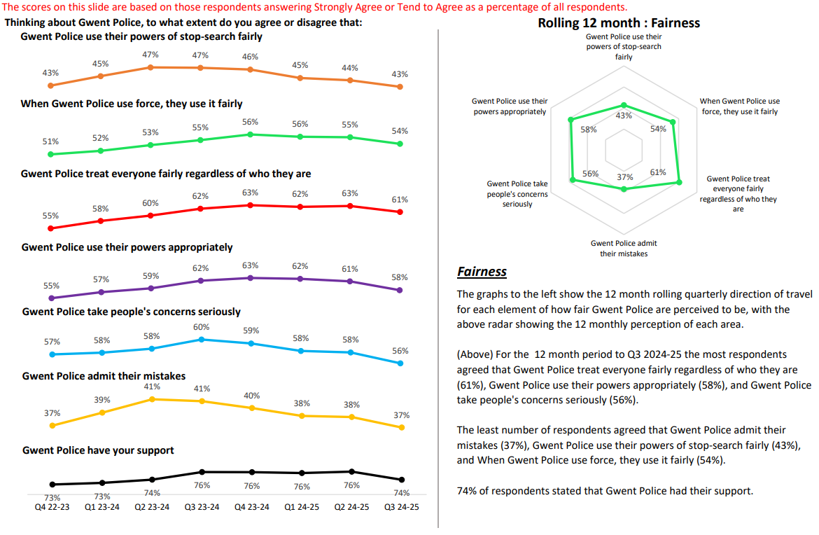
3. Perceptions Survey: Fairness

Slide 28
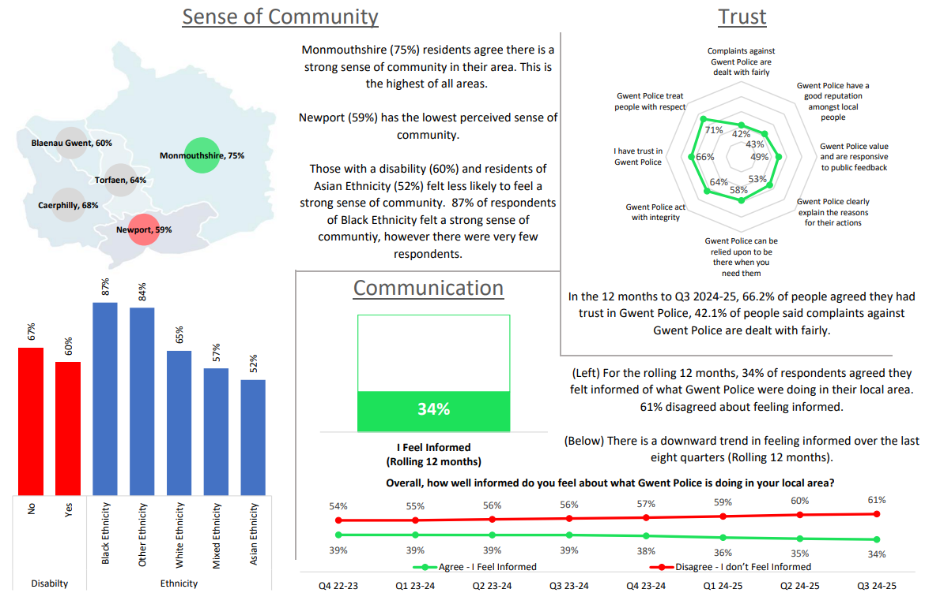
4. Perceptions Survey: Engagement

Slide 29
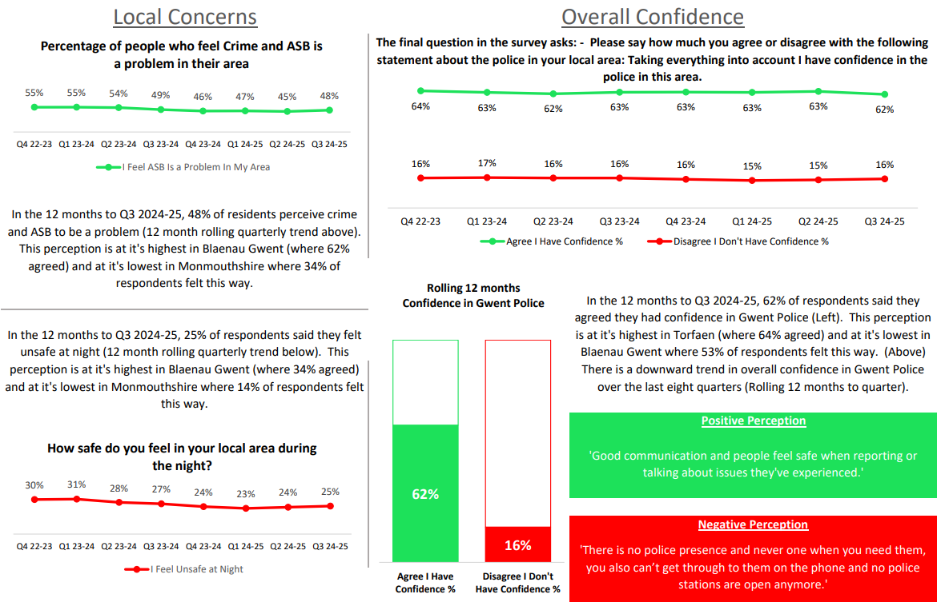
5. Perceptions Survey: Local Concerns and Overall

Slide 30
6. Victim Satisfaction
Victim Satisfaction Survey Data for FYTD 2024-25
Survey Question | Percentage of Respondents Satisfied | Quarter-on-Quarter Difference |  | Number of Respondents Satisfied | Total Responses Received
How satisfied are you with the ease of initial contact with the Police? | 79% | -1% | â | 201 | 254
How satisfied are you with the response time to your contact? (e.g. how long it took for your call to be answered) | 74% | -1% | â | 190 | 257
Overall, how satisfied are you with your experience of the first point of contact with the police? | 73% | +1% | á | 187 | 257
If an officer attended, how satisfied are you with the time it took for them to arrive? | 85% | -1% | â | 117 | 138
How satisfied are you with the actions taken by the attending officer/s? | 77% | -1% | â | 108 | 140
Thinking about your overall experience, how satisfied are you with the treatment you have received from Gwent Police? | 65% | 0% | à | 166 | 256
Overview
Alterations have been made to the victim satisfaction survey model, following an internal review. Going forward, a single survey will be provided to victims with the aim of assessing their satisfaction with the initial response provided by Gwent Police, as it is recognised that the force’s first interactions with victims can often be the most impactful. Whilst the value of surveys assessing all stages of the criminal justice journey has been acknowledged, the volume of responses received for these subsequent surveys was unfortunately insufficient to constitute a meaningful dataset.
A total of 257 respondents have engaged with the victim satisfaction survey during the current FYTD. Of those who replied to the given question, 85% of respondents were satisfied with officer attendance times, whereas only 65% of respondents were satisfied with the overall treatment they received from Gwent Police.
Data accurate as of 01/01/2025. All questions within the survey are optional, which may result in a disparity between the number of responses received for each question.

Slide 31
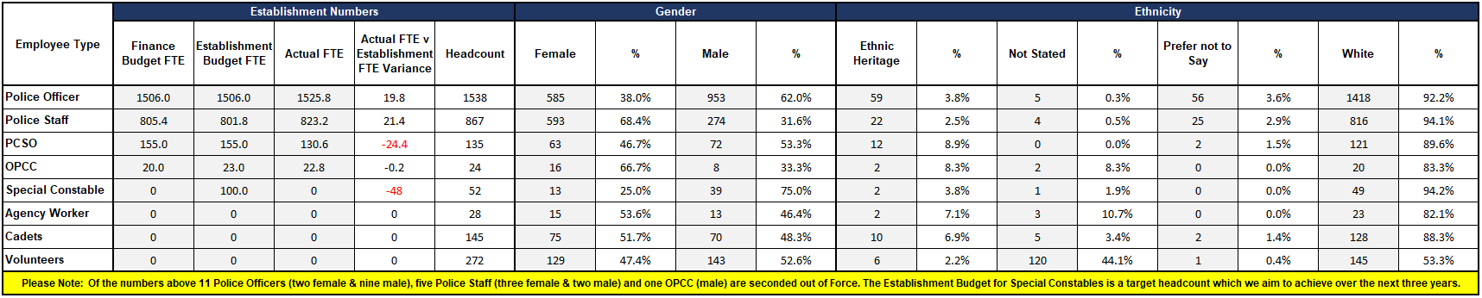
7. Representative Workforce
Overview
There is a gender disparity evident in the workforce for both officers and staff. For officers, females are under-represented by approximately 13 percentage points (females account for 51% of the population in Gwent based on the 2021 Census). However, females are overrepresented in the staff workstream area by approximately 17 percentage points.
There is also a disparity in ethnic heritage representation within the workforce. In Census 2021, 5.8% of the Gwent population are people of ethnic heritage. Currently 3.8% of police officers are of ethnic heritage, whereas ethnic heritage representation in the staff workstream is lower, at 2.5%.
Data correct as of the 31st of December 2024.

Slide 32
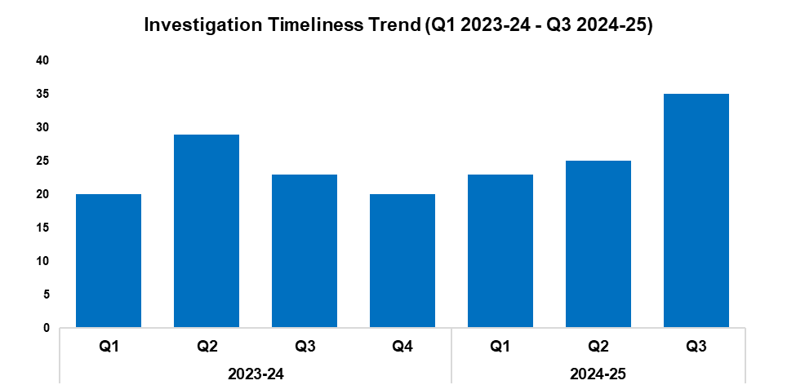
8. Investigation Timeliness
Overview
The median number of days within which an investigation is completed has risen by 40.0% when compared to the quarter prior, an increase of 10 days to 35. This continues the upward trend observed for this metric following Q4 2023-24, and represents the highest quarterly figure within the timeframe. A more prominent increase of 52.2% (12 additional days) can be observed when comparing Q3 2024-25 against the same quarter during the previous financial year. The median investigation length for the current FYTD stands at 28 days, an increase of 16.7% (four additional days) when compared to the previous FYTD.
As of Q3 2024-25, there are 18,458 crimes classified as unfinalised. Of these, 11,681 are marked as under investigation, with the remaining 6,777 either pending finalisation or subject to an administrative process.
Of the 11,681 crimes currently under investigation, 7,693 have been under investigation for less than six months. A further 2,066 have been under investigation for between six and 12 months, whereas 1,922 have been under investigation for over 12 months.
Of those crimes which have been under investigation for over 12 months, Violence without Injury offences are the most common, accounting for 18.5% of the total with 355 crimes. This is followed by Rape offences, which comprise 16.2% of the total with 312 crimes.
2023-24 |  |  |  | 2024-25
Q1 | Q2 | Q3 | Q4 | Q1 | Q2 | Q3 | Q4
20 | 29 | 23 | 20 | 23 | 25 | 35 | -

Slide 33
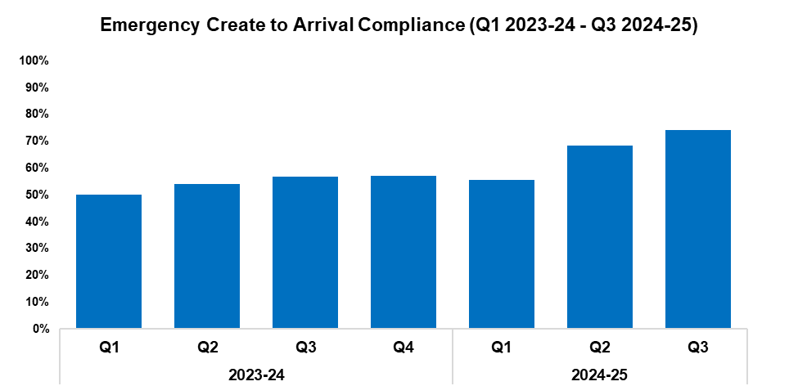
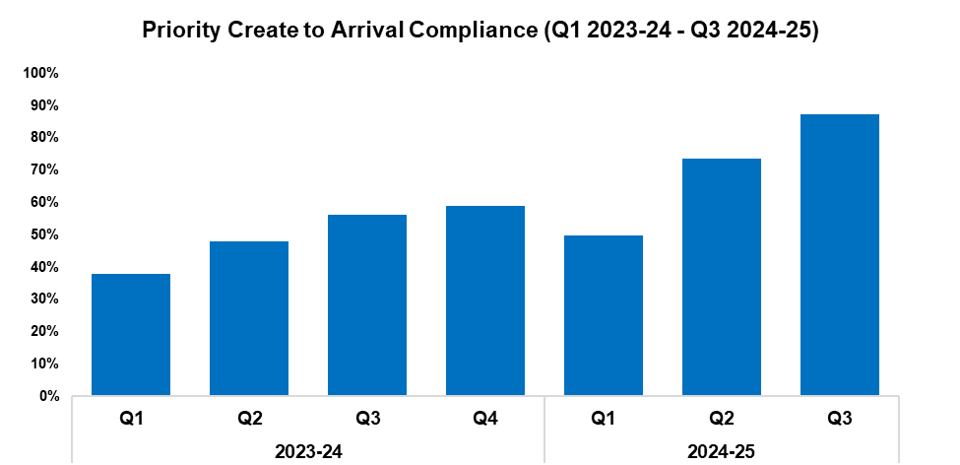
9. Response Rates
2023-24 |  |  |  | 2024-25
Q1 | Q2 | Q3 | Q4 | Q1 | Q2 | Q3 | Q4
50.0% | 54.1% | 56.9% | 57.0% | 55.5% | 68.3% | 74.2% | -
2023-24 |  |  |  | 2024-25
Q1 | Q2 | Q3 | Q4 | Q1 | Q2 | Q3 | Q4
38.0% | 48.1% | 56.1% | 58.8% | 49.7% | 73.7% | 87.2% | -
Overview
Based on the target arrival time of 15 minutes, emergency create to arrival compliance has increased by 5.9 percentage points during Q3 2024-25 when compared to the quarter prior, and currently stands at 74.2%. This represents the highest quarterly figure within the timeframe, establishing an upward trend following Q1 2024-25. A more prominent increase of 17.3 percentage points can be observed when comparing Q3 2024-25 against the same quarter during the previous financial year. Emergency compliance for the current FYTD stands at 66.1%, an increase of 11.7 percentage points when compared to the previous FYTD.
Based on the target arrival time of one hour, priority create to arrival compliance has increased by 13.5 percentage points during Q3 2024-25 when compared to the quarter prior, and currently stands at 87.2%. As with emergency compliance, this represents the highest quarterly figure within the timeframe, and establishes an upward trend following Q1 2024-25. A further increase of 31.1 percentage points can be observed when comparing Q3 2024-25 against the same quarter during the previous financial year. Priority compliance for the current FYTD stands at 69.9%, an increase of 22.6 percentage points when compared to the previous FYTD.

Slide 34
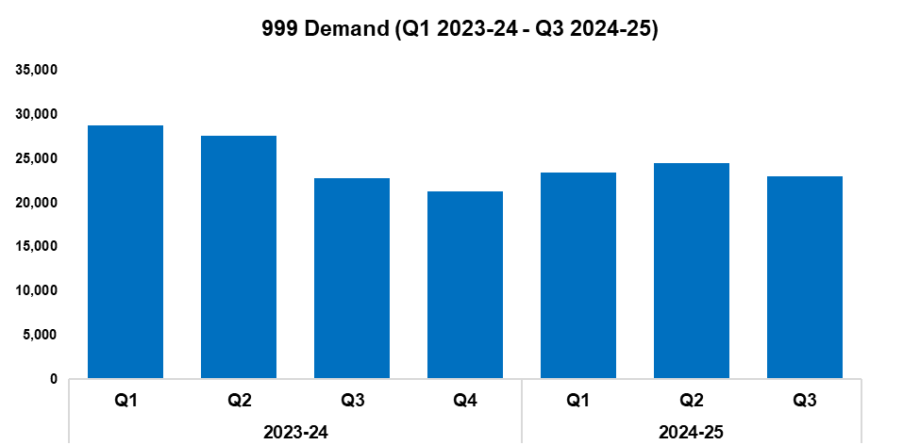
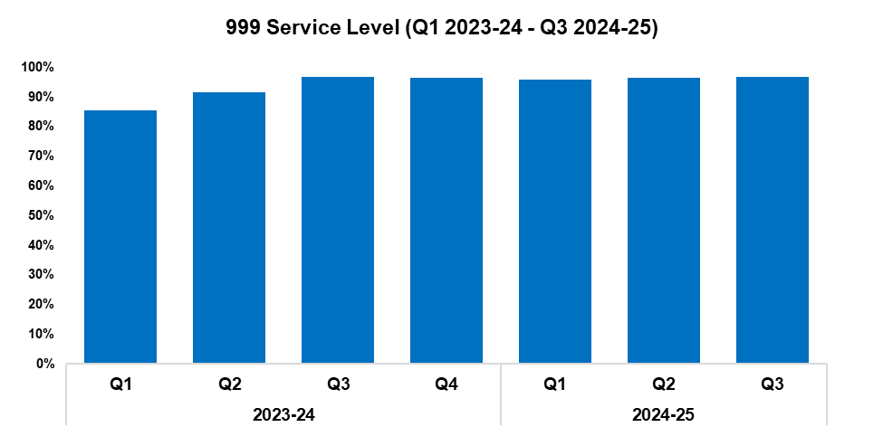
10. 999 Demand
2023-24 |  |  |  | 2024-25
Q1 | Q2 | Q3 | Q4 | Q1 | Q2 | Q3 | Q4
28,737 | 27,600 | 22,806 | 21,326 | 23,412 | 24,453 | 22,969 | -
2023-24 |  |  |  | 2024-25
Q1 | Q2 | Q3 | Q4 | Q1 | Q2 | Q3 | Q4
85.5% | 91.5% | 96.9% | 96.4% | 95.9% | 96.5% | 96.9% | -
Overview
999 demand has fallen by 6.1% during Q3 2024-25 when compared to the quarter prior, with 1,484 fewer calls received for a total of 22,969. This disrupts the upward trend observed following Q4 2023-24. Conversely, a slight increase of 0.7% (163 additional calls) can be observed when comparing Q3 2024-25 against the same quarter during the previous financial year. A reduction of 10.5% has been recorded when comparing the current FYTD against the previous FYTD, with 8,309 fewer calls received for a total of 70,834.
999 service level (the percentage of 999 calls answered within 10 seconds) has increased during Q3 2024-25 when compared to the quarter prior, rising by 0.4 percentage points to 96.9%. This represents the joint-highest quarterly figure within the timeframe, and establishes an upward trend following Q1 2024-25. 999 service level has remained steady when comparing Q3 2024-25 against the same quarter during the previous financial year. An increase of 5.6 percentage points has been recorded when comparing the current FYTD against the previous FYTD, with the service level for this period currently standing at 96.8%.
999 Average Answer Speed
(Minutes/Seconds)
2023-24 |  |  |  | 2024-25
Q1 | Q2 | Q3 | Q4 | Q1 | Q2 | Q3 | Q4
00:10 | 00:07 | 00:04 | 00:04 | 00:04 | 00:03 | 00:03 | -
The average answer speed for 999 calls during Q3 2024-25 was three seconds. This is equal to the figure recorded during the quarter prior, and represents the joint-lowest value within the timeframe. 999 average answer speed has improved by one second when comparing Q3 2024-25 against the same quarter during the previous financial year, and by three seconds when comparing the current FYTD against the previous FYTD, falling from seven seconds to four.
A new command and control system upgrade has been introduced in force contact and control (FCC). Functional upgrades and process changes have also been implemented, with the aim of increasing efficiency and improving service delivery.

Slide 35
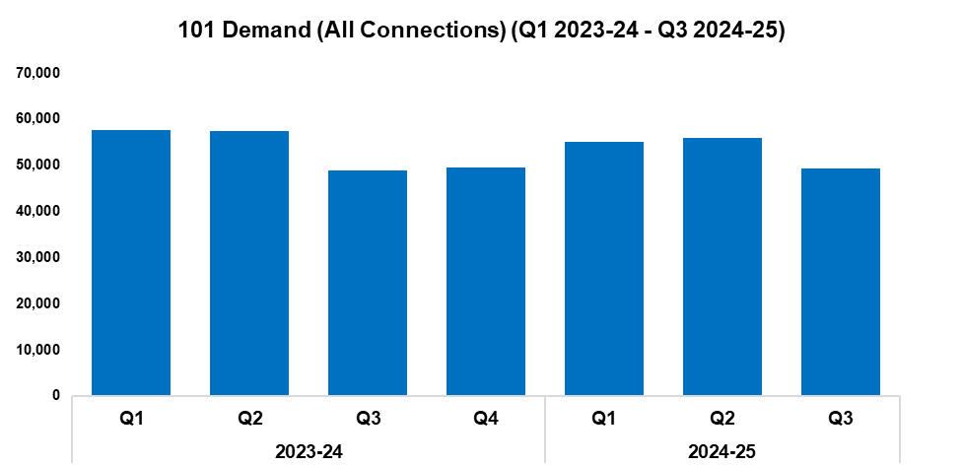
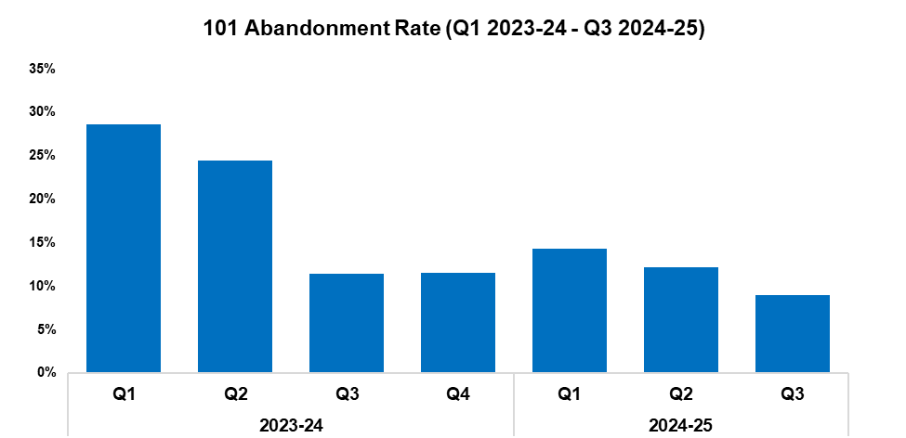
11. 101 Demand
2023-24 |  |  |  | 2024-25
Q1 | Q2 | Q3 | Q4 | Q1 | Q2 | Q3 | Q4
57,552 | 57,466 | 48,881 | 49,457 | 54,969 | 55,892 | 49,199 | -
2023-24 |  |  |  | 2024-25
Q1 | Q2 | Q3 | Q4 | Q1 | Q2 | Q3 | Q4
28.6% | 24.4% | 11.4% | 11.5% | 14.3% | 12.2% | 9.0% | -
Overview
101 demand (all connections) has fallen by 12.0% during Q3 2024-25 when compared to the quarter prior, with 6,693 fewer calls received for a total of 49,199. This disrupts the upward trend observed following Q3 2023-24. Conversely, a slight increase of 0.7% (318 additional calls) can be observed when comparing Q3 2024-25 against the same quarter during the previous financial year. A reduction of 2.3% has been recorded when comparing the current FYTD against the previous FYTD, with 3,839 fewer calls received for a total of 160,060.
The 101 abandonment rate (for options one & two) has fallen by 3.2 percentage points during Q3 2024-25 when compared to the quarter prior, and currently stands at 9.0%. This represents the lowest quarterly figure within the timeframe. A similar reduction of 2.4 percentage points can be observed when comparing Q3 2024-25 against the same quarter during the previous financial year. A further reduction of 11.7 percentage points has been recorded when comparing the current FYTD against the previous FYTD, with the abandonment rate for this period currently standing at 10.2%.
101 Average Answer Speed
(Minutes/Seconds)
2023-24 |  |  |  | 2024-25
Q1 | Q2 | Q3 | Q4 | Q1 | Q2 | Q3 | Q4
06:29 | 05:05 | 02:20 | 02:14 | 02:57 | 02:22 | 01:35 | -
The average answer speed for 101 calls during Q3 2024-25 was one minute and 35 seconds, a reduction of 47 seconds when compared to the quarter prior. A similar improvement of 45 seconds can be observed when comparing Q3 2024-25 against the same quarter during the previous financial year. A significant improvement of two minutes and thirty-nine seconds has been recorded when comparing the current FYTD against the previous FYTD, with the average answer speed for this period currently standing at one minute and fifty-six seconds.
FCC operators have been participating in ‘ride alongs’ on their training days, allowing them to gather feedback and suggestions from front-line officers.

Slide 36
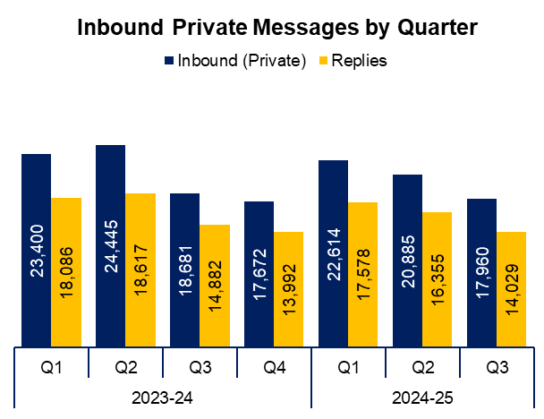
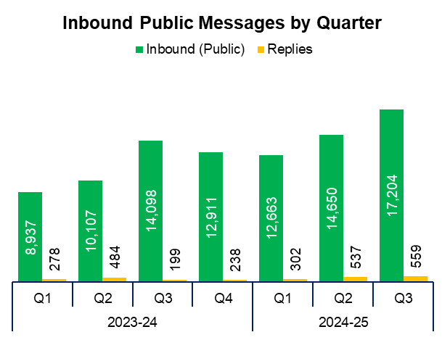
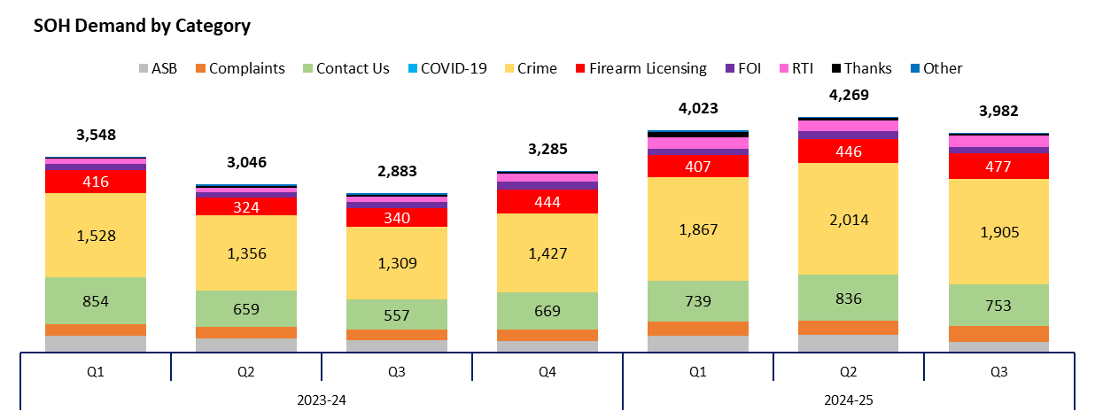
12. Social Media and Single Online Home
Overview
The volume of inbound private messages received via Gwent Police’s social media platforms has reduced by 14.0% during Q3 2024-25 when compared to the quarter prior, with 2,925 fewer messages received for a total of 17,960. This establishes a downward trend following Q1 2024-25. Of these messages, 94.0% (16,875 messages) were received via Facebook platforms.
Conversely, the volume of inbound public messages received via Gwent Police’s social media platforms increased by 17.4% during Q3 2024-25 when compared to the quarter prior, with 2,554 additional messages received for a total of 17,204. This represents the highest quarterly figure within the timeframe, establishing an upward trend following Q1 2024-25. Of these messages, 94.0% (16,169 messages) were received via Facebook platforms.
This digital contact data includes Gwent Police’s English and Welsh Facebook and X accounts.
3,982 Single Online Home (SOH) forms were submitted during Q3 2024-25, a reduction of 6.7% (287 fewer forms) when compared to the quarter prior. This disrupts the upward trend observed following Q3 2023-24.
The adjacent chart presents these forms by category, with the most numerous being crime reports. These account for 47.8% of the quarterly total, with 1,905 forms submitted. They are followed by general ‘contact us’ messages (accounting for 18.9% of the total with 753 forms submitted), and firearms licensing (accounting for 12.0% of the total with 477 forms submitted). ‘Other’ includes forms with low volume, including events and processions, filming, fingerprints and IP licensing.

Slide 37
13. Initiatives & Events
Overview
The IAG (facilitated by the EDI team) is invaluable in enhancing the community’s trust in policing. The latest quarterly IAG meeting was held during October, in which the IAG heard from local policing area leads on their progress in tackling crime and engaging with the community. They also discussed the force’s Culture Strategy with the Assistant Chief Constable, as well as Gwent Police’s work with children and young people.
The EDI team continue to provide training on EDI topics for new staff and officers. The IAG are also involved in this process, allowing them to share their lived experiences of diversity. In addition, the IAG attended the Team Gwent event in December, in order to discuss culture in policing.
The EDI team facilitated the quarterly mosque representatives meeting in December, bringing together mosque leaders and senior Muslim community representatives from across Newport to discuss issues of importance to their communities.
The Women’s Voices Group has been developed further during this quarter. This group was established following the racist riots in the summer of 2024, to ensure that women are given a voice to share their communities’ concerns and are kept updated on how Gwent Police are working to improve public safety and tackle crime. As of this quarter, the group have visited Gwent Police headquarters, toured FCC, and met with female officers and staff to discuss topics including stop and search and positive action.
The EDI team arranged a display in headquarters of storyboards from Age Alive, a Newport-based group for older people from minority ethnic backgrounds. The also invited members of the group into headquarters, where they visited FCC and met with chief officers. This allowed staff to learn more about the diversity of Gwent’s communities, as well as building trust and engagement between Gwent Police and the group.
An event was held with Urban Circle, a Newport-based group for young people, predominantly from minority ethnic backgrounds. This event brought together young people, police officers, community support officers, and members of the EDI and positive action teams. Issues such as stop and search and knife crime were discussed, with numerous attendees commenting afterwards that they felt more confident and engaged with the police as a result.
The EDI team attended several events of importance to local communities, including Interfaith week, Black History Month, and St Nicholas Day. The Interfaith week event brought together religious leaders from across South Wales, and was also attended by the Chief Constable.
FCC have continued to support external engagement with community groups. This quarter, the department have hosted several visits from Able, an organisation which provides life skills for people with learning difficulties. These visits allowed staff to demonstrate the work that goes on when calls are made to the police and officer dispatch.
Across 2024, the Men’s Health Forum arranged for the screening of 237 colleagues for prostate cancer, jointly funded by Unison and the Police Federation. The testing identified eight red cases and one confirmed case of cancer. The next testing event is already over-subscribed, with a waiting list being put in place for future events. The Police Federation and Unison have agreed to fund two further testing days in 2025.
A new police base was opened in Abergavenny during December. This facility will increase Gwent Police’s visibility in the area, with local neighbourhood teams able to access the town centre on foot from this location. The base also provides the response officers stationed there with easy access to local road networks, allowing them to more effectively respond to calls.
Two additional local policing Facebook accounts were launched during November, covering Blaenau Gwent and Torfaen respectively. These pages allow the force to inform communities of local issues and initiatives, as well as facilitating increased engagement with the public.

Slide 38
Professional Standards Department
PSD Total Recorded Complaint Allegations
PSD Schedule 3 and Non-Schedule 3 Complaint Cases
PSD Misconduct Cases
Vetting
Disproportionality

Slide 39

1. PSD Total Recorded Complaint Allegations
Overview
There has been a 33.5% increase in complaint allegations received during Q3 2024-25 when compared to the quarter prior, with 78 additional complaints received for a total of 311. This rise disrupts the downward trend observed for this metric following Q2 2023-24.
The three categories of complaint with the greatest volume are as follows:
A1. Police action following contact 127
H3. Unprofessional attitude and disrespect 35
A3. Information 24
Within these sub-categories, the following changes have been observed:
There has been an increase in A1. Police action following contact when compared to the quarter prior, with 16 additional complaints recorded.
H3. Unprofessional attitude and disrespect has become the second most prevalent category, with eight additional complaints recorded when compared to the quarter prior. This displaces A4. General level of service.
A3. Information is now the third most prevalent category, replacing H3. Unprofessional attitude and disrespect. The number of recorded complaints has risen by 10 when compared to the quarter prior.
As noted during the commentary in the previous report, there had been a backlog of complaints which had impacted the timeliness of recording and initial contact. This was addressed in Q3 2024-25, with additional resources approved. The removal of part of this backlog has contributed to the increase in volume observed during this quarter.
Please note that multiple allegations can be recorded by one complainant.
2022-23 |  |  |  | 2023-24 |  |  |  | 2024-25
Q1 | Q2 | Q3 | Q4 | Q1 | Q2 | Q3 | Q4 | Q1 | Q2 | Q3 | Q4
296 | 256 | 268 | 311 | 320 | 426 | 326 | 291 | 286 | 233 | 311 | -

Slide 40


2. PSD Schedule 3 and Non-Schedule 3 Complaint Cases
2022-23 |  |  |  | 2023-24 |  |  |  | 2024-25
Q1 | Q2 | Q3 | Q4 | Q1 | Q2 | Q3 | Q4 | Q1 | Q2 | Q3 | Q4
43 | 41 | 37 | 45 | 34 | 39 | 37 | 34 | 32 | 19 | 37 | -
2022-23 |  |  |  | 2023-24 |  |  |  | 2024-25
Q1 | Q2 | Q3 | Q4 | Q1 | Q2 | Q3 | Q4 | Q1 | Q2 | Q3 | Q4
73 | 89 | 59 | 125 | 131 | 260 | 149 | 124 | 155 | 86 | 153 | -
Overview
Schedule 3 relates to complaints dealt with under the Police Reform Act 2002, whereby the complainant can request a review if they are not satisfied.
Non-Schedule 3 allows complaints to be dealt with outside of the Police Reform Act 2002, previously regarded as ‘dissatisfaction’.
A significant increase of 94.7% has been recorded for Schedule 3 cases during Q3 2024-25 when compared to the quarter prior, with 18 additional complaints recorded for a total of 37. This disrupts the downward trend observed for this metric following Q2 2023-24. A similarly prominent increase of 77.9% can be observed for Non-Schedule 3 cases, with 67 additional complaints recorded for a total of 153. Please see the previous slide for commentary and explanation.
At the time that the data was extracted there were 34 live Schedule 3 complaint cases and four live Non-Schedule 3 complaint cases. This is compared to the 52 live Schedule 3 complaint cases and four live Non-Schedule 3 complaint cases recorded in the previous report.
Figures will contain cases with multiple allegations.

Slide 41

3. PSD Misconduct Cases
Overview
The number of misconduct cases has risen by 37.5% during Q3 2024-25 when compared to the quarter prior, with six additional cases recorded for a total of 22.
This increase represents a return to the levels recorded during 2023-24, following the decline observed during the first two quarters of 2024-25. Nevertheless, a reduction in overall misconduct cases is forecast when comparing the two financial years.
2022-23 |  |  |  | 2023-24 |  |  |  | 2024-25
Q1 | Q2 | Q3 | Q4 | Q1 | Q2 | Q3 | Q4 | Q1 | Q2 | Q3 | Q4
12 | 14 | 16 | 28 | 22 | 25 | 23 | 22 | 15 | 16 | 22 | -
Q3 2024-25 Misconduct Outcomes
One Gross Misconduct Hearing was held. The officer would have been dismissed had they not resigned. The former officer was placed on the Police Barred List.
Three Accelerated Gross Misconduct Hearings were held. One officer was dismissed, and two officers would have been dismissed had they not resigned. All former officers were placed on the Police Barred List.
Three Misconduct Meetings were held, resulting in three written warnings being issued.
Two Police Staff Disciplinary Hearings were held, resulting in one individual being dismissed, and another being issued with a final written warning.

Slide 42


4. Vetting
Vetting Checks | 2022-23 |  |  |  | 2023-24 |  |  |  | 2024-25
Q1 | Q1 | Q2 | Q3 | Q4 | Q1 | Q2 | Q3 | Q4 | Q1 | Q2
Police Staff/Officers | 165 | 173 | 148 | 162 | 132 | 107 | 136 | 54 | 111 | 115
Contractors/Outside Agency | 260 | 166 | 245 | 217 | 195 | 230 | 240 | 205 | 148 | 125
Vetting Health Checks | 35 | 42 | 47 | 45 | 39 | 49 | 45 | 47 | 37 | 34
National Security Vetting | 0 | 0 | 0 | 0 | 21 | 20 | 10 | 11 | 16 | 23
Total | 460 | 381 | 440 | 424 | 387 | 406 | 431 | 317 | 312 | 297
Vetting Refusals | 2022-23 |  |  |  | 2023-24 |  |  |  | 2024-25
Q1 | Q1 | Q2 | Q3 | Q4 | Q1 | Q2 | Q3 | Q4 | Q1 | Q2
Residency | 0 | 0 | 0 | 0 | 0 | 0 | 0 | 0 | 0 | 0
PSD | 0 | 0 | 0 | 0 | 2 | 0 | 3 | 1 | 2 | 1
Convictions, Cautions & Impending Cases | 13 | 3 | 8 | 13 | 7 | 5 | 12 | 3 | 10 | 4
TAINT | 0 | 0 | 0 | 0 | 1 | 3 | 1 | 0 | 1 | 2
Intelligence & Non-conviction Data | 11 | 5 | 6 | 11 | 17 | 18 | 20 | 12 | 24 | 10
Open Source | 0 | 0 | 0 | 0 | 1 | 1 | 0 | 0 | 0 | 1
Associations | 1 | 2 | 7 | 8 | 2 | 3 | 4 | 3 | 5 | 4
Financial Integrity | 0 | 4 | 11 | 6 | 5 | 6 | 8 | 2 | 4 | 4
Integrity | 0 | 0 | 0 | 0 | 2 | 4 | 8 | 4 | 5 | 3
National Security and Terrorism | 0 | 0 | 0 | 0 | 0 | 0 | 0 | 0 | 0 | 0
Abuse of Position | 0 | 0 | 0 | 0 | 1 | 0 | 0 | 0 | 0 | 0
Total Vetting Refusals (There can be multiple reasons per refusal) | 28 | 16 | 32 | 42 | 32 | 25 | 35 | 17 | 32 | 15
Overview
Data is submitted a quarter behind, therefore Q3 2024-25 is not currently included.
Please note the new national categories for vetting refusals that will allow all forces to benchmark data and performance.

Slide 43
5. Disproportionality
Vetting Refusals Protected Characteristics Data (OLEEO cases only) |  | 2023-24 |  |  |  | 2024-25
 |  | Q1 | Q2 | Q3 | Q4 | Q1 | Q2
Ethnic Heritage | Received | 3 | 10 | 6 | 3 | 4 | 1
 | Refused | 0 | 2 | 1 | 0 | 1 | 0
Sexual Orientation | Received | 11 | 15 | 8 | 3 | 31 | 6
 | Refused | 1 | 1 | 1 | 0 | 2 | 0
Disability | Received | 0 | 9 | 0 | 5 | 7 | 4
 | Refused | 0 | 1 | 0 | 0 | 0 | 1
Gender Reassignment | Received | 0 | 1 | 0 | 0 | 0 | 0
 | Refused | 0 | 0 | 0 | 0 | 0 | 0
Male | Received | 70 | 89 | 62 | 42 | 61 | 51
 | Refused | 7 | 10 | 2 | 4 | 10 | 0
Female | Received | 47 | 63 | 54 | 36 | 101 | 56
 | Refused | 5 | 2 | 2 | 1 | 4 | 3
Total Cases on OLEEO (There can be multiple protected characteristics per refusal) |  | 117 | 152 | 116 | 78 | 162 | 107
Appeal Panels Protected Characteristics Data |  | 2023-24 |  |  |  | 2024-25
 |  | Q1 | Q2 | Q3 | Q4 | Q1 | Q2
Ethnic Heritage | Received | 0 | 0 | 0 | 0 | 5 | 0
 | Overturned | 0 | 0 | 0 | 0 | 1 | 0
Sexual Orientation | Received | 0 | 0 | 0 | 0 | 1 | 0
 | Overturned | 0 | 0 | 0 | 0 | 0 | 0
Disability | Received | 0 | 0 | 0 | 0 | 0 | 0
 | Overturned | 0 | 0 | 0 | 0 | 0 | 0
Gender Reassignment | Received | 0 | 0 | 0 | 0 | 0 | 0
 | Overturned | 0 | 0 | 0 | 0 | 0 | 0
Male | Received | 10 | 0 | 3 | 4 | 5 | 9
 | Overturned | 1 | 0 | 0 | 0 | 0 | 0
Female | Received | 3 | 0 | 1 | 1 | 8 | 5
 | Overturned | 1 | 0 | TBD | 1 | 1 | 0
Total Cases Heard at Appeal (There can be multiple protected characteristics per appeal) |  | 13 | 0 | 4 | 5 | 13 | 14
Overview
The vetting disproportionality data is a new measure that will allow the force to track vetting refusals and appeal panel decisions across all areas of protected characteristics. As more data is gathered this will allow us to benchmark our figures against other Home Office forces.

