Slide 1
Strategy and Performance Board
Quarter 1 2023-24
PEEL Overview

Slide 2
PEEL causes for concern related to Responding to the Public. This summary document provides an overview in support of the PEEL update report to show currently performance in areas affected by this cause for concern -
Response rates
999 / 101 demand
Outcome rates
In line with the PEEL improvement plan the next report will provide a thematic position in relation to –
Stop and search – specifically reasonable grounds
DVDS – current demand

Slide 3
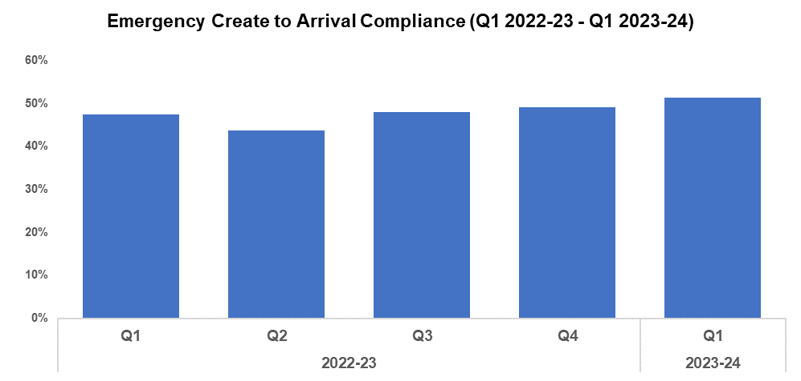
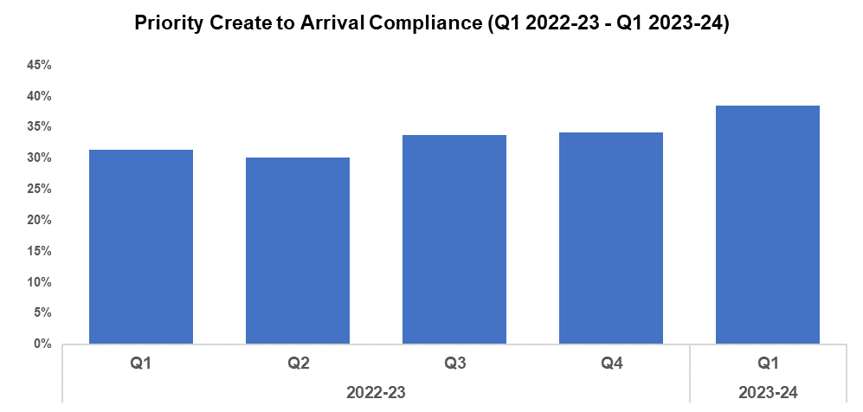
Response Rates
Overview
Based on the target arrival time of 15 minutes, emergency create to arrival compliance has increased by 2.4 percentage points during Q1 2023-24 when compared to the quarter prior, and currently stands at 51.4%. Seven of the nine Gwent sectors recorded improvements in compliance when compared to the previous quarter. Emergency response compliance has increased by 4.0 percentage points when comparing the current FYTD against FYTD 2022-23.
The median create to arrival time for emergency graded incidents during Q1 2023-24 was 14 minutes and 43 seconds, an improvement when compared to the 15 minutes and 16 seconds recorded during the quarter prior. Timings also improved when comparing the current FYTD against FYTD 2022-23, during which they stood at 15 minutes and 36 seconds.
Based on the target arrival time of one hour, priority create to arrival compliance has increased by 4.3 percentage points during Q1 2023-24 when compared to the quarter prior, and currently stands at 38.5%. All Gwent sectors recorded improvements in compliance when compared to the previous quarter. Priority response compliance has increased by 7.1 percentage points when comparing the current FYTD against FYTD 2022-23.
The median create to arrival time for priority graded incidents during Q1 2023-24 was one hour, 23 minutes and 44 seconds, an improvement when compared to the one hour, 44 minutes and eight seconds recorded during the previous quarter. Timings also improved when comparing the current FYTD against FYTD 2022-23, during which they stood at two hours, four minutes and 34 seconds.

Slide 4
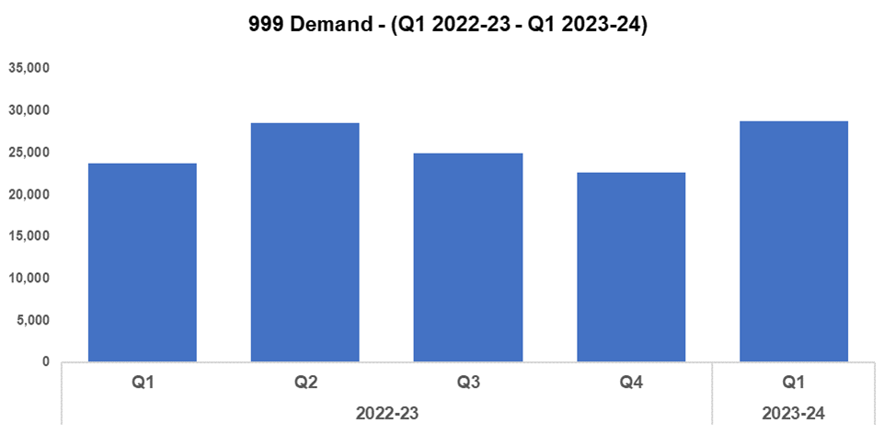
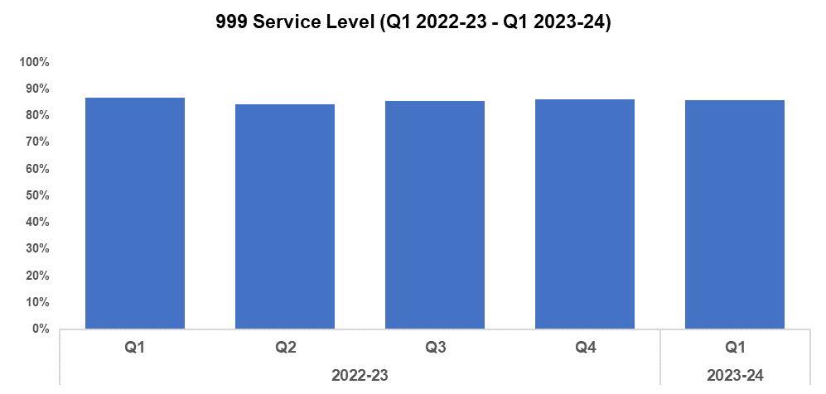
999 Demand
Overview
999 demand increased significantly during Q1 2023-24 when compared to the quarter prior, rising by 26.7% (6,063 additional calls) to 28,737. This disrupts the downward trend in 999 call volume observed following Q2 2022-23, influenced by the elevated figures recorded during May and June. There has been a similar increase of 21.2% (5,017 additional calls) when comparing the current FYTD against FYTD 2022-23.
999 service level (the percentage of calls answered within 10 seconds) deteriorated slightly during Q1 2023-24 when compared against the quarter prior, falling by 0.2 percentage points to 85.9%. A more prominent decline of 0.9 percentage points can be observed when comparing the current FYTD against FYTD 2022-23.
The average answer speed for 999 calls has remained steady at 10 seconds during Q1 2023-24 when compared to the quarter prior, plateauing after the downward trend observed following Q1 2022-23. When comparing the current FYTD against FYTD 2022-23 the 999 average answer speed has improved by three seconds, down from 13.
999 Average Answer Speed
(Minutes/Seconds)
Following a Victim Services Assessment conducted by His Majesty's Inspectorate of Constabulary and Fire & Rescue Services (HMICFRS), a Threat, Harm, Risk, Investigation, Vulnerability and Engagement (THRIVE) script was introduced as a requirement for every call within the force. Since its introduction, THRIVE script performance and THRIVE compliance have improved significantly. At the end of Q1 2023-24 (June 2023), the percentage of eligible calls with a THRIVE script was 91.5%, and the THRIVE compliance rate stood at 89.9% (6,072 completed and 763 aborted). The THRIVE completion rate was positioned at 77.0%.

Slide 5
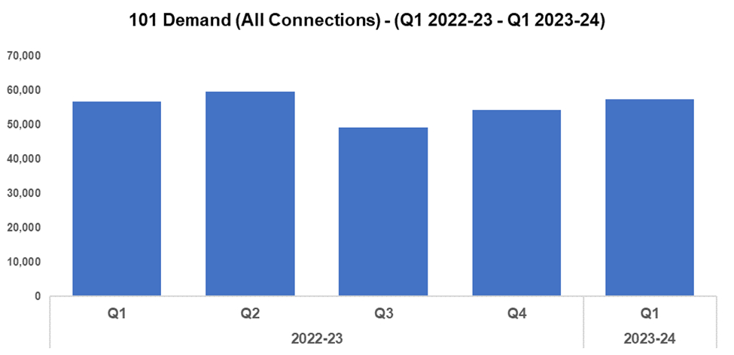
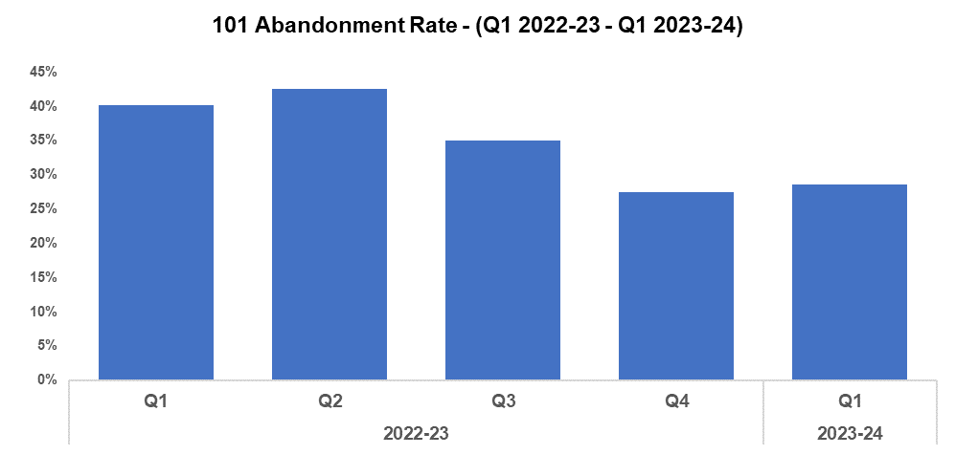
101 Demand
Overview
101 demand (all connections) increased during Q1 2023-24 by 5.8% (3,170 additional calls) when compared to the quarter prior, for a total of 57,552. This rise was influenced by June 2023 recording the highest monthly 101 demand since August 2022. After decreasing during Q3 2022-23, demand has risen for the second consecutive quarter. Demand has also increased when comparing the current FYTD against FYTD 2022-23, by 1.2% (666 additional calls).
The 101 abandonment rate increased by 1.1 percentage points during Q1 2023-24 when compared to the quarter prior, and currently stands at 28.6%. This disrupts the downward trend observed for this metric following Q2 2022-23, influenced by a rise in 101 abandonment rate from 23.7% in April to 32.4% in June. However, 101 abandonment rate has improved significantly when comparing the current FYTD against FYTD 2022-23, having fallen by 11.6 percentage points.
101 Average Answer Speed
(Minutes/Seconds)
The average answer speed for 101 calls decreased by one minute and 18 seconds to six minutes and 29 seconds during Q1 2023-24 when compared to the quarter prior. This represents the second consecutive improvement in average answer speed performance.
It is likely that the improvement observed during Q1 2023-24 was influenced by the average answer speed of five minutes and 20 seconds recorded during April 2023, which marked it as the best performing month within the last four quarters. The average speed of answer has also decreased when comparing the current FYTD against FYTD 2022-23, by 24 seconds.

Slide 6
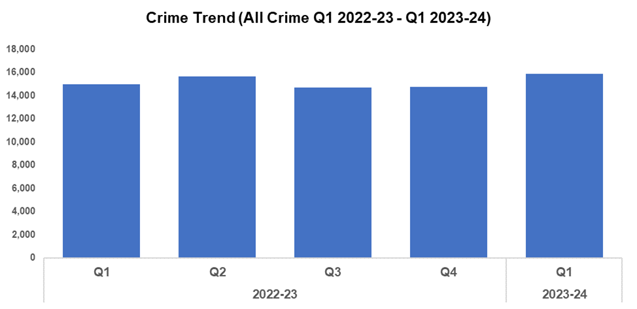
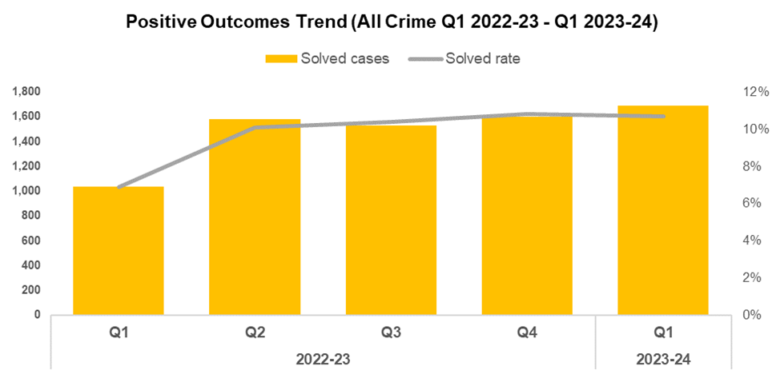
All Crime
Overview
Overall crime levels have increased by 7.3% during quarter one (Q1) of 2023-24 when compared to the quarter prior, with 1,079 additional offences recorded for a total of 15,861. This is the highest quarterly total recorded within the timeframe. A less prominent increase of 5.8% (876 additional offences) can be observed when comparing the current financial year to date (FYTD) against FYTD 2022-23.
The timeframe presented in this report has been limited to Q1 2022-23 onwards, excluding the financial years of 2020-21 and 2021-22 as they were anomalous due to the influence of COVID-19.
When compared to the previous quarter, the overall solved rate has fallen by 0.1 percentage points to 10.7%. This reduction, whilst minor, disrupts the upward trend which had been observed during the three quarters following Q1 2022-23. Whilst the solved rate has declined, the number of solved crimes has continued to increase, rising by 5.8% (92 additional solved crimes). This may indicate that the elevated volume of crime recorded during Q1 2023-24 has contributed to the decline in solved rate.
The solved rate for the current FYTD is 3.8 percentage points higher than that observed during FYTD 2022-23, although FYTD 2022-23 represents an outlier of poor performance in this regard.

