Slide 1
Engagement Strategy 2025-2028
Ch Supt Ian Roberts
December 2023
Notes:
1

Slide 2
Today’s Objectives
Introductions and purpose (15 mins)
To discuss the realities of day-to-day policing in Neighbourhood Teams (45 mins)
To discuss the importance of effective community engagement and neighbourhood policing (30 mins)
To discuss the barriers to effective working (40 mins)
To explore ideas for greater job satisfaction and the effective delivery of neighbourhood policing (40 mins)

Slide 3
Sources of information
Literature
Scarman Inquiry Report (1981)
Stephen Lawrence Inquiry Report (1999)
Police Reform and Social Responsibility Act (2011)
College of Policing APP on Engagement (2013)
Code of Ethics for Policing (2014)
College of Policing Neighbourhood Policing Guidelines (2018)
Gwent Police Communications and Engagement Strategy (2018-2022)
Casey Review of Metropolitan Police (2023)
Policing Vision 2030 (2023)
UK Government Police Reform Agenda (2024)
Neighbourhood Alert project documents (2024)
Internal Staff
Chief Constable Mark Hobrough
Staff Focus Group
T/ACC Vicki Townsend
C/Supt Carl Williams
Supt Jason Williams
CI’s Stevie Warden and Shaun Conway
Richard Blakemore (Problem Solving)
Rachel Evans (Victims)
Angela Roper (Change)
Brian Amos (Positive Action and Staff Networks)
Harry Petty (EDI)
Ps Chris Johnson (Newport West NPT)
Neighbourhood Inspectors
External
Chris Davies et al (MD at Visa V)

Slide 4
Why Engagement is Important
…without public cooperation, policing in developed democracies would become unworkable. Effective community engagement, targeted foot patrols, and collaborative problem-solving can significantly increase public confidence in policing activities
Engagement is essential for building trust and legitimacy in the police service. It helps in reducing crime by encouraging respect for the law and fostering social responsibility
APP Engagement – College of Policing 2013

Slide 5
Where are we now?
Some passionate officers and staff doing meaningful engagement – but they are a minority
Engagement is less than 10% of the work of NPT’s
NPT’s dealing with response policing demands
Culture doesn’t value engagement
Staff lack confidence to engage
No effective tools or corporate memory to support engagement work or to manage the information which comes from it
Good on victim engagement through Victim Care Unit – but we could do more

Slide 6
Our vision – where we want to be….
A workforce that is clear on the mission and priorities of the force
Engagement is understood to be everybody’s responsibility and is valued
Every member of the organisation can describe the link between their work and the delivery of the force mission
Relationships between Gwent Police and our communities is strong
We listen, respond and provide feedback about our work
We work with our network of communities and partners together to solve problems together
We put the needs of victims at the heart of our improvement plans
Trust and confidence is improved through a strong focus on prevention, problem solving, and involvement

Slide 7
How we get there…..
Improved Trust and Confidence
Strand 1:
Engaging our Workforce
Strand 2:
Engaging Communities and Stakeholders
Strand 3:
Engaging Victims and Survivors

Slide 8
1. Workforce Engagement - Leadership
Setting the direction of the organisation and being clear on how this translates into daily work
Creating the right culture, building an inclusive workplace, enhancing wellbeing, and maintaining standards of professional behaviour
Improving our performance, and maximising operational efficiency and effectiveness. Leaders at all levels understanding how things work on the ground. Empowering and involving the workforce in improvement work and priority setting

Slide 9
2. Community and Stakeholder Engagement
Understanding communities and their preferences for communication and engagement. Building networks and effective two-way communication
Understanding and agreeing community priorities, responding, and problem solving in partnership
Building trust and confidence through greater public involvement in the provision of advice to policing, scrutiny of policing services, volunteering, and building a representative workforce.

Slide 10
3. Engaging Victims
Understanding what matters to victims and survivors at all stages of an investigation and focusing on meeting needs
Capturing qualitative feedback about our services
Using feedback to improve service design and to prioritise innovation

Slide 11
Next steps
Consultation and sign off
Delivery plan, with clear objectives and assigned owners
Quick wins – investment in the tools and the appropriate tasking of NPT’s
Develop metrics to measure progress
Communicating the strategy – roadshows
Governance – strategic, tactical and operational
Notes:
11

Slide 12
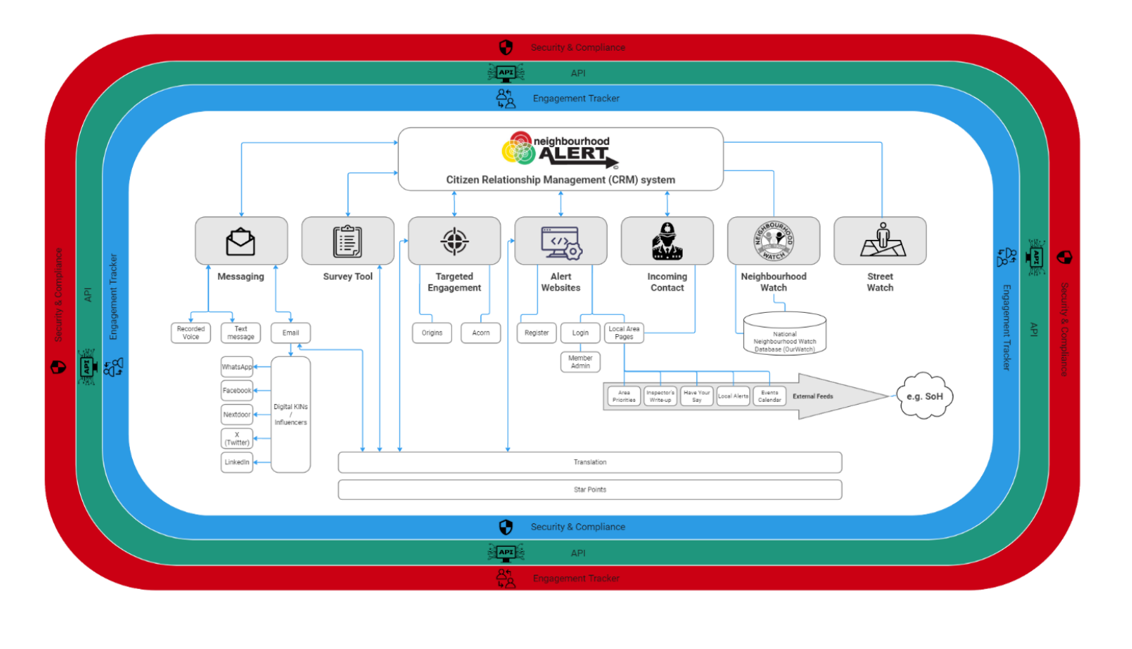
Tools - Neighbourhood Alert System

Slide 13
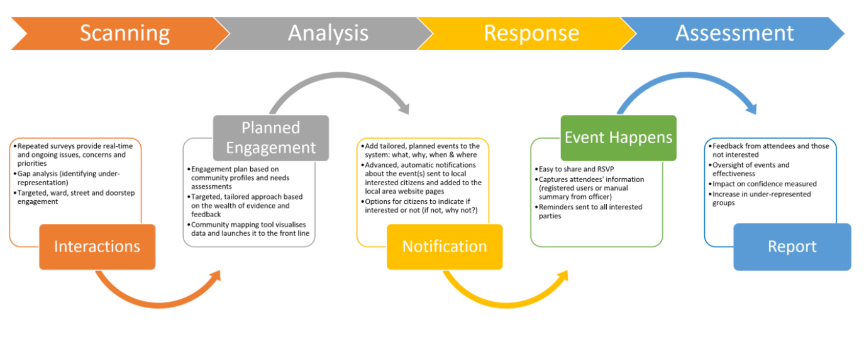
Supporting Problem Solving

Slide 14
Key Questions for Leaders
How do we create the capacity for effective engagement?
What knowledge and skills do officers and staff need?
How will you ensure implementation of the engagement strategy in your area?

